Slide 1
Lifecycle of a
live customer
in SaaS
Matthias
Adalbjorg
Matthiasson
Karlsdottir

Slide 2
SaaS environment
regular updates

Slide 3
Regular major upgrade
Two major versions a year
Apr. | May | June | July | Aug. | Sep. | Oct. | Nov. | Dec. | Jan. | Feb. | Mar. | Apr.
Upgrade period
Retry weekly
Uninstall -> Force
Forced
Last
minor
26
26.5
Upgrade period
Forced
27
Last
minor
27.5
28

Slide 4
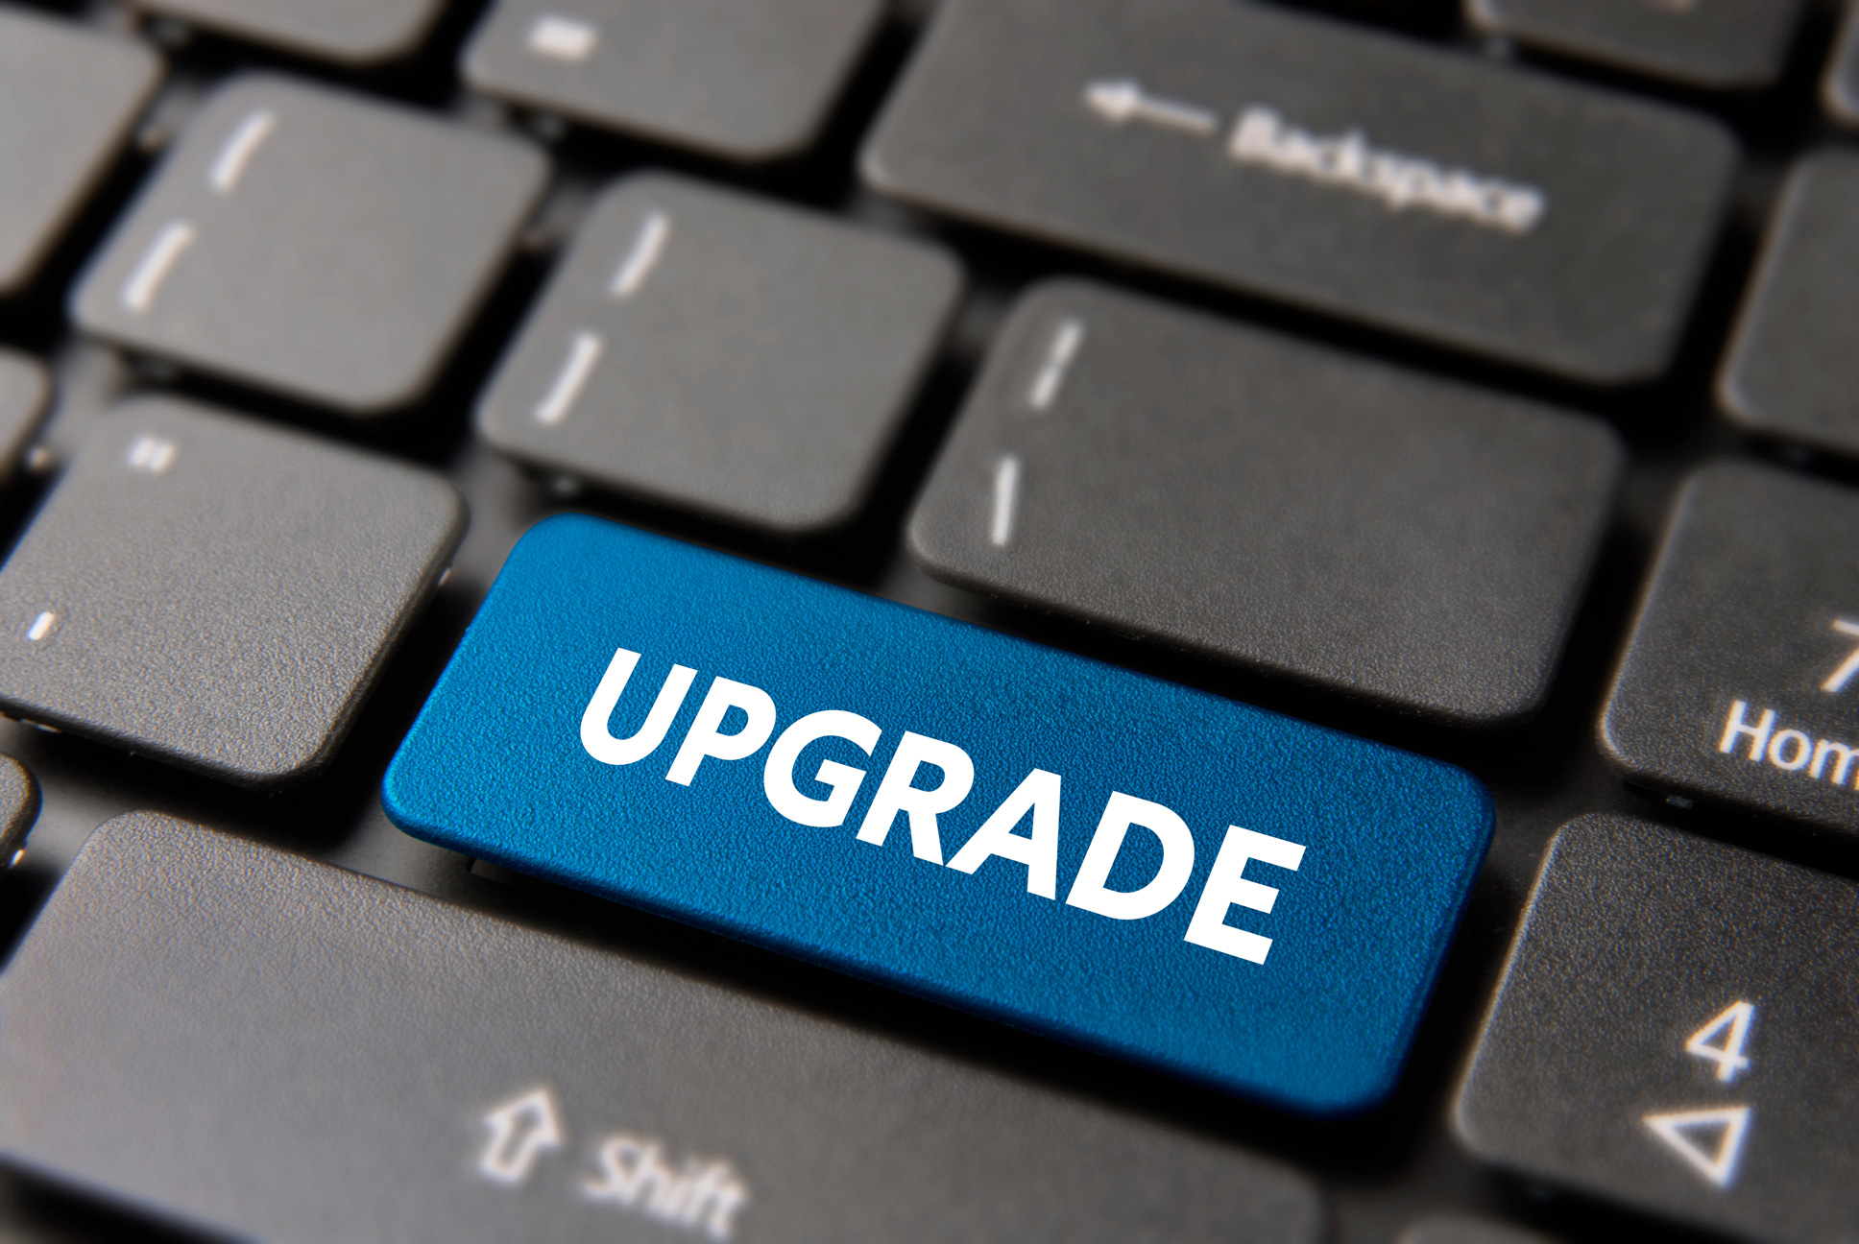
Major version upgrade process
Test upgrade in a sandbox environment
If needed, create a fresh sandbox copied from production and upgrade that first. This gives customers and partners time to:
  Validate extensions
  (ISV + per‑tenant)
  Test integrations
  (APIs, Power Automate, Dataverse, POS, eCommerce)
  Verify critical business processes (posting, reporting, jobs)

Slide 5
Major version upgrade process
Schedule production upgrade​
  Microsoft assigns a default upgrade date
  Admins can:
    Reschedule within the allowed upgrade window
    Define a maintenance/update window (minimum 6 hours)

Slide 6
BC SaaS Platform
Core application & runtime
Microsoft owns, operates, upgrades
AppSource Extension
Per-Tenant Extension (PTE)
Microsoft does
Certify App
Run technical validation
Enforce upgrade rules
Validate against next major release
Microsoft does NOT
Certify app
Test app
Validate code
Guarantee compatibility
Partner/ISV responsible for:
Business logic testing
Customer Scenarios
Enforce upgrade rules
Ongoing compatibility
Partner/Customer responsible for:
All testing
Upgrade readiness
Fixing breaking changes

Slide 7

LS Retail QA process for major releases
For each major version, the QA team conducts extensive testing with a focus on:
  New features and enhancements
  Backwards compatibility testing
  Exploratory testing
  Critical business functionality, including:
    System operability
    Transaction processing
    Financial processes such as purchasing, payments, and statement processing

Slide 8

Minor version upgrade
Minor releases contain no-breaking changes
Microsoft
  Automatic monthly upgrade
  Admin can manually apply a minor release
  Admin controls the timing of the upgrade with the update window definition
LS Central
  Optional for customers
  Admin manually applies the minor release
  Minor release is a cumulative update of all released Hotfixes and new fixes.

Slide 9
Minor and hotfix QA process
Hotfixes and partner‑requested Fixes
Hotfixes are isolated and have minimal /no impact on other customers.
Due to their urgency,
hotfixes do not undergo full system‑wide regression testing.
While all hotfixes are tested before delivery, the scope of testing is reduced compared to standard QA cycles.

Slide 10
Hotfixing supported on
Current version
Two major versions backward – last Hotfix on Major Release
  Needs to be requested in the ticket
v26 | v26.1 | v27 | v27.1 | v28
Last release
Last release

Slide 11
Offline POS
regular updates

Slide 12
Offline POS – Backward compatibility
Offline POS 3 major version supported
v25 | V25.1 | v26 | v26.1 | v27 | v27.1 | v28 | v28.1 | v29

Slide 13
Updates in the store

Slide 14
Updates in the store
BC SaaS
Offline POS
Online POS (Windows)
Online POS (Android / iOS)
Mobile Inventory (Android)
Business Central
LS Central
Azure SQL
BC company
Environment
Store
Offline POS
Online POS
POS mobile dev.
HHT Mobile Inv.

Slide 15
Update Service
BC SaaS
Hosted by the customer in Azure
Offline POS
Online POS (Windows)
Business Central
LS Central
Azure SQL
BC company
Update Service
Environment
Store
Offline POS
Online POS

Slide 16
Update Service
BC SaaS
Hosted by the customer in Azure
Offline POS
Online POS (Windows)
LS Retail in Azure
planned 2027
Business Central
LS Central
Azure SQL
BC company
Update Service
Update Service
as a service
Environment
Store
Offline POS
Online POS

Slide 17
Updates on the Offline POS
BC SaaS
Hosted by the customer in Azure
Offline POS
Business Central
LS Central
Azure SQL
BC company
Update Service
Environment
Store
Offline POS

Slide 18


Offline POS – How do you update?
Hosted by the customer in Azure
  POS Bundle
  Packages to run on the POS
  BC Platform / Apps
  LS Central Apps
  (Customer) License
  Custom Apps
  Hardware Station
  Hardware Station Configuration
  App Shell
  App Shell Configuration
  SQL Express
  Others…
  New packages for the new Offline POS
  Web Replication using Azure Storage data package
  Automatic Web Services Subscription package
UPDATE SERVICE

Slide 19
Offline POS – How do you update?
Hosted by the customer in Azure
  POS Bundle
  Packages to run on the POS
  BC Platform / Apps
  LS Central Apps
  (Customer) License
  Custom Apps
  Hardware Station
  Hardware Station Configuration
  App Shell
  App Shell Configuration
  SQL Express
  Others…
  New packages for the new Offline POS
  Web Replication using Azure Storage data package
  Automatic Web Services Subscription package
UPDATE SERVICE

Slide 20
Offline POS – How do you update?
Hosted by the customer in Azure
  POS Bundle
  Packages to run on the POS
  BC Platform / Apps
  LS Central Apps
  (Customer) License
  Custom Apps
  Hardware Station
  Hardware Station Configuration
  App Shell
  App Shell Configuration
  SQL Express
  Others…
  New packages for the new Offline POS
  Web Replication using Azure Storage data package
  Automatic Web Services Subscription package
UPDATE SERVICE

Slide 21

Offline POS – How do you update?
Offline POS / Store
Hosted by the customer in Azure
Offline POS
STORE 1
INSTALLER
Offline POS
UPDATE SERVICE
  POS Bundle
POS Bundle
STORE 2
Offline POS server

Slide 22
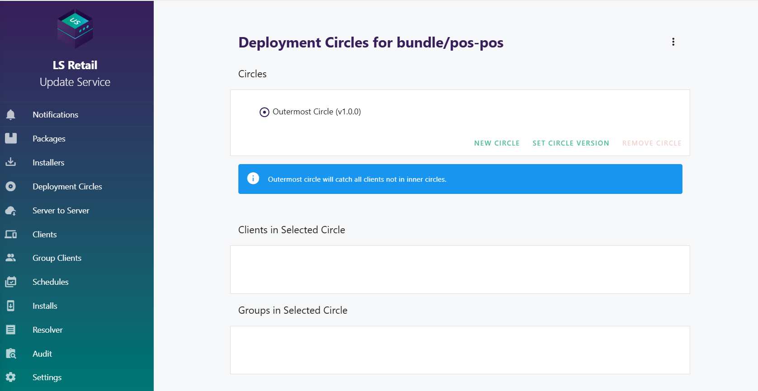
Update Service – Deployment circles
Roll out updates in a controlled way
Group clients to simplify creating and managing the circles

Slide 23
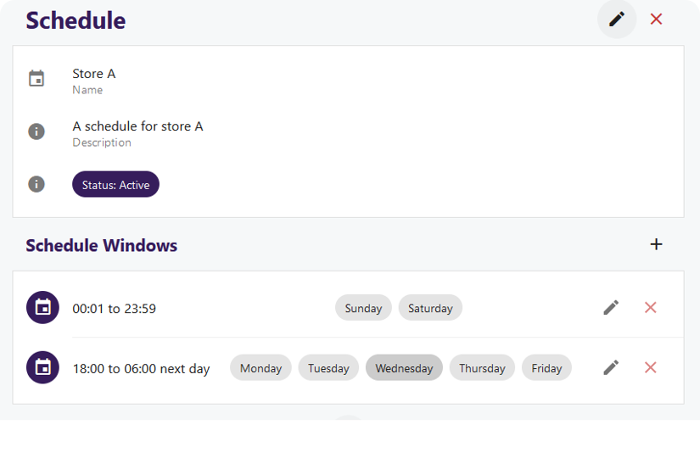
Update Service – Scheduling windows
A way to limit when a client can deploy updates during the day or week.
Create time slots for upgrade ​
Select day of the week upgrades can run

Slide 24
Updates on the Offline POS
BC SaaS
Hosted by the customer in Azure
Offline POS
Business Central
LS Central
Azure SQL
BC company
Update Service
Sandbox
Store
Offline POS - Test

Slide 25
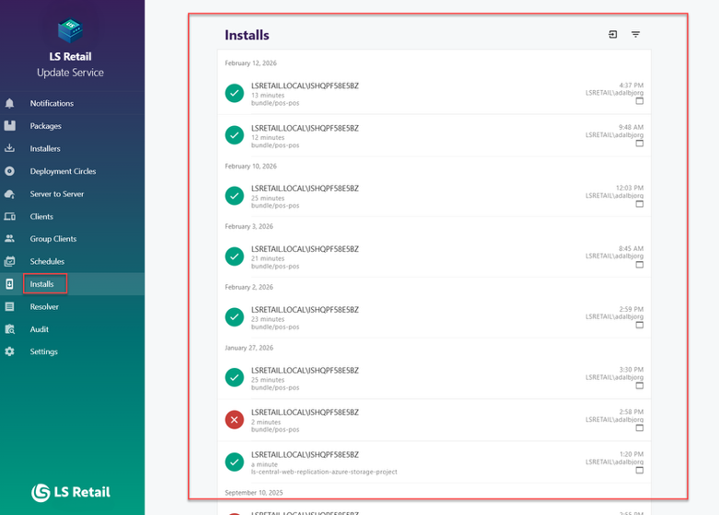
Updates on the Offline POS
Monitor the progress of the updates in the Update Service user interface.

Slide 26
Updates on the Online POS
BC SaaS
Hosted by the customer in Azure
Online POS (Windows)
Business Central
LS Central
Azure SQL
BC company
Update Service
Environment
Store
Online POS

Slide 27



Updates on the mobile devices
Online POS (Android / iOS)
Mobile Inventory (Android)
BC SaaS
Azure
Business Central
LS Central
Azure SQL
Commerce Server
BC company
App Mgmt system
Environment
Store
POS mobile dev.
HHT Mobile Inv.

Slide 28
Monitoring
system health

Slide 29
Microsoft Business Central telemetry
Built‑in monitoring system that automatically collects data
Performance, usage, errors and bottlenecks
Sent to Azure Application Insights
Analyze them using tools like
Kusto Query Language (KQL), Azure Log Analytics, or Power BI.
Helps understanding
System health, diagnose problems, and improve performance

Slide 30
LS Central
Telemetry in LS Central (LS Central 28)
  Framework
    Used by all LS Central modules
    Available for partners to utilize
Planned for LS Central 29
  Configurable consumption of signals
  Standard LS Central modules will start to provide signals
PTE can be used to analyze problems
  Created by customer/partner
  Created by LS Retail CAP team

Slide 31
Data maintenance
discipline

Slide 32
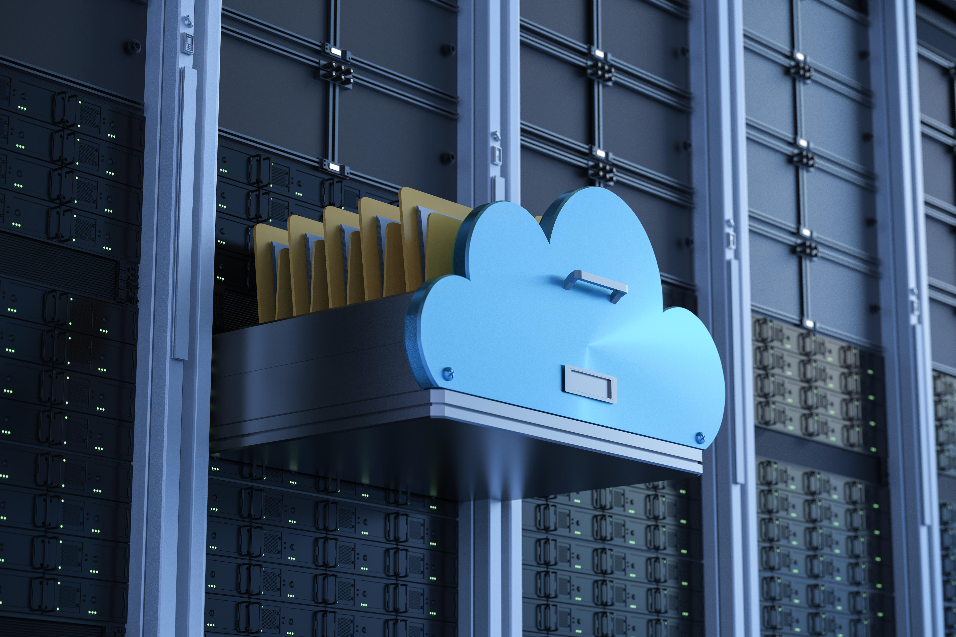
Reasons for data discipline
Improve performance
Control storage costs
Smoother upgrades

Slide 33
Table size analysis
The most common and largest tables
Business Central
  Archive historic
  sales/purchase documents
  Retention policies to
  auto-delete data
LS Central
  Archiving transactions
    Archived to tables
    Archive to Azure Storage
  Retention policies to
  auto-delete data
  G/L Entry
  Value Entry
  Item Ledger Entry
  G/L - Item Ledger Relation
  Item Application Entry
  Cust. Ledger Entry
  Detailed Cust. Ledg. Entry
  Warehouse Entry
  Change Log Entry
  LSC Transaction Header
  LSC Trans. Sales Entry
  LSC Trans. Infocode Entry
  LSC Trans. Sales Entry Status
  LSC Trans. Payment Entry
  LSC POS Card Print Text
  LSC Member Contact
  LSC Membership Card
  LSC Replen. Planned Sales Dem.
  LSC Replen. Calc. Log Lines V2
Bold
Tools
available

Slide 34
Possible improvements
Install the Aggregated Inventory solution
  Slow down growth of Item Ledger and Value Entry tables
  Compresses ILE and VLE records to AGRI entries
  AGRI entries can be compressed and truncated
  Move from pre-actions to timestamps
  Inactivate indexes (New in BC28)
65% - 81% data reduction
Duration improvements
30% Statement Costing
97% Adjust Cost
34% Posting Cost

Slide 35
SaaS environment
improvements

Slide 36
SaaS improvements
Business Central SaaS
Hybrid Component Server
  No more HCS
  (Azure Storage Replication)
High volume of Transactions (StorageQueue)
Update Service
  No more on-premise server
Mobile Inventory App
  No more Commerce Server
eCommerce
  No more Commerce Server
Commerce Server
eCommerce
On-premises
Update Service
BC/LS
SaaS
Azure
Storage
Service Bus
Planned
AZURE
Commerce Server
Update Service
HCS
Online POS
HHT Mobile Inv.
Offline POS
On-premises
On-premises
On-premises

Slide 37

Thank
You

