Slide 1
LS Central
Data migration in a SaaS environment
Ricardo Moinhos
Migration Buddy

Slide 3
Data migration in SaaS environment

Slide 4
Upgrade path for LS Central
On Prem
SaaS
The recommended way
LS NAV 2015
LS NAV 2016
LS NAV 2017
LS NAV 2018
LS NAV on BC v13
LS Central 13
LS Central 14.2
LS Central 15
LS Central 16
LS Central 17
LS Central 18
LS Central 19
LS Central 19
Using Upgrade Codeunits
Using Table Migration Extensions
Using Cloud Migration Tool
Spoiler: Although it is recommended to migrate from the same LS Central version on-prem to the same version on SaaS, in theory you should be able to migrate directly from LS Central 17.5 or later to SaaS (as long as there are no breaking changes in your own extensions).
LS Central 17.5 or later
LS Central 19

Slide 5
Upgrade path for LS Central
Preparing the database to be migrated to SaaS
Preparing the database to be migrated to SaaS
Migrating from on-prem to SaaS
Challenges
LS Migration Process
LS Migration Tools
Challenges
LS Migration Process
LS Migration Tools
Production Environment
Data Administration page
Cloud Migration Tool

Slide 6
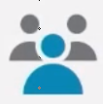
Production Environment
Every Production environment comes with 3 sandboxes which all add up to the 80 GB (plus 1 to 3 GB per licensed user/device) of free space.
50% compression
Images are not included
+ 2 Gb/User (Essentials)
+ 3 Gb/User (Premium)
+ 1 Gb/Device
Dynamics 365 Business Central
Base entitlement
80 GB
Per user allocation
2 Gb/User (Essentials)
3 Gb/User (Premium)
1 Gb/Device

Slide 7
Production Environment
Storage Examples
Named users | License type | Total free space
20 | Essentials | 120 GB (20*2 Gb + 80 GB)
30 | Essentials | 140 GB (30*2 Gb + 80 GB)
125 | Premium | 455 Gb (125*3 Gb + 80 Gb)
250 | Premium | 830 Gb (250*3 Gb + 80 Gb)
Example taken from Dynamics 365 Licensing FAQ
Storage Pricing
Offer name | Capacity | Price/tenant/month
D365 Business Central Database Capacity | 1 Gb | $ 10
D365 Business Central Database Capacity 100GB | 100 Gb | $ 500
D365 Business Central Database Capacity Overage* | 1 Gb | $ 5
For more information check our Pricelist in the Partner Portal
* Prerequisite Business Central Database Capacity 100GB

Slide 8
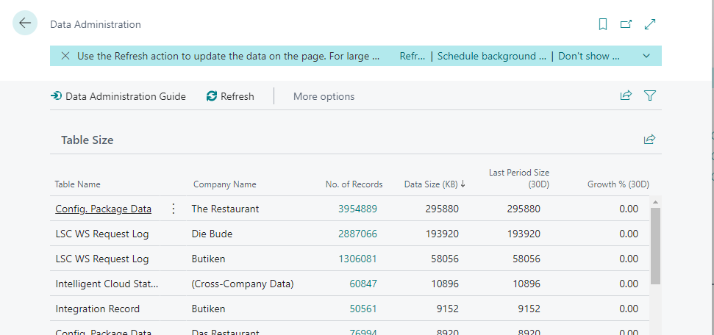
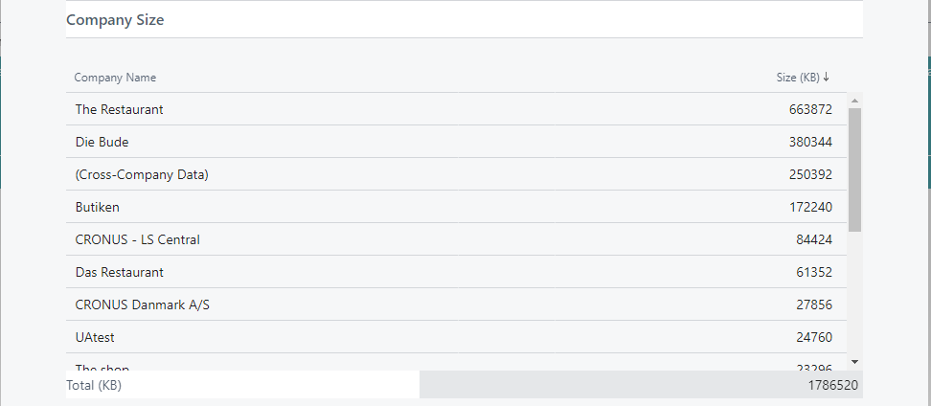
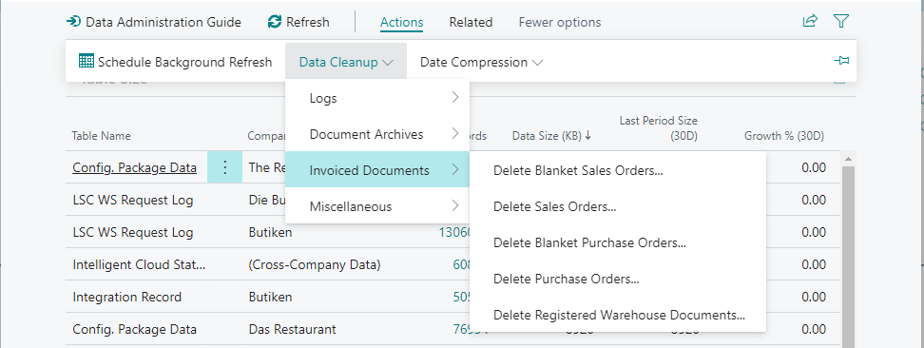
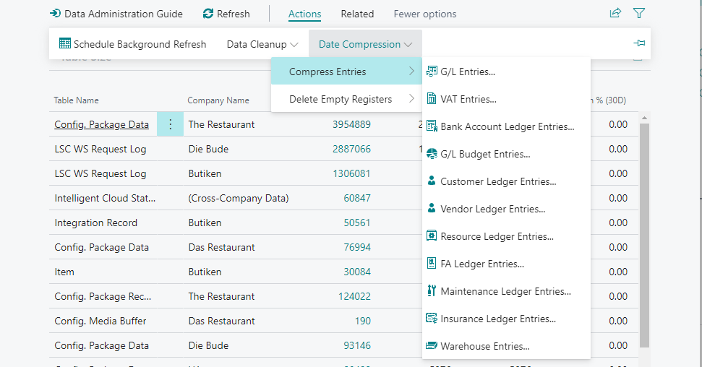
Data Administration
When moving to SaaS, you should clean up your data.
Data Administration page allows you to:
List the following, per table:
Nr of records
Data Size
Data Size 30 days before
Growth % in the last 30 days
List the total size per Company
Use the Cleanup Data methods
Use the Data Compression methods
Access to the Retention Policies page

Slide 9
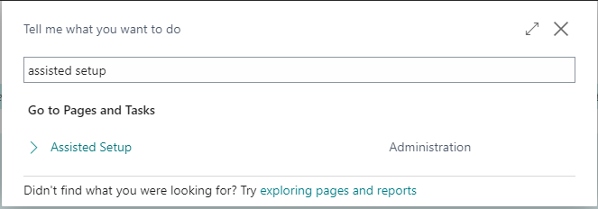
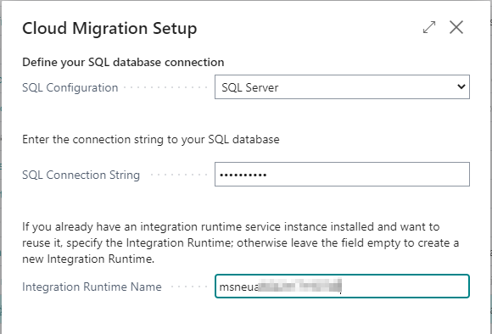
Cloud Migration Tool
Search for Assisted Setup
Select Set up Cloud Migration
Select the product version
Current version for V19
Earlier versions for V15 to 18
Enter:
SQL Connection String
Integration Runtime Name

Slide 10
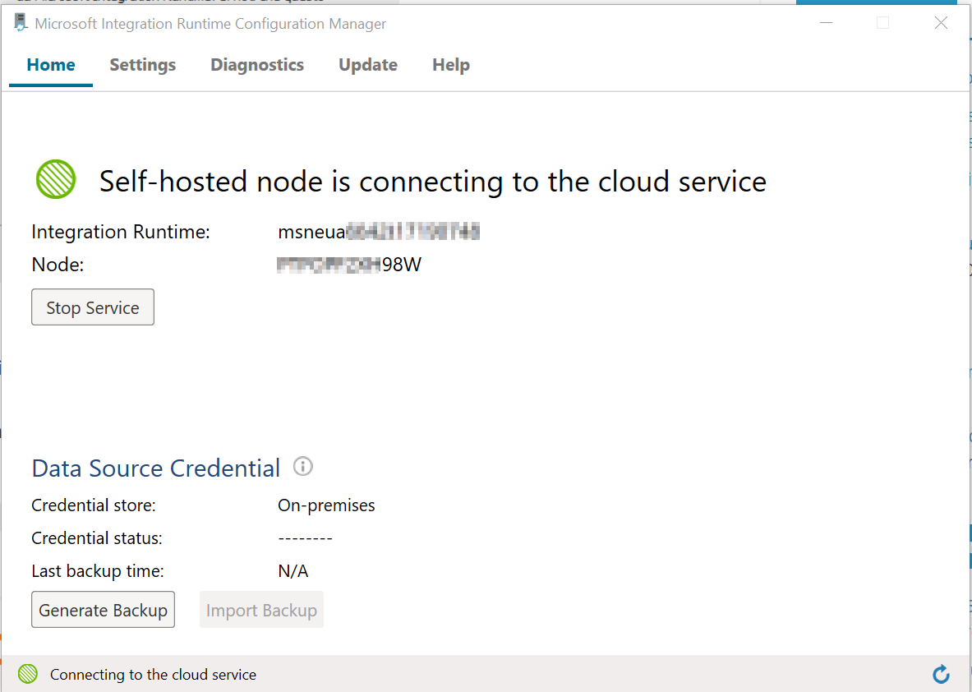
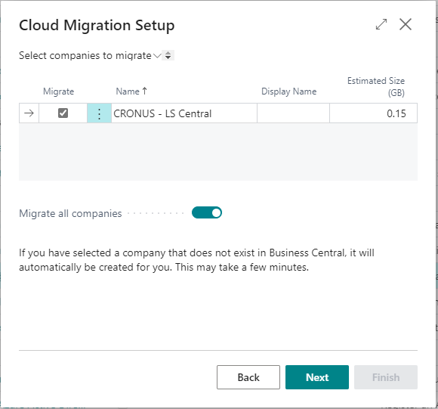
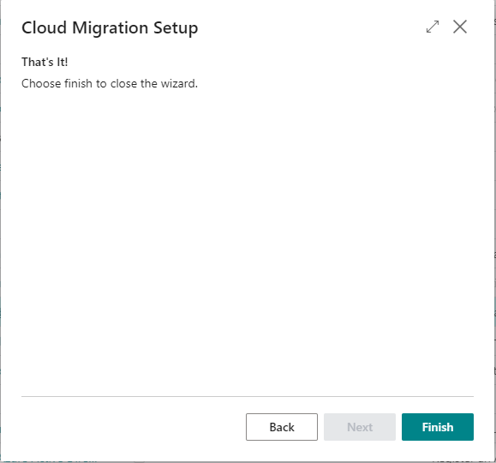
Cloud Migration Tool
The Integration Runtime is installed locally
Select the companies to migrate
Finish the Cloud Migration Setup
Integration Runtime Name

Slide 11
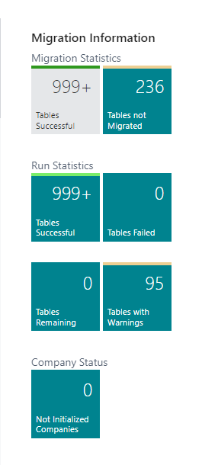
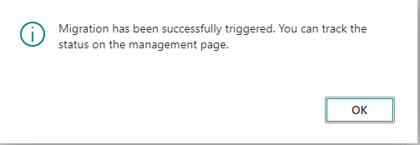
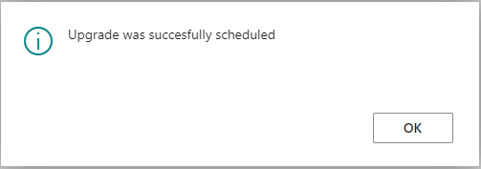
Cloud Migration Tool
Run Migration Now
Run Data Upgrade Now

Slide 12
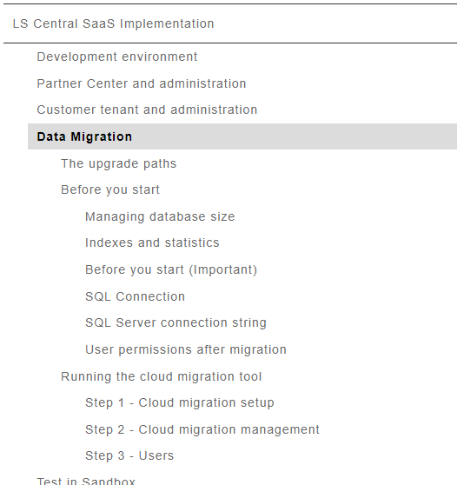
Cloud Migration Tool
For more information, look at our LS Central SaaS implementation guide

Slide 13
Preparing the database to be migrated to SaaS
Migrating from on-prem to SaaS
Migrating from on-prem to SaaS
Challenges
LS Migration Process
LS Migration Tools
Production Environment
Data Administration page
Cloud Migration Tool
Production Environment
Data Administration page
Cloud Migration Tool

Slide 14
Challenges
Migration process suggested by Microsoft is challenging:
Has too many steps
Error-prone
Requires Powershell knowledge
If going from LS Central 15 up to 17.4 to the latest version:
Objects renaming introduced in LS Central 17.5
References to our objects needs to be updated in your existing extensions
If going from BC 14 or earlier to the latest version:
Application code upgrade to apps/extensions using event driven programming
Tables renaming introduced in LS Central 17.5
Must be handled during the migration process
Data migration from custom fields to different tables/fields
Unexpected issues ☺

Slide 15
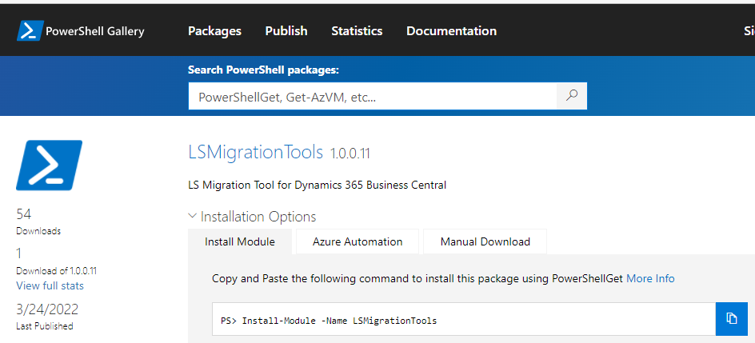
LS Migration Process
Documentation
Step-by-step documentation based on Microsoft’s guidelines
LS Migration Tools
Powershell module to automate some migration steps
Already available on the Powershell Gallery

Slide 16
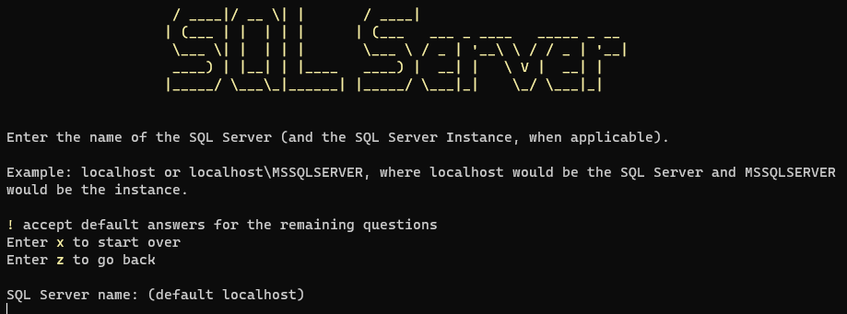
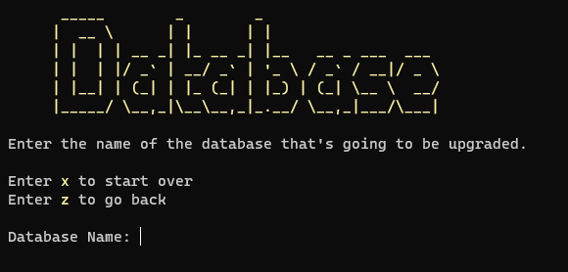
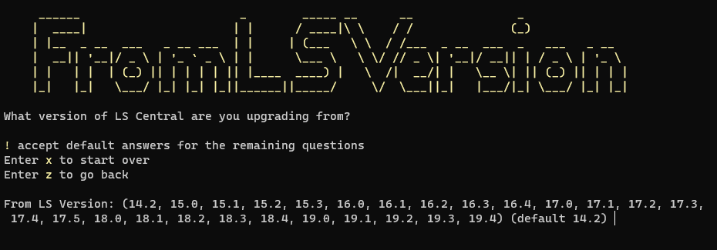
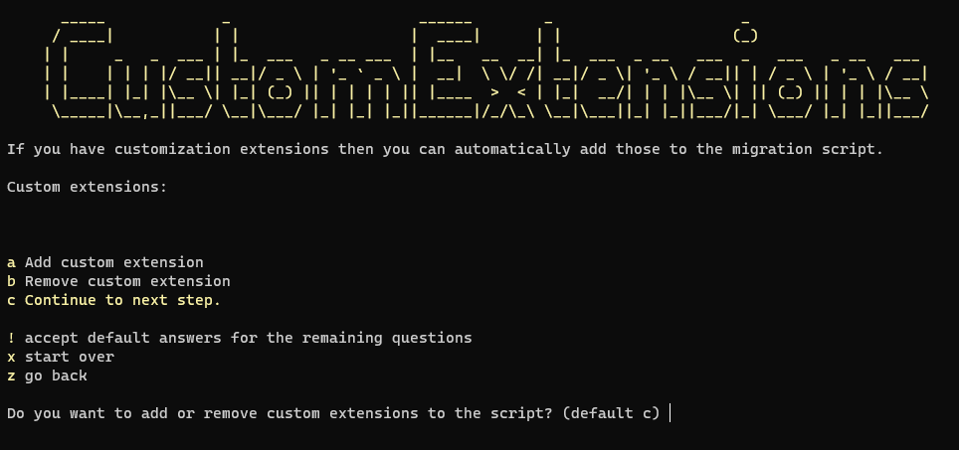
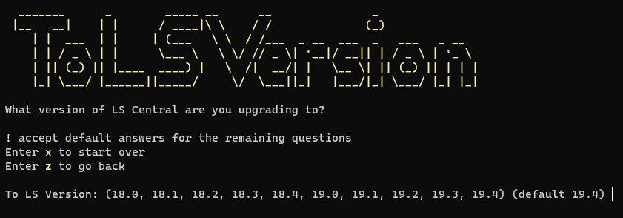
LS Migration Tools
New-UpgradeInitializationScript
A wizard to automate the migration scripts creation

Slide 17
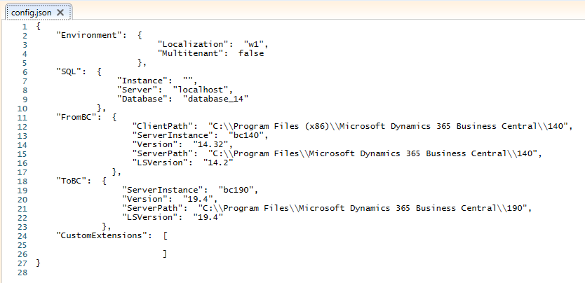
LS Migration Tools
The wizard generates a config.json file that can be reused

Slide 18
LS Migration Tools
Two scripts are created, that allows you to go through the migration process
Preparation-Script.ps1
- Setup the folder structure and create the extensions needed for the migration

Slide 19
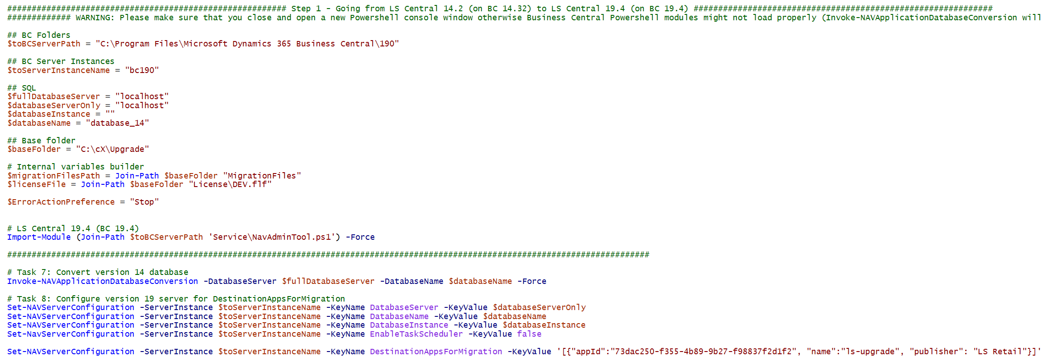
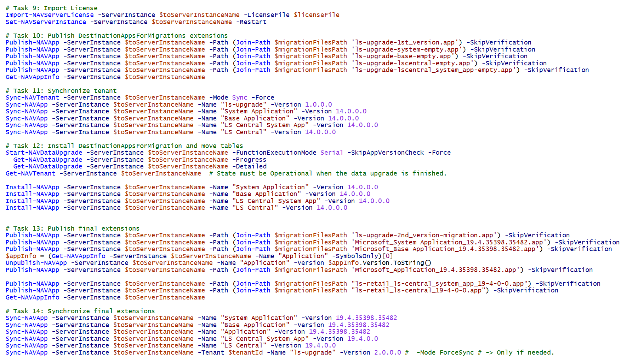
LS Migration Tools
Migration-Script.ps1
The migration process itself

Slide 20
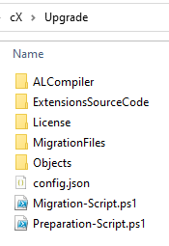
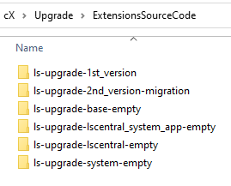
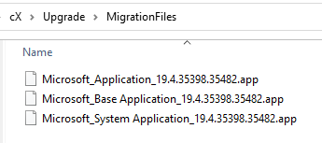
LS Migration Tools
New-UpgradeAppsStructure
Creates the migration extensions needed for the migration process, as suggested in Microsoft guidelines.
New-UpgradeAppsStructure
Creates the migration extensions needed for the migration process, as suggested in Microsoft guidelines.

Slide 21
LS Migration Tools
Convert-BC14CALObjectsToTableSchemaOnly
Applies to Business Central 14
Strips out all the code from tables, for an existing C/AL text file, while renaming the LS Central tables name
- Only properties and fields will be included
Converted file will be imported back in BC 14
Allows to easily rename all the LSC tables in BC 14 before moving forward
Before
After importing the converted file

Slide 22
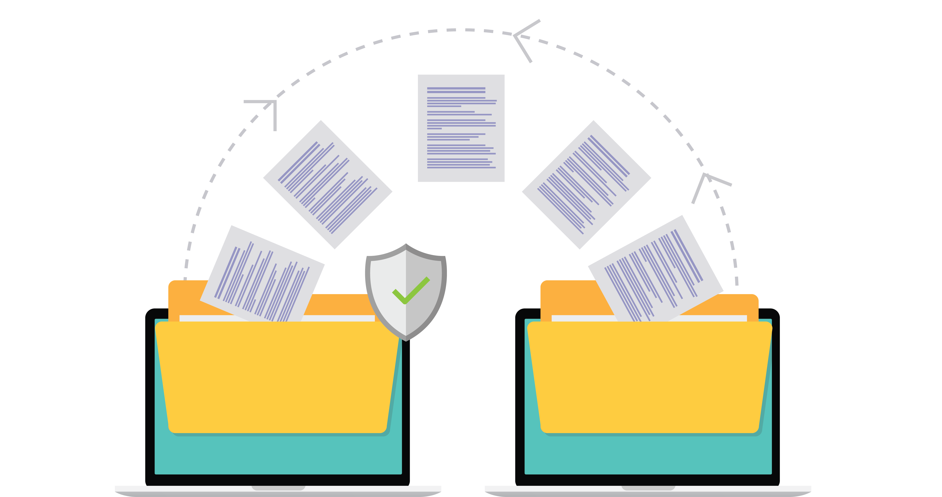
LS Migration Tools
Repair-CustomExtensionFrom174orEarlier
Will update references to LS Central objects in your custom extensions
Variables
Before
After

Slide 23
LS Migration Tools
Repair-CustomExtensionFrom174orEarlier
Will updating references to LS Central objects in your custom extensions
Variables
Parameters
Before
After

Slide 24
LS Migration Tools
Repair-CustomExtensionFrom174orEarlier
Will updating references to LS Central objects in your custom extensions
Variables
Parameters
Tables, pages and other object extensions
Before
After

Slide 25
LS Migration Tools
Repair-CustomExtensionFrom174orEarlier
Will updating references to LS Central objects in your custom extensions
Variables
Parameters
Tables, pages and other object extensions
Other properties
Before
After

Slide 26
Resources
LS Central SaaS Implementation Guide
LS Retail Partner Portal - Pricelists
Dynamics 365 Business Central Development - Yammer
Dynamics 365 Licensing Deck
Dynamics 365 Licensing FAQ

Slide 27
Now is time for questions

