Slide 2


Analytics for LS Central
Discover the finance reports,
BC SaaS integration,
and more…
Martin F.
Bjarni
Kleindl
Asmundsson

Slide 3
From Data to Wellbeing
A day at the Analytics SPA
Martin F.
Bjarni
Kleindl
Asmundsson

Slide 4

Wiesbaden – meadow bath
(Aquae Mattiacorum, 14 AD)

Slide 5
From Data to Wellbeing
A day at the Analytics SPA
Martin F.
Bjarni
Kleindl
Asmundsson

Slide 6






Agenda
Analytics for LS Central page
Finance Power BI template
Fabric Data Agents

Slide 7
Agenda
Finance Power BI template
Fabric Data Agents
Machine Learning

Slide 8
Agenda
Fabric Data Agents
Machine Learning
Data export with bc2adls

Slide 9
Agenda
Machine Learning
Data export with bc2adls
Continuous Improvements

Slide 10
Agenda
Data export with bc2adls
Continuous Improvements

Slide 11
Agenda
Continuous Improvements

Slide 12
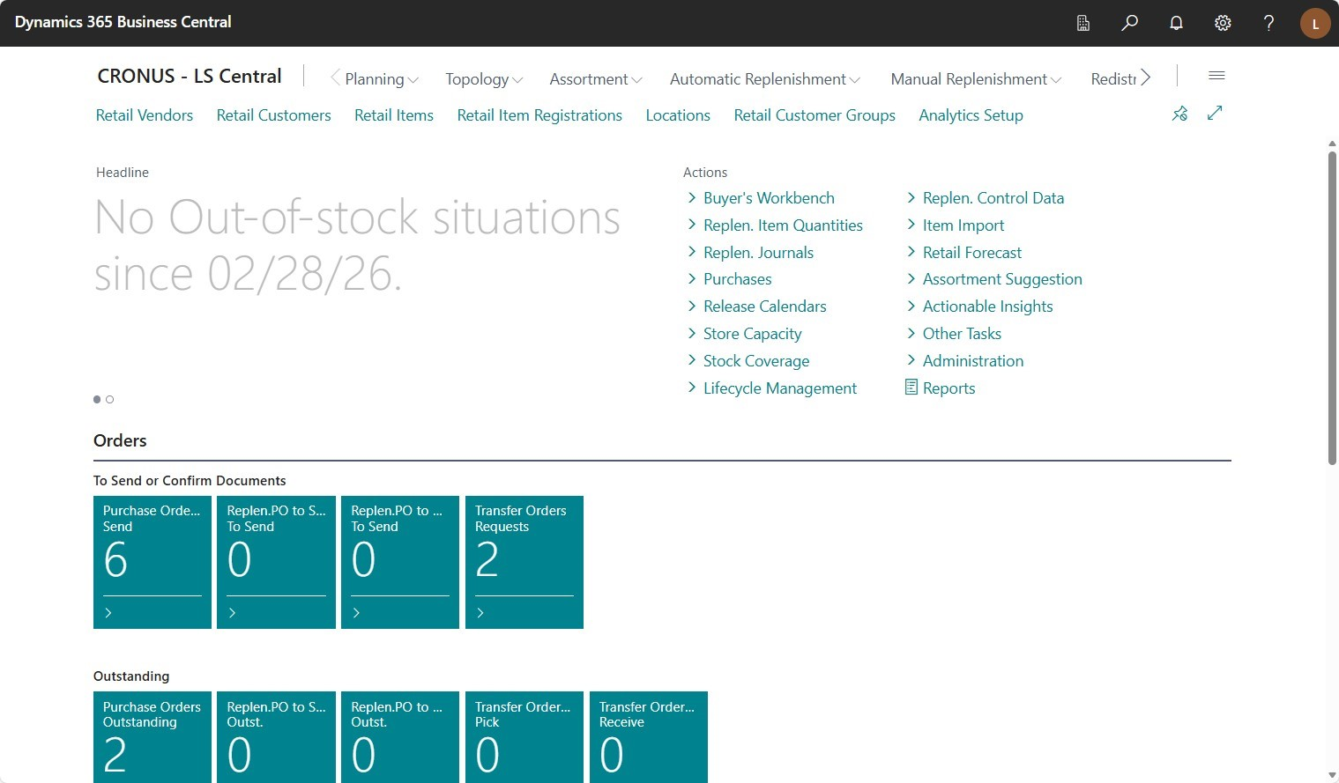
Analytics page
All operational insights into one welcoming, organized space

Slide 13
LS Central Analytics page

Slide 14
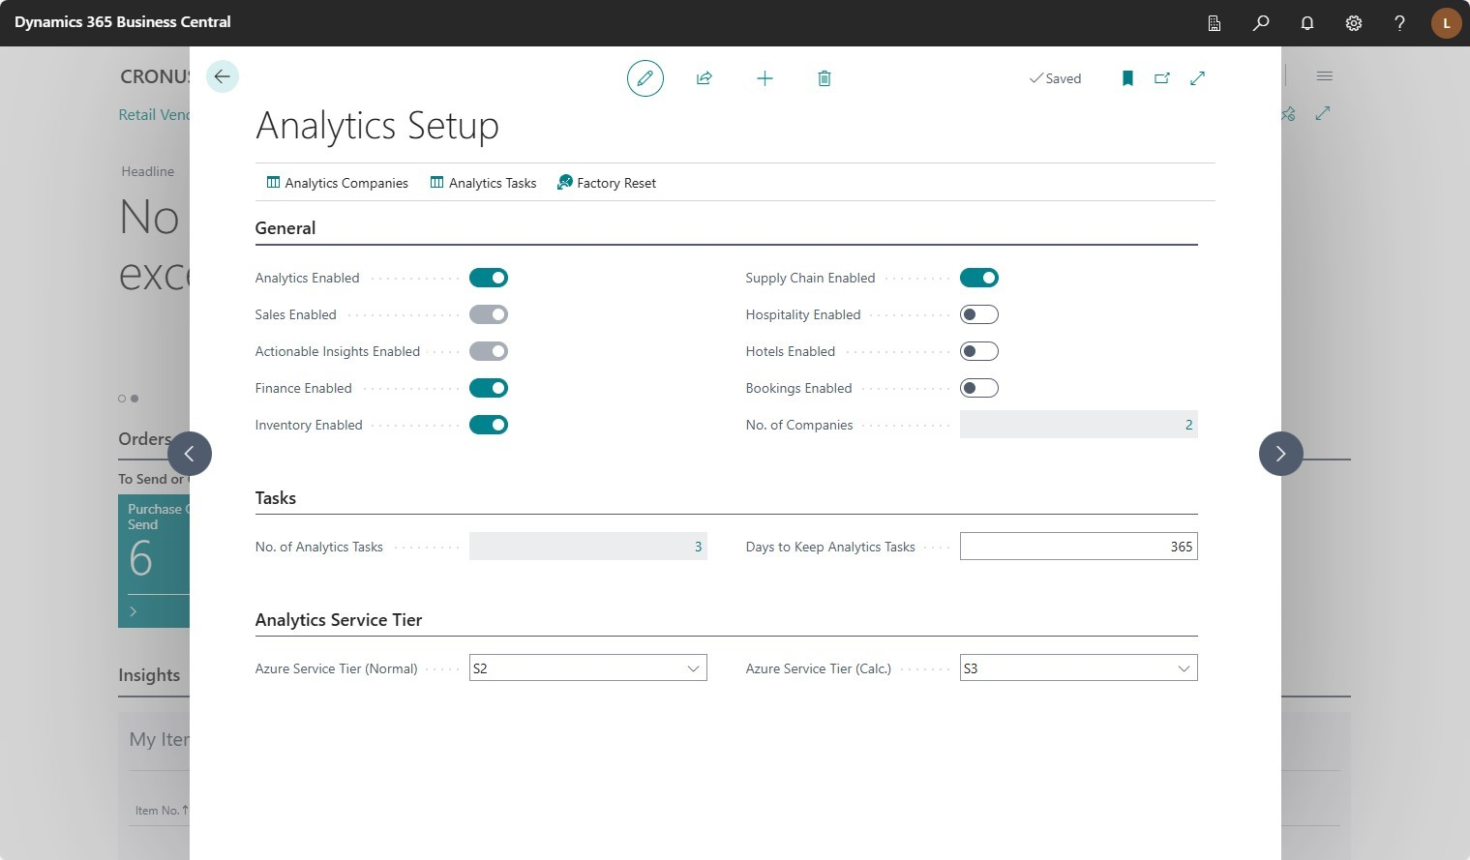
LS Central Analytics page

Slide 15
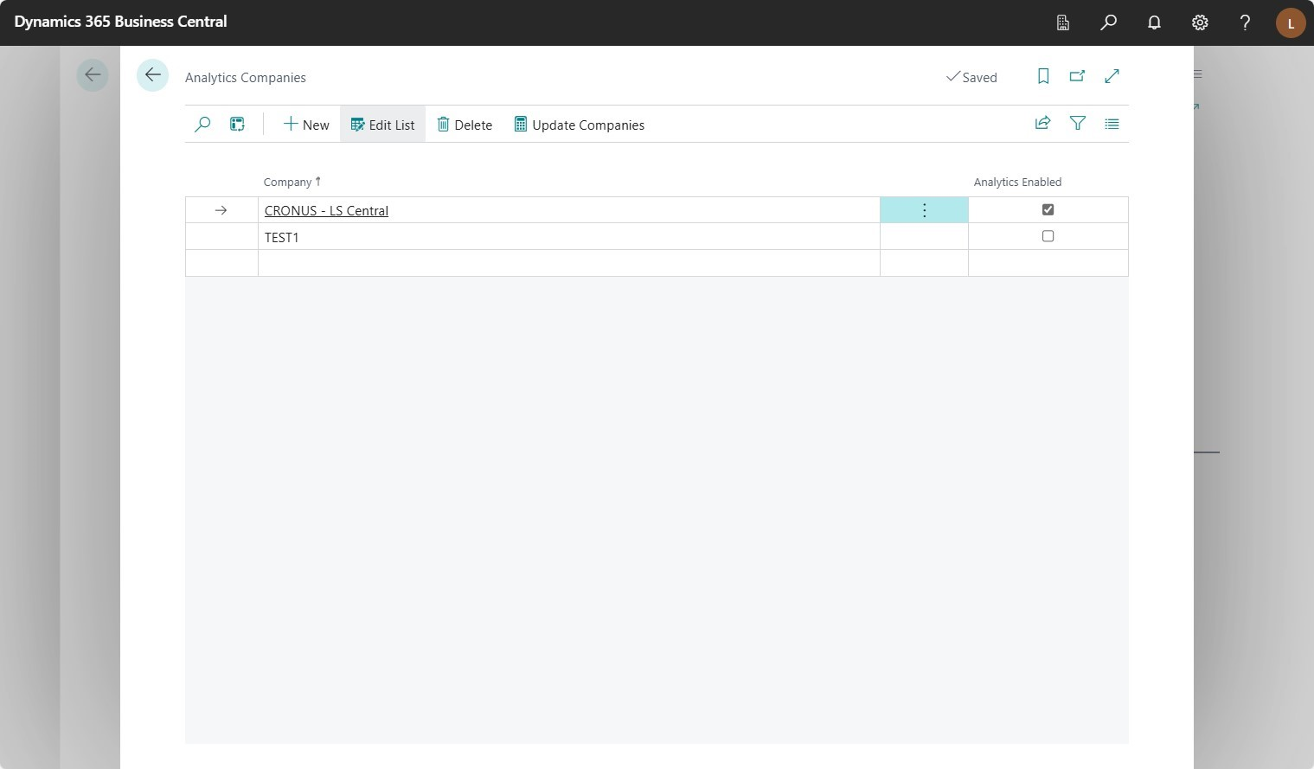
LS Central Analytics page

Slide 16

LS Central Analytics page

Slide 17
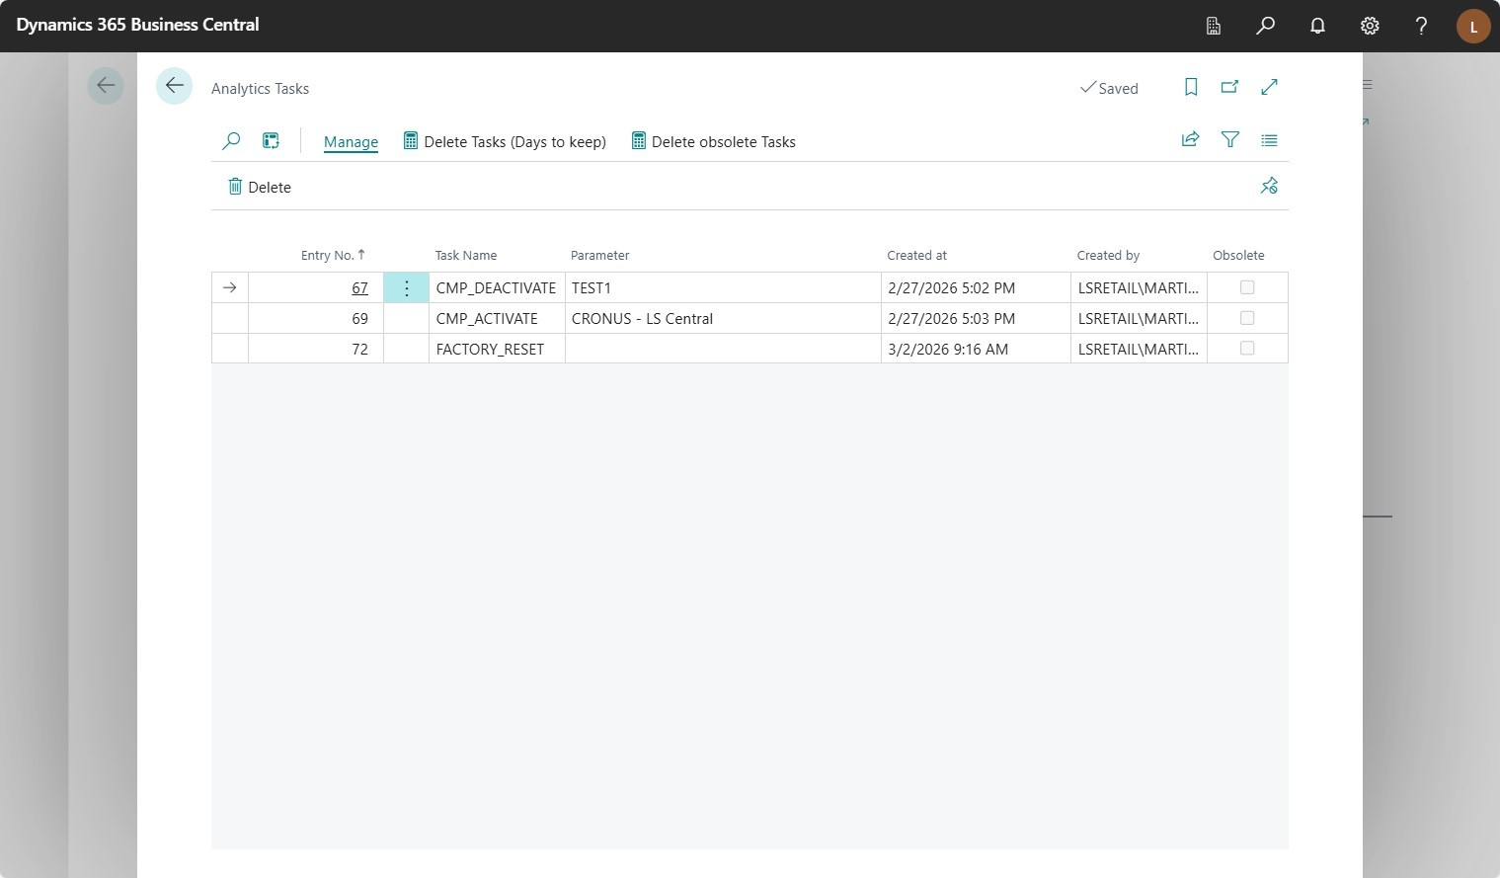
LS Central Analytics page

Slide 18
LS Central Analytics page

Slide 19
Analytics page
All operational insights into one welcoming, organized space

Slide 20
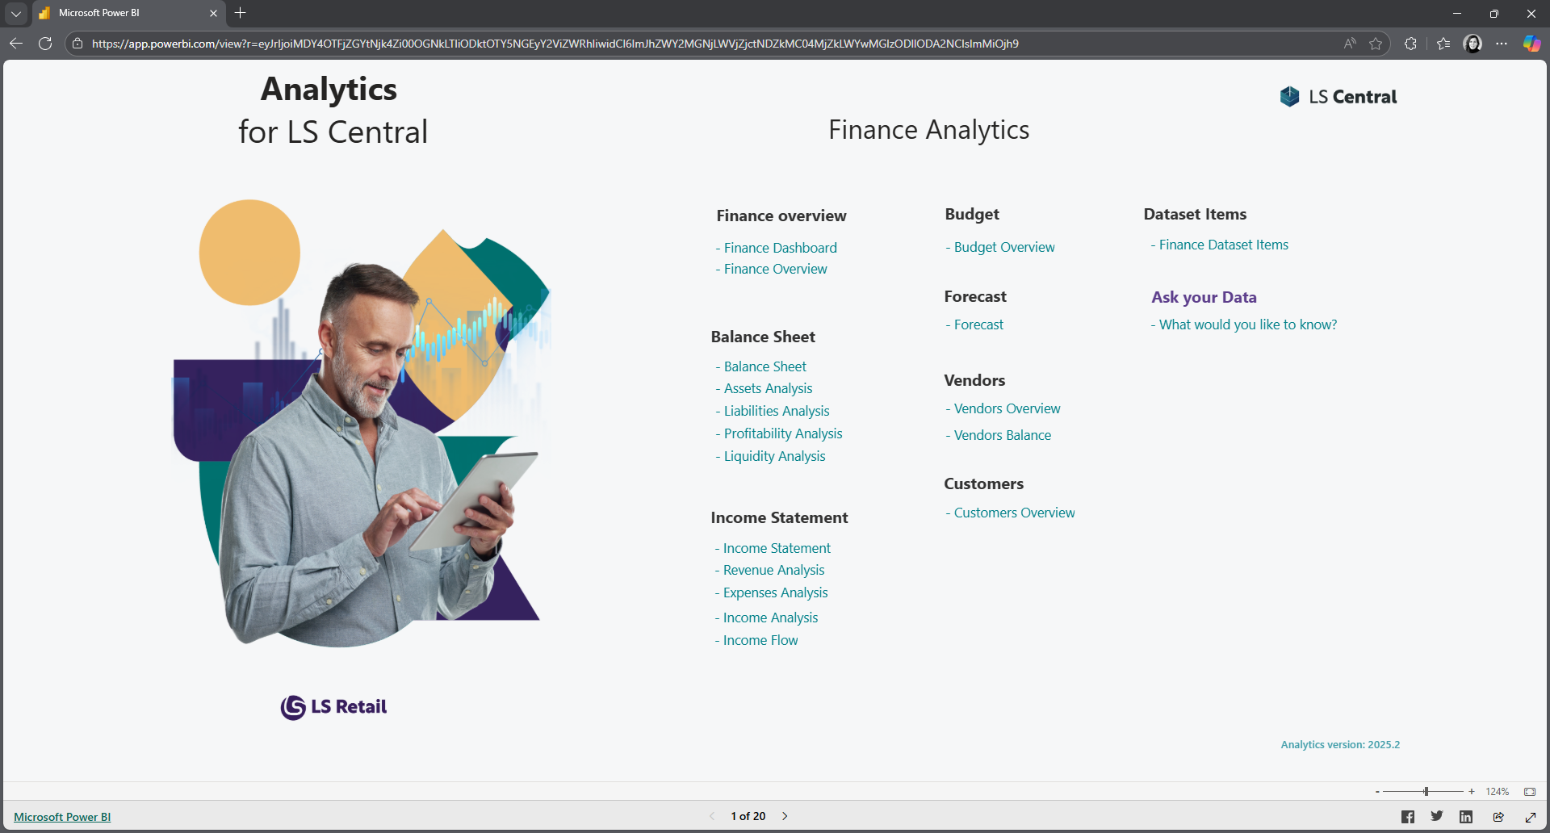
Finance Power BI template
Filter complexity and clarify your decisions

Slide 21
Finance Power BI template

Slide 22
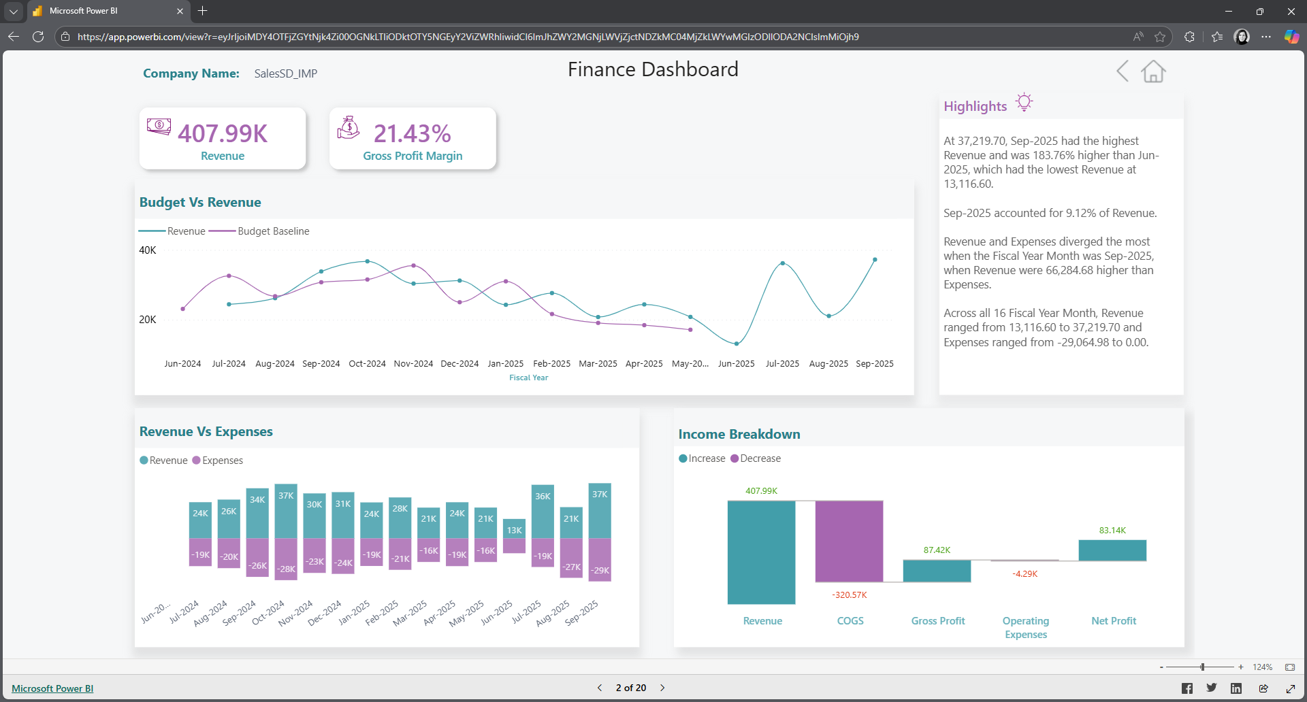
Finance Power BI template

Slide 23
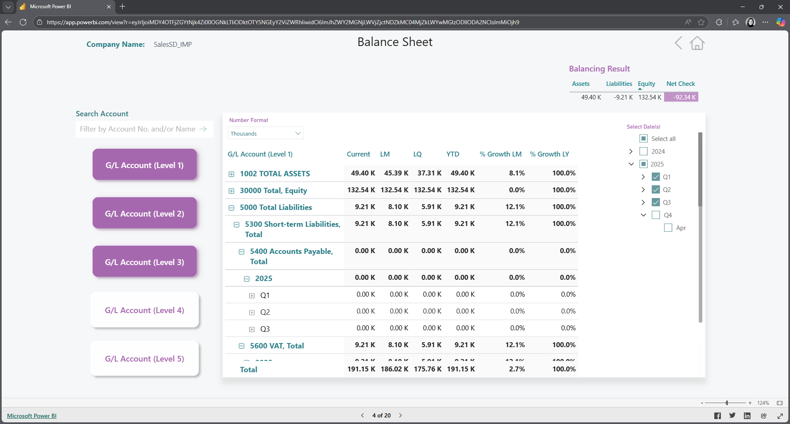
Finance Power BI template

Slide 24
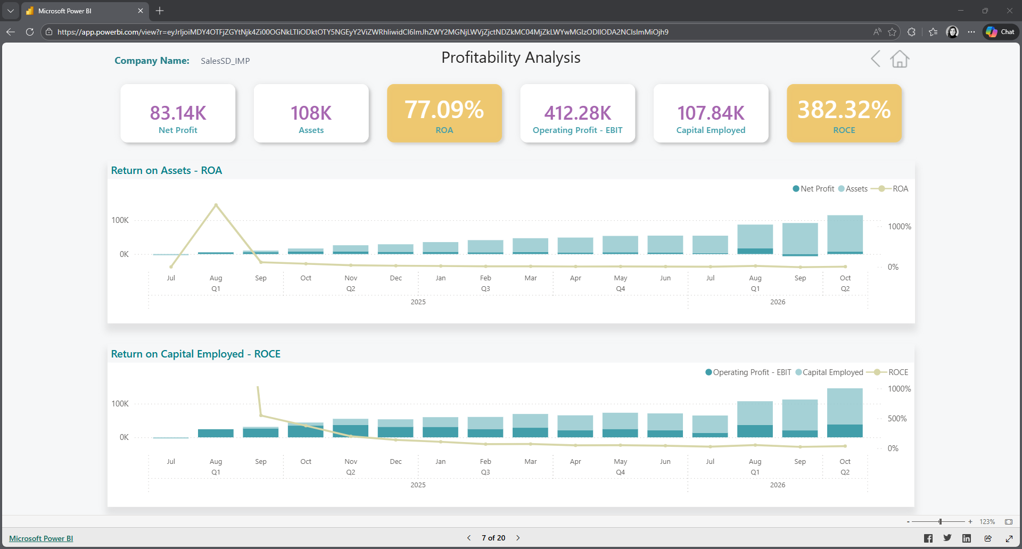
Finance Power BI template

Slide 25
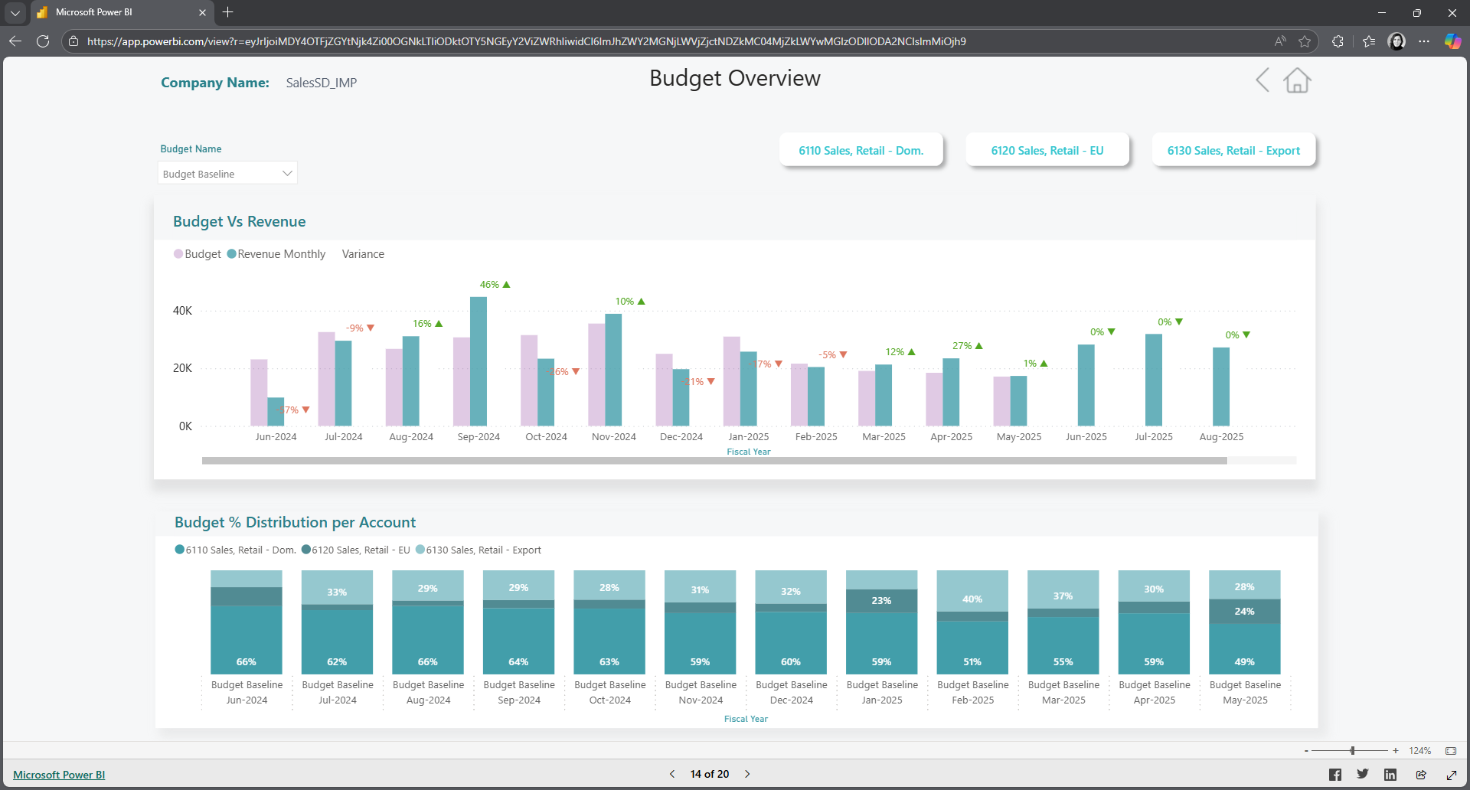
Finance Power BI template

Slide 26
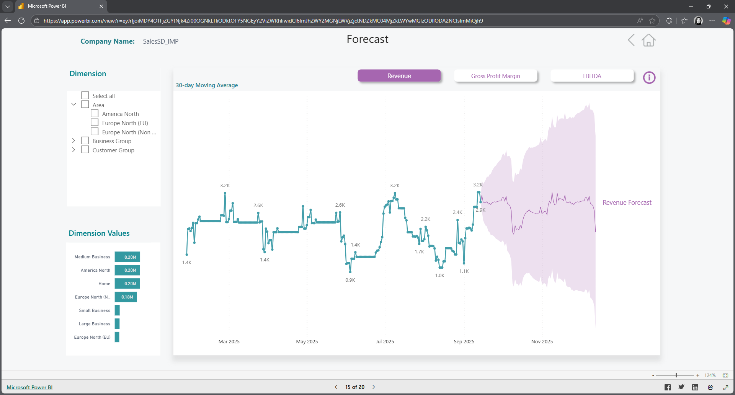
Finance Power BI template

Slide 27
Finance Power BI template

Slide 28
Finance Power BI template
Filter complexity and clarify your decisions

Slide 29
Fabric Data Agents
Concentrated energy guiding towards revelation

Slide 30
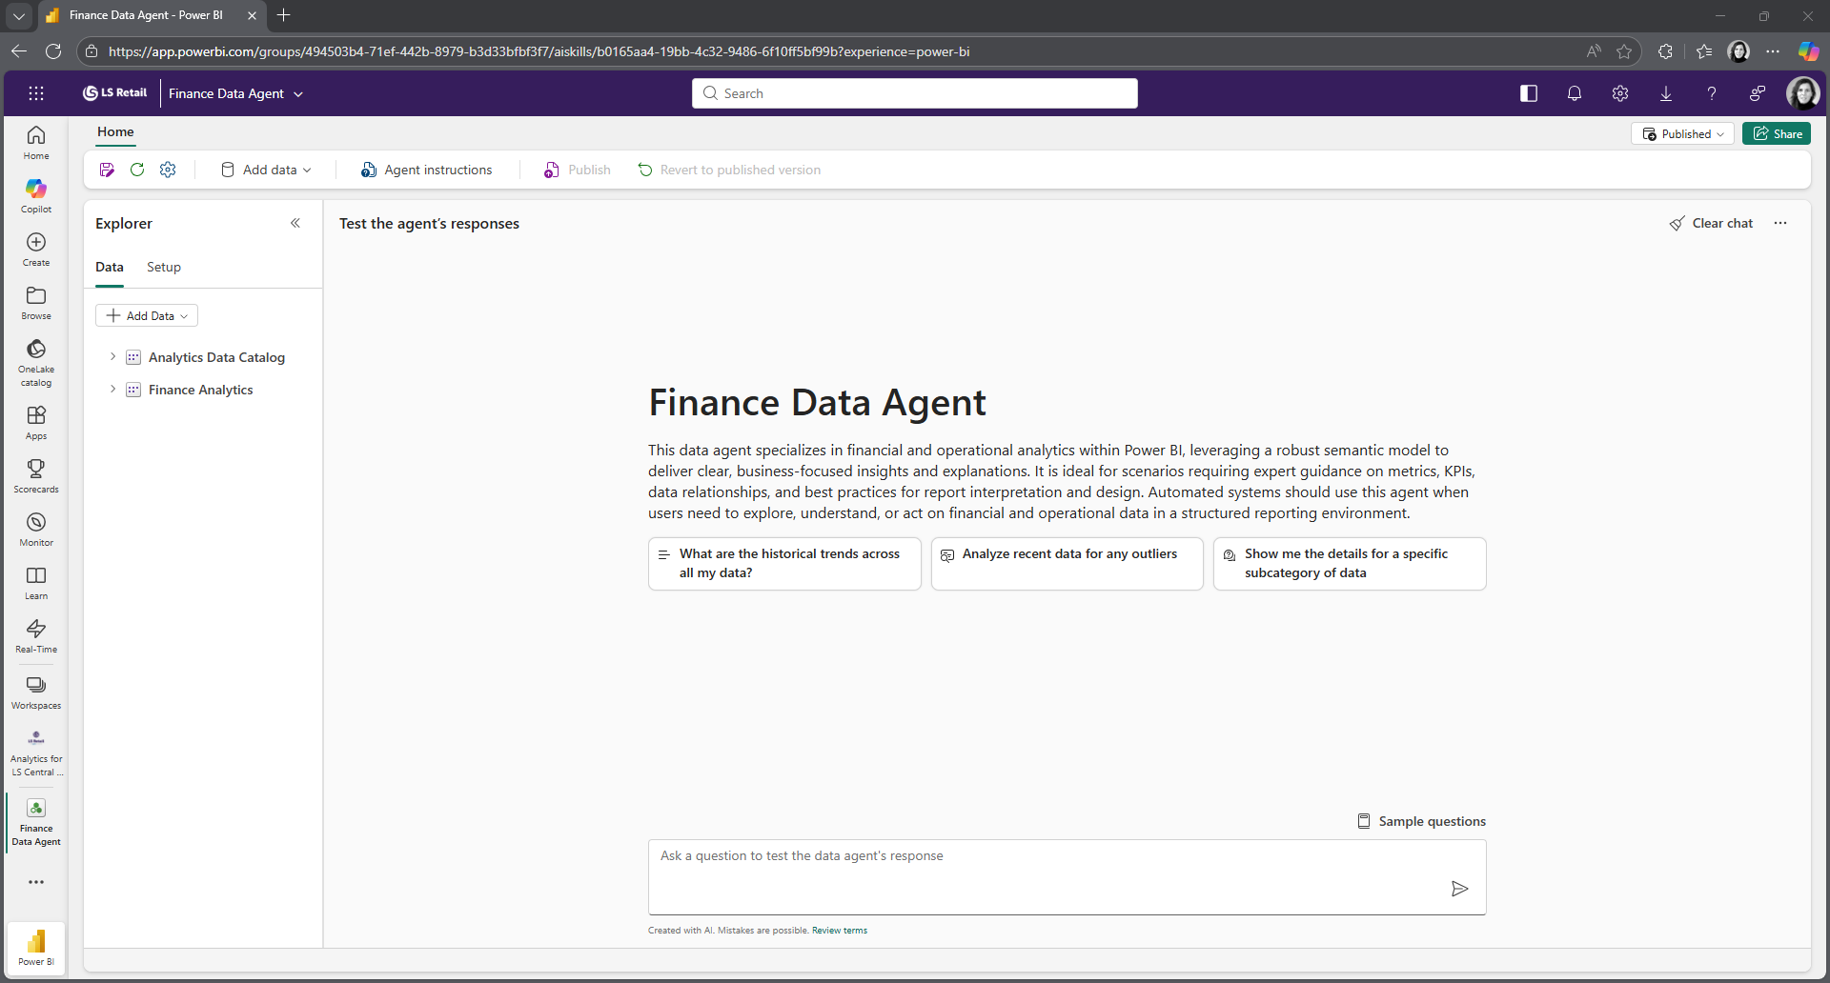
Fabric Data Agents

Slide 31
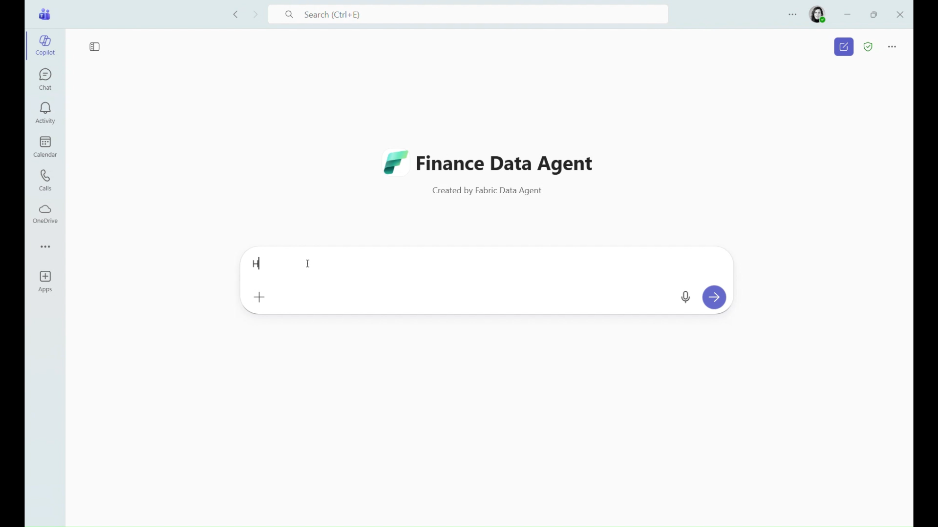
Fabric Data Agents

Slide 32











Fabric Data Agents
Fabric
Data Warehouse
Lakehouse
Eventhouse
Semantic Model
Fabric Data Agent
Fabric
Copilot
Teams
Copilot Studio
Foundry

Slide 33
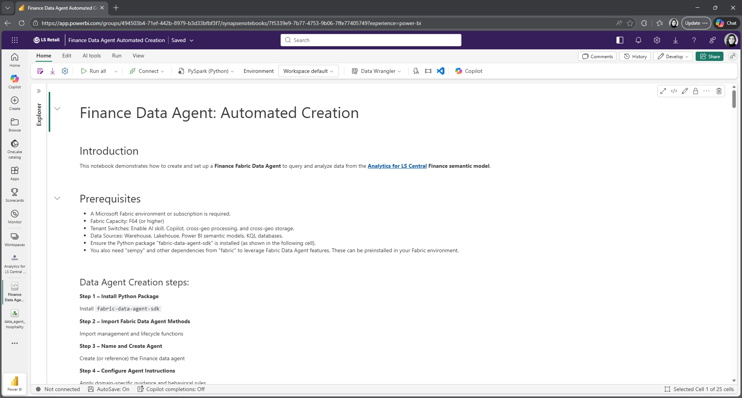
Fabric Data Agents

Slide 34
Fabric Data Agents
Concentrated energy guiding towards revelation

Slide 35
Machine Learning
Feel better for the Future

Slide 36









Machine Learning
Fabric Workspace
Power BI
Report
Semantic Link
Semantic Model
MLflow
OneLake
Data Science
Warehouse
Train and Evaluate Model
Experiment
PREDICT
Lakehouse
Batch Scoring
Model

Slide 37
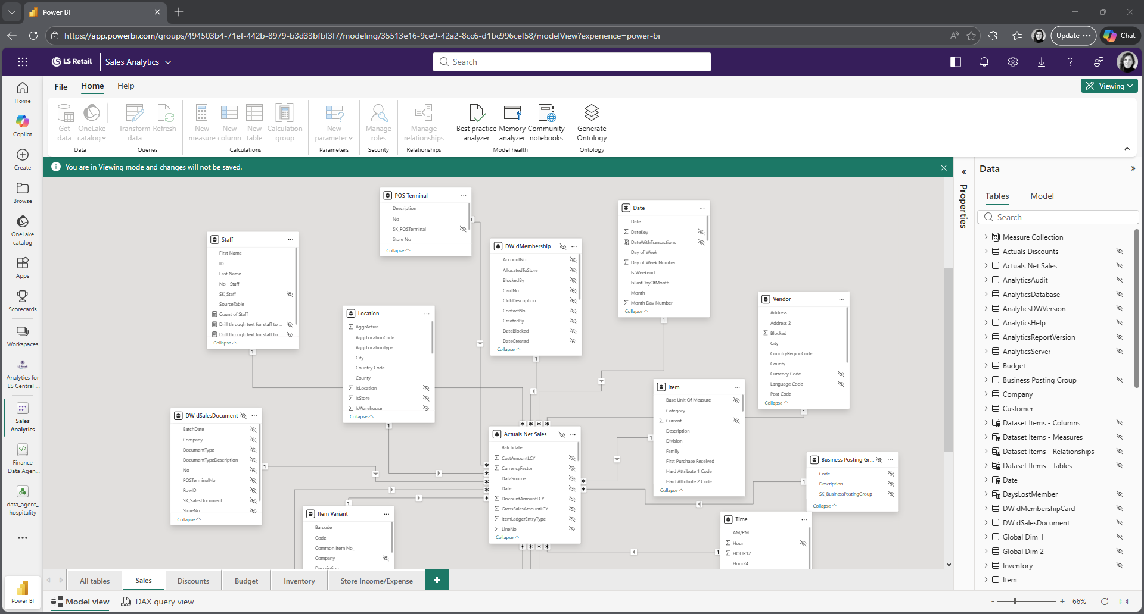
Machine Learning

Slide 38
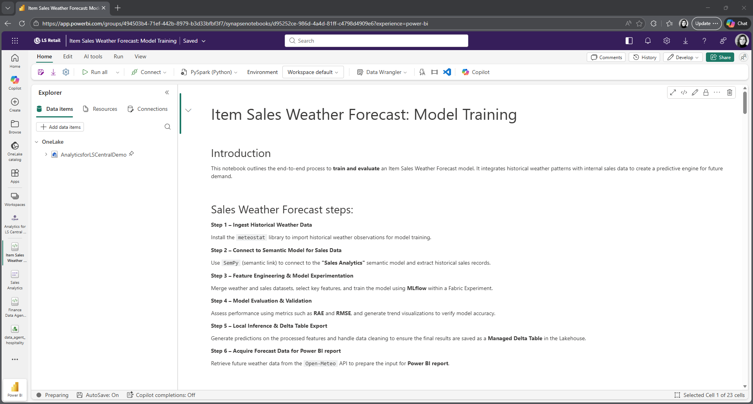
Machine Learning

Slide 39
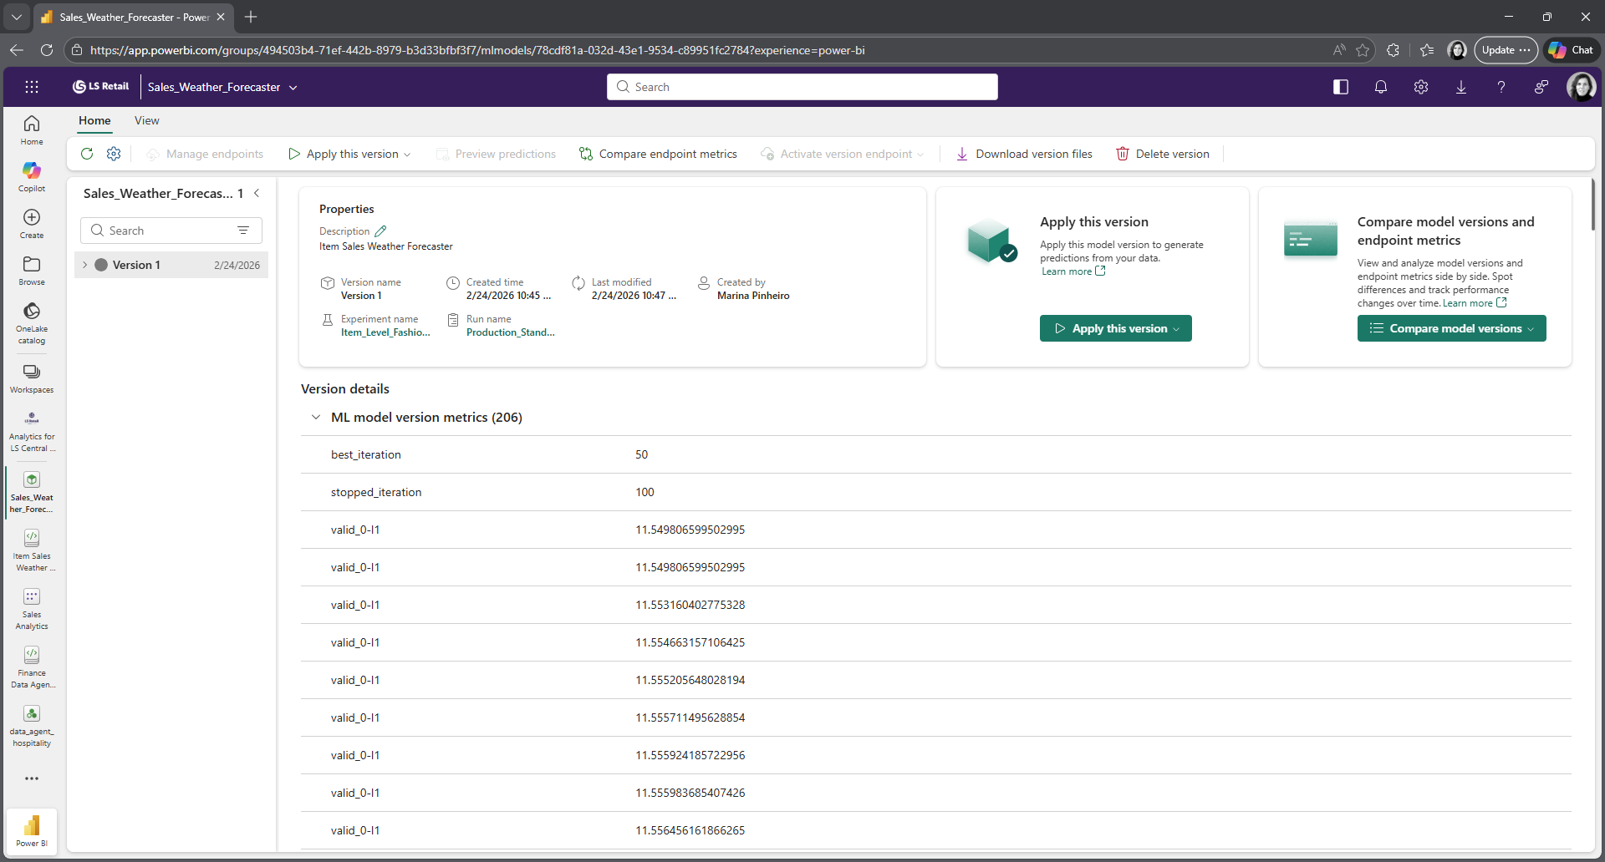
Machine Learning

Slide 40
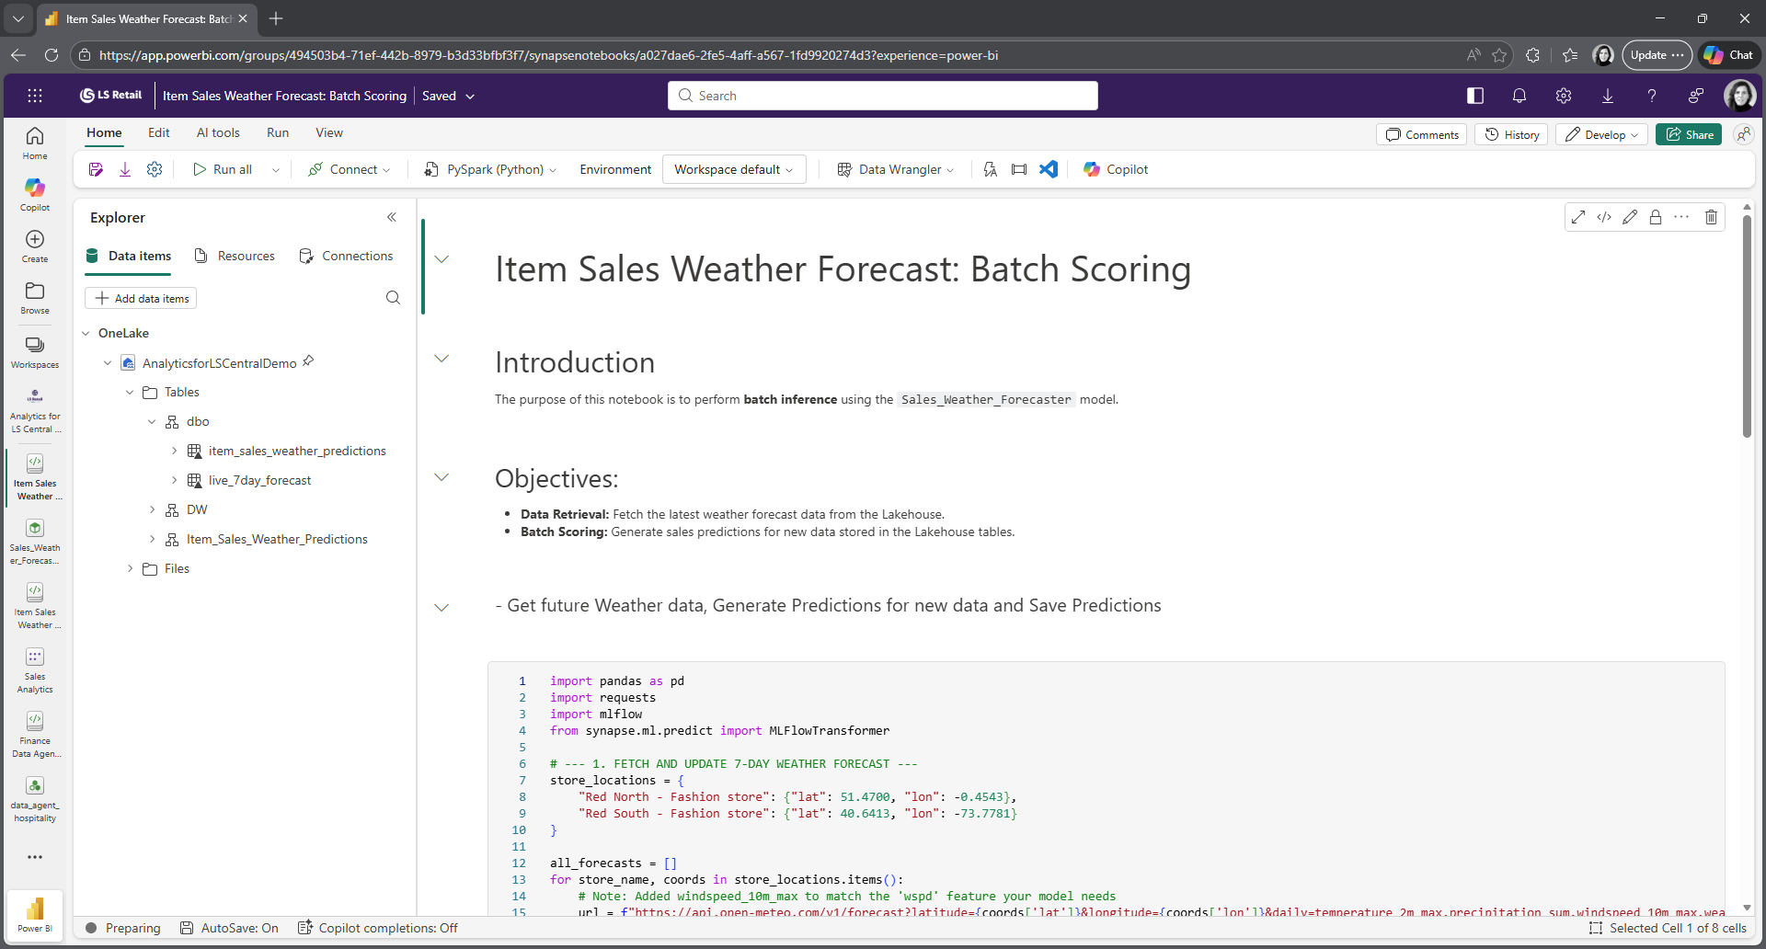
Machine Learning

Slide 41
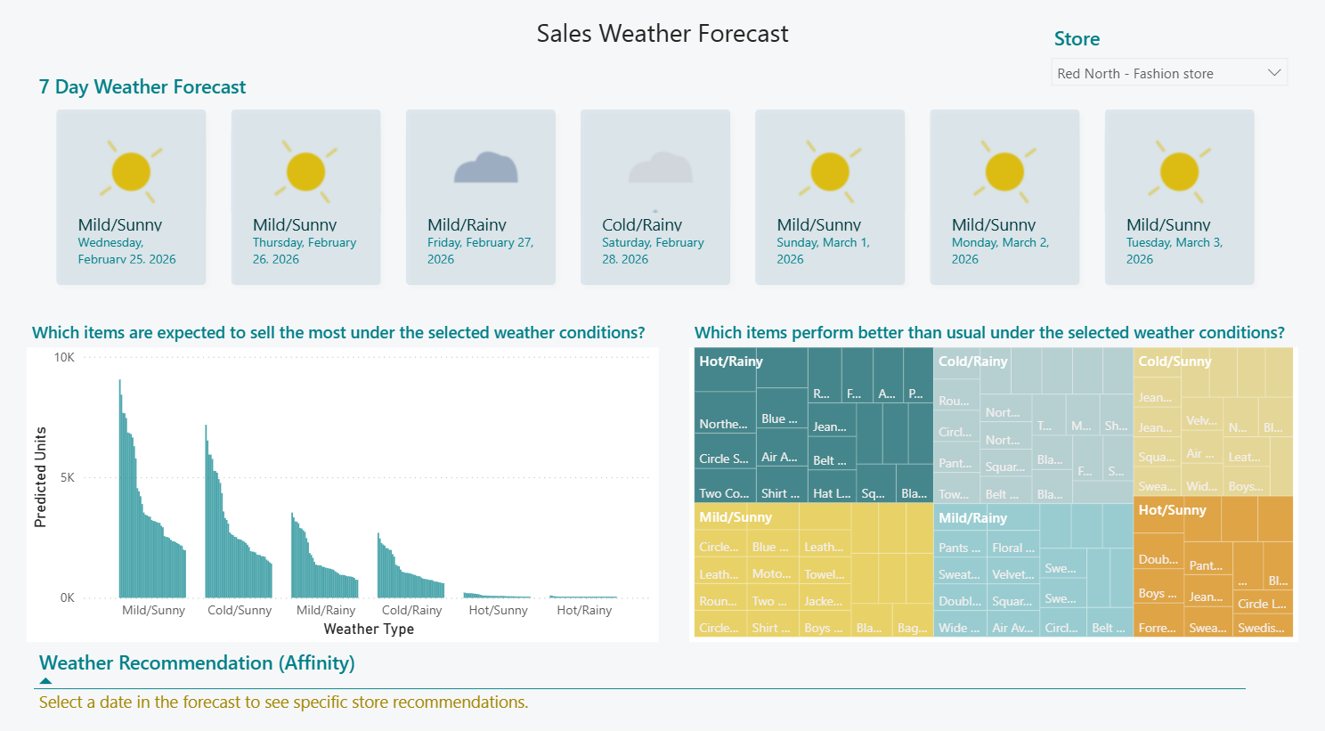
Machine Learning

Slide 42
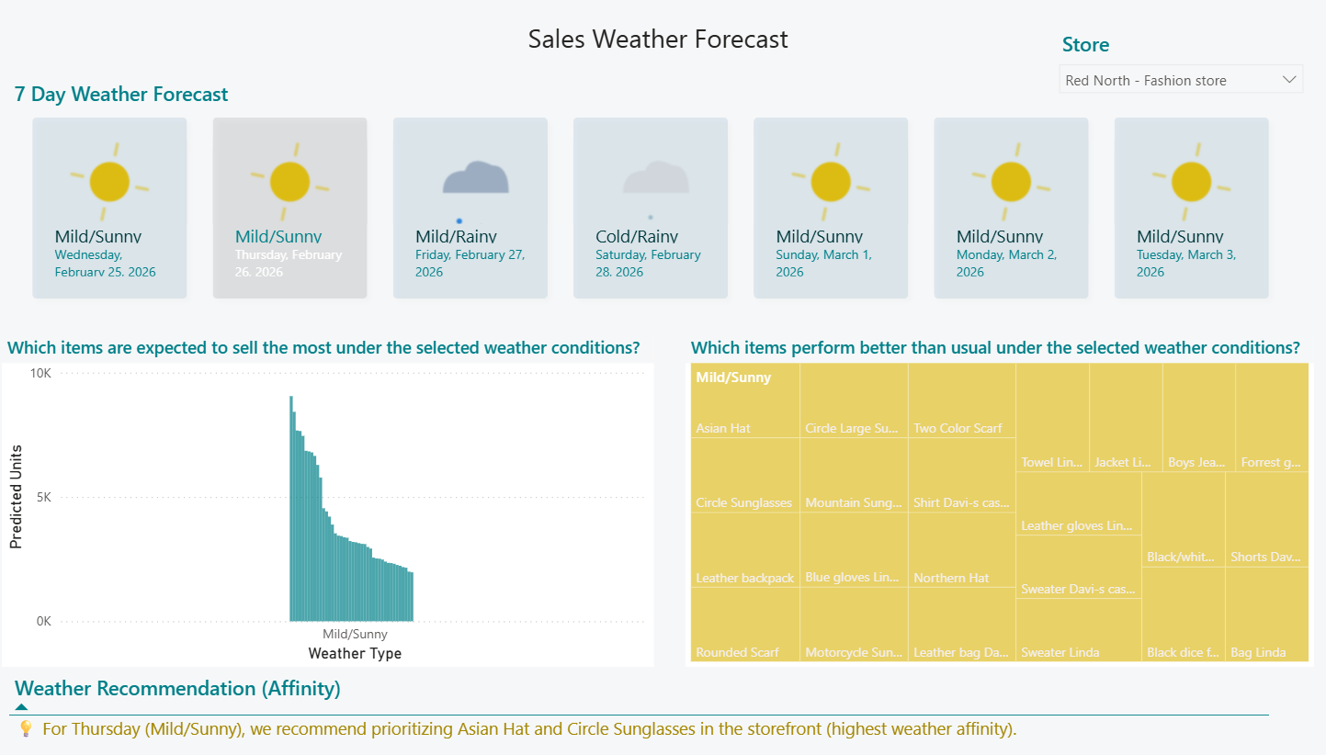
Machine Learning

Slide 43
Machine Learning
Feel better for the future

Slide 44
Data export with bc2adls
Transport data fast into the lake of analytics

Slide 45





Data export from BC SaaS – the “old” way
Azure Data
Factory
Power BI
Service
On-Prem / Virtual machine
(Orchestration)
Reports
Web Services
Business Central
Saas
Data
Director
Scheduler
Server
Analytics
Database
Semantic Models
Fabric Data Agent

Slide 46

Data export from BC SaaS with bc2adls
Azure Data
Factory
Power BI
Service
(Orchestration)
Reports
Bc2adls
Business Central
Saas
Azure Data Lake
Storage
Analytics
Database
Semantic Models
Fabric Data Agent

Slide 47
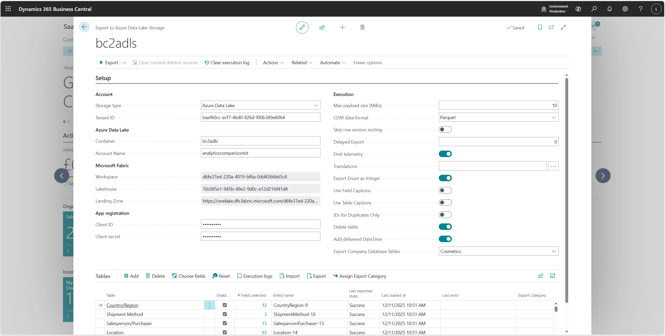
Data export with bc2adls
Setup

Slide 48
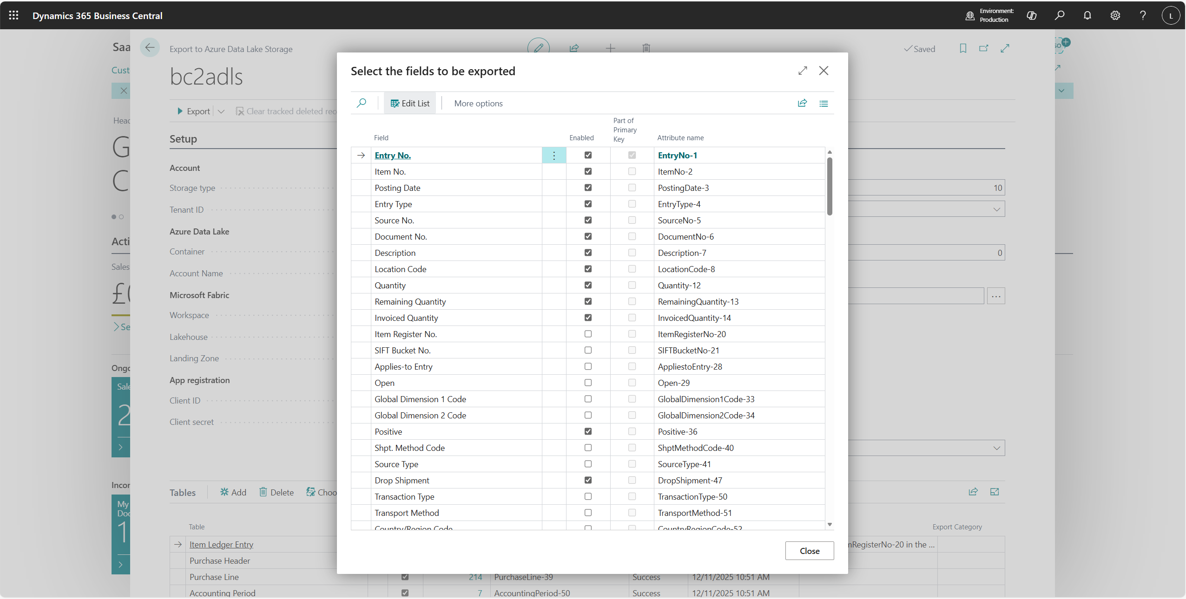
Data export with bc2adls
Tables Export

Slide 49
Data export with bc2adls
Superior Performance
Performance test
100 Mio. Item Ledger Entries
SaaS Data Export
Schedule run
6 Hours
(DD 5 Days)
10 Minutes
(DD 1 Hour)

Slide 50
Data export with bc2adls
Partner Testimonial
“(…) so far, it’s been all positive. It was easily the smoothest deployment I’ve done compared to previous on-prem and SaaS deployments (…)
It has now been running in production for around a month, and the syncing has been working extremely well. We haven’t seen any reconciliation issues to date, which is a significant improvement over what we previously experienced with the SaaS/hybrid VM solution.(…)”
Josh Torrisi, Canary Technology Solutions

Slide 52
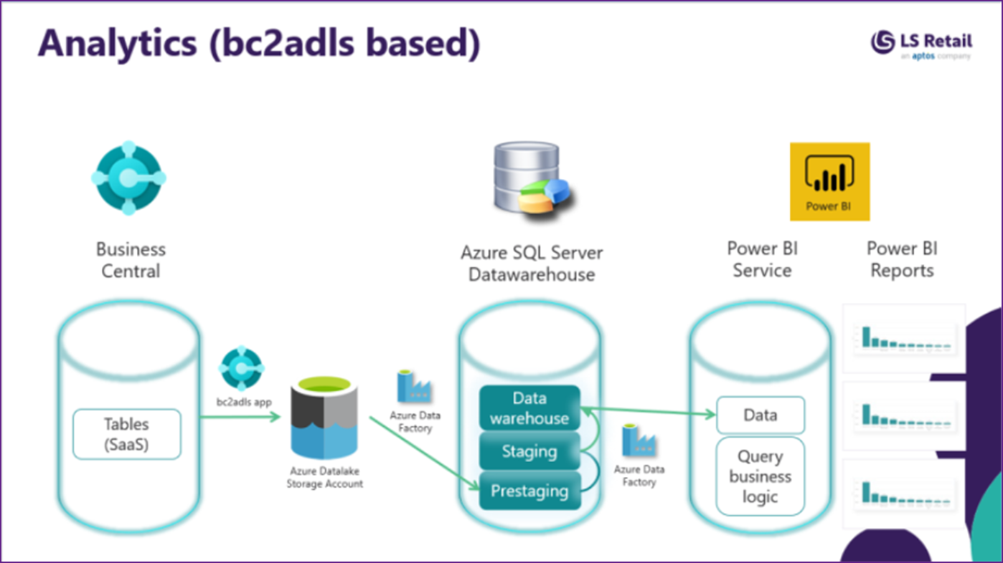
Implementation
Ahliki Wholesale Samoa
United Friendly Society Pharmacies
Community Care Pharmacies
bc2adls

Slide 53
Implementation & Duration
First production deployment completed in ~2 hours
Initial sync (1 year, 20 stores) completed in ~1 hour
Previously required days of manual effort
Operational Experience
Very straightforward to implement and operate
Simpler than previous VM-based reporting architectures
Handles incremental changes and deltas reliably
Strategic Impact
Minimal changes required to existing reports
Enables a fully cloud-native analytics stack
Default approach for new and future BC SaaS customers
bc2adls

Slide 54
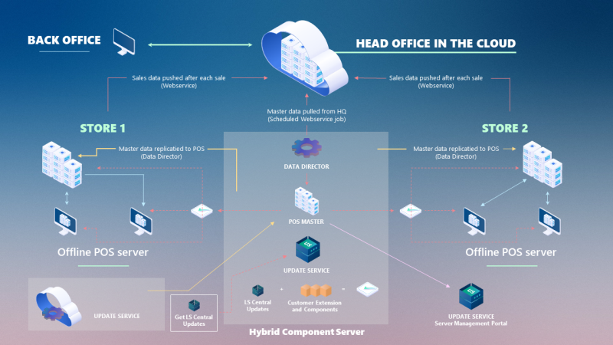
Say goodbye to our old friend HCS for SaaS customers!!
bc2adls

Slide 55




Our Practices
Cloud & Data
Cyber Security
We recognise that data is your most valuable asset.
Our solutions ensure your data is always in the right location at the right time, while leveraging Public, Private, and Hybrid Cloud to provide secure, flexible, and scalable environments.
We safeguard your business against evolving threats. Our security solutions encompass Endpoint Protection, Network and Cloud Security, Managed Detection and Response (MDR), and comprehensive Security Assessments to ensure your data and systems are secure.
ERP Solutions
Managed Services
We specialise in empowering retail & pharmacy organisations.
Our expertise includes LS Retail and Microsoft Business Central, helping you streamline operations and enhance the customer experience.
Managing your IT environment can be complex, time consuming and costly.
Our 24x7 Support & Service Desk supports your entire IT environment, allowing you to focus on your core business.

Slide 56

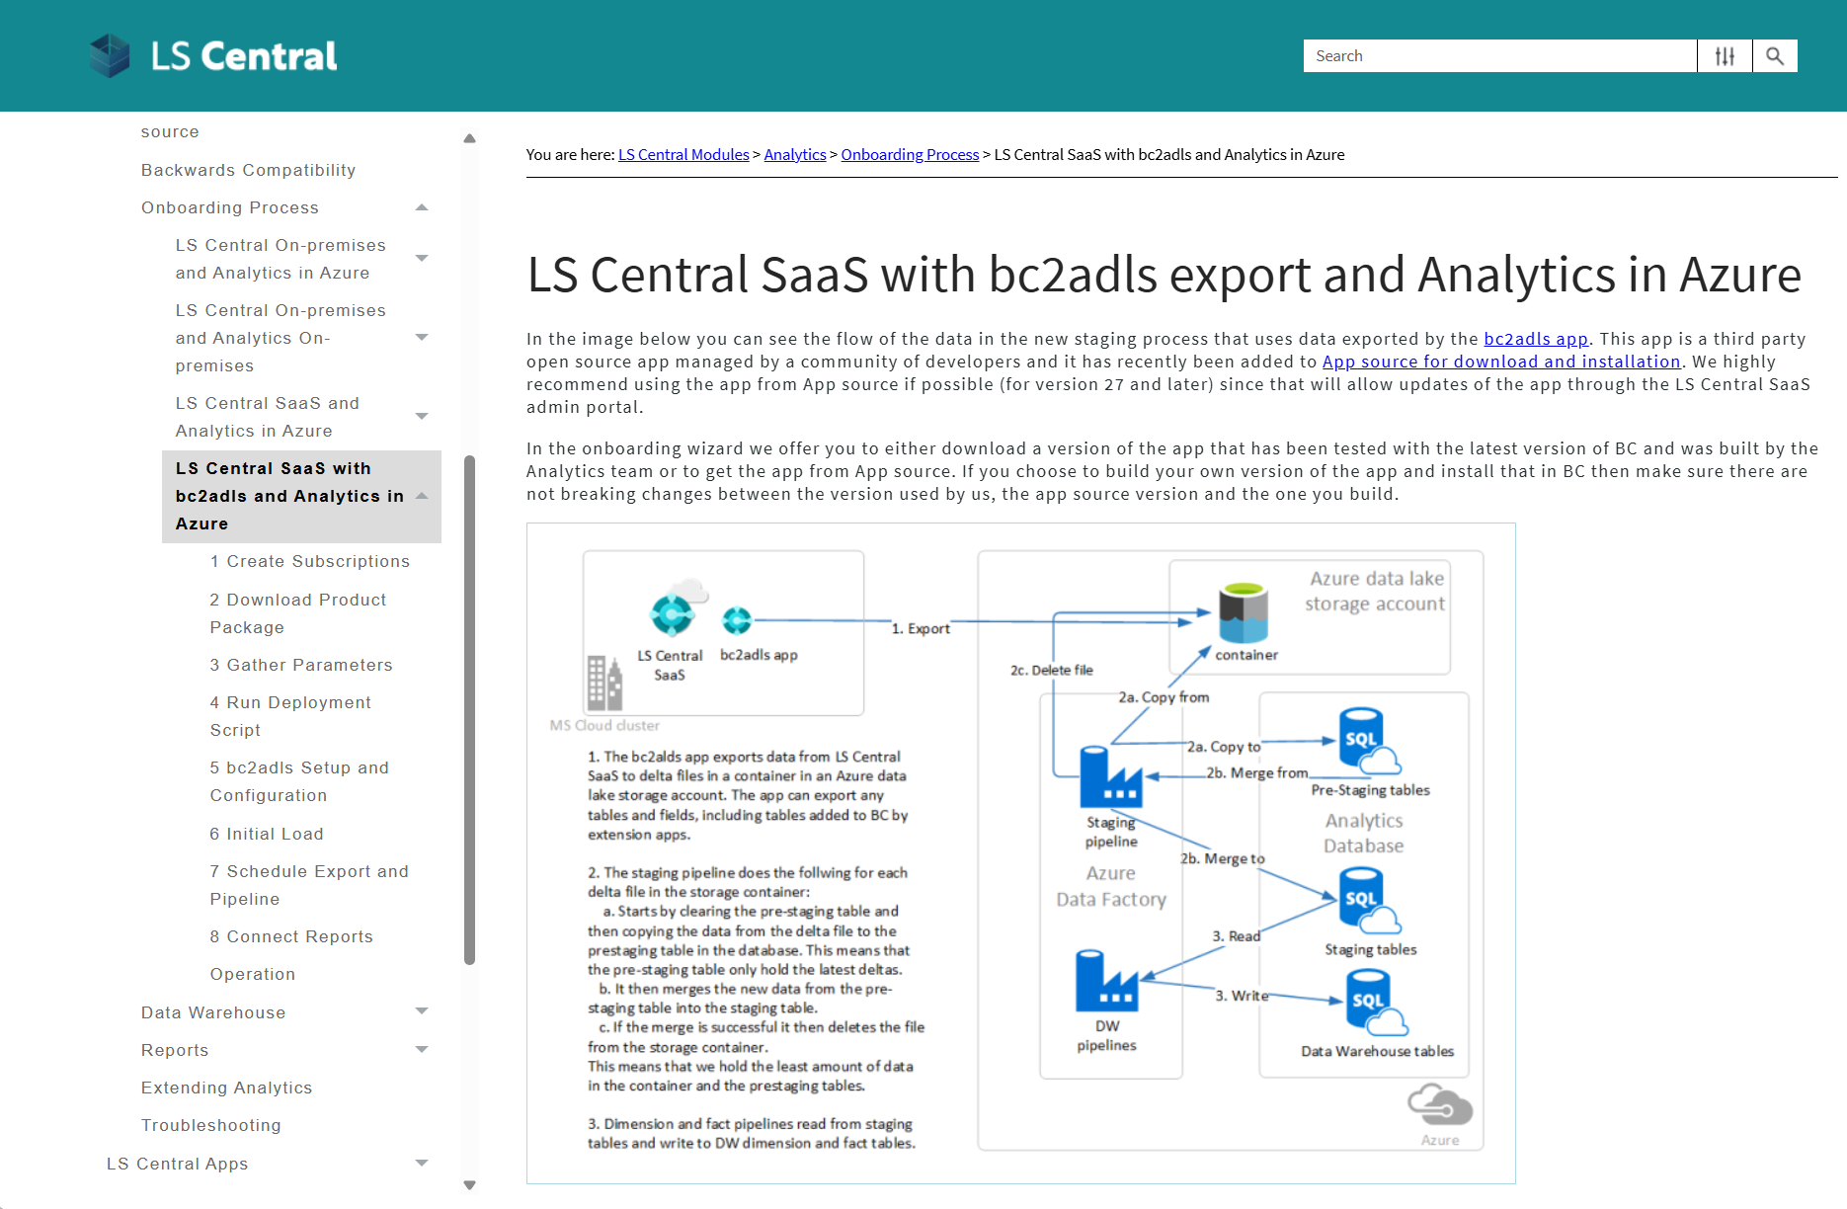
Data export with bc2adls
How to get started
Download the
Analytics package
Setup and configure Analytics
Get bc2adls app
Setup and configure bc2adls
Run initial export and load
Setup schedules
Connect reports

Slide 57
Data export with bc2adls
Transport data fast into the lake of analytics

Slide 58
Continuous Improvements
A plethora of enhancements for your analytics comfort and wellbeing

Slide 59
Continuous Improvements
Reports
Power BI Sales template in Spanish
Power BI Sales template Forecasting page
Power BI Sales template Item Variant Analysis page
Data Dictionary
Analytics for LS Central Agent – Online
Analytics for LS Central and Tableau
Analytics for lS Central and Excel
Data Catalog Semantic models diagram page
Power BI Finance template YouTube video tutorial
Power BI Store Income Overview page
Power BI Gratuity Overview page
Power BI Gratuity Overview by Staff page
Data Enhancements
Added Store Income/Expense account entries to the data warehouse
Enabled Store Income/Expense and Tips reporting
Updated cost calculator with new setup cost model for BC → ADLS exporting
Updated linked service types
Pipelines
Fixed metadata extraction issues with varchar(max) columns in GetLSCentralMetadata query
Data Warehouse Improvements
Transfer Order Shipments now use only the latest shipment line version
Retail Sales Budget now joins only to currently valid item lines
Kitchen Display Station logic split for v24/v25; original procedure renamed
Member merge procedures optimized to improve performance on high sales volumes
POS Payments fact table fixed to load incrementally
New v25 member dimension uses Contact Gender where available (Member Gender obsolete)
Hospitality Type merge updated to include Service Type
Unlinked reservation items excluded from Activity Reservations fact
Dining Reservation facts updated to:
  Use max number of guests per table/reservation
  Aggregate duration across rows to match fact grain
Fixed incorrect joins in Purchase Credit Memo, Invoice, and Receipt facts
Added Document Number joins to Purchase Invoice facts

Slide 60
Continuous Improvements
A plethora of enhancements for your analytics comfort and wellbeing

Slide 61


Analytics for LS Central

