Slide 1
Offer contactless shopping with LS Central
Ólafur Jónsson
Product owner

Slide 4
eCommerce

Slide 5
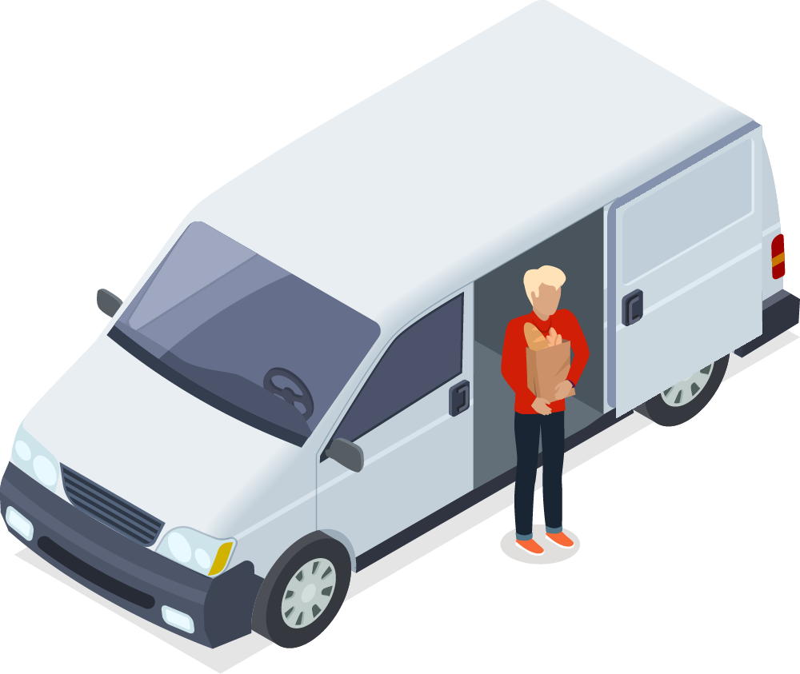
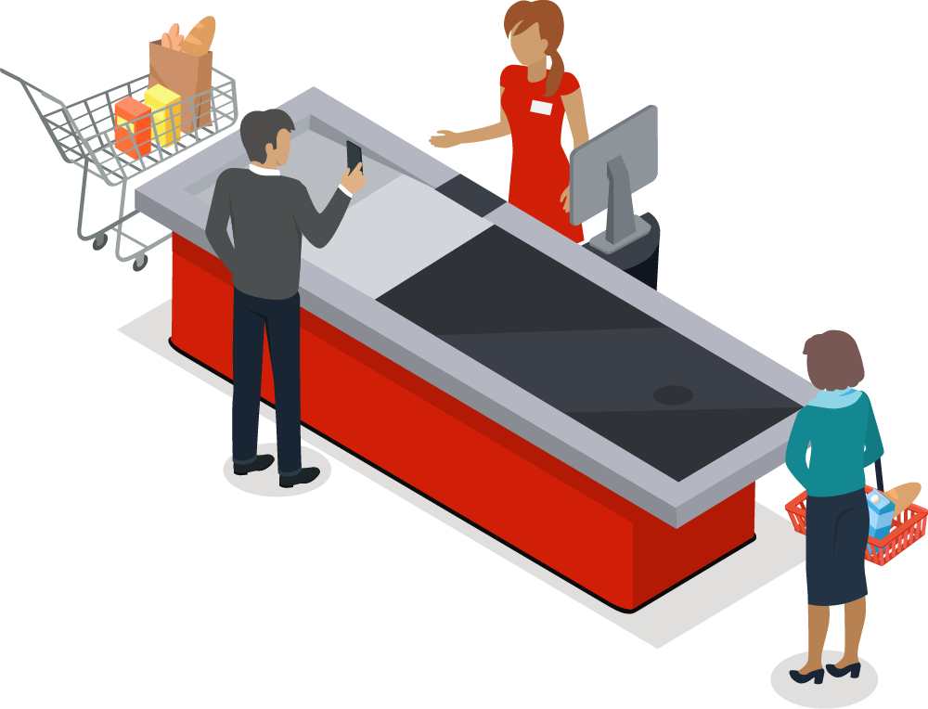
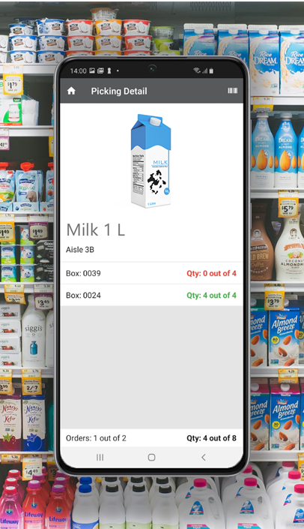
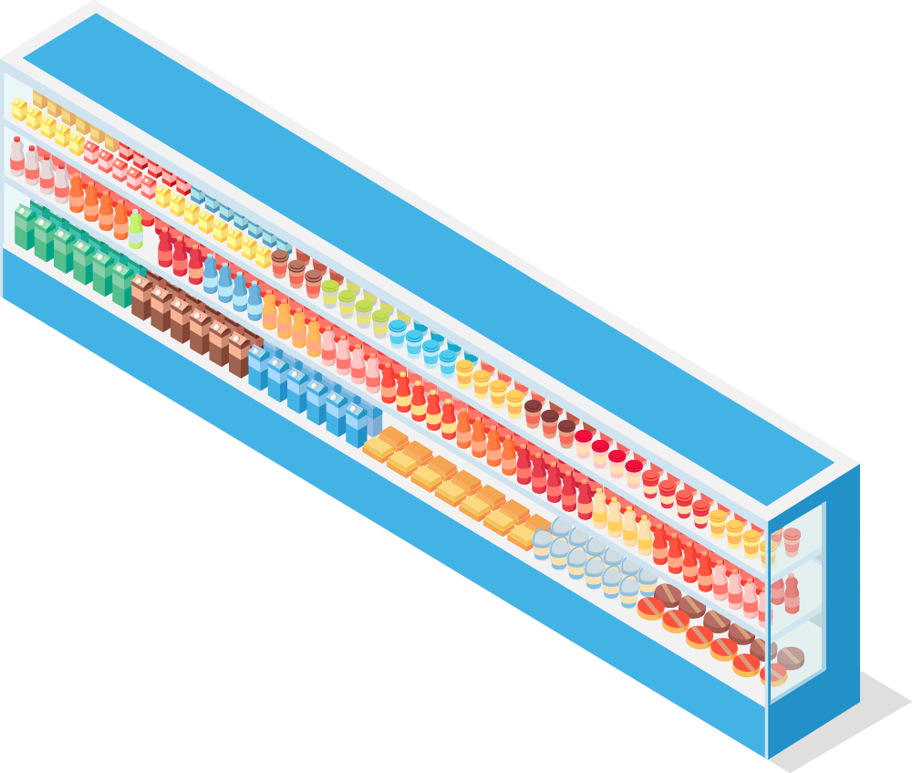
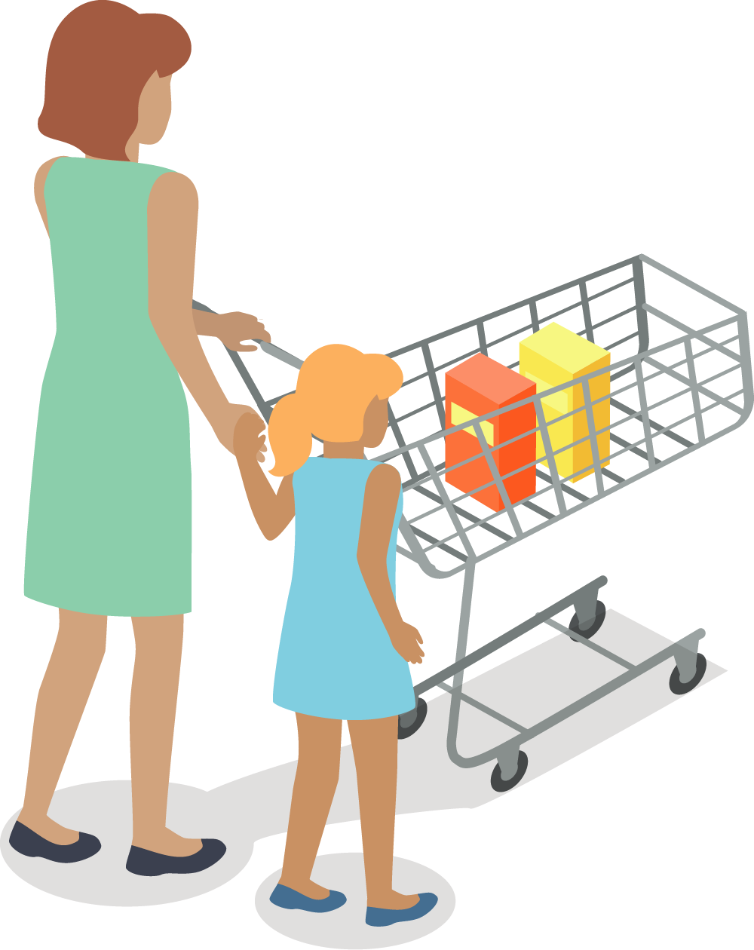
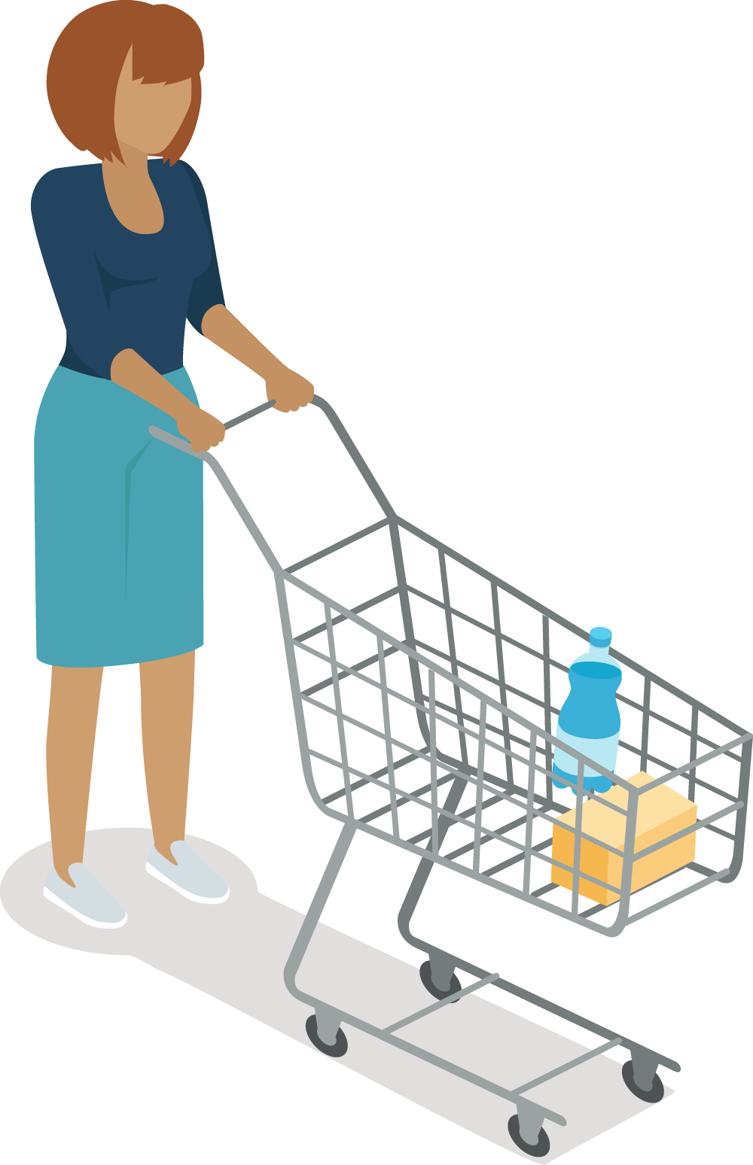
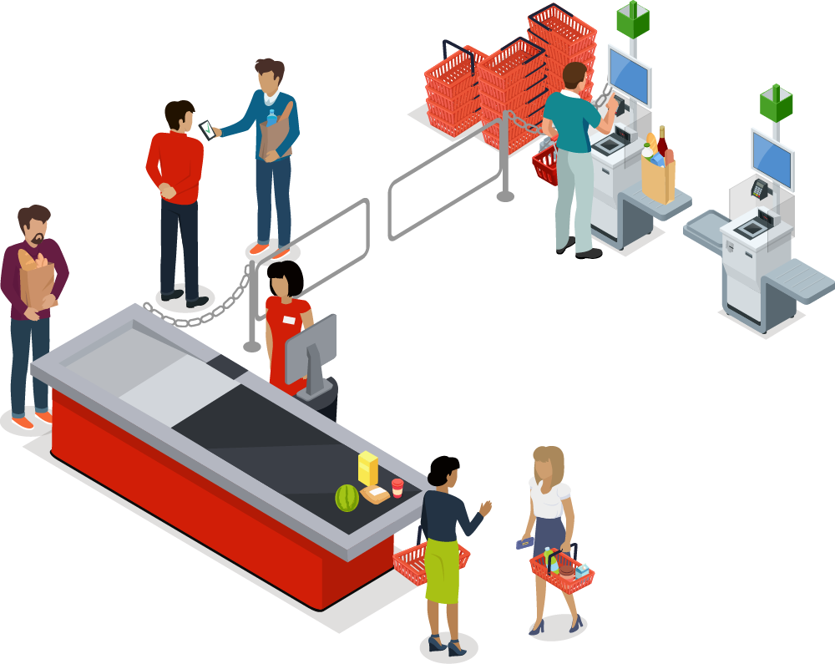
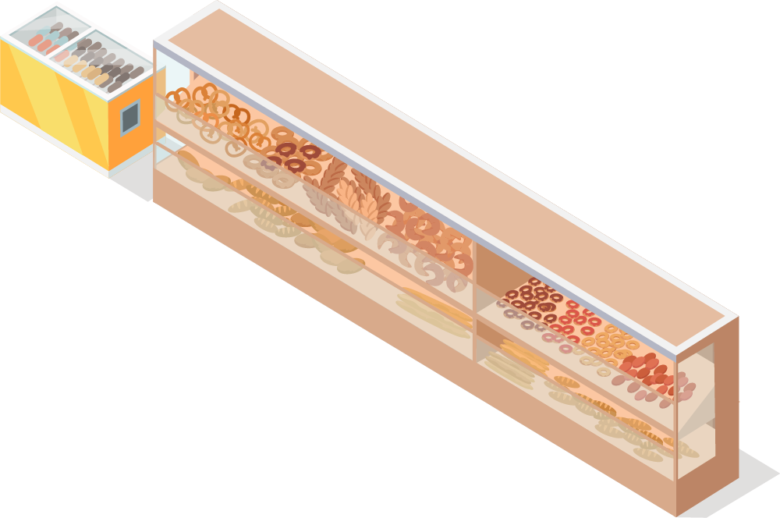
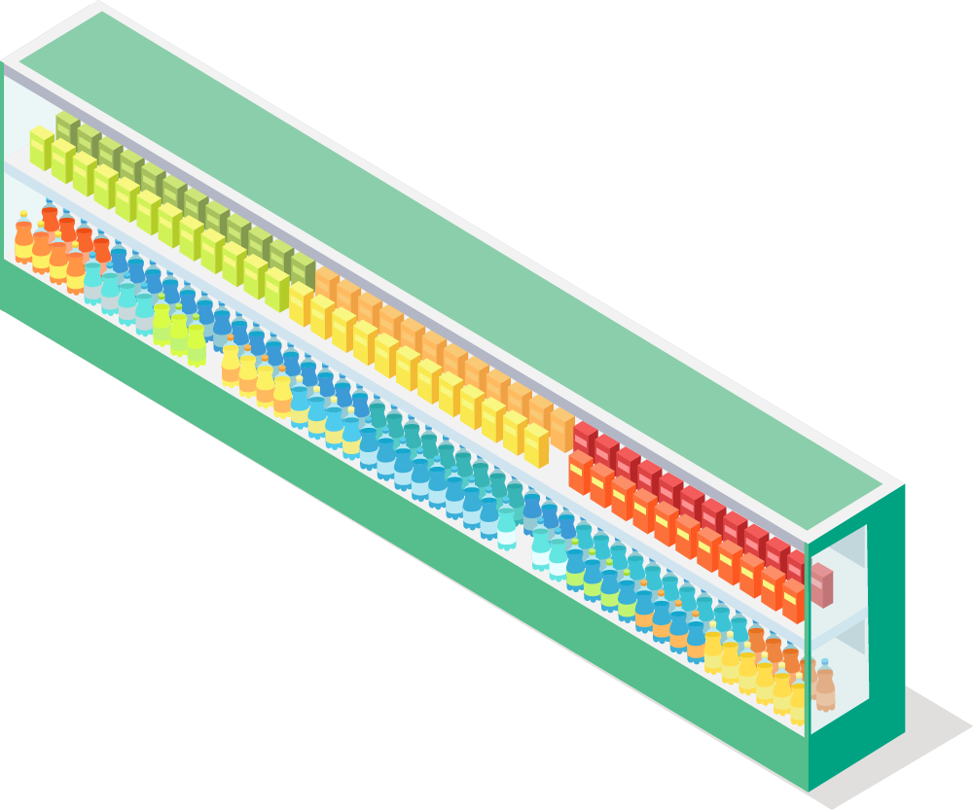
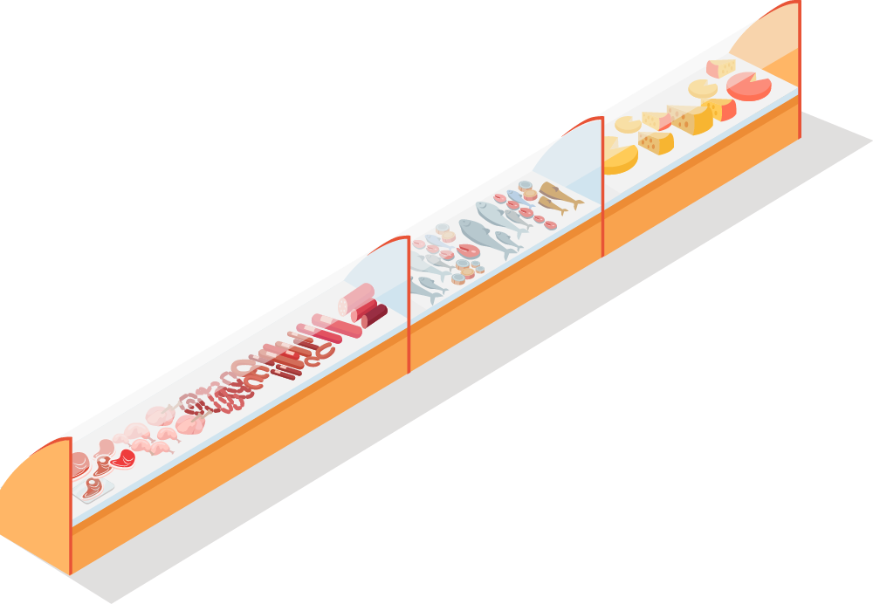
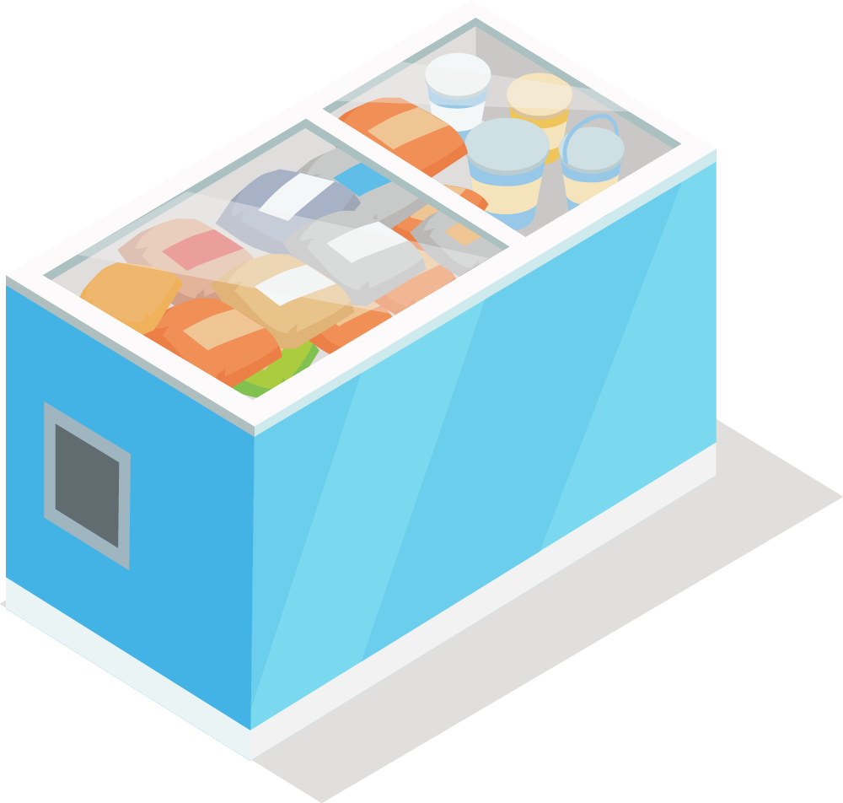
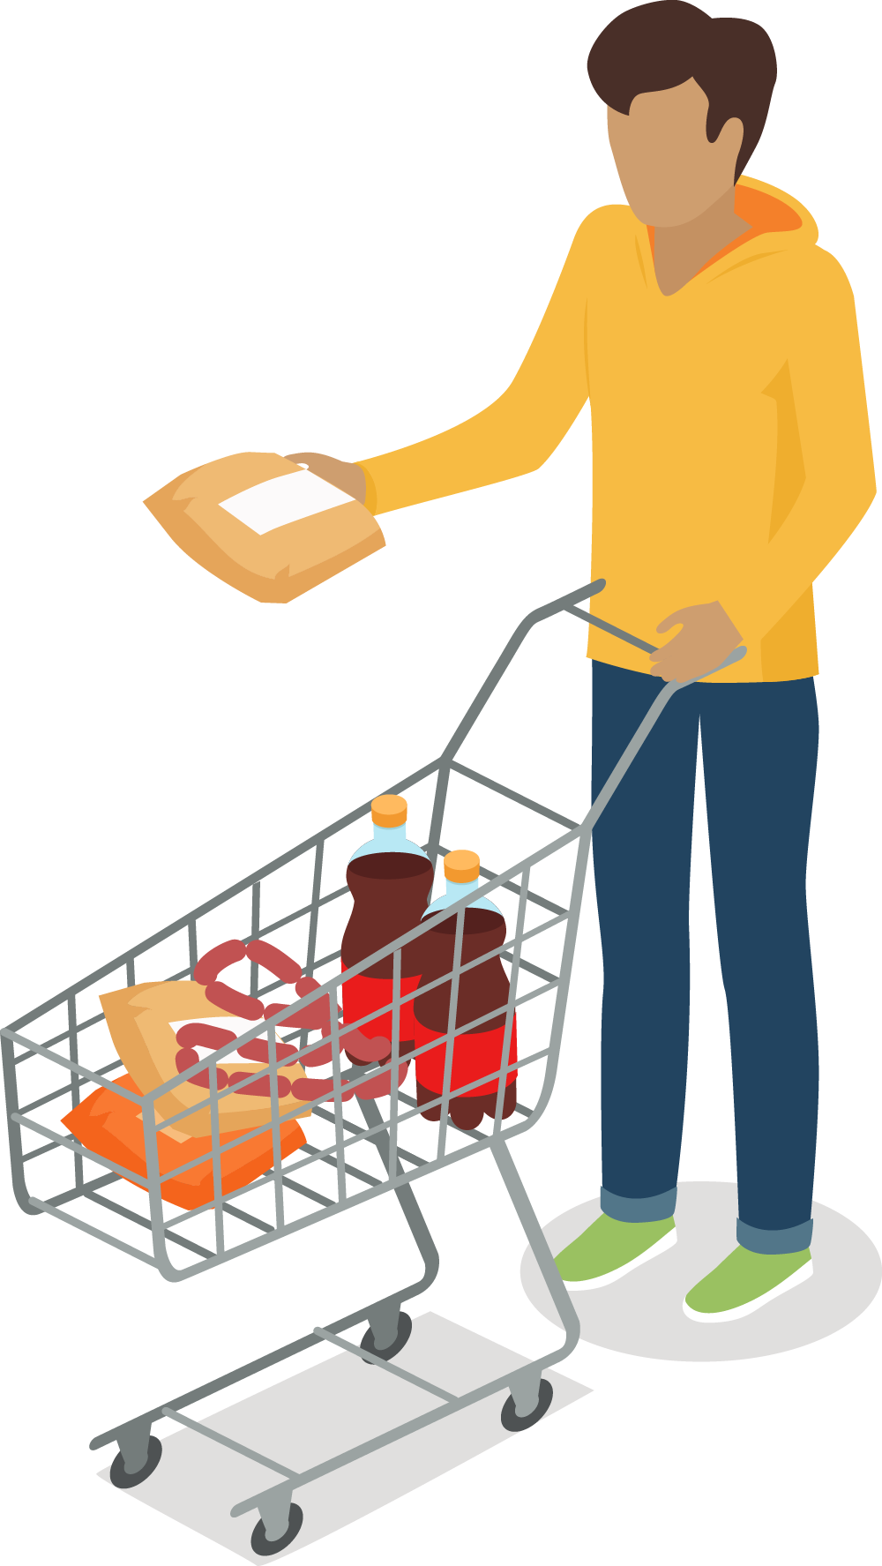
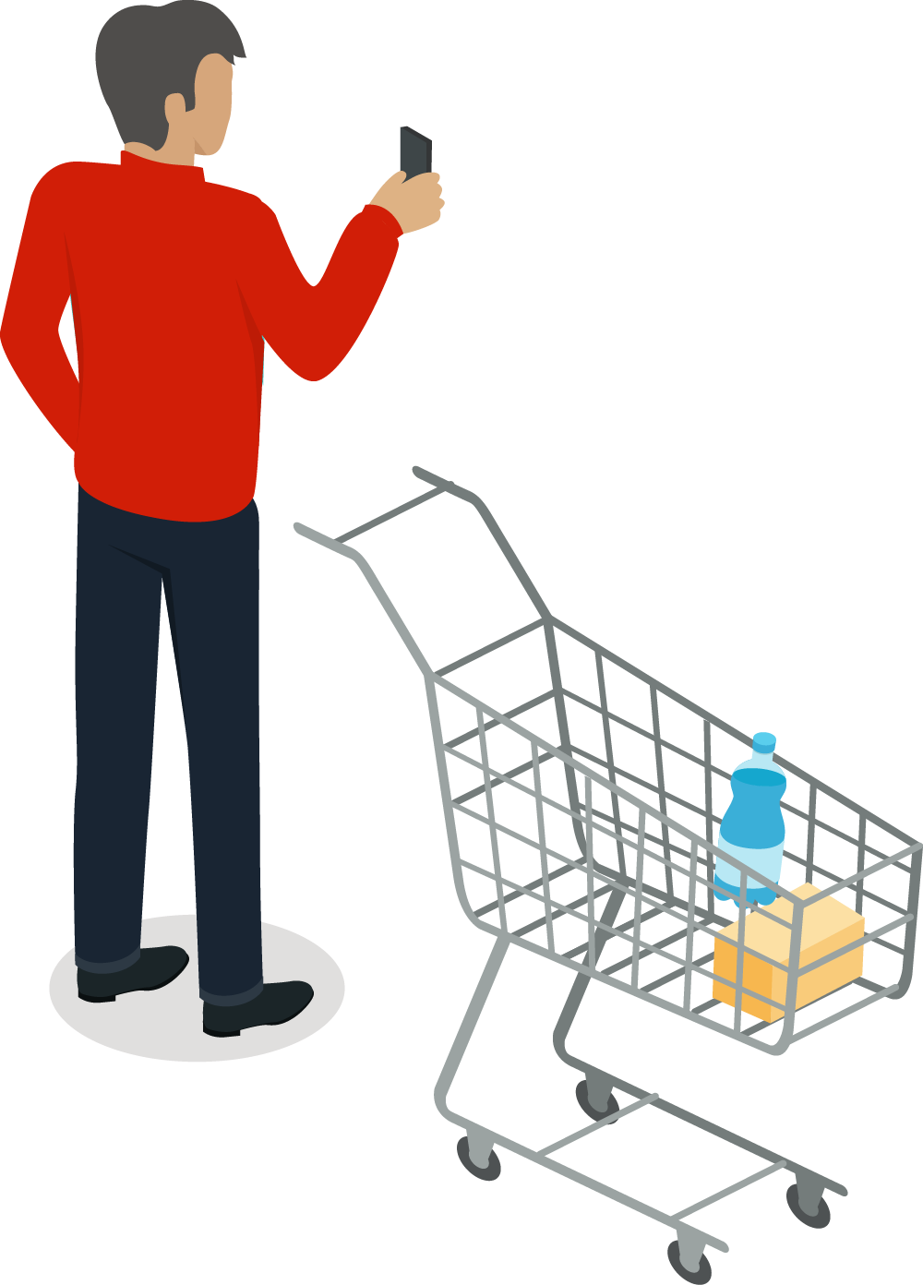
eCommerce – store sourcing
Home delivery
Collect in-store
Customer
order picking

Slide 6
DIY – Do It Yourself

Slide 7
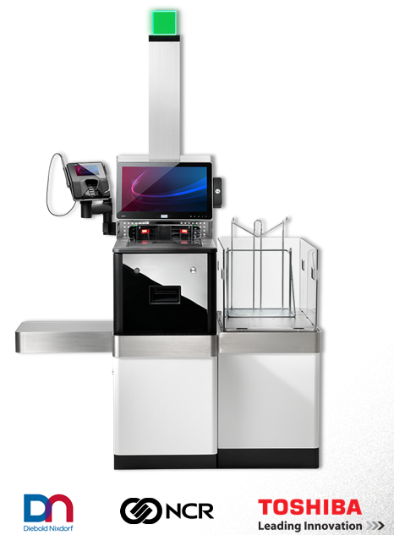
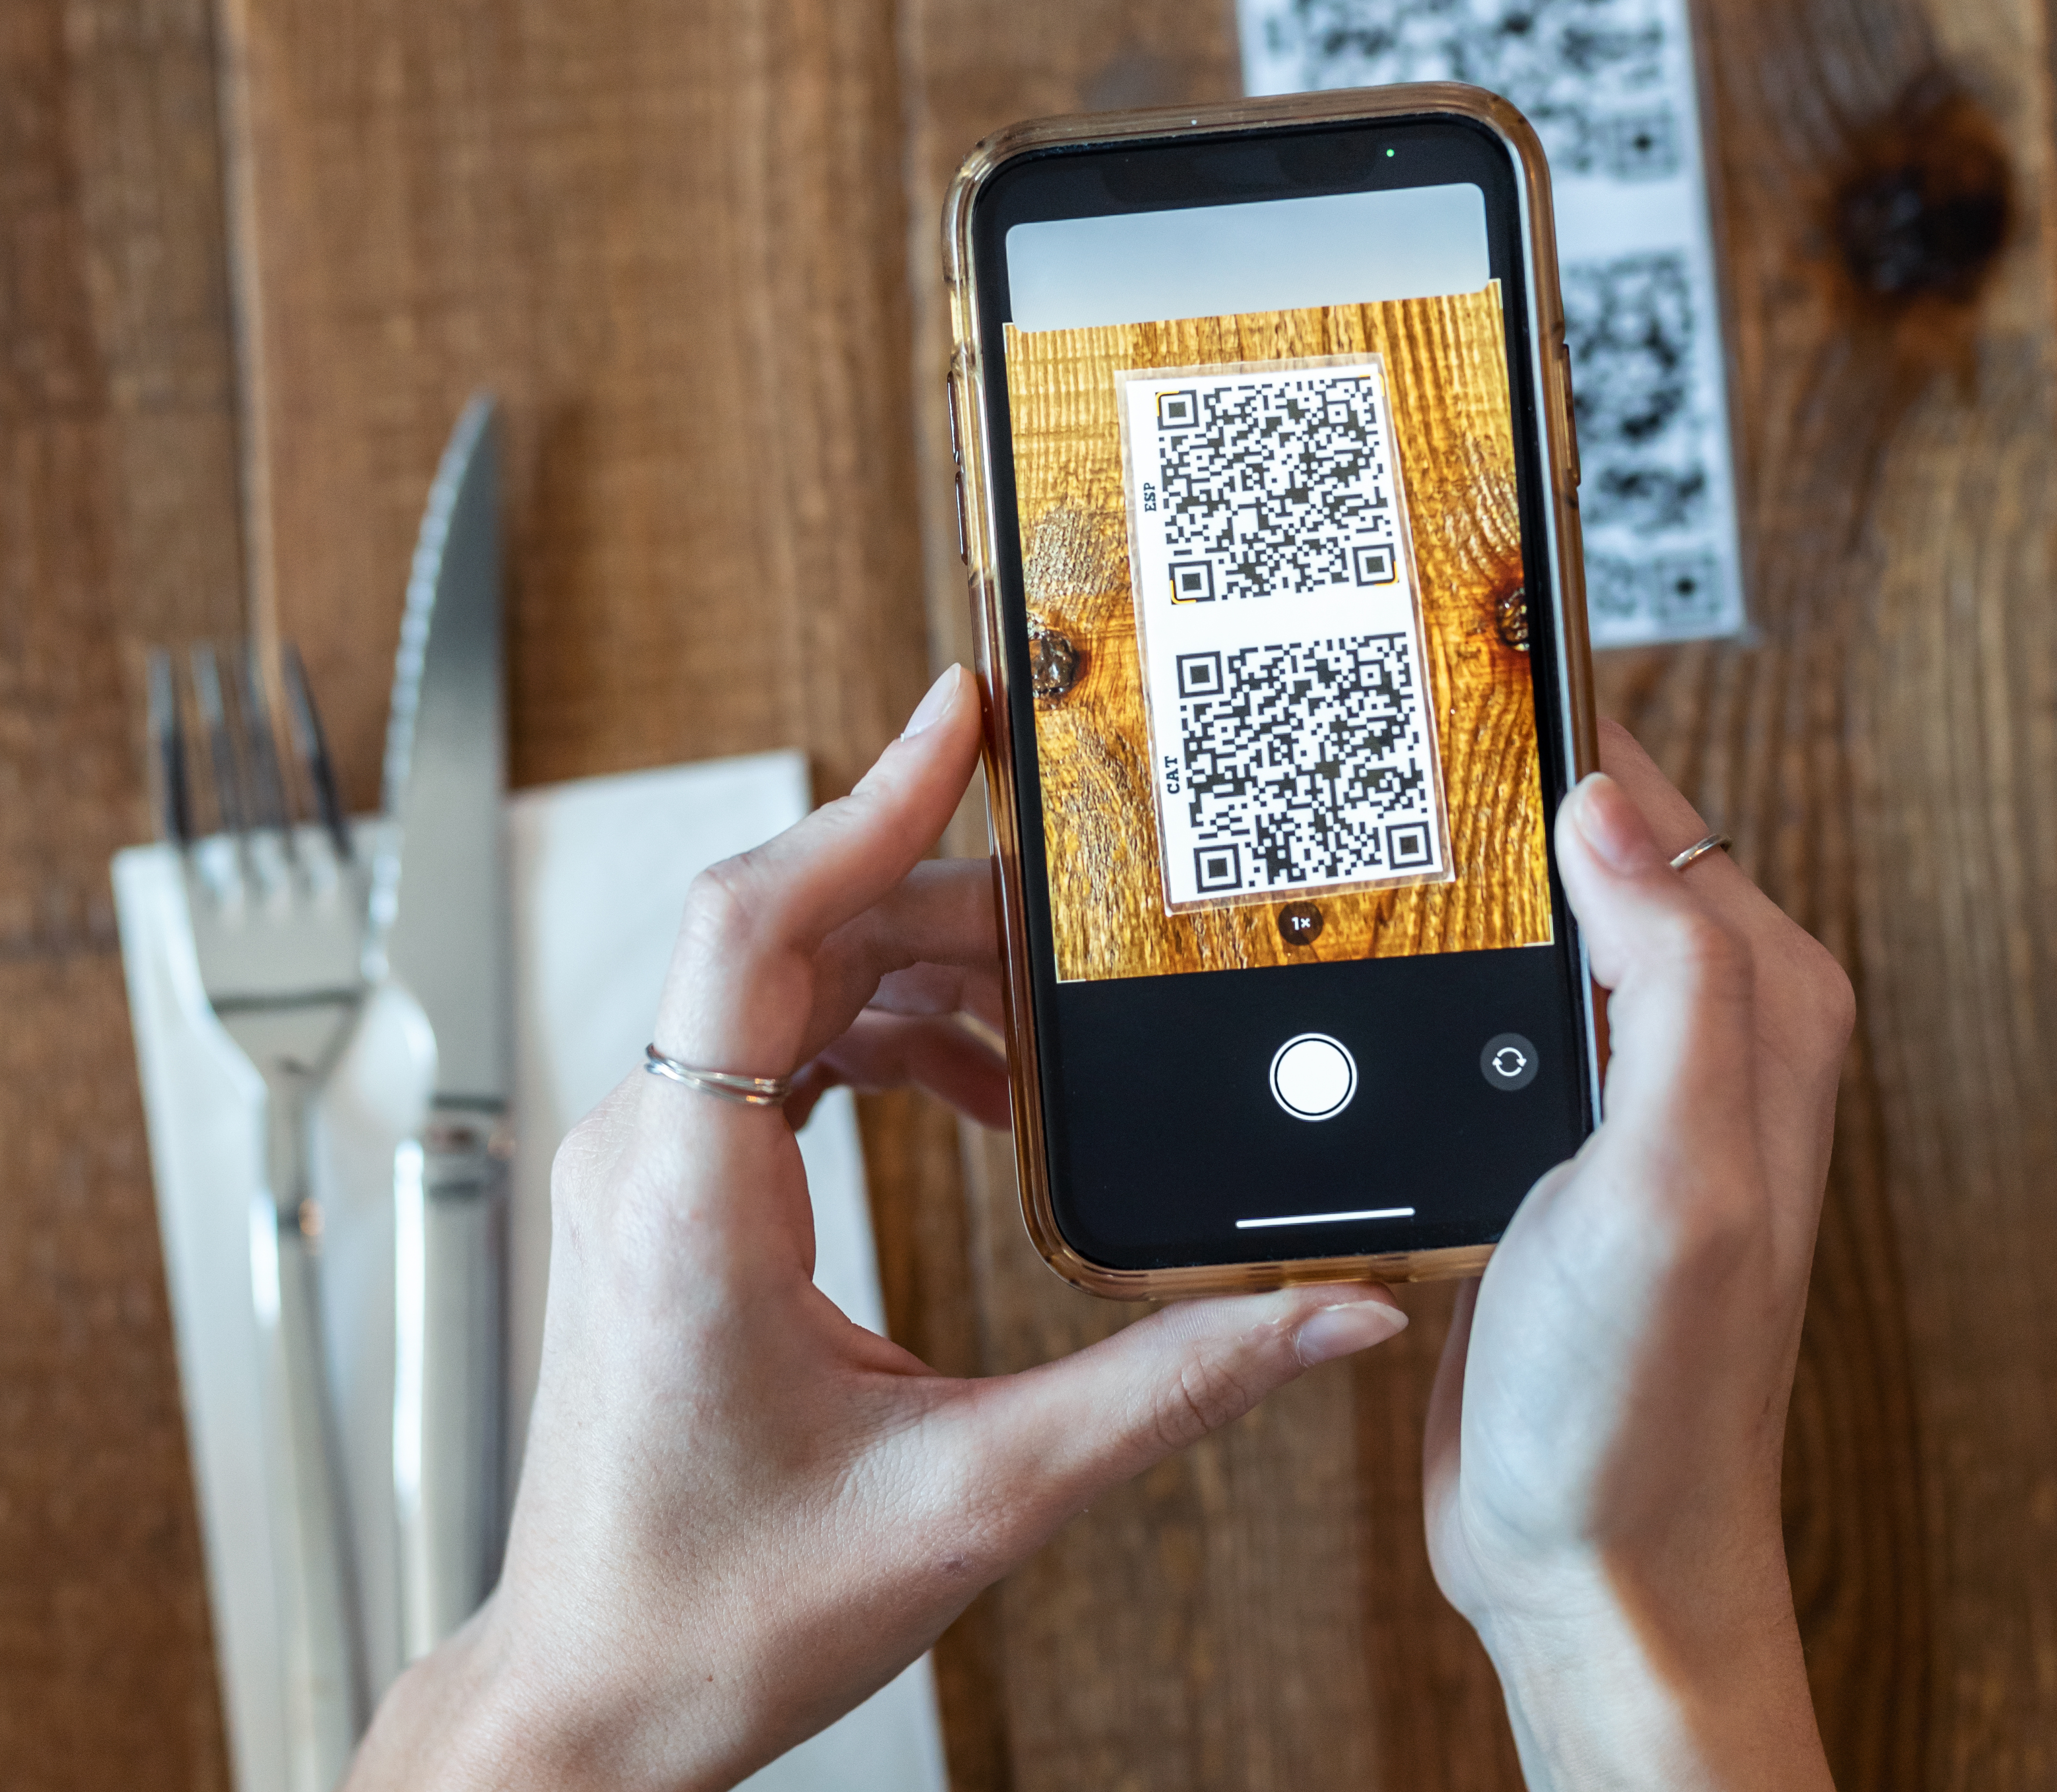
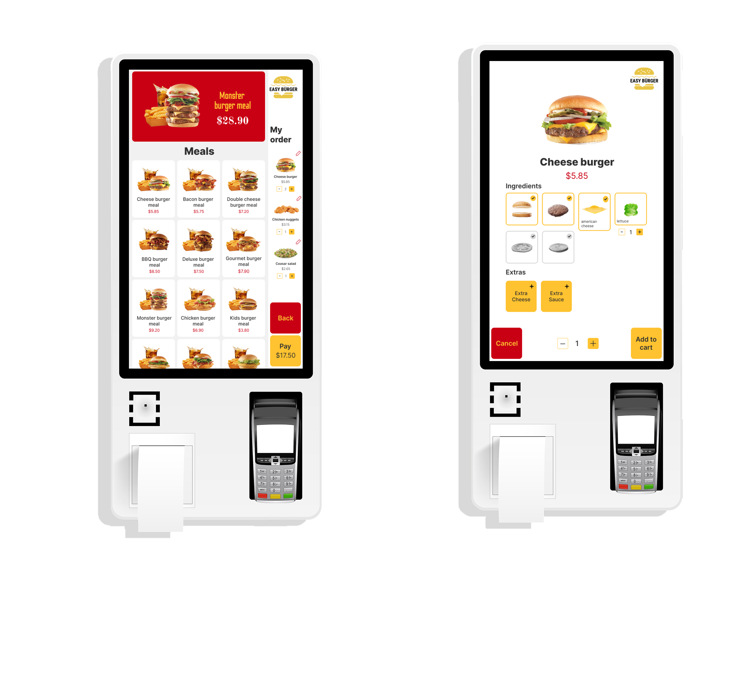
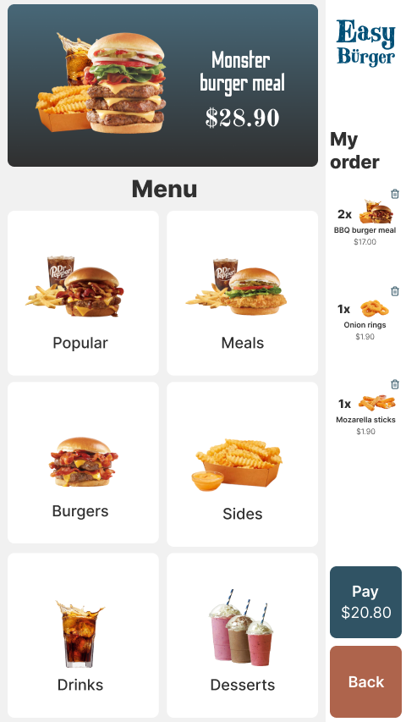
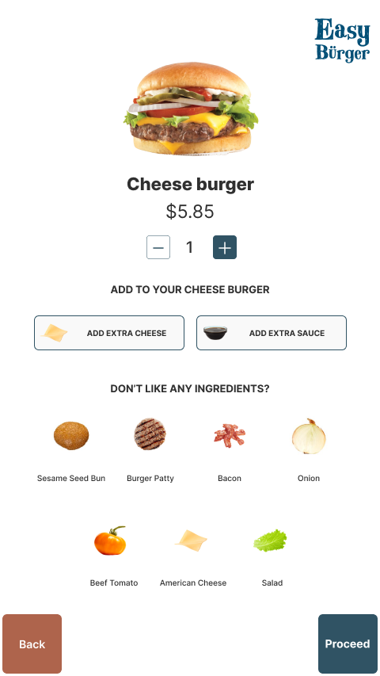
Some DIY options …
Contactless food ordering
Self-Service Kiosk
Self Checkout

Slide 8
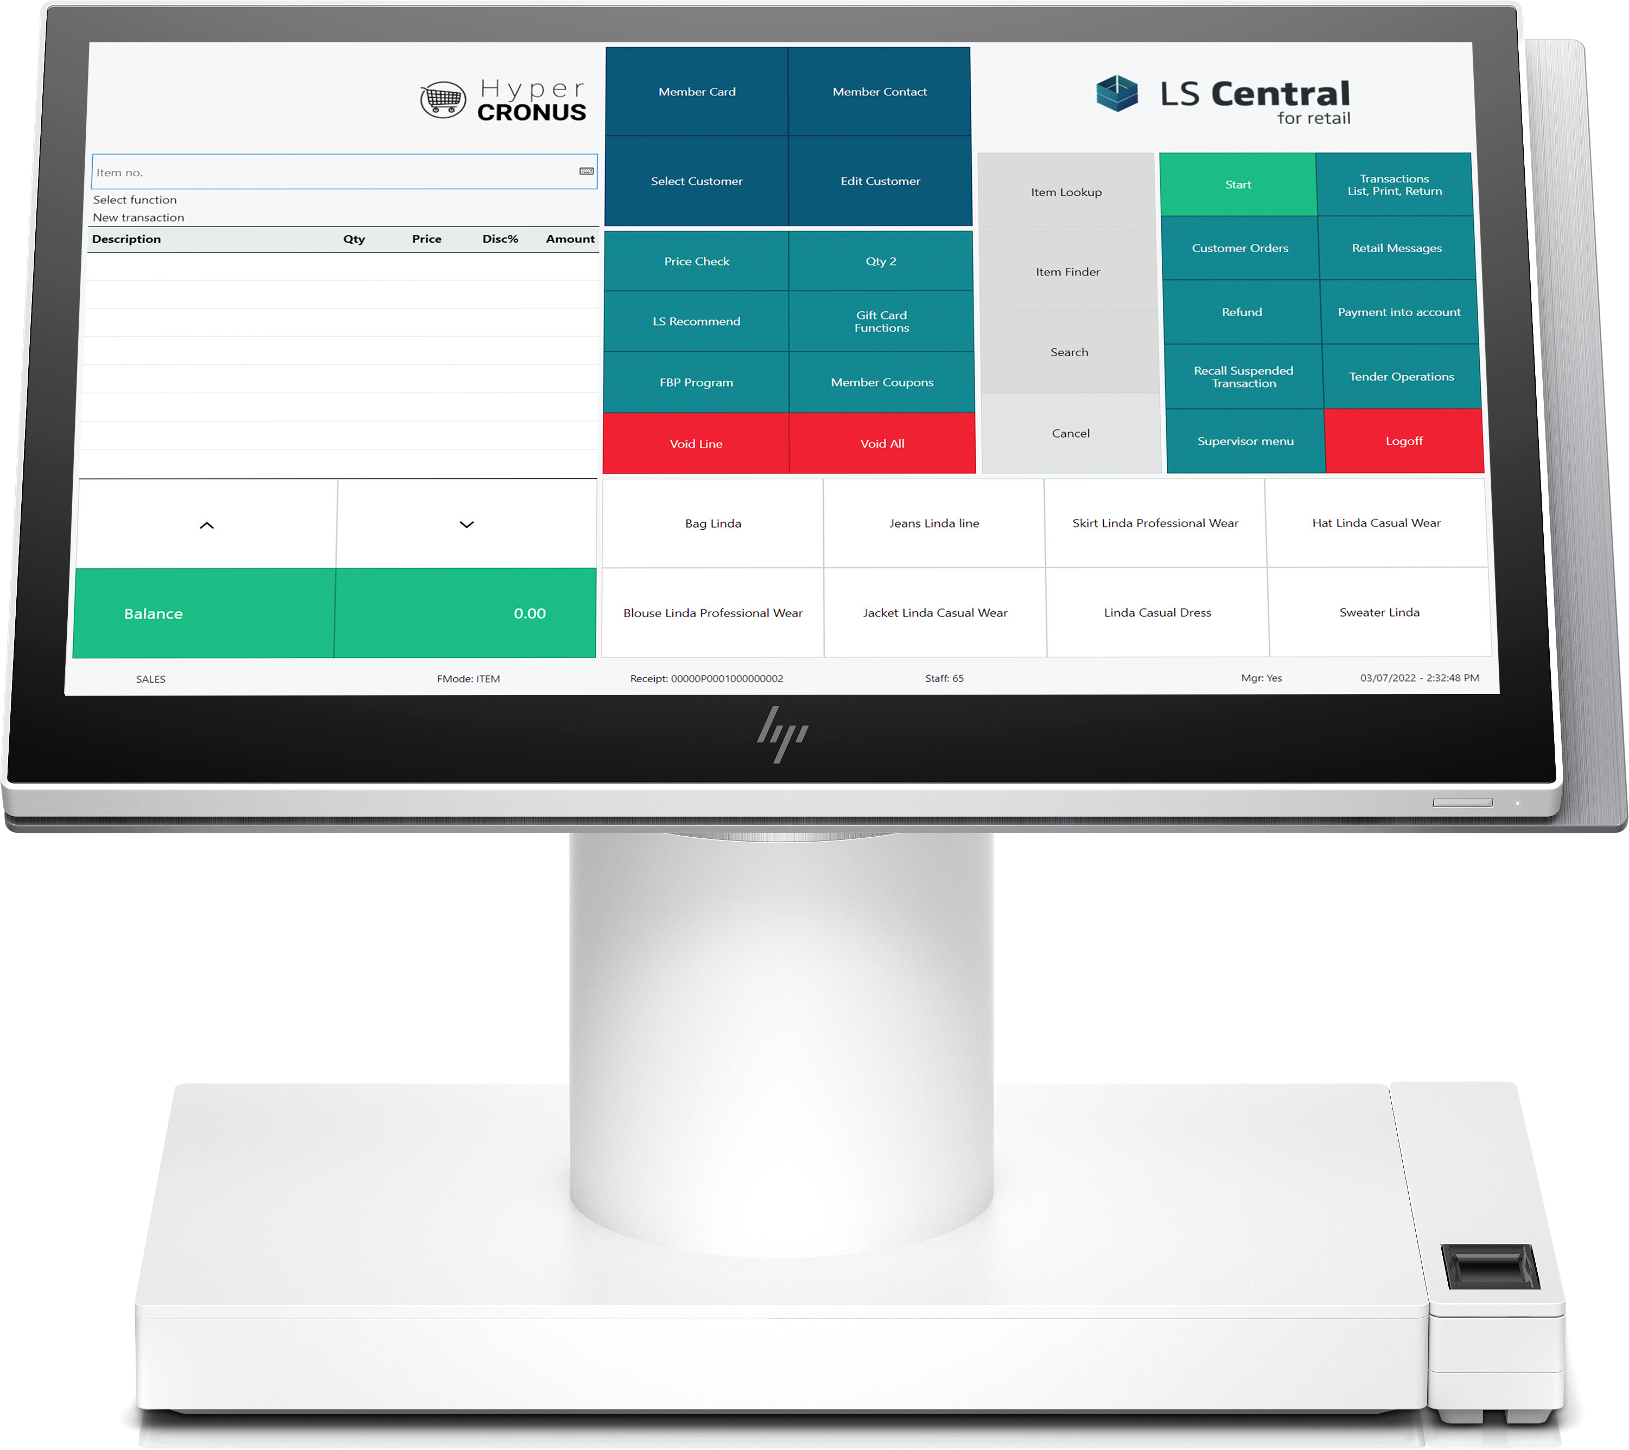
Self Checkout Connection
LS SCO
?

Slide 9
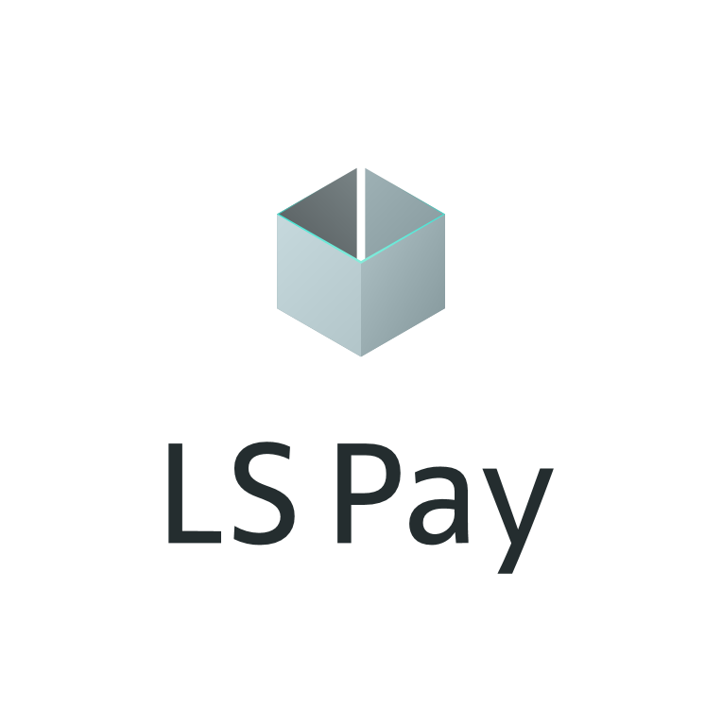
We have seen this before ..
?

Slide 10
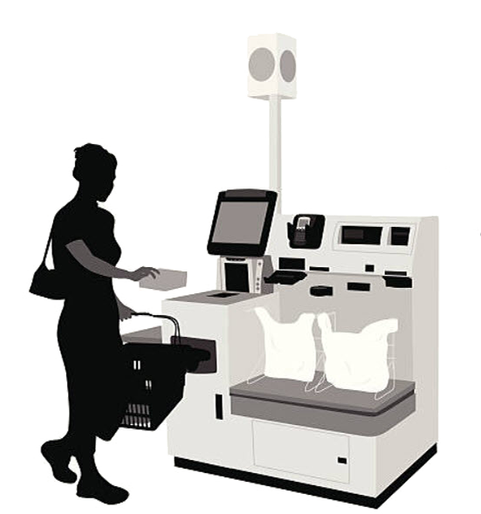
Evolution – what is retail’s next step?

Slide 11
LS ScanPayGo

Slide 12
LS ScanPayGo
App for Android & iOS
Released by the retailer
Downloaded to and operated from the customers mobile device
The journey for the Nutrice grocery chain

Slide 13
Nutrice journey to use ScanPayGo
Nutrice
Grocery store chain
Operates 10 stores
Running LS Central 19.5 in SaaS
The steps
Download the code for SPG
Add logo and set color schema
Configure SPG in LS Central BO
Payment, Security etc

Slide 14
SPG – Payment options
Configured in LS Central
Available options
Pay with card
Pay at POS
Pay using loyalty points
Planned
Pay at Self Checkout
Self-checkout
3rd Party self-checkout
POS lane
POS station
Payment station

Slide 15
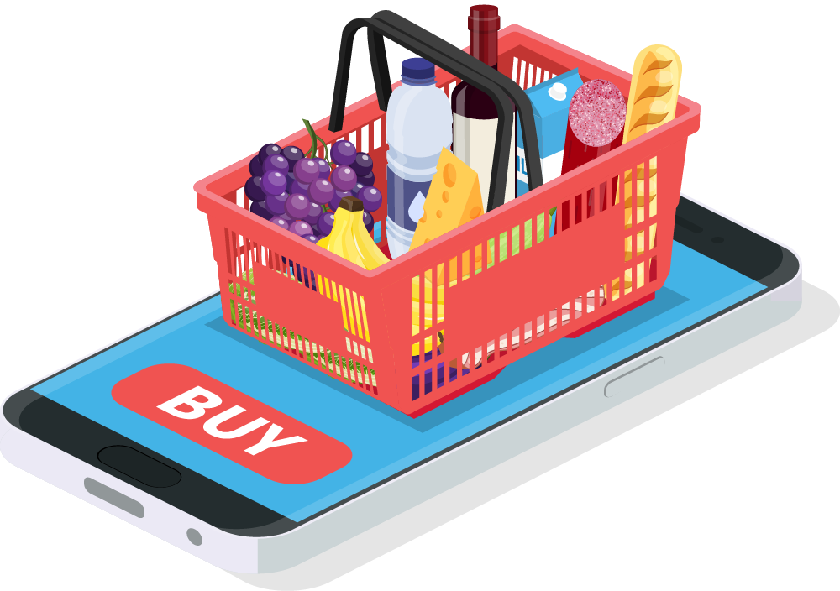
ScanPayGo architecture
Head office
External
ScanPayGo
LS Commerce Services
LS Central posting services
LS Central Data and basket calculation
eCommerce API
Store 1
Store N
…
…
POS 1
POS N
POS 1
POS N

Slide 16
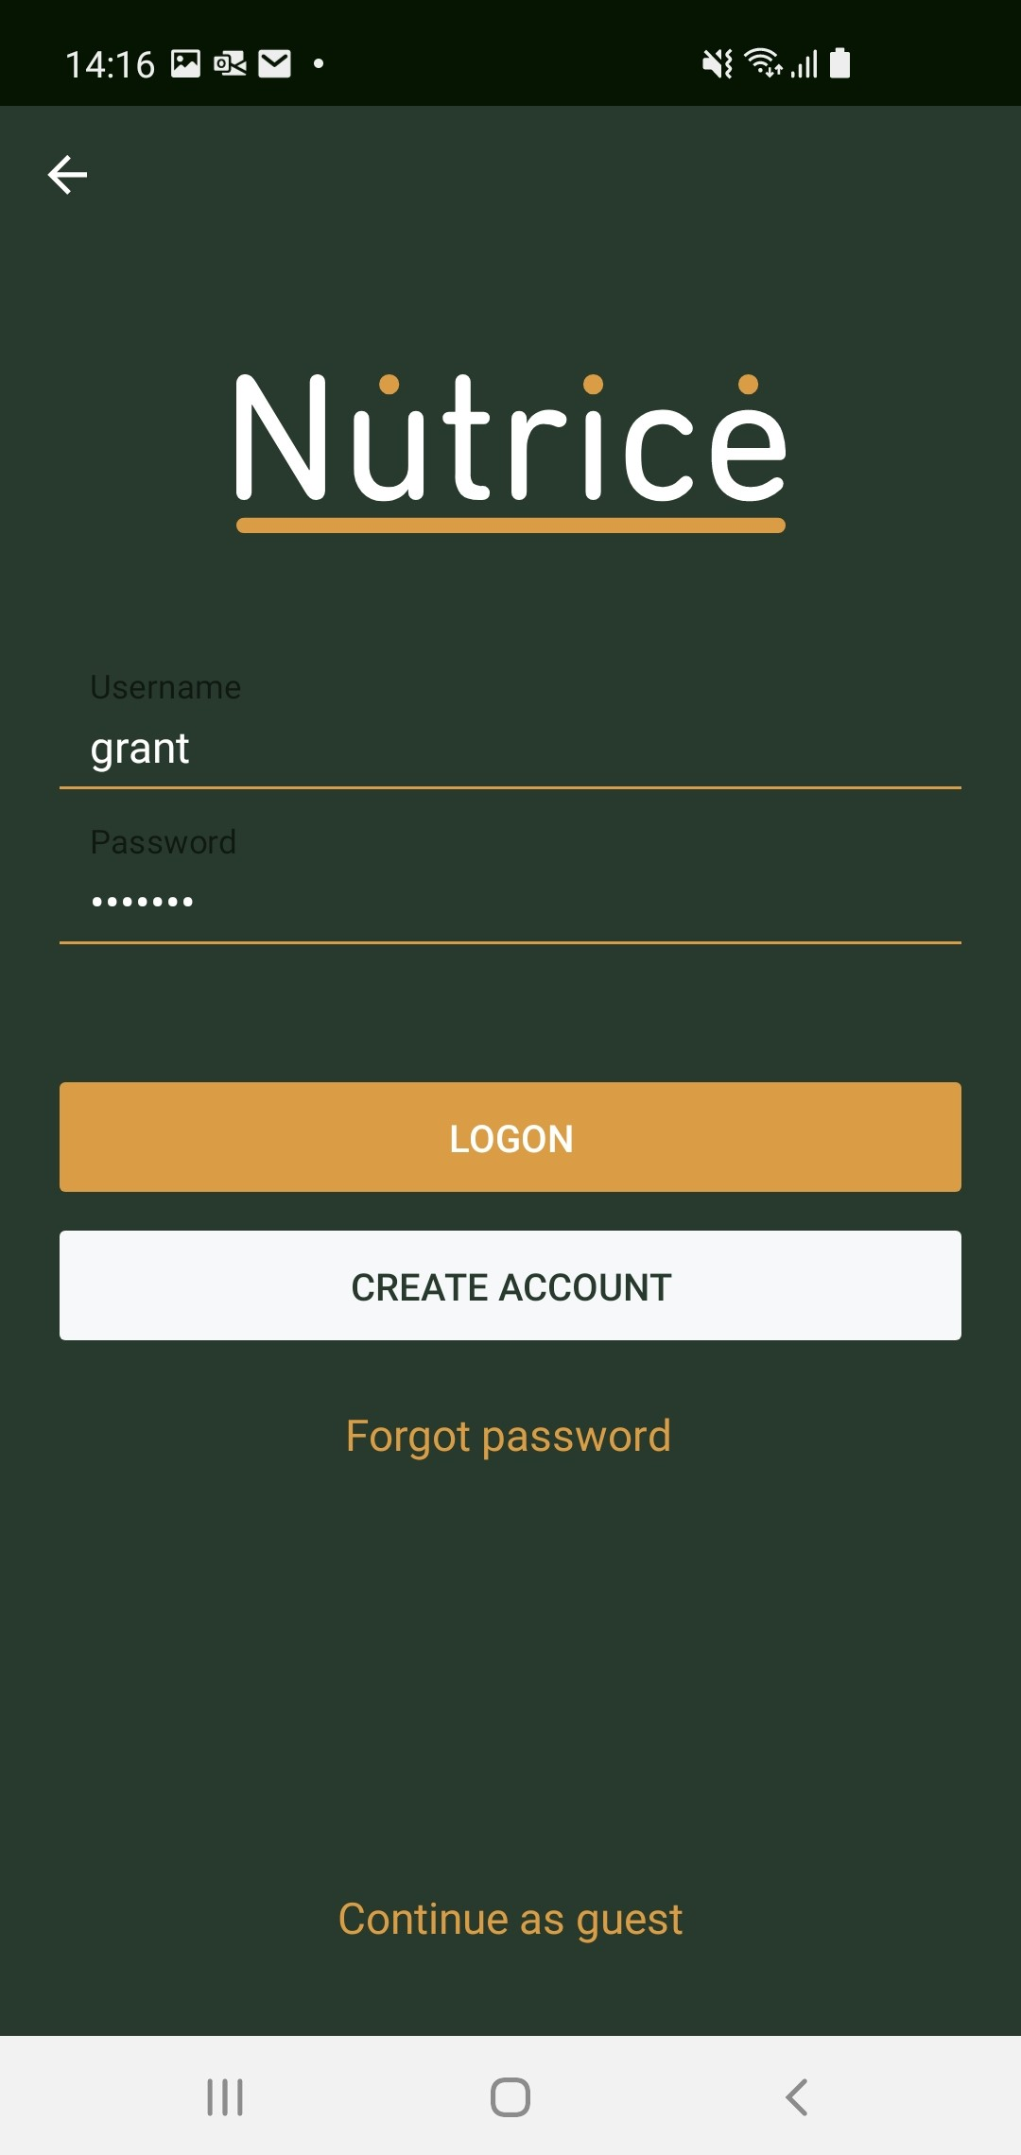
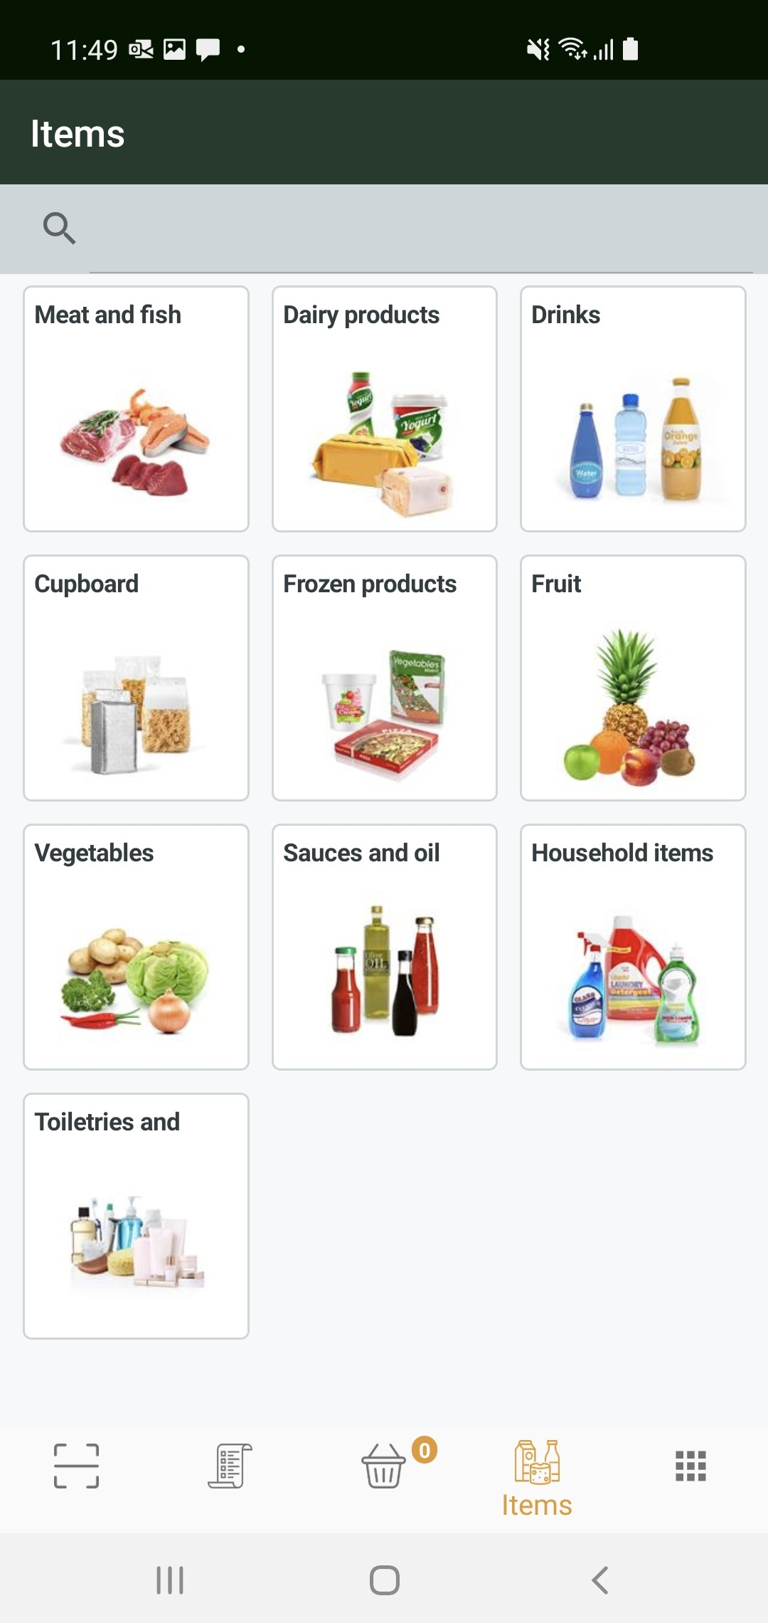
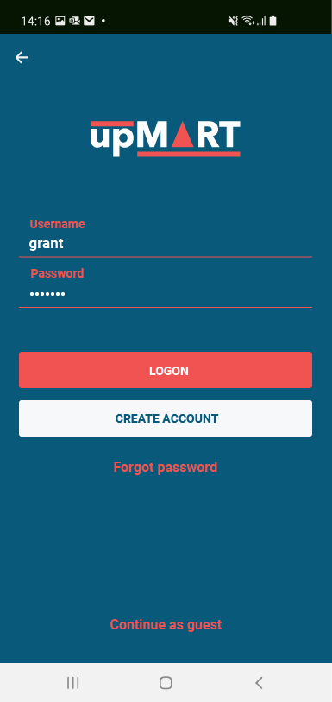
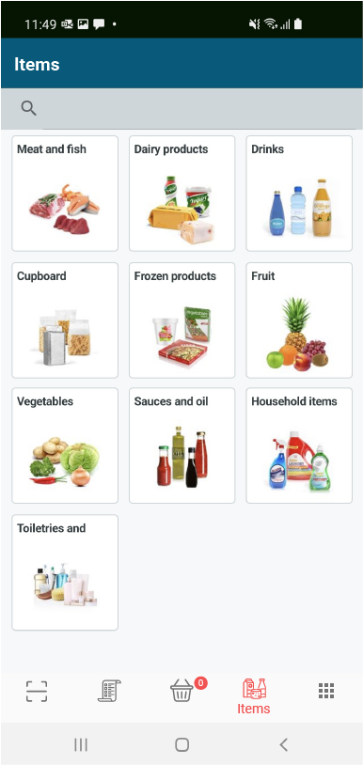
Retailers branding

Slide 17
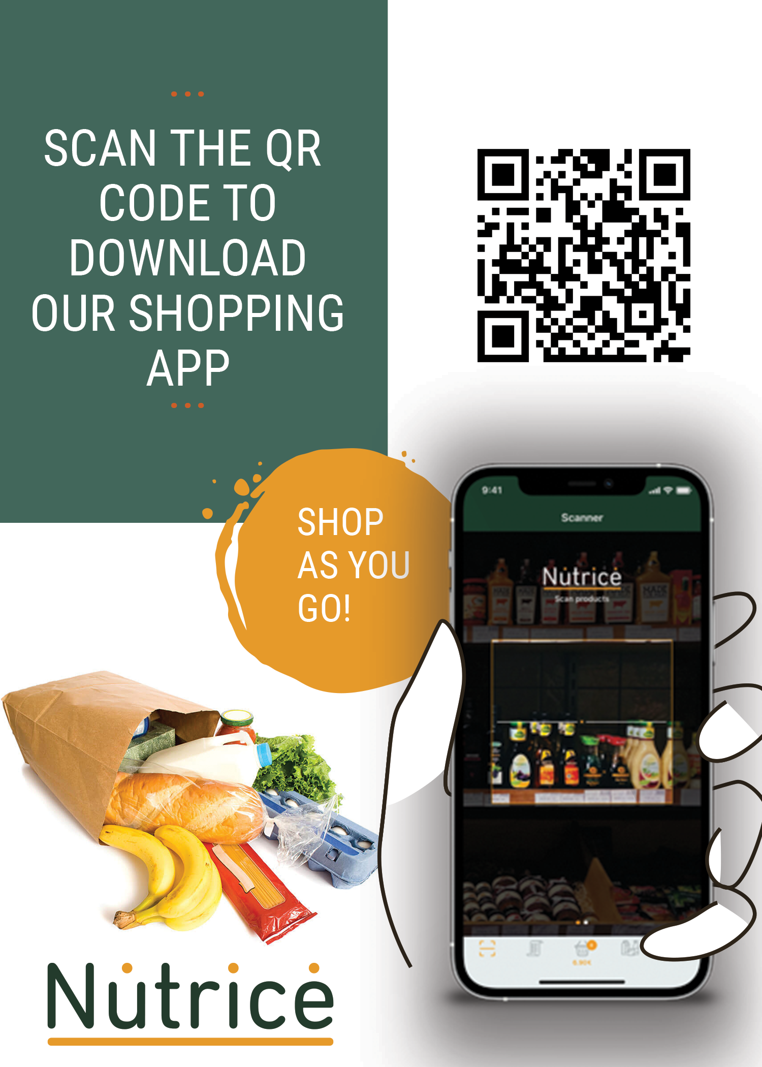
Take shopping into your own hands today with Nutrice ScanPayGo

Slide 18
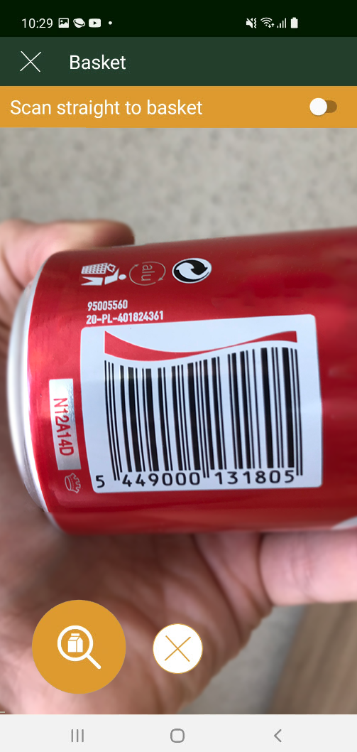
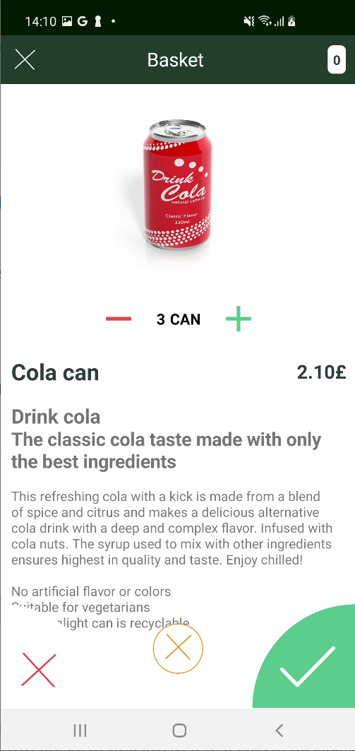
When in the store ..
Open the app and select store
Scan barcode of item
View item info and add to basket
Put the items straight into shopping bag in cart
Repeat until end of shopping

Slide 19
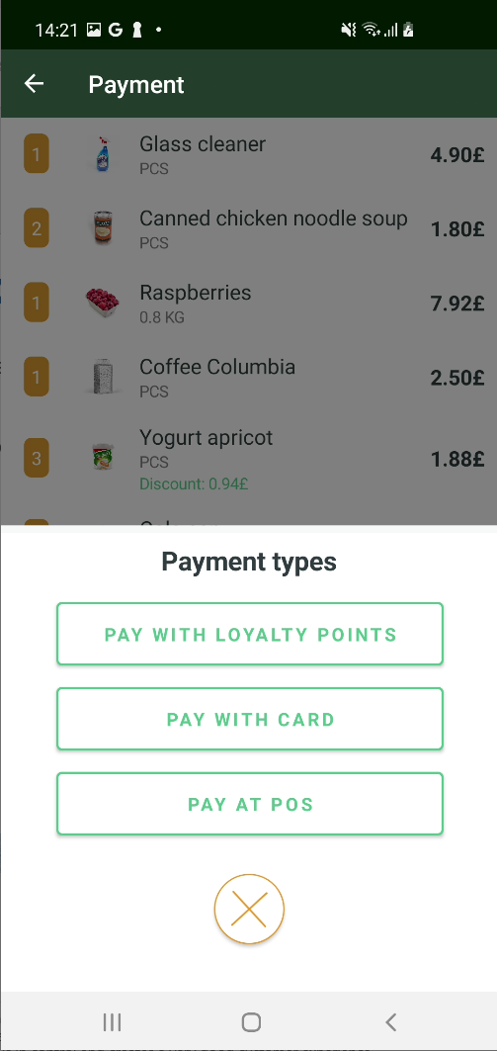
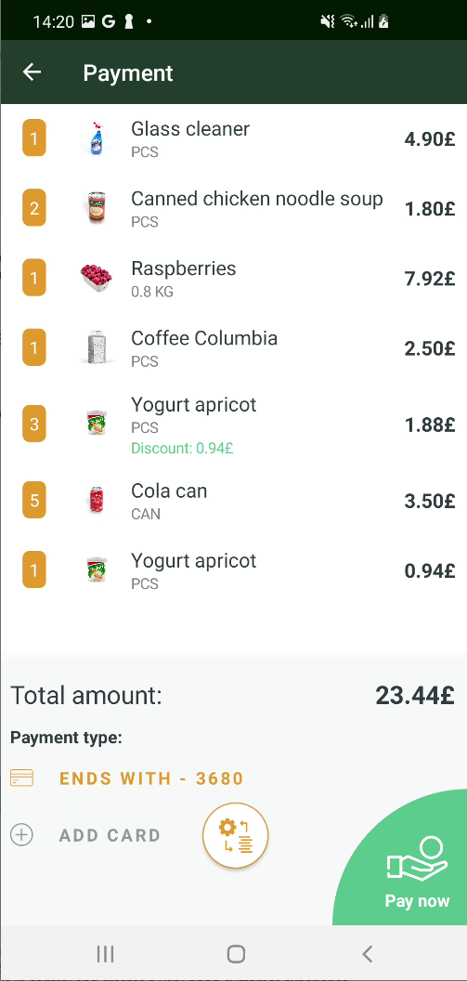
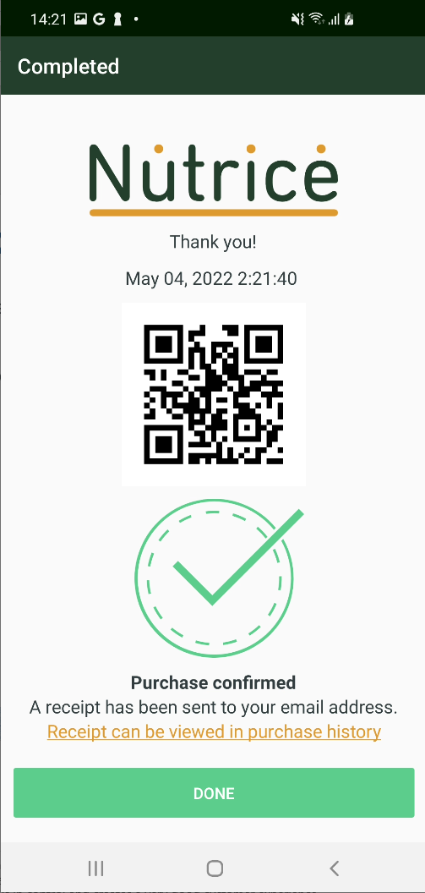
Easy checkout
Select payment method
Finalize payment
Receive confirmation and
Leave the store

Slide 20
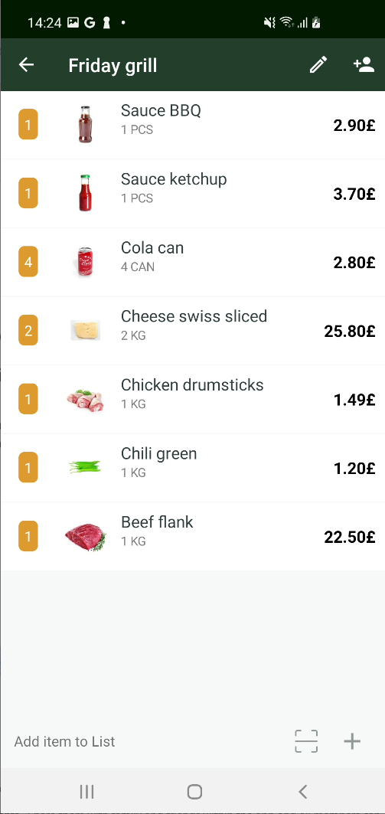
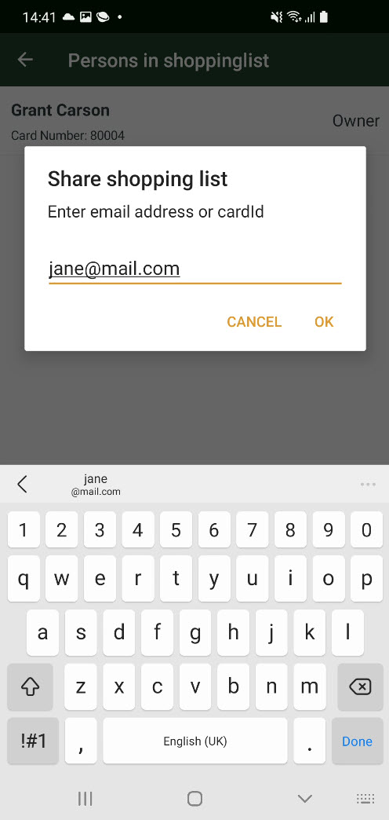
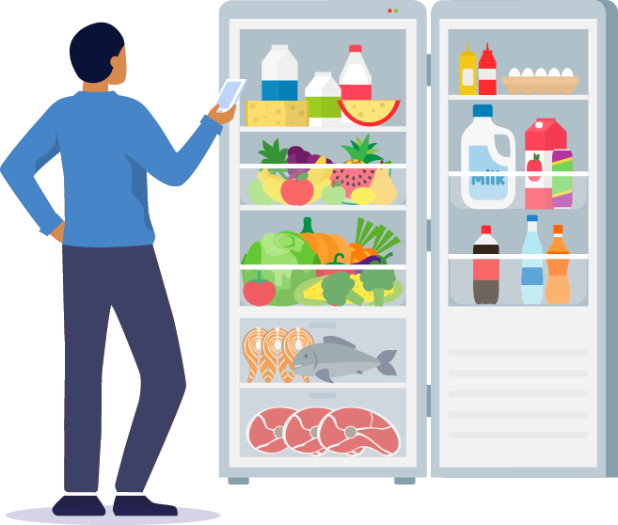
Use shopping lists
Create your shopping lists in the app
As many as you want
Share your shopping lists with family and friends within the app
All members can change, add and delete items in the lists
The best friend of the organized shopper

Slide 21
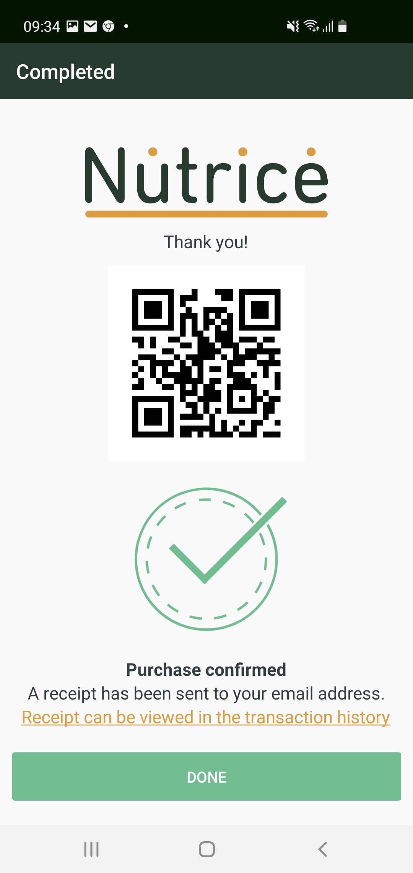
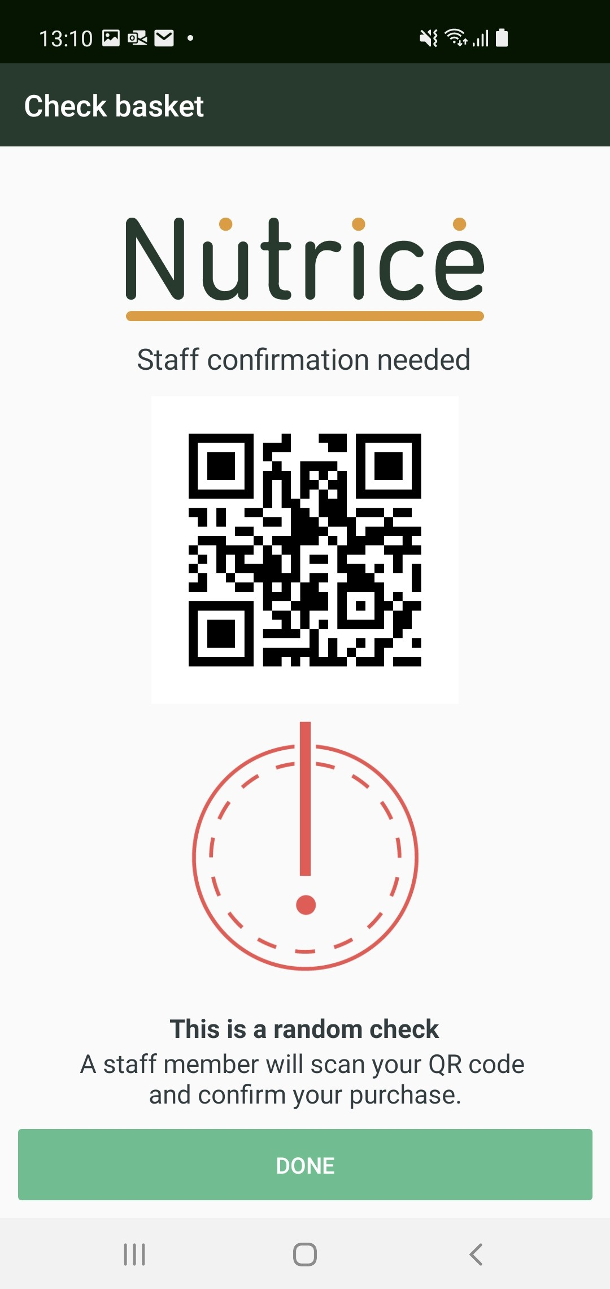
Security considerations
Concerns
Is the customer scanning all items and using the correct quantities?
Is everything paid for when the customer leaves?
In ScanPayGo
After payment, two types of messages can be displayed:
Purchase confirmed
A store employee must first verify purchase
Controlled by LS Central settings
A part of implementation
Configure to line with retailers’ rules and processes

Slide 22
Availability and licensing
Availability – Scan Pay Go will be available with LS Central 20.1 (June)
Licensing - Transaction fees for the app’s usage to be charged in the following month.

