Slide 3
Analytics for LS Central
Martin Kleindl | Omair Zuberi
Product Director | Solution Architect
Martin.Kleindl@LSRetail.com| OmairZu@LSRetail.com

Slide 4
The king is dead, long live the king ! LS Insight is now … Analytics for LS Central

Slide 5
Agenda
Why Analytics for LS Central?
Covered Business Intelligence scenarios
Classical BI (focus on history)
Near real-time BI (focus on today)
Roadmap
How to get started

Slide 6
Business Intelligence software options
…
Microsoft
Connector

Slide 7
The Microsoft way (with PBI connectors)

Slide 8
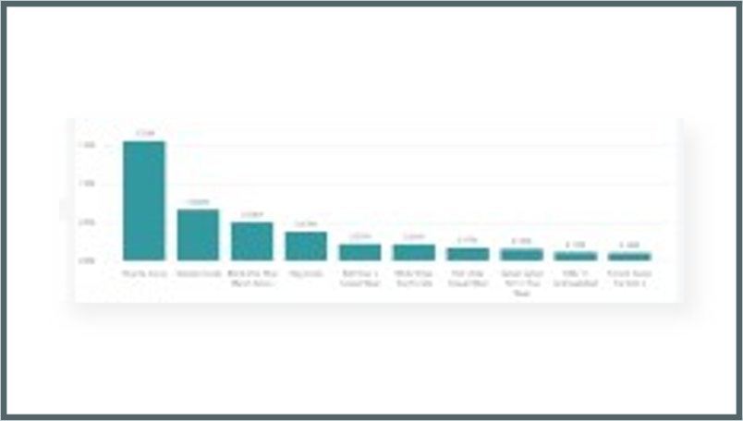
The Microsoft way
Business Central
Power BI Service
Power BI Reports
Power BI Connector
Data
API
API
Query business logic
API

Slide 9
The Microsoft way
Business Central
Power BI Service
Power BI Reports
Complexity
API
Power BI Connector
Data
API
API
API
API
API
API
API
API
Query business logic
API
API
API
API
API
API
API
API
API

Slide 10
The Microsoft way
Business Central
Power BI Service
Power BI Reports
Direct Query or Import ?
Power BI Connector
Data
API
API
Query business logic
API

Slide 11
The Microsoft way
Business Central
Power BI Service
Power BI Reports
Direct Query Performance issues if high data volume
Power BI Connector
Data
API
API
Query business logic
API

Slide 12
The Microsoft way
Business Central
Power BI Service
Power BI Reports
Import Mode Data size issues and cost
Power BI Connector
Data
API
API
Query business logic
API

Slide 13
The Microsoft way
Business Central
Power BI Service
Power BI Reports
Good for small projects
Power BI Connector
Data
API
API
Query business logic
API

Slide 14
The Microsoft way
Business Central
Power BI Service
Power BI Reports
Reports No templates → start from zero
Power BI Connector
Data
API
API
Query business logic
API

Slide 15
Analytics for LS Central

Slide 16
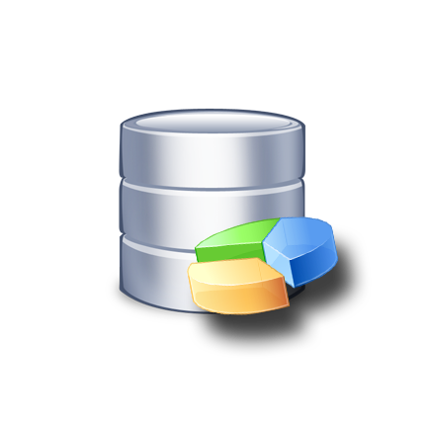
Analytics for LS Central
Business Central
Azure SQL Server Datawarehouse
Power BI Service
Power BI Reports
Tables (on-prem)
Data warehouse to load and aggregate data
Data
Tables (SaaS)
Query business logic

Slide 17
Analytics for LS Central
Business Central
Azure SQL Server Datawarehouse
Power BI Service
Power BI Reports
Tables (on-prem)
Dataware house
Data
Tables (SaaS)
Staging
Query business logic
Prestaging

Slide 18
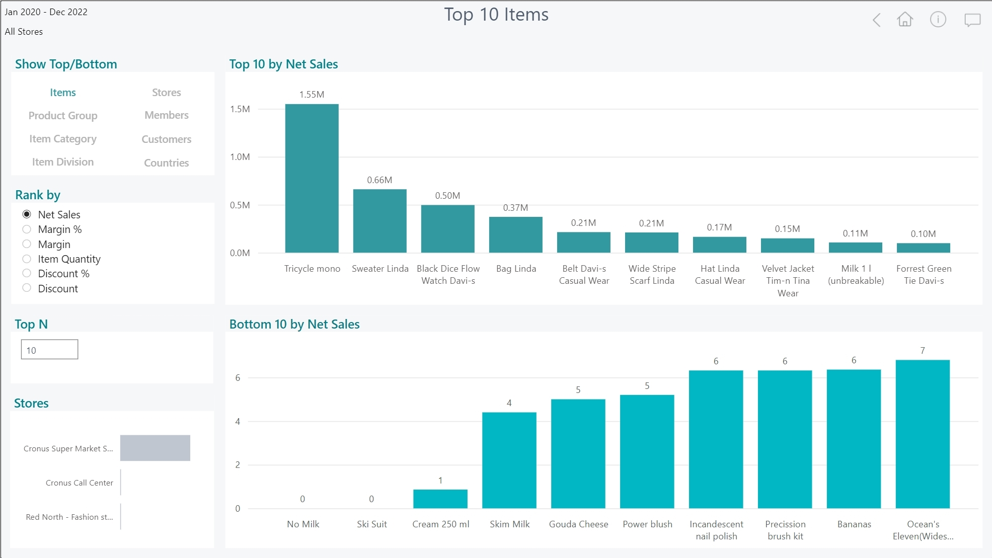
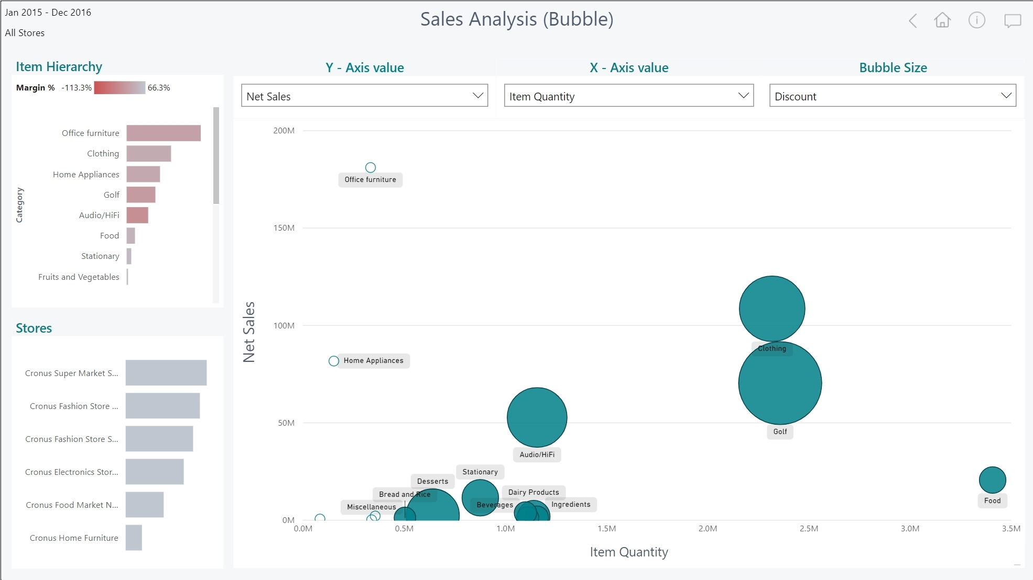
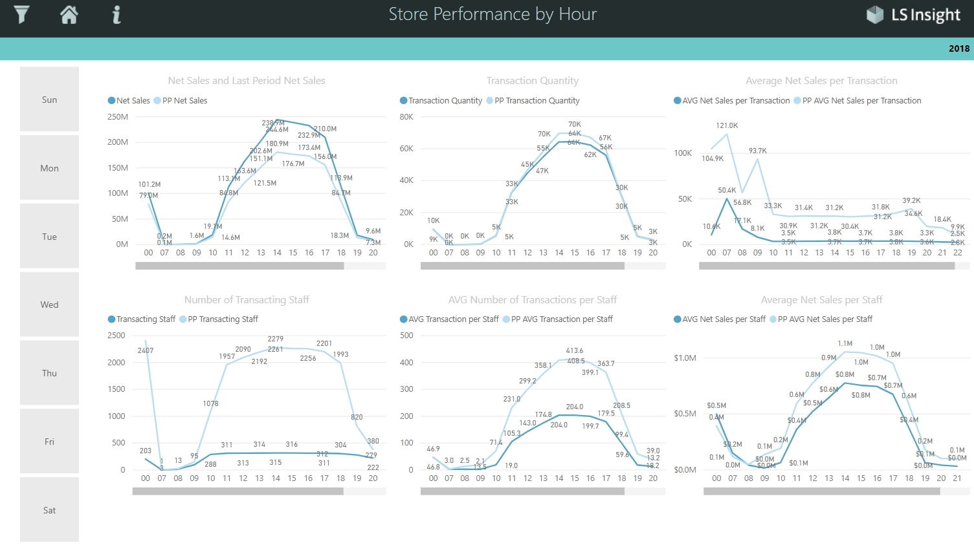
Analytics for LS Central
100+
Business Central
Azure SQL Server Datawarehouse
Power BI Service
Power BI Report templates
Azure Data Factory
Dataware house
Tables (on-prem)
Dataware house
Data
Staging
Staging
Query business logic
Tables (SaaS)
Query business logic
Prestaging
Prestaging
Data Director Webservices
Azure Data Factory

Slide 19
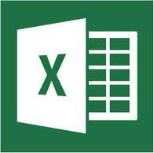
Analytics for LS Central
Analytics - Data warehouse
Standard Microsoft technology
Azure SQL Server or SQL Server
Azure Data Factory (ETL processes and pipelines)
Easy to extend (new fields, tables, and other data sources)
LS Retail ….
Provides ready-to-use data model, pipelines and logic
You ….
Setup SQL Server (Azure /on-prem)
Download and setup the deployment package from LS Retail
Connect to BC, Load data → GO!
…
Analytics – Data WH
LS Central

Slide 20
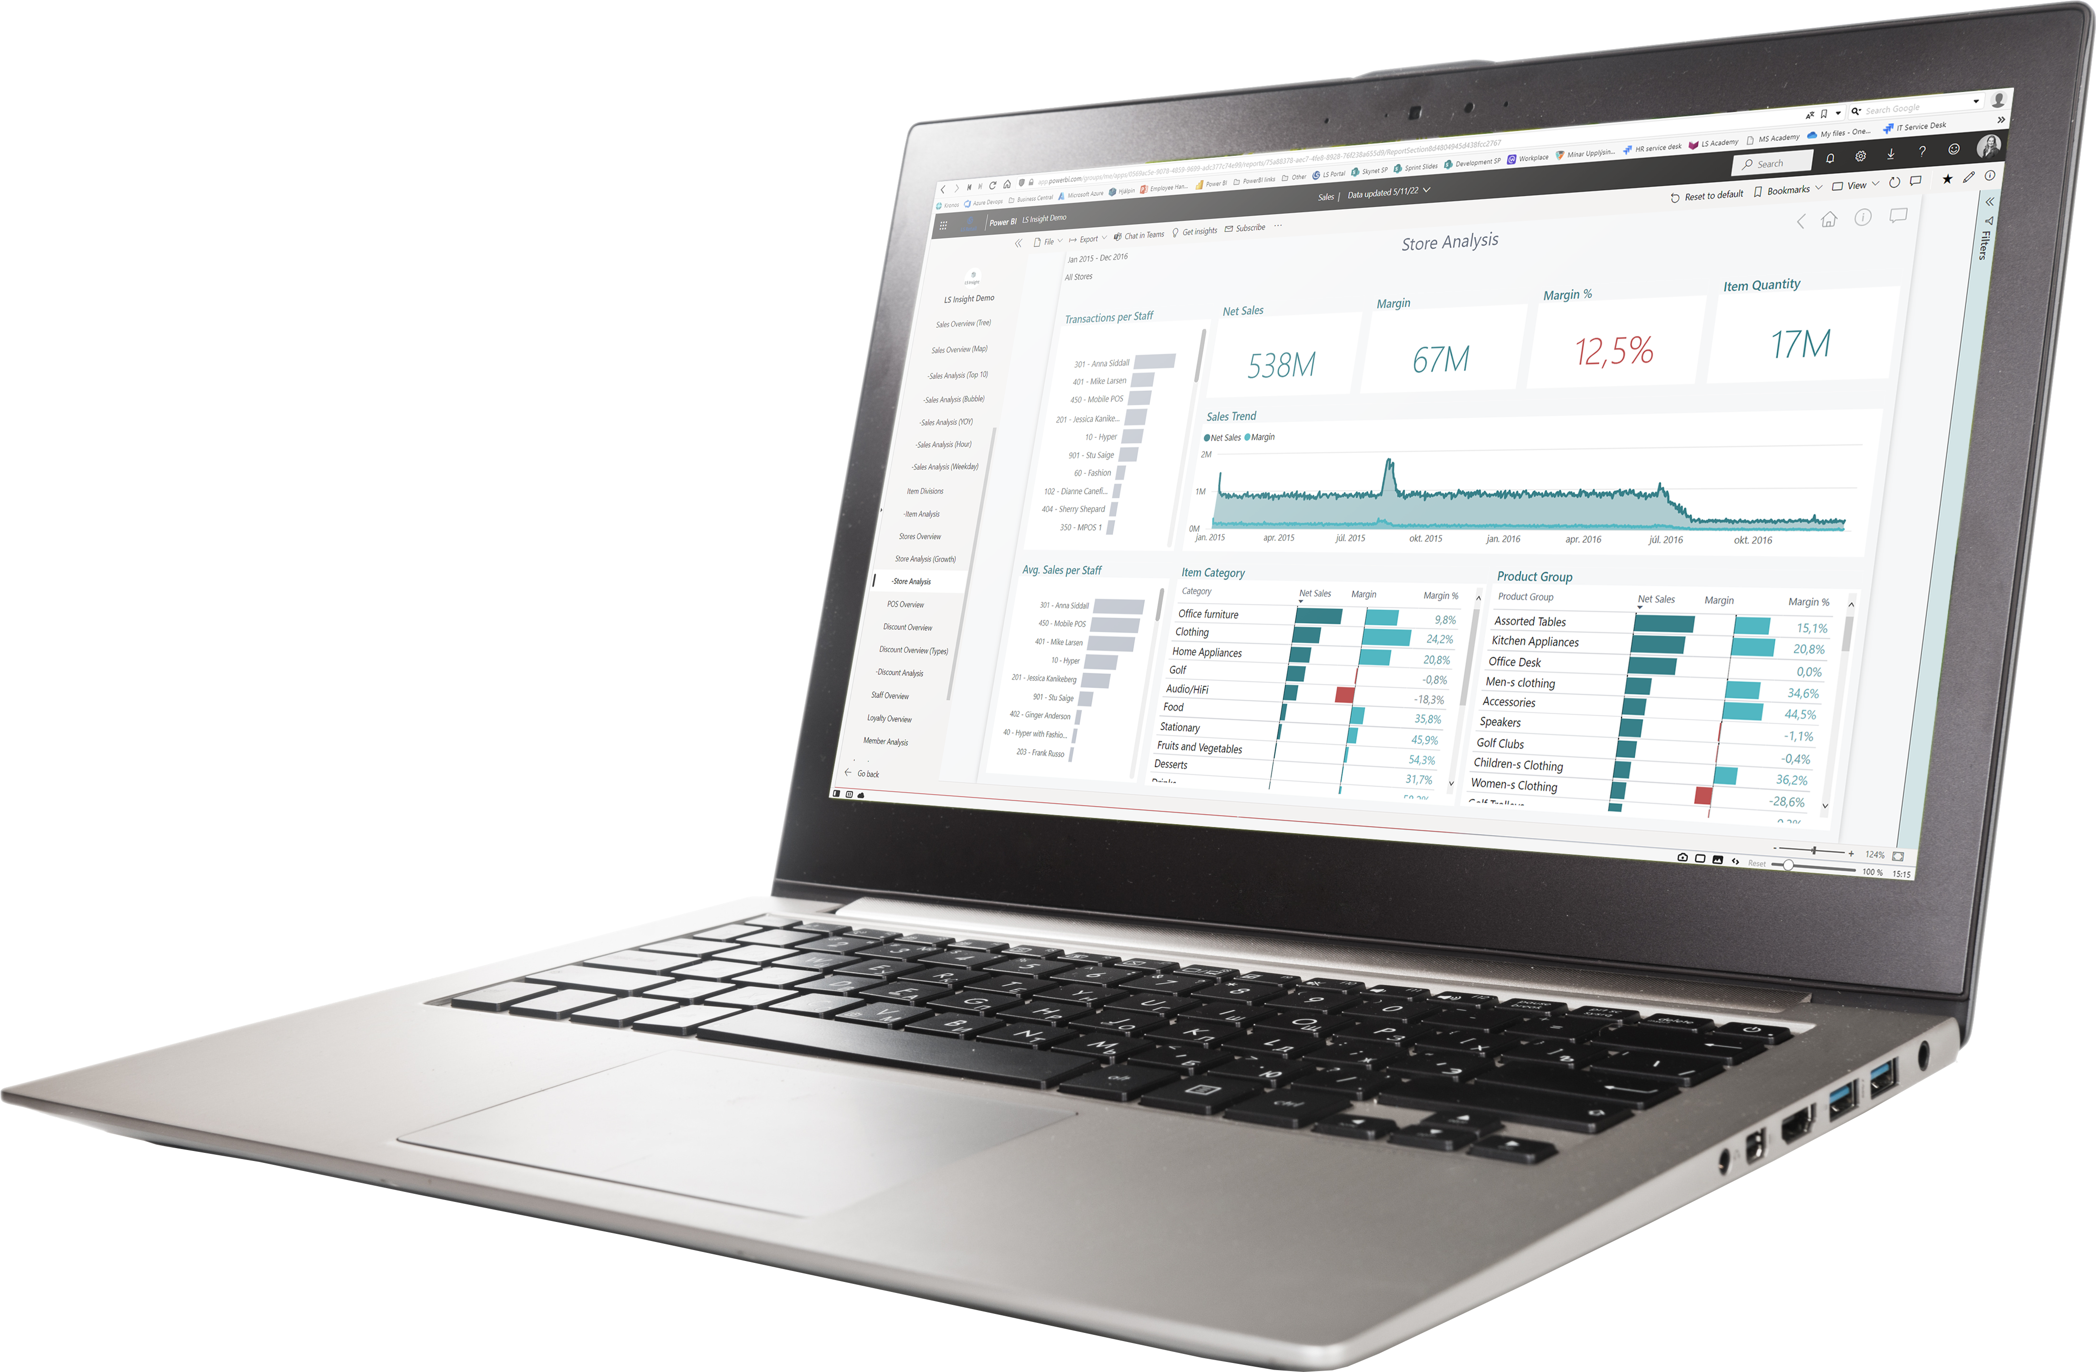
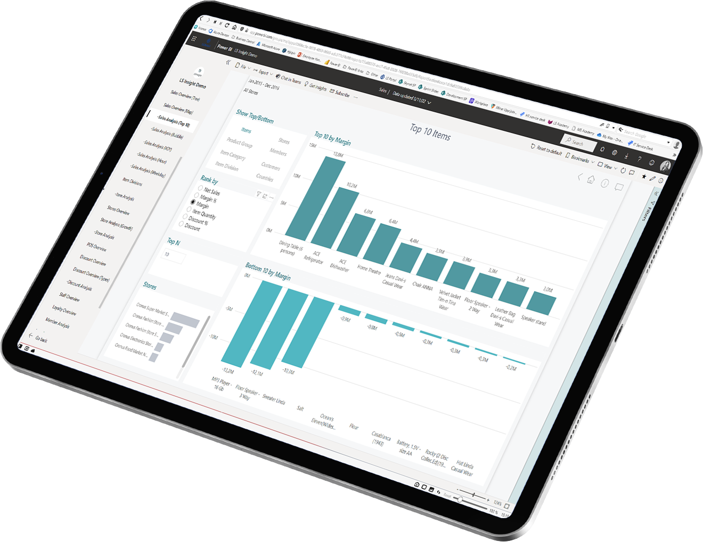
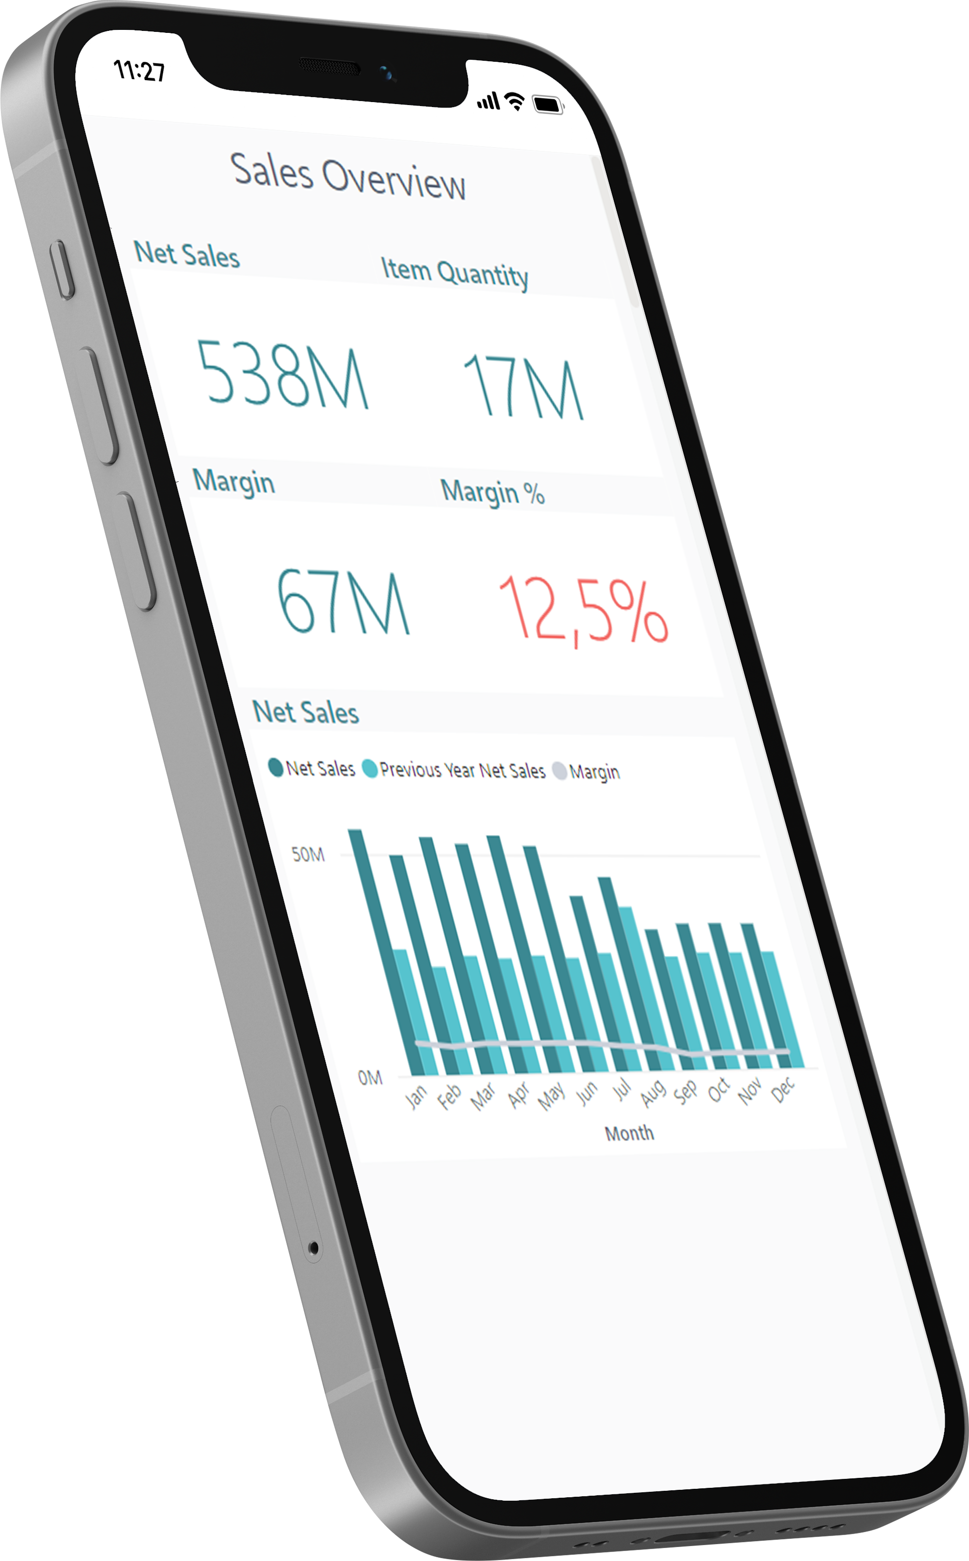
Analytics for LS Central
Analytics - Reports
Power BI based Report and Dashboard templates
Built on data from Analytics Data warehouse
100+ report page templates
Easy to adapt, extend or build your own
Strong integration with MS Teams, Excel and Powerpoint
LS Retail ….
Provides ready-to-use report templates
You ….
Subscribe Power BI (@ Microsoft)
Setup the report packages from the deployment package
Connect to DW, Load data → GO!

Slide 21
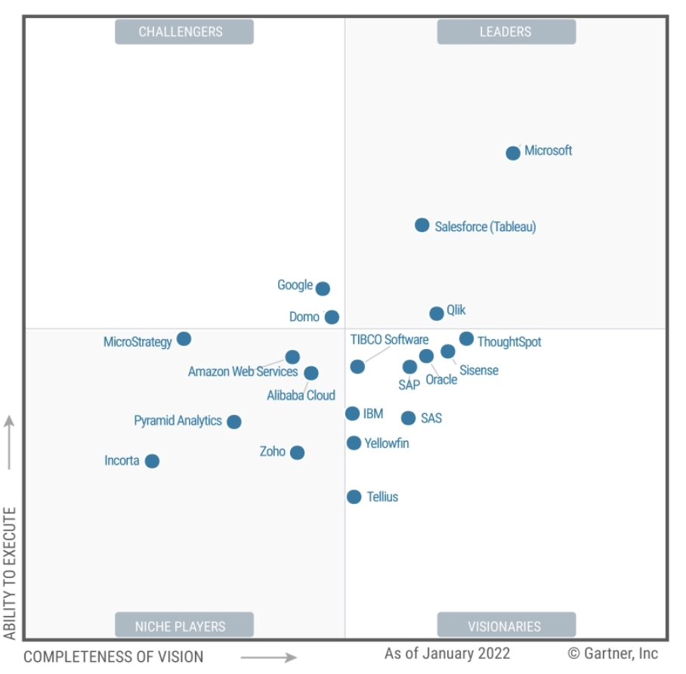
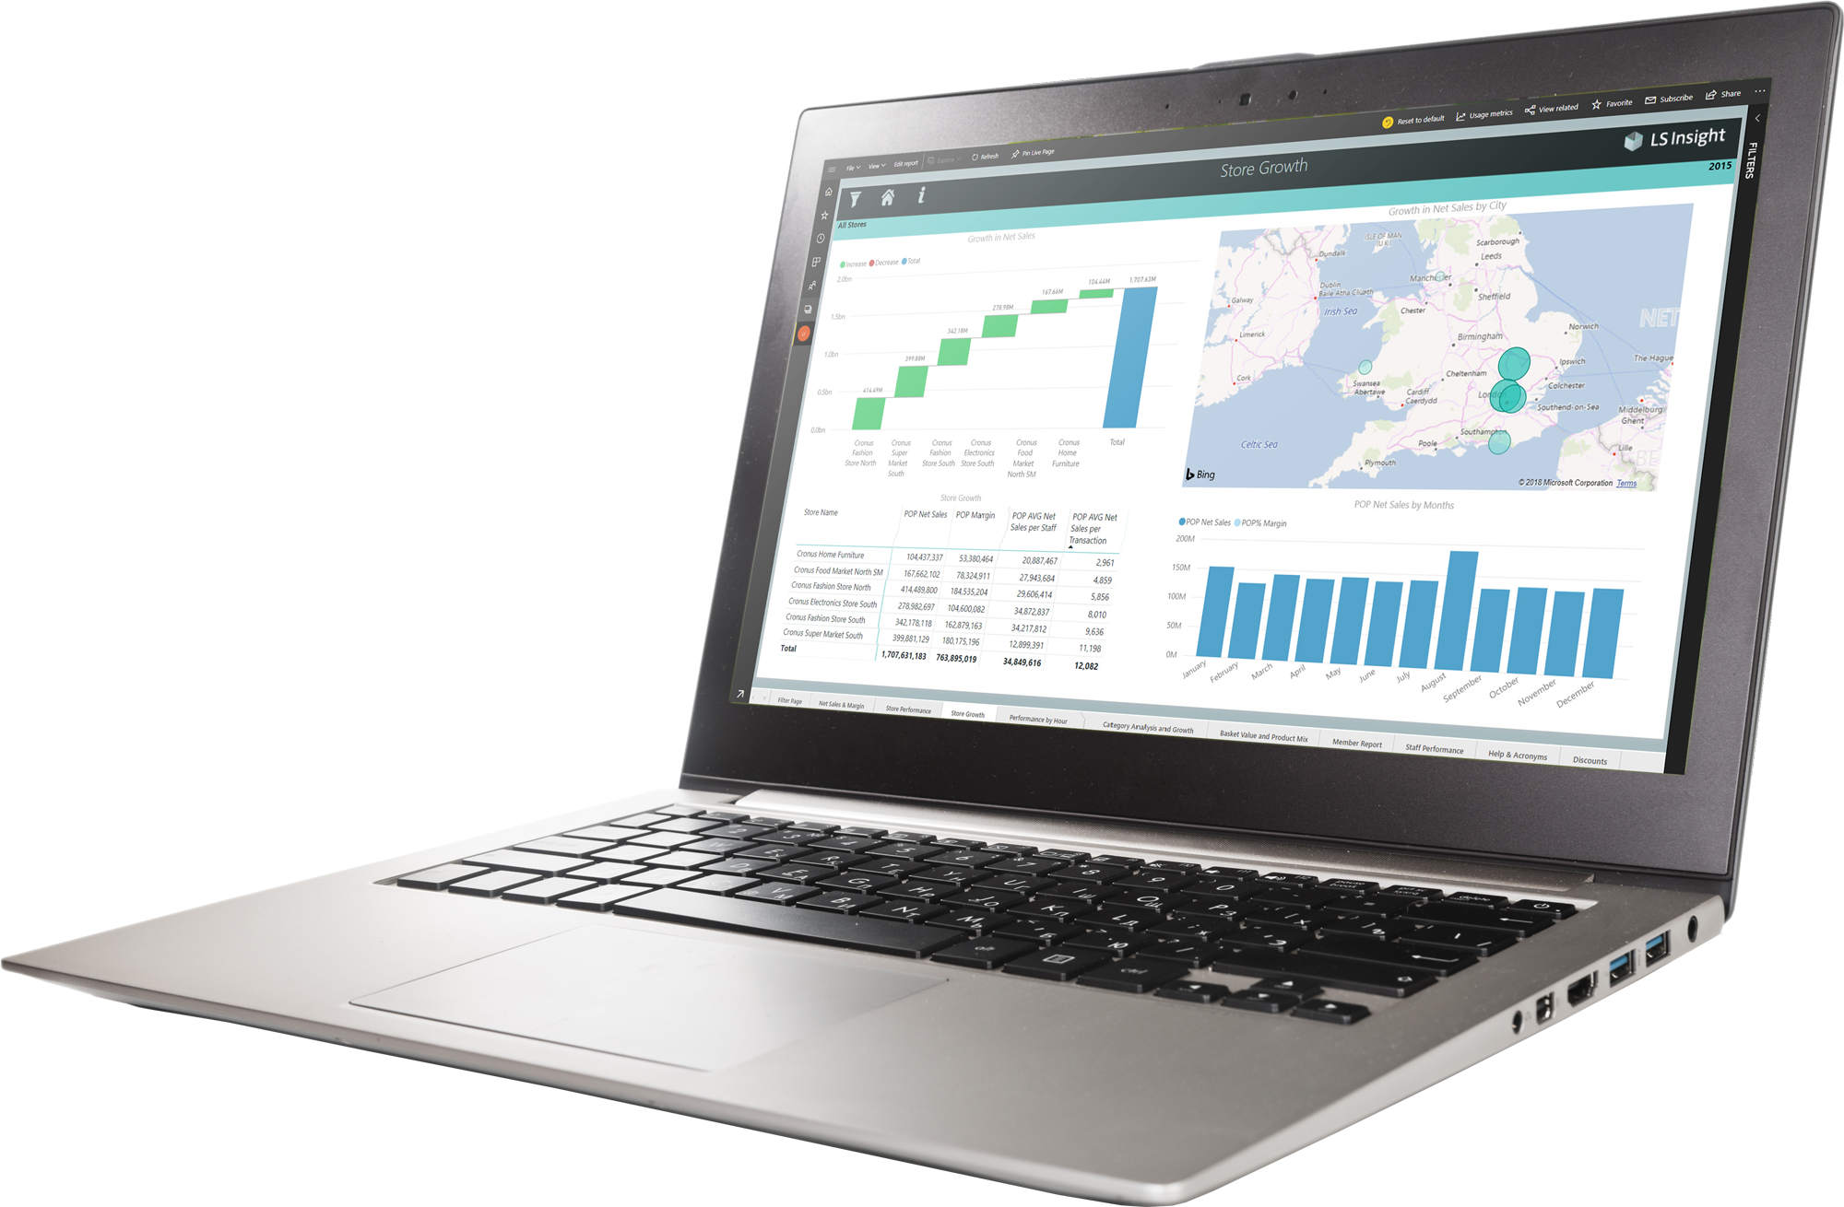
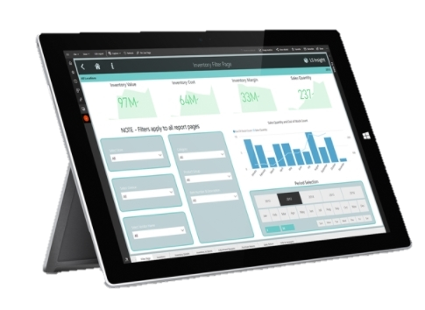
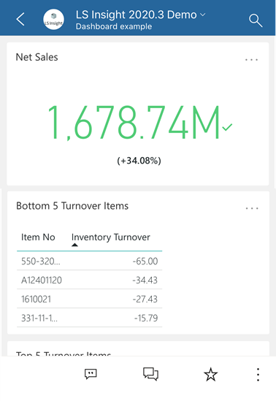
Analytics for LS Central
Gartner®
^{March 2022} PBI named as Leader in Analytics & BI Platforms and scored highest for the 4th consecutive year. ^{Microsoft Power BI has helped} ^{over 250,000 organizations} including 97 percent of Fortune 500
*) Magic Quadrant for Analytics and Business Intelligence Platforms, from 2013 – 2022

Slide 22
Analytics for LS Central
Report packs
Sales
Inventory
Supply Chain
Actionable Insights
Hotels
Constant improvements and additions based on customer feedback
Industry specific report packs currently in development

Slide 23
Analytics for LS Central – Sales (Live)

Slide 25
Near real time reports

Slide 26
Business Central
Azure SQL Server Datawarehouse
Power BI Service
Power BI Report templates
Tables (on-prem)
Datawarehouse
Data
Tables (SaaS)
Staging
Query business logic
Azure Data Factory
Prestaging
Data Director Webservices
Replicating transactions every 10 minutes
Direct query to unprocessed and filtered data in the data warehouse

Slide 27
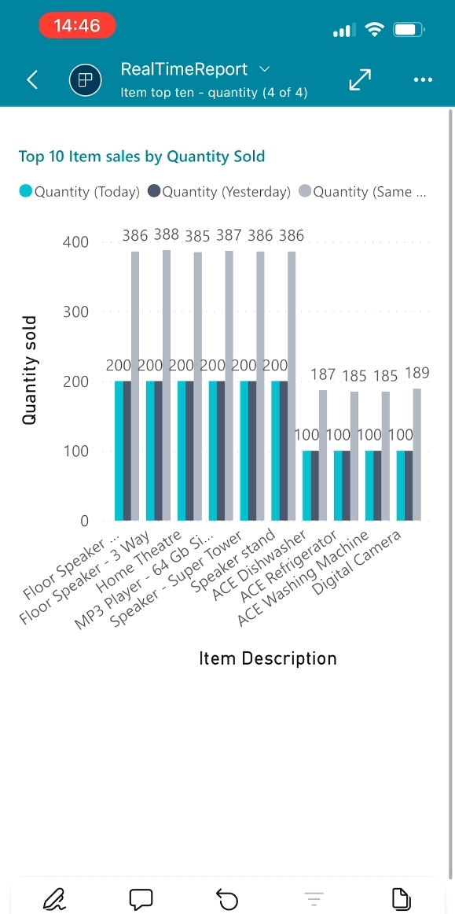
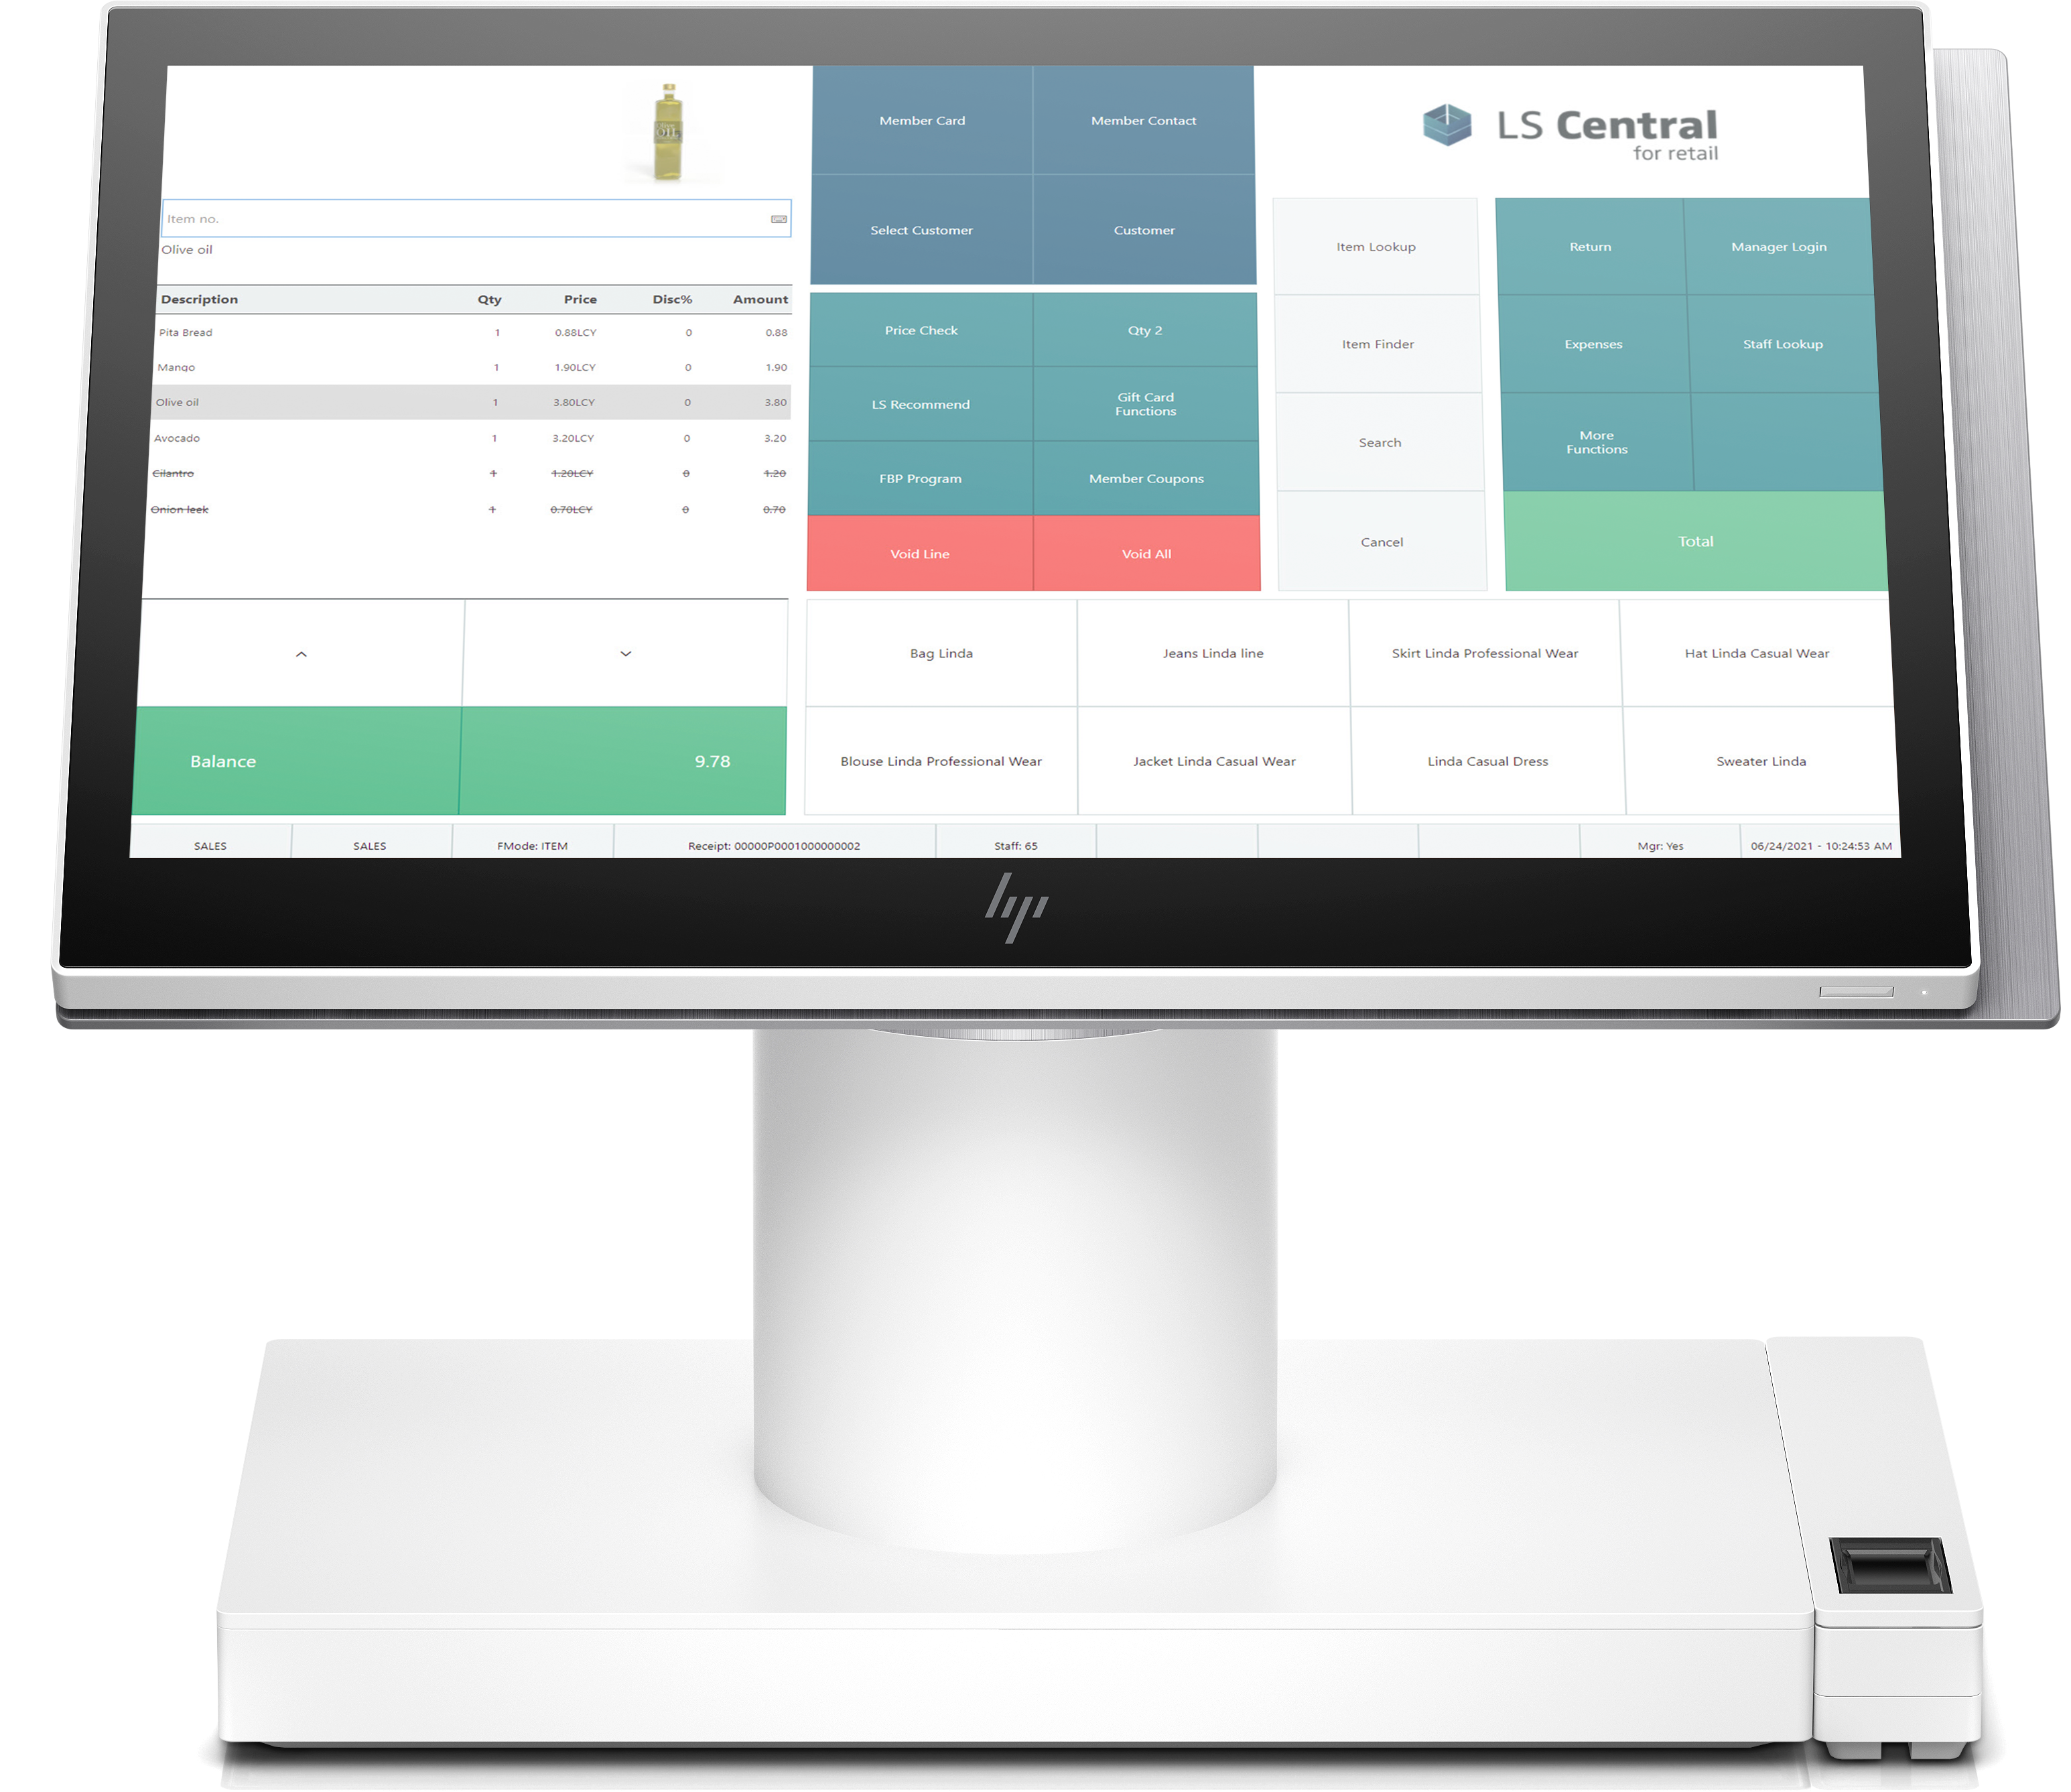
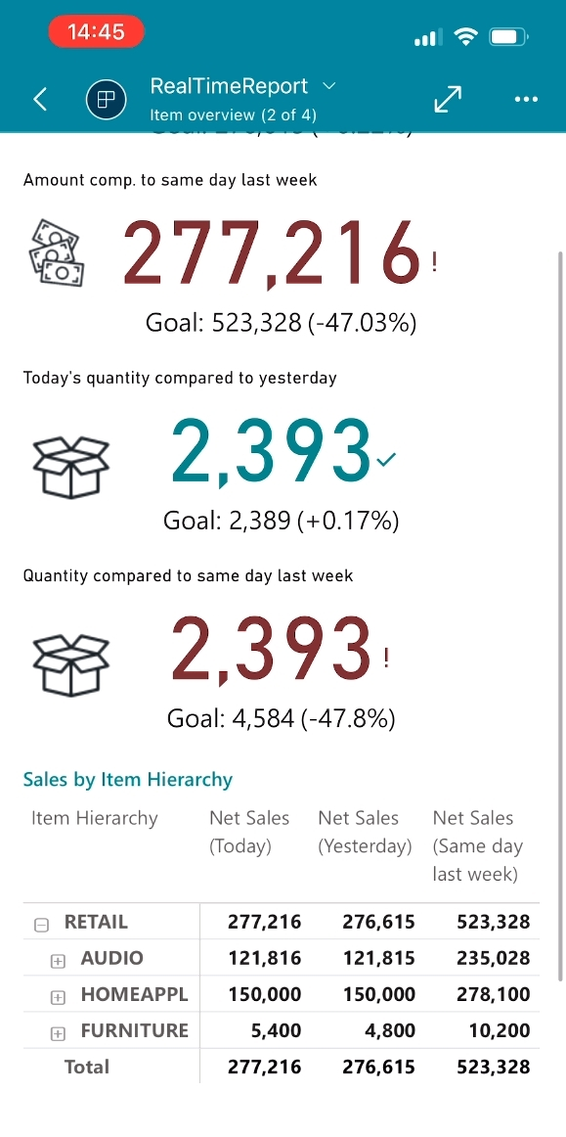
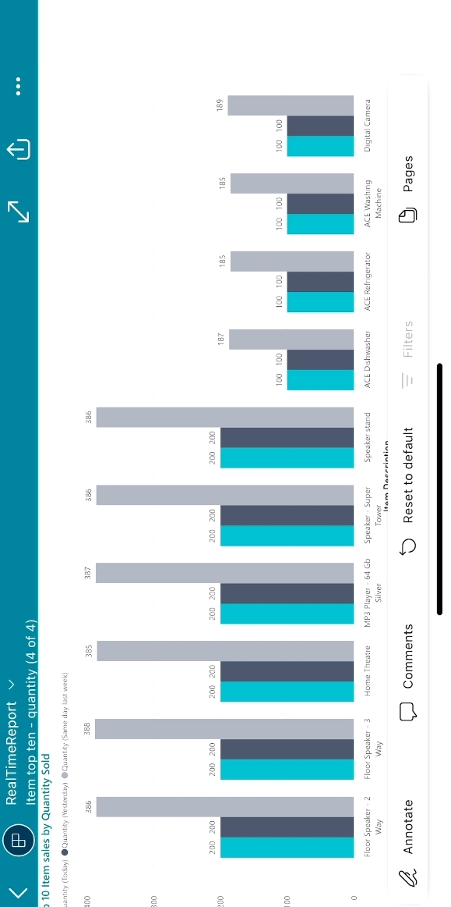
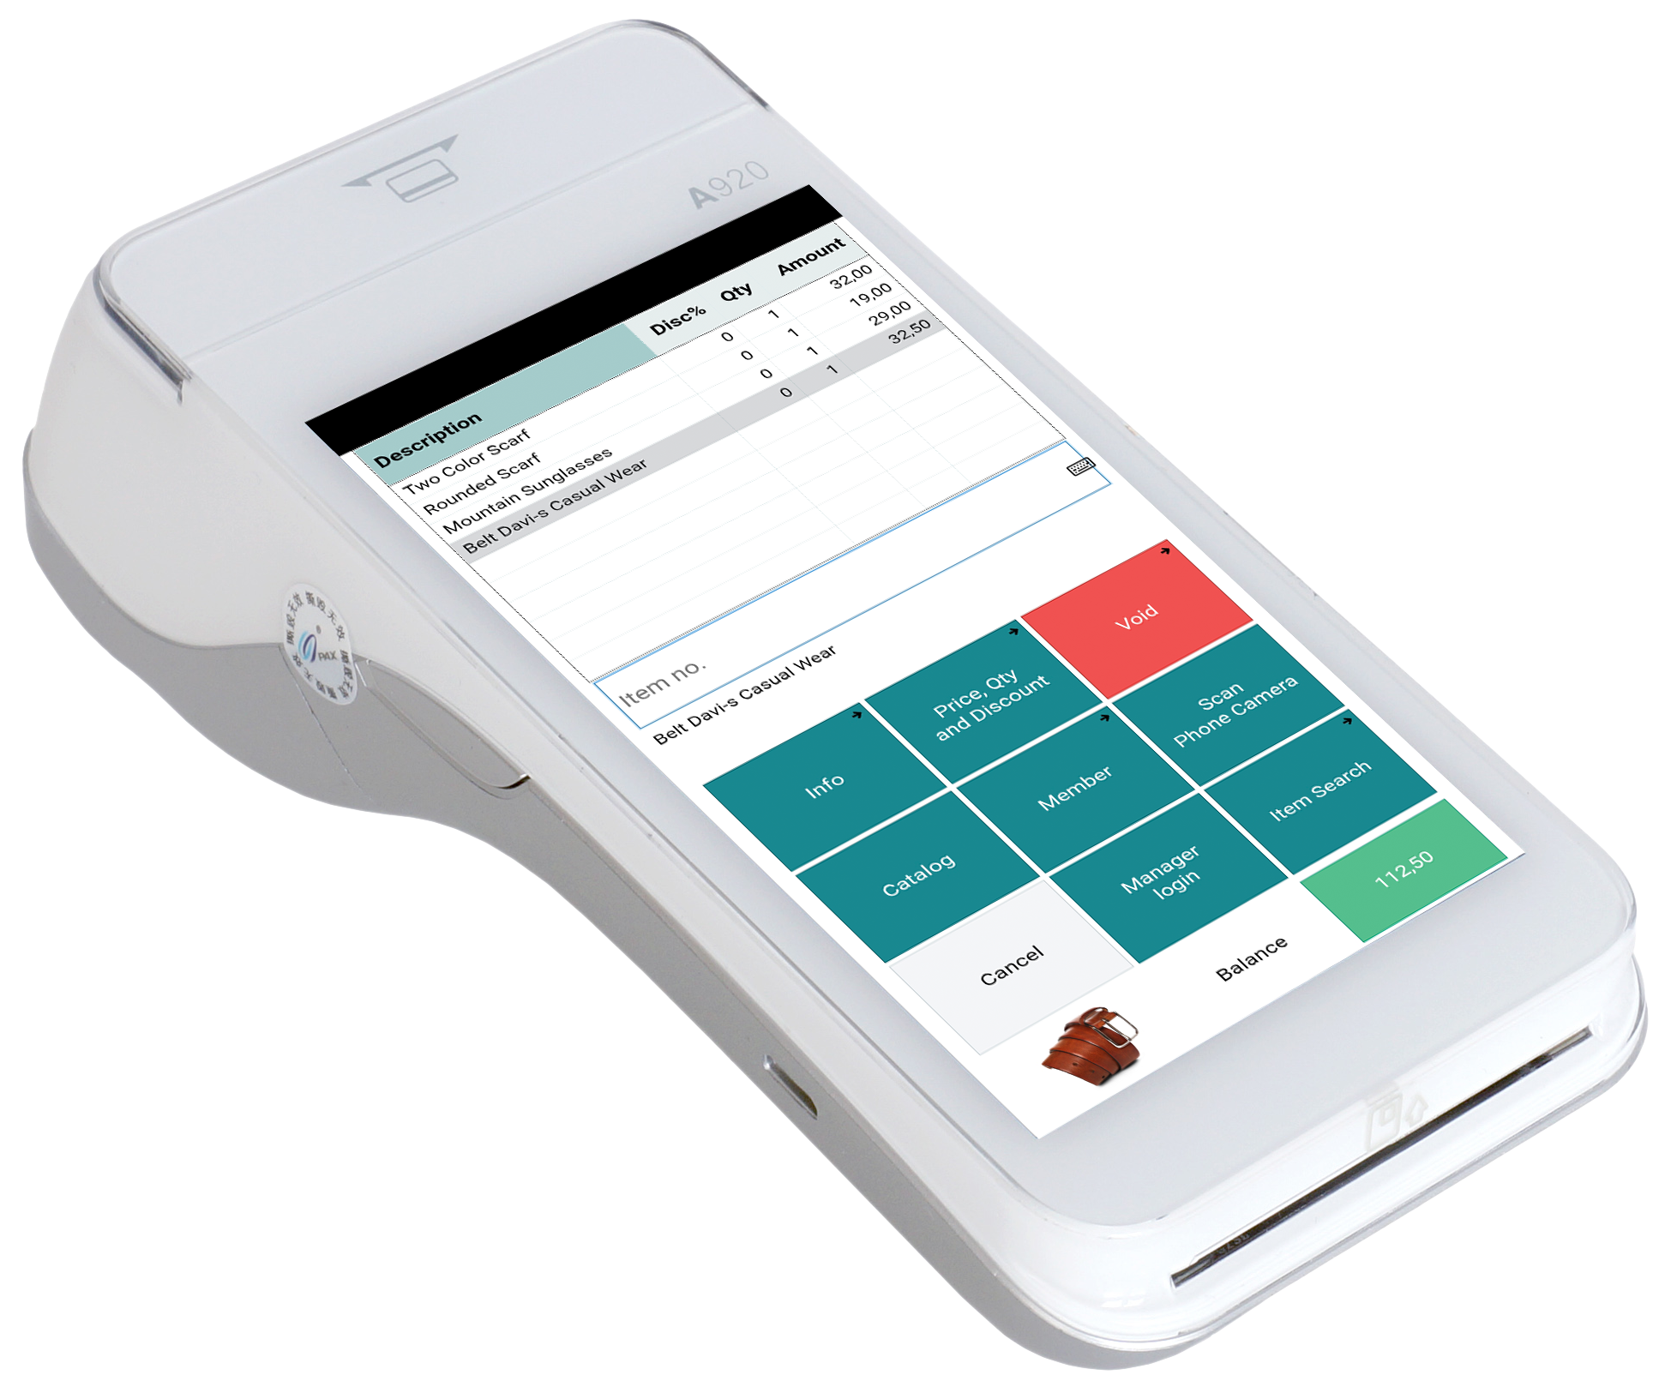
Near real-time reporting (today’s sales)

Slide 28
Analytics for LS Central Architecture Options Customization

Slide 29
Analytics for LS Central – Architecture options
Business Central
Analytics DW for LS Central
Power BI Service
Business Central
Cloud
DW on Azure SQL
DW on on-prem SQL
Azure Data Factory
Data Director Webservices
On-premise
Power BI Connector

Slide 30
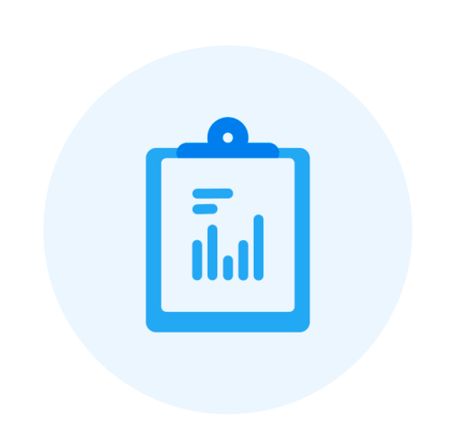
Customizations
LS Central
Additional field(s) in existing tables
Additional table(s)
Additional extension
3rd party data (store movement tracker, CCTV, …)
Power BI
New reports (from scratch or from existing)
Report modifications
Get data from external sources in Power BI
Documentation for customization scenarios is available in online help

Slide 31
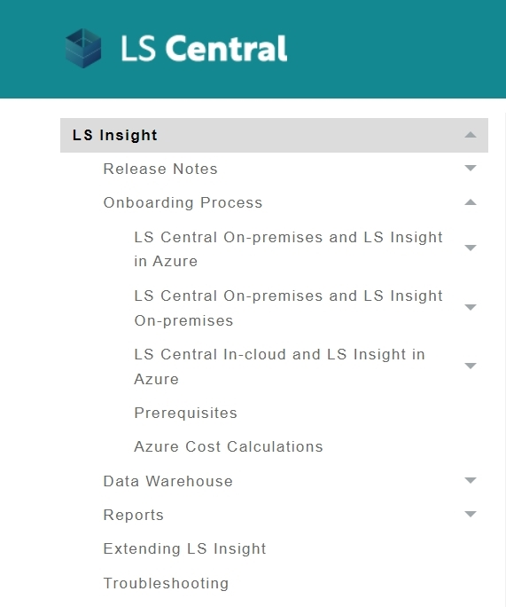
How to get started
Apply for Analytics
Reach out LS Retail’s License department
Request your License Code
Setup
Receive mail with personalized download link
Download product deployment package from LS Retail
Follow documentation in LS Retail’s Online Help
Setup environment
Run deployment script for data warehouse, setup data load
Subscribe to Power BI
Connect Power BI reports to data warehouse
Done ☺
We are here to help !
LS Retail Online Help

Slide 32
The future
Report packs
General improvements
More operational, list oriented, report pages
Hospitality report pack
Finance report pack (tbd)
Near real-time reports
Demo data generation tool
We listen to you!

Slide 33
When will you start your strategic move with Analytics for LS Central ?

Slide 34
Thank you

