Slide 2
Partner Update
New Partner Program & License Update
Peter Vach
VP Partner Operations

Slide 3
Agenda
Our Partnership
Price Changes & License Promotions
Updates on Business Center

Slide 4


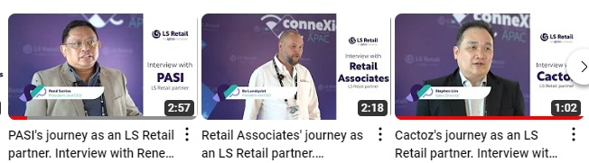
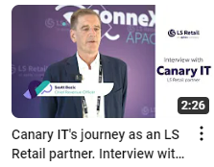
The LS Retail Partner Community
280 LS Central Partners
85 Countries
2,500 Certified Consultants
4,500 People in our Partner Community
300 LS Retail staff to help you

Slide 5

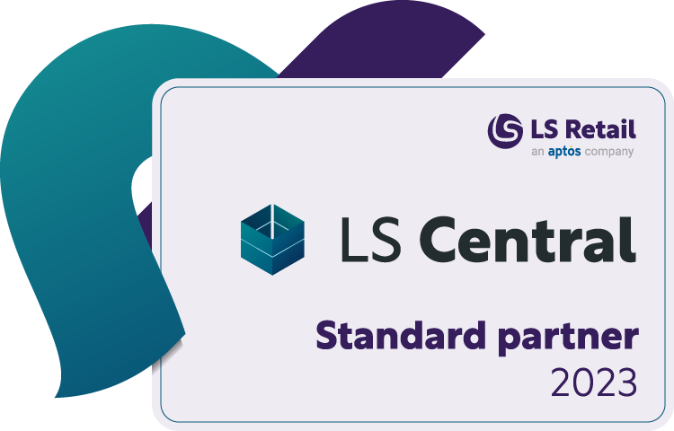
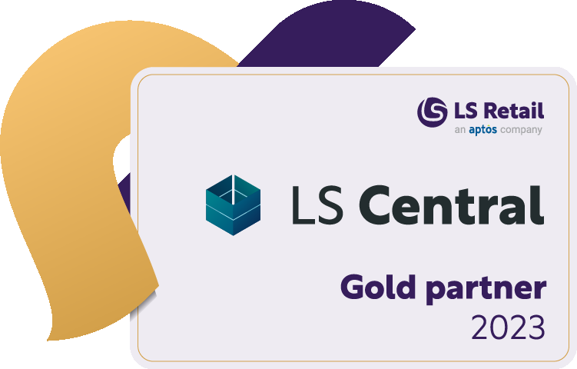
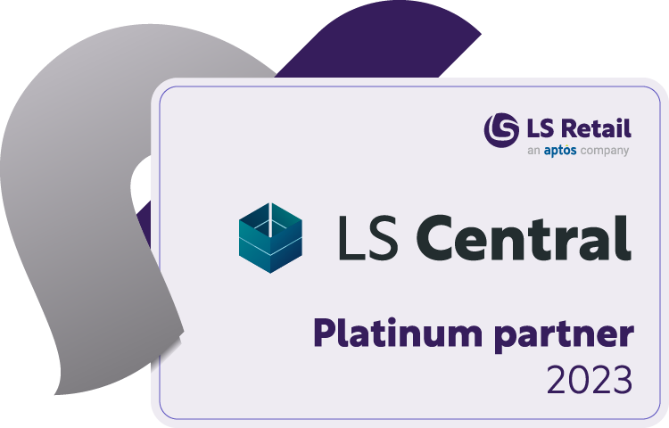
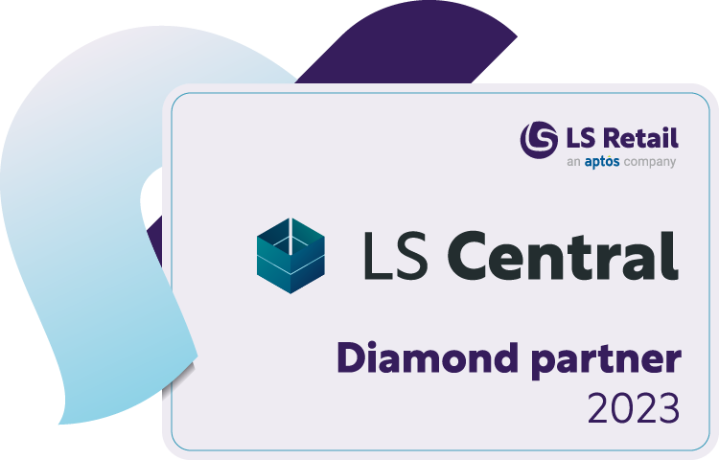
Count Partner Levels 2022 vs 2023 - Global
+ 9 Diamond Partners
+ 4 Platinum Partners
+ 7 Gold Partners

Slide 6
Partner Initiatives
The Diamond Club
High Volume Program
Partner Focus Groups
New Partner Program
Partner Success Track
LS Retail Academy On-Demand

Slide 7
The DIAMOND Club

Slide 8














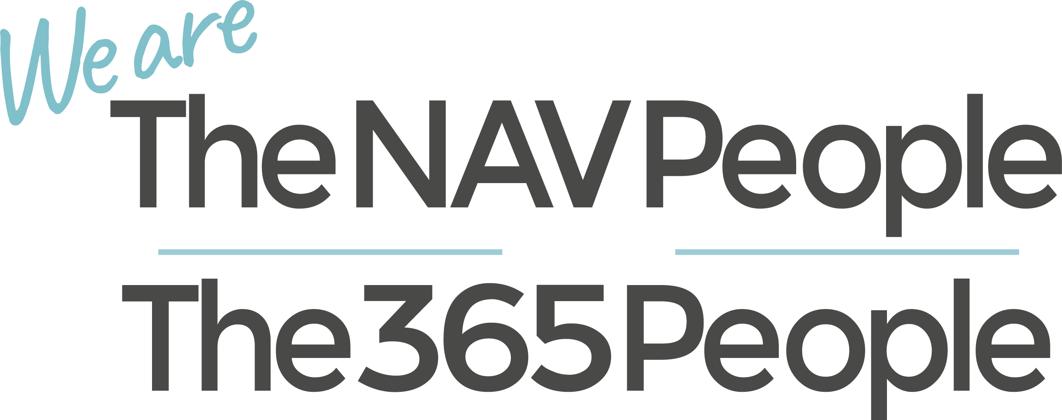


Slide 9
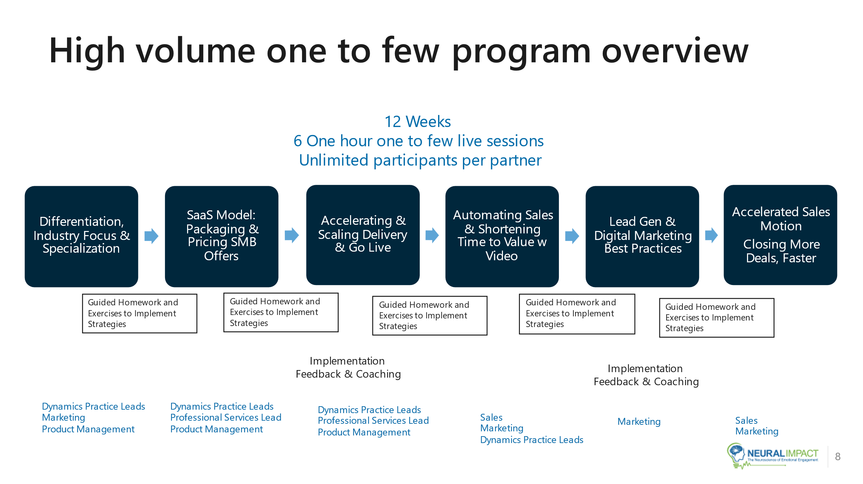
High Volume Program with Microsoft

Slide 10










Expected Outcome
Packaged Offerings for many LS Central Verticals
Fashion
Restaurants
Grocery
QSR
Duty free
Pharmacy
Electronics
Forecourt
Furniture
Hotels

Slide 11
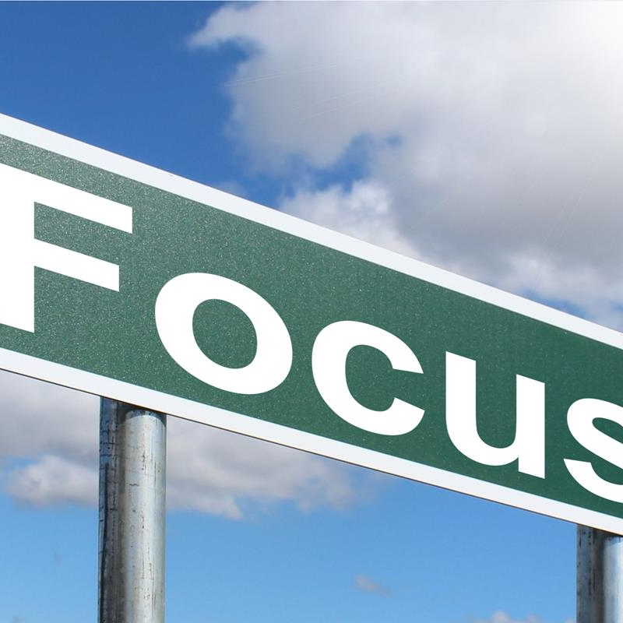

Partner Focus Groups

Slide 12
Objectives & Format
Get structural feedback on product and product improvements
Partners with knowledge and a voice
Quarterly Meetings with follow ups
Run & Owned by the Product Director

Slide 13
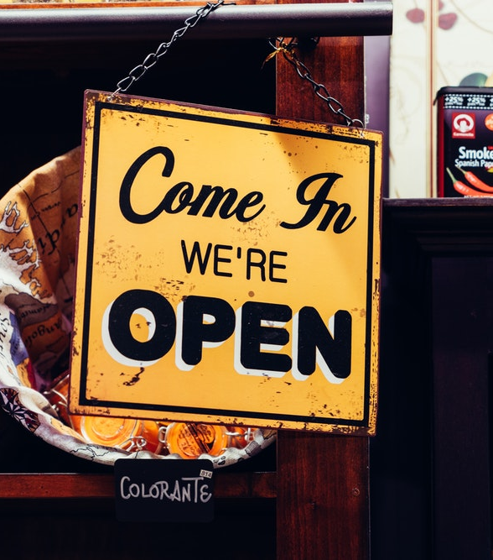
Focus Groups
Replenishment / Fashion
Point of Sales
Unified Commerce
Hospitality
Architecture & Deployments

Slide 14
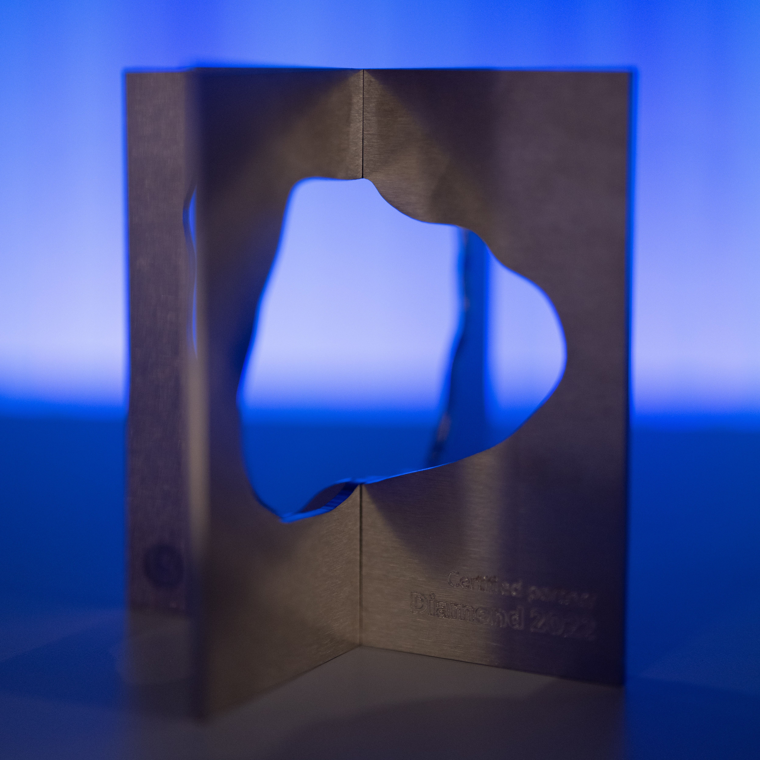

Partner Program 2023

Slide 15
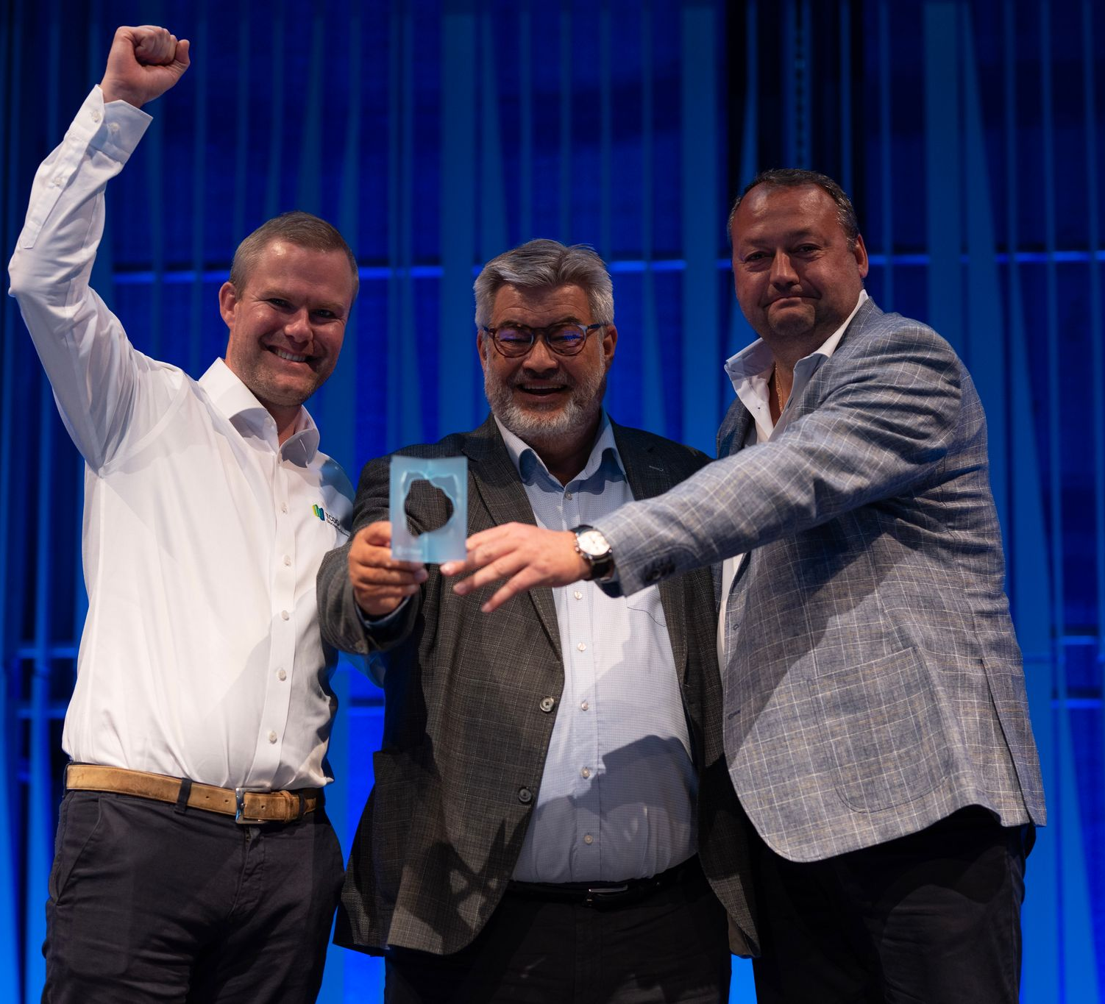
Joint contributions to our mutual success
We expect all our partners to…
Participate in
LS Retail events
network, exchange ideas and get answers
face to face
Seek training
focus on advancing their expertise
bring the latest and greatest to their customers
Promote LS Retail on their website, create awareness on multiple channels, create customer stories, exhibit LS Retail’s solutions
Continuously work closely with LS Retail’s team on winning business

Slide 16
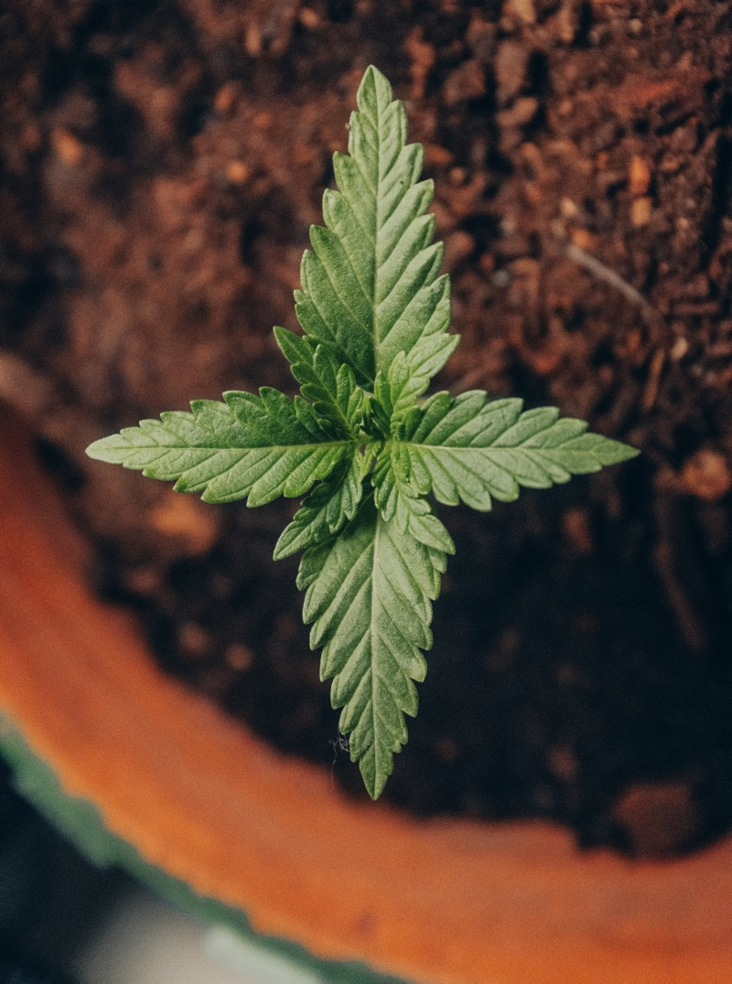
What’s new for 2023-2024
Start November 1st 2023
LS Express incorporated in LS Central Partner Program
Certification refresh every 3rd year
Base & Advanced Level Certifications
Customer Add target
2 Customer Stories for Diamond Level
Standard level needs € 10k Revenue
Shutdown LS One Partner Program
Launch Partner Success Track

Slide 17

Partner Success Tracks
BASIC € xxx/month
Partner Support
CSP Support
Licensing Ordering & Support
Partner Management
Technical Support
Knowledge Base access
Product Support
Sales & Marketing Support
Listed on LS Retail Partner Finder
RFP /RFI support
Marketing Advisory
Services
3 seats for LS Retail Academy OD
3 certification test per year
Cloud Acceleration Program
GENERAL € xxx/month
Partner Support
CSP Support
Licensing Ordering & Support
Partner Management
Technical Support
Knowledge Base access
Product Support
Sales & Marketing Support
Listed on LS Retail Partner Finder
RFP /RFI support
Marketing Advisory
Up to € 1,000 contribution for 1 video customer story*
1 Ticket to ConneXion per year
35% discount for 3 customer tickets*
Services
5 seats LS Retail Academy OD
5 Certification Test per year
Cloud Acceleration Program
ADVANCED € xxx/MONTH
Partner Support
CSP Support
Licensing Ordering & Support
Partner Management
Technical Support
Knowledge Base access
Product Support
Sales & Marketing Support
Listed on LS Retail Partner Finder
RFP /RFI support
Marketing Advisory
Up to € 2,500 contribution for 1 video customer story*
2 Ticket to ConneXion per year
50% discount for 5 customer tickets*
Services
7 seats LS Retail Academy OD
7 Certification Test per year
Cloud Acceleration Program

Slide 18
Partner level and discounts
Benefits and requirements
 | Certified Partners |  |  |  | Lean
 | Diamond | Platinum | Gold | Standard
New License /Subscription Revenue in € ¹ | > 350.000 | > 175.000 | > 50.000 | > 10.000 | -
New Customer Adds | 5 | 3 | 2 | 1
SaaS Discount ² | 30% | 25% | 20% | 15% | 5%
Subscription /Perpetual Discount ² | 25% | 20% | 15% | 10% | 5%
Customer stories per year ³ | 2 | 1 | - | - | -
Minimum Number of Certified Employees: ⁴
Base Level (CF 300 + CF 400+ CF 900) | 7 | 5 | 4 | 3 | 1
Advanced Level | 2 | 1
  A 0,8 factor is applied when calculating the revenue cap for emerging markets. A full list of countries that qualify for this factor can be found on the FAQ slide.
  Same discount applies to all modules in the LS Central combined solution.
  Nominate a customer for a customer story before March 31st, each year
  Renew your certifications every third year

Slide 19
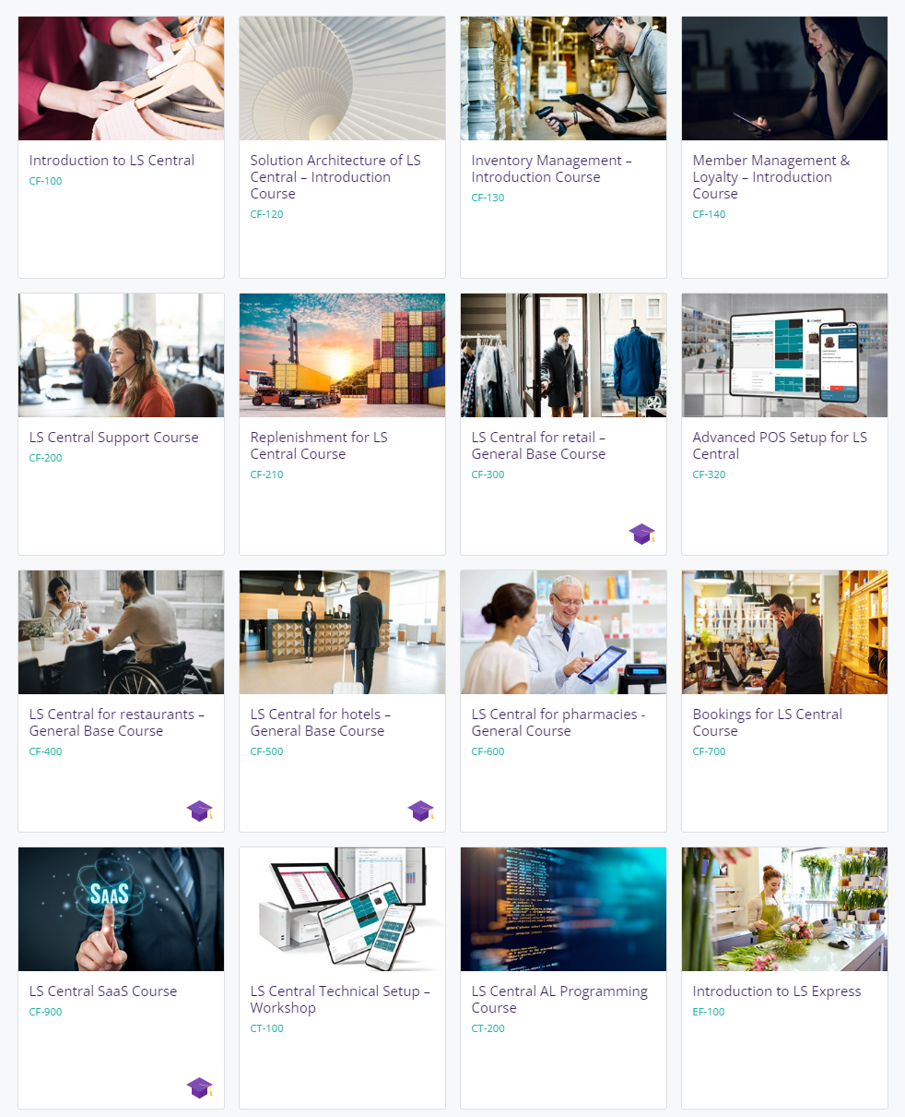
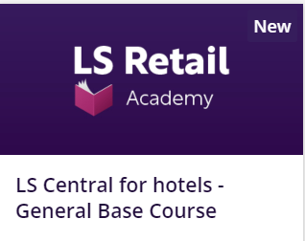
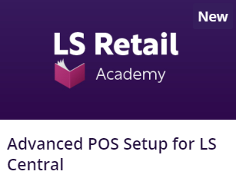
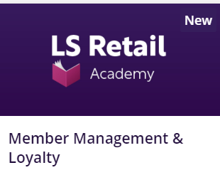
LS Retail Academy Advanced Level
Available On-Demand

Slide 20
License Promotions & Price Changes

Slide 21
Price Changes 1st of October 2023
Subscription Pricing adapted in line with the Microsoft announcements of 1st of April 2023
Perpetual Pricing global price adaption
BREP for LS Central from 18% to 19%
BREP for LS NAV from 18% to 22%

Slide 22
Current Promotions
New Customers
Existing Customers
Moving from On-Prem Subscription to SaaS
Introduction to LS Central on BC SaaS
Cloud Migration Promo
Bridge to the Cloud 2

Slide 23
Current Promotions
 | Introduction to LS Central on BC SaaS
Eligible License Type | New SaaS License
Eligible customers | New LS Central on BC SaaS customers
Extra Discount | 16,67% on their Monthly Term LS Central SaaS subscription until June 29, 2023.
Offer/Promotion Duration | At the end of the duration, the customer will be automatically renewed into another monthly subscription term at the then standard, non-introduction price. Alternatively, if the customers want to maintain the introductory price, they can transition from a Monthly Term Subscription to an Annual Term Subscription with either a Monthly or a Yearly Charge Term.
Dual Use Rights License-DUR- (3rd license) | YES (customer needs to purchase Offline stores with LSR)

Slide 24
Current Promotions
 | Moving from on-Prem Subscription to SaaS
Eligible License Type | On Prem Subscription
Eligible customers | Active LS Central/LS Nav on-Prem Subscription customers, registered prior to Nov. 1, 2022
Extra Discount | 35% for 3 years- 100% cloud. 15% for 3 years- Hybrid setup
Offer/Promotion Duration | December 15, 2022- June 29, 2023. Fixed 3-year term, non-renewable/non-cancellable from enrollment. After the promotion ends, normal LS Central on BC SaaS pricing will apply
Dual Use Rights License-DUR- (3rd license) | NO (for 100% cloud, with Online stores) YES (customer needs to purchase Offline stores with LSR)

Slide 25
Migrate to Cloud Promotions comparition-
 | Cloud Migration Promo | Bridge to the Cloud 2
Eligible License Type | On Prem Perpetual & On Prem Subscription | On Prem Perpetual
Eligible customers | Active LS Central customers | Active on EP and licensed prior to September 1, 2022.
Extra Discount | 35% for 3 years, non-renewable, prices revert to list price at the end of 3rd year | 40% discount, 3-year term, non-renewable, non-cancelable
Offer/Promotion Duration | August 1, 2021- June 30, 2023 | February 1, 2023- December 30, 2024 Fixed 3-year term from enrollment. Non-renewable, non-cancellable After promotion ends, normal pricing will apply
Dual Use Rights License-DUR- (3rd license) | NO- On Prem Perpetual -The customer will use their active on prem perpetual license until fully migrated to cloud. NO -On Prem Subscription (for a hybrid setup, the customer can enroll in Moving from on-Prem Subscription to SaaS Promo | YES 3rd license provided, anything purchased into the cloud license is added into the 3rd license.
One Way? | Yes, must Migrate | Yes, must Migrate
Adjust for concurrent users | Yes | Yes, during term when cost >2x EP spend
Switch between user types | YES | NO
Lower User count | YES | NO

Slide 26
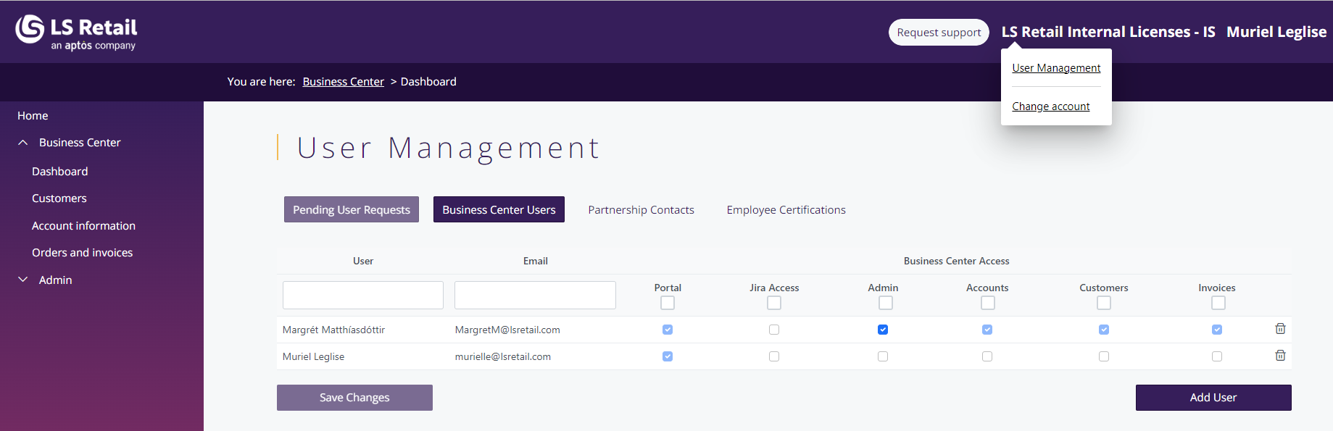
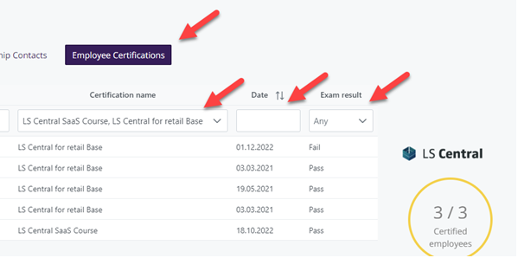
Business Center Updates
New look
User Management
Certifications
Upcoming:
Paying with Creditcard
Multiple download
Partner Program Status
New name ?

Slide 27
Thank you

