Slide 2
Replenishment
Auto-resume and more new features
Order Fulfillment
Martin F.
Hilmar
Kleindl
Vilhjalmsson

Slide 3


Slide 4

Performance
improvements
Parallel processing
with Job Queue
(supporting 50+ parallel sessions)

Slide 5

Parallel calculation with Job Queue
API
Entra App
User 1
Entra App
User 2
Entra App
User 3
Creates JQ Entries
Calls Webservice to start Job Queue, using Entra App users
Linked JQ Job 1
Linked JQ Job 6
Linked JQ Job 11
Master Job
…
…
…
run as
JQ-User
Linked JQ Job 5
Linked JQ Job 10
Linked JQ Job 15

Slide 6
Parallel calculation with Job Queue
API
Entra App
User 1
Entra App
User 2
Entra App
User 3
Creates JQ Entries
Calls Webservice to start Job Queue, using Entra App users
Processing in parallel
Linked JQ Job 1
Linked JQ Job 1
Linked JQ Job 1
Linked JQ Job 6
Linked JQ Job 6
Linked JQ Job 6
Linked JQ Job 11
Linked JQ Job 11
Linked JQ Job 11
Master Job
…
…
…
…
…
…
…
…
…
run as
JQ-User
Linked JQ Job 15
Linked JQ Job 15
Linked JQ Job 5
Linked JQ Job 15
Linked JQ Job 5
Linked JQ Job 5
Linked JQ Job 10
Linked JQ Job 10
Linked JQ Job 10

Slide 7
Test in BC SaaS Production
50.000 items, 250 stores,
50 parallel processes (10 users)
RIQ
0.9 hours
(245k rec/min)
Journals
2.1 hours
(100k rec/min)
OOS
0.7 hours
(313k rec/min)

Slide 8

Customer (Fashion)
36.000 item-variants, 240 stores, 8.5 Mio. RIQ
50 parallel processes (10 users)
RIQ
0.9 hours
(170k rec/min)
Journals
1.7 hours
(85k rec/min)
OOS
---
(--k rec/min)

Slide 9
Findings and lessons learned
1. Split Templates
(into smaller templates)
to avoid timeouts in cleanup
One
“Monster”
Template
all items,
all variants,
all stores
Template 1
Item Category 1
Hint:
Don’t be too ambitious and avoid balancing overhead
Template 2
Item Category 2

Slide 10

Findings and lessons learned
2. Journal Logs
(detailed calculation steps)
should be turned OFF
8+ Mio.
Journal Detail lines
32+ Mio.
Journal Log lines

Slide 11
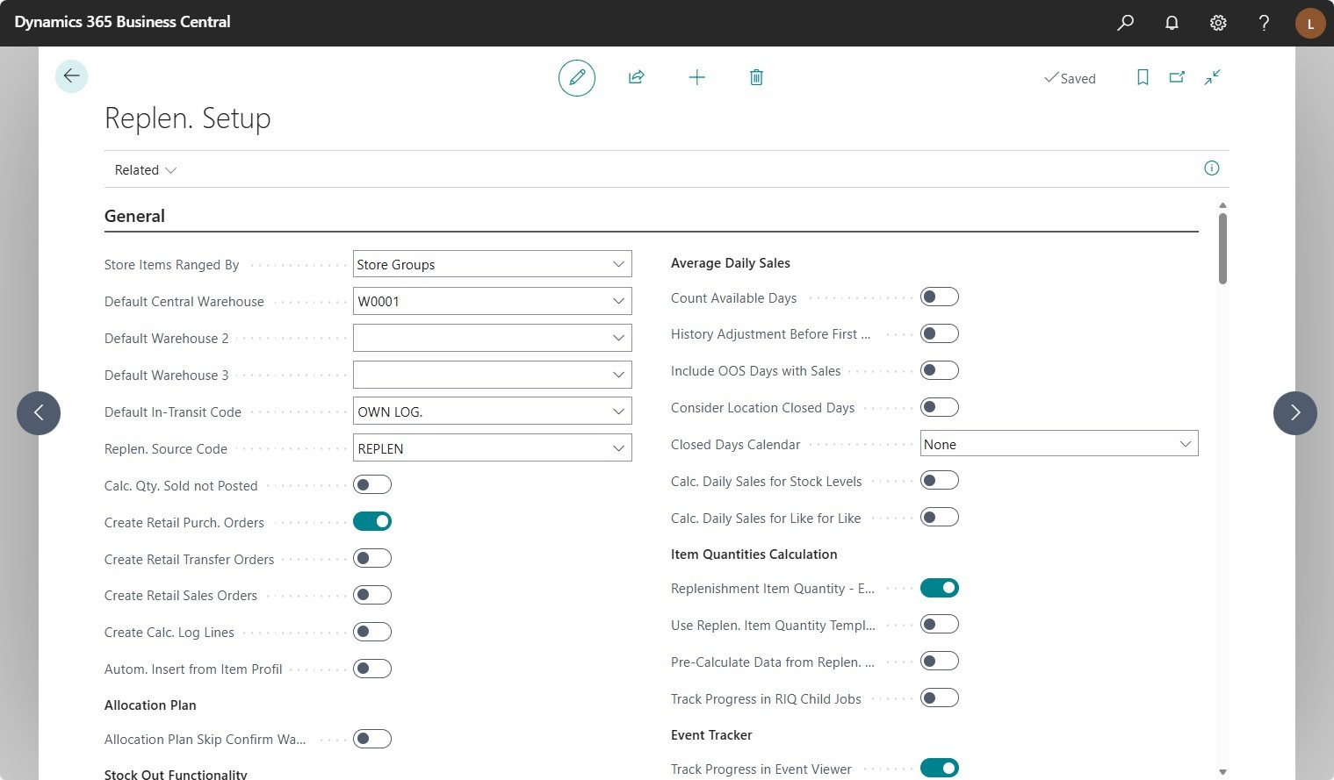
Findings and lessons learned
2. Journal Logs
(detailed calculation steps)
should be turned OFF
Cleanup with DeleteAll()
can take very long.
Hints:
- Turn off in Replen. Setup
- Use only in dedicated
Journals with Filters
Improvements: Using the
new Truncate() function
Journal
all items,
all variants,
all stores
Journal calculation Log
times 4+
number of recs of the
Journal Details
table

Slide 12
Findings and lessons learned
3. Journal parameter "Skip zero Lines"
(to avoid creation of empty lines)
should be turned ON

Slide 13
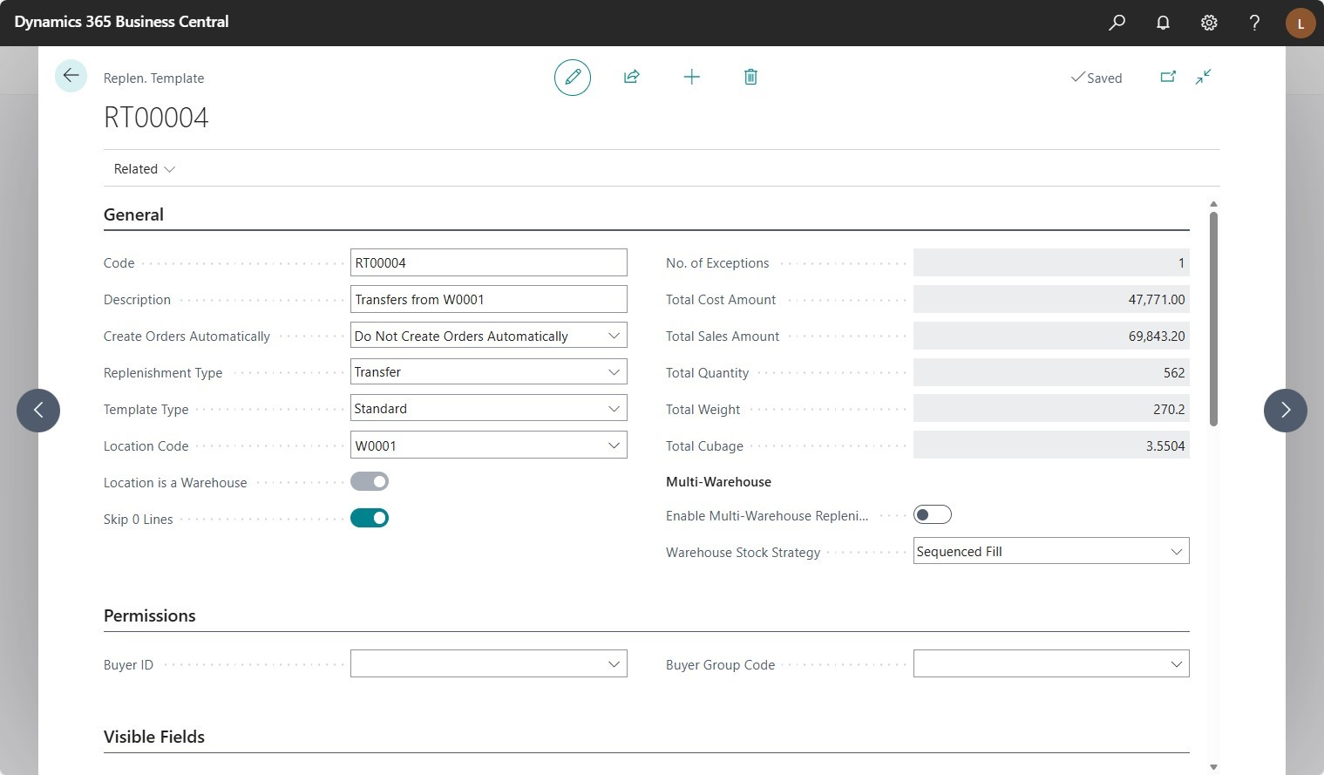
Findings and lessons learned
2. Journal Logs
(detailed calculation steps)
should be turned OFF
Hint:
- Always ON for
Transfer Journals
- Potentially ON for
Purchase Journals
This reduces cleanup, calculation, and document creation time.
Journal
all items,
all variants,
all stores
Journal calculation Log
times 4+
number of recs of the
Journal Details
table

Slide 14


Slide 15

Technical details
Job Queue Entry
LS Retail Scheduler
Replen. Item Qty.
(MASTER)
Job Queue Entry
Replen. Item Qty.
(Child)
Job Queue Entry
Replen. Item Qty.
(Child)

Slide 16
Technical details
Job Queue Entry
LS Retail Scheduler
Replen. Item Qty.
(MASTER)
Job Queue Entry
Replen. Item Qty.
(Child)
Restarting ….
Job Queue Entry
Replen. Item Qty.
(Child)

Slide 17
Technical details
Job Queue Entry
LS Retail Scheduler
Replen. Item Qty.
(MASTER)
Job Queue Entry
Replen. Item Qty.
(Child)
Job Queue Entry
Replen. Item Qty.
(Child)
Microsoft
resurrects
Job Queue
Jobs start
from the
beginning

Slide 18


Slide 19
New approach
Job Queue Entry
LS Retail Scheduler
Replen. Item Qty.
(MASTER)
Job Queue Entry
Replen. Item Qty.
(Child)
Job Queue Entry
Replen. Item Qty.
(Child)
Microsoft
resurrects
Job Queue
Jobs continue
from last
calculation point

Slide 20
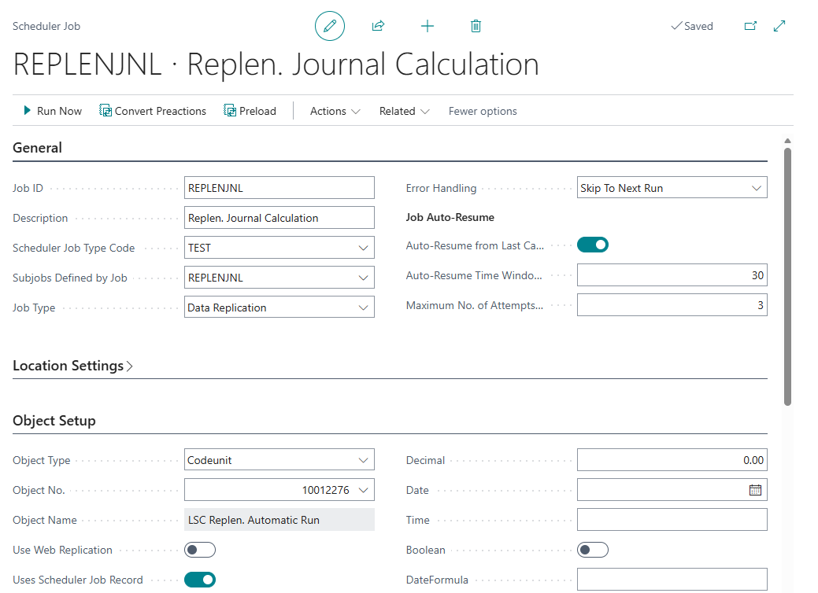
Auto-resume for
Replenishment calculation
Conditions that qualify a Replen. Job
for Auto-Resume
Auto-Resume enabled
The job did not complete in the last run
Within Auto-Resume time window
Does not exceed max. number of attempts

Slide 21

New attractions

Slide 22

New attractions
Assortment
Suggestion
Worksheet
Planned Sales Demand from Sales History
Item Distri-bution List

Slide 23
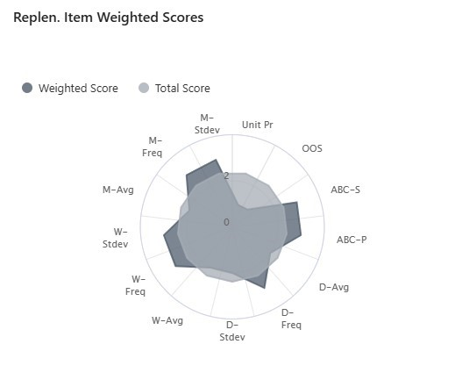
Assortment Suggestion Worksheet
Business goal:
To provide assortment suggestions
based on calculated KPIs
  Sales velocity (day, week, month)
  Sales frequency & volatility
  OOS situations
  ABC classification
  Unit price range
Using a weighted scoring model

Slide 24
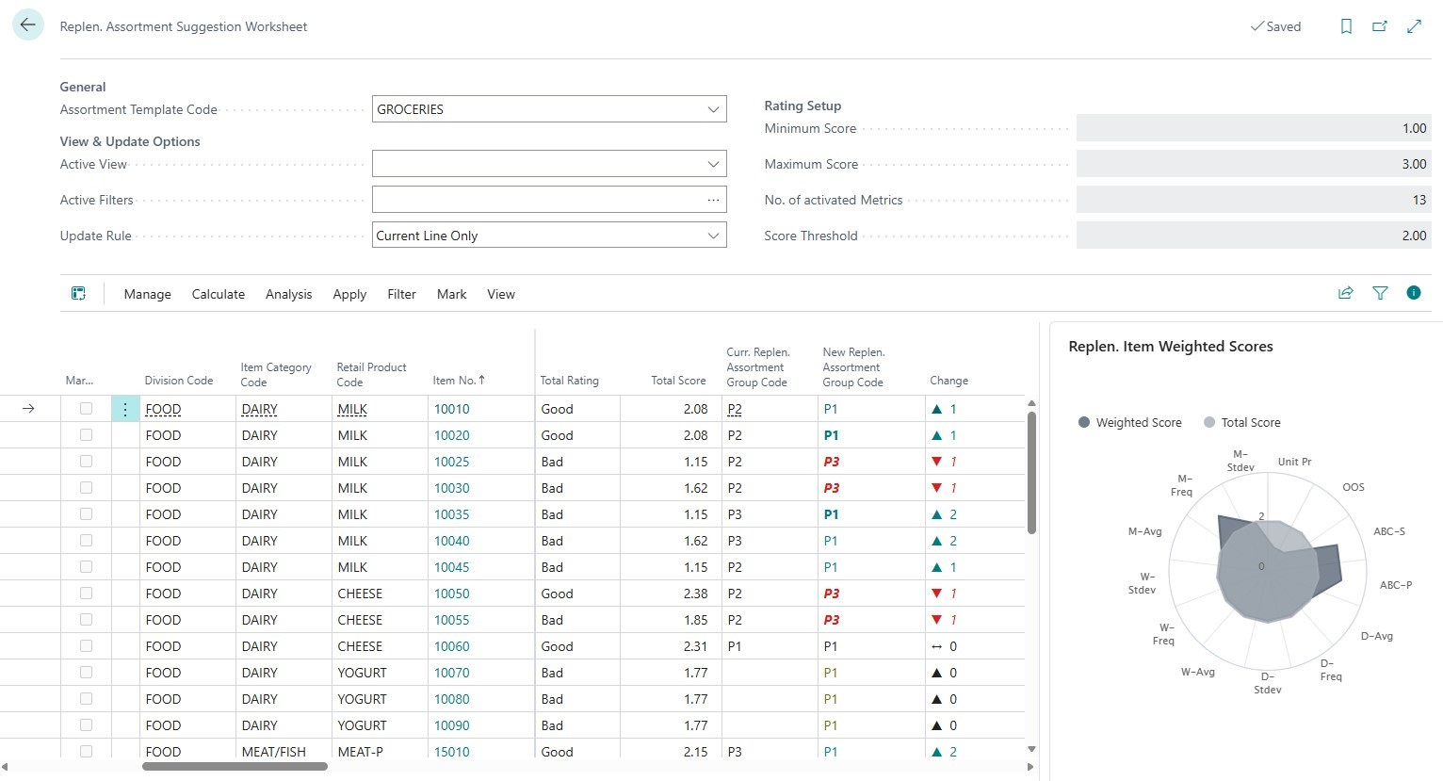
Assortment Suggestion Worksheet
Solution:
(1) New field Assortment Group Code on Item Card
(2) Worksheet to
  Calculate scores
  Propose changes
  Roll-out changes
(3) Hierarchies consider
Assortment Group Code

Slide 25
Assortment Suggestion Worksheet

Slide 26
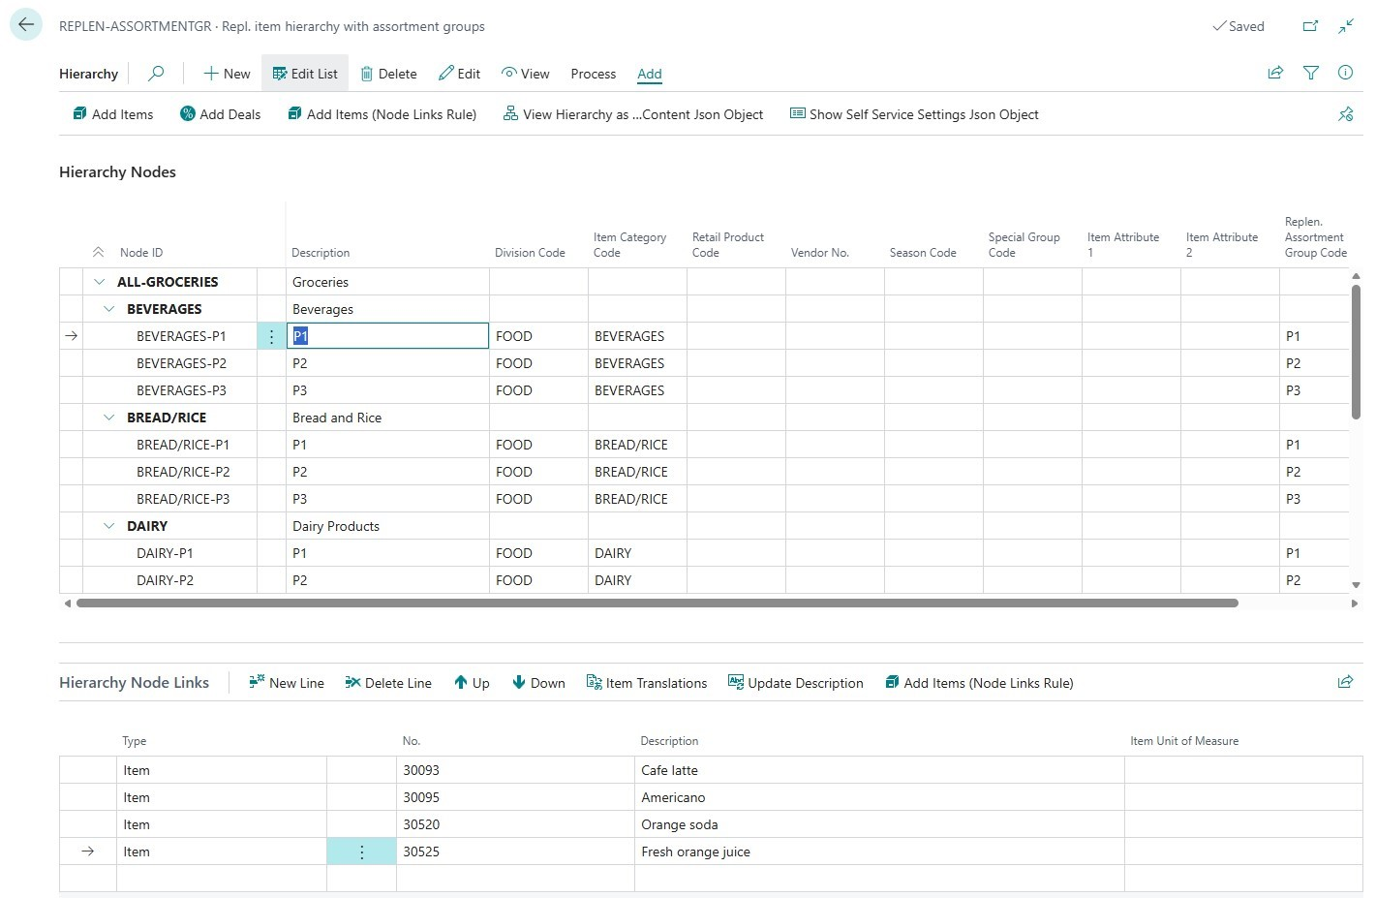
Assortment Suggestion Worksheet

Slide 27
New attractions
Assortment
Suggestion
Worksheet
Planned Sales Demand from Sales History
Item Distri-bution List

Slide 28
Planned Sales Demand
from sales history
Business goal:
To predict sales demand for
upcoming discount offers
Concept:
20 %
15 %
25 %
Old Discount
Offer
Old Discount
Offer
Link
New Discount
Offer
Link
Planned Sales
Demand
Calculate performance
(Sales increase %)
Create (Discount%)
Consider in Autom. Replenishment
Calculate planned (Sales increase %)

Slide 29
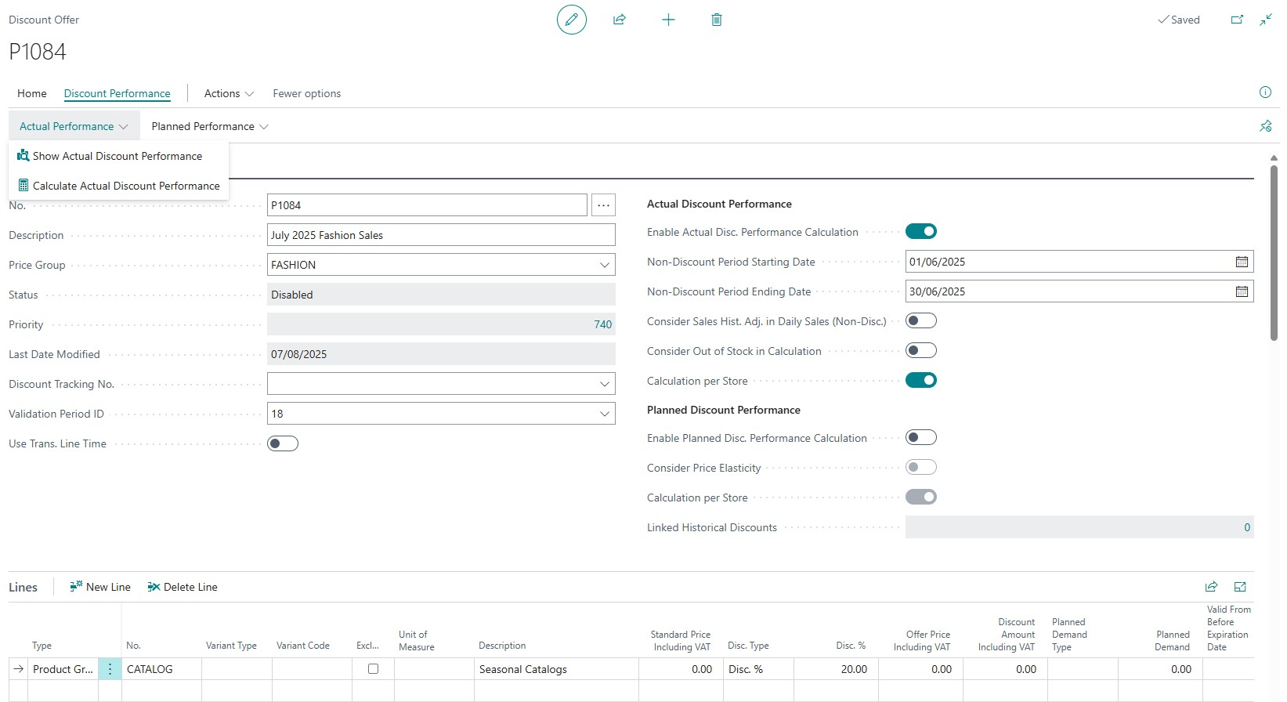
Planned Sales Demand

Slide 30
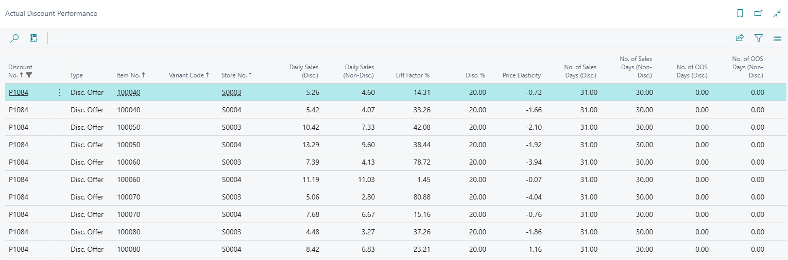
Planned Sales Demand
Price Elasticity
Measures how much the demand quantity increases as a result of the price drop.
>1 : Elastic
<1 : Inelastic
=1 : Unitary

Slide 31
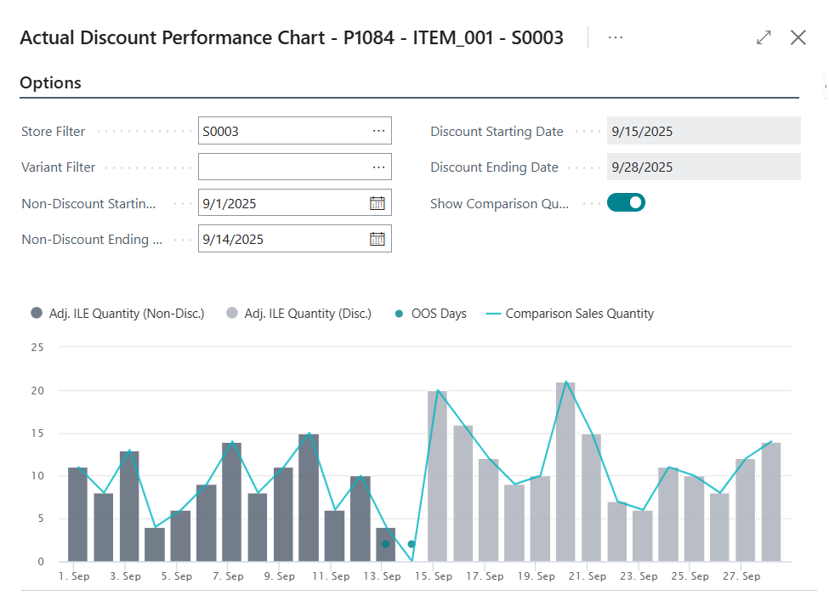
Planned Sales Demand

Slide 32
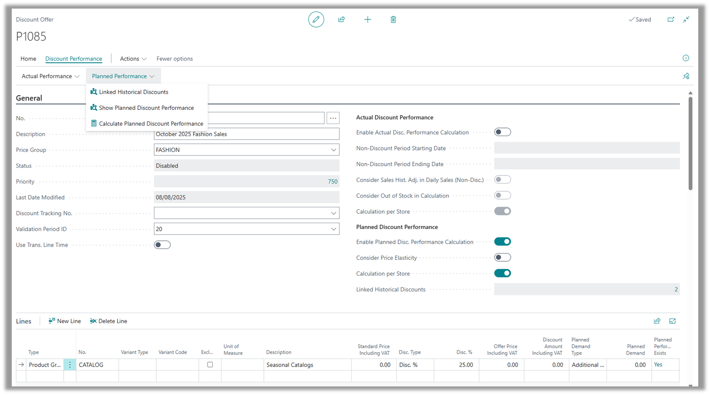
Planned Sales Demand

Slide 33
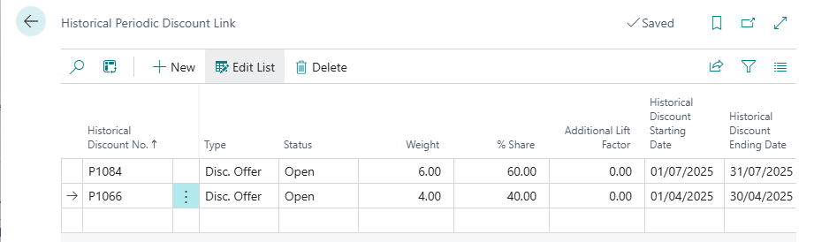
Planned Sales Demand

Slide 34
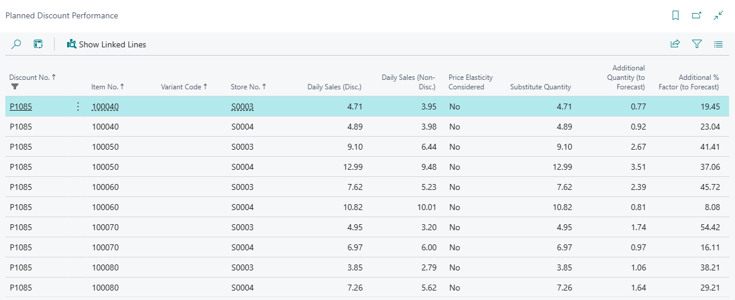
Planned Sales Demand

Slide 35
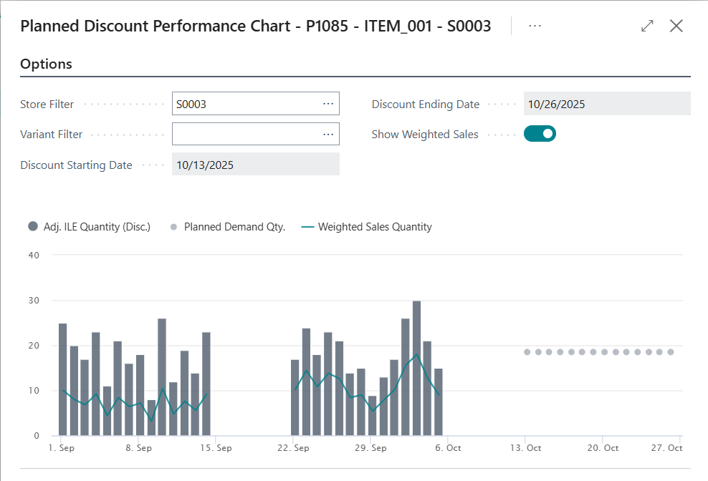
Planned Sales Demand

Slide 36
New attractions
Assortment
Suggestion
Worksheet
Planned Sales Demand from Sales History
Item Distri-bution List

Slide 37
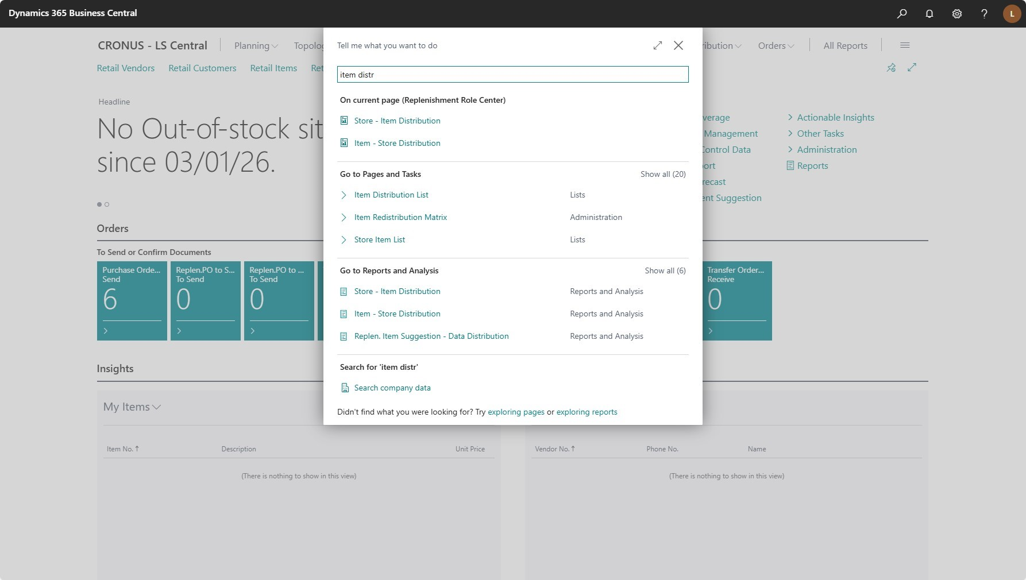
Item Distribution List

Slide 38
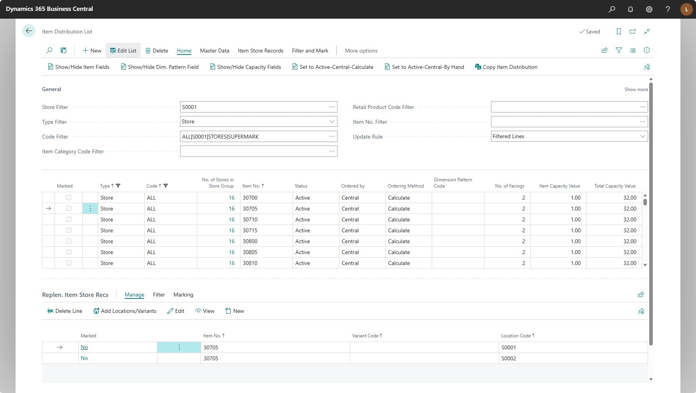
Item Distribution List

Slide 39
Item Distribution List

Slide 40
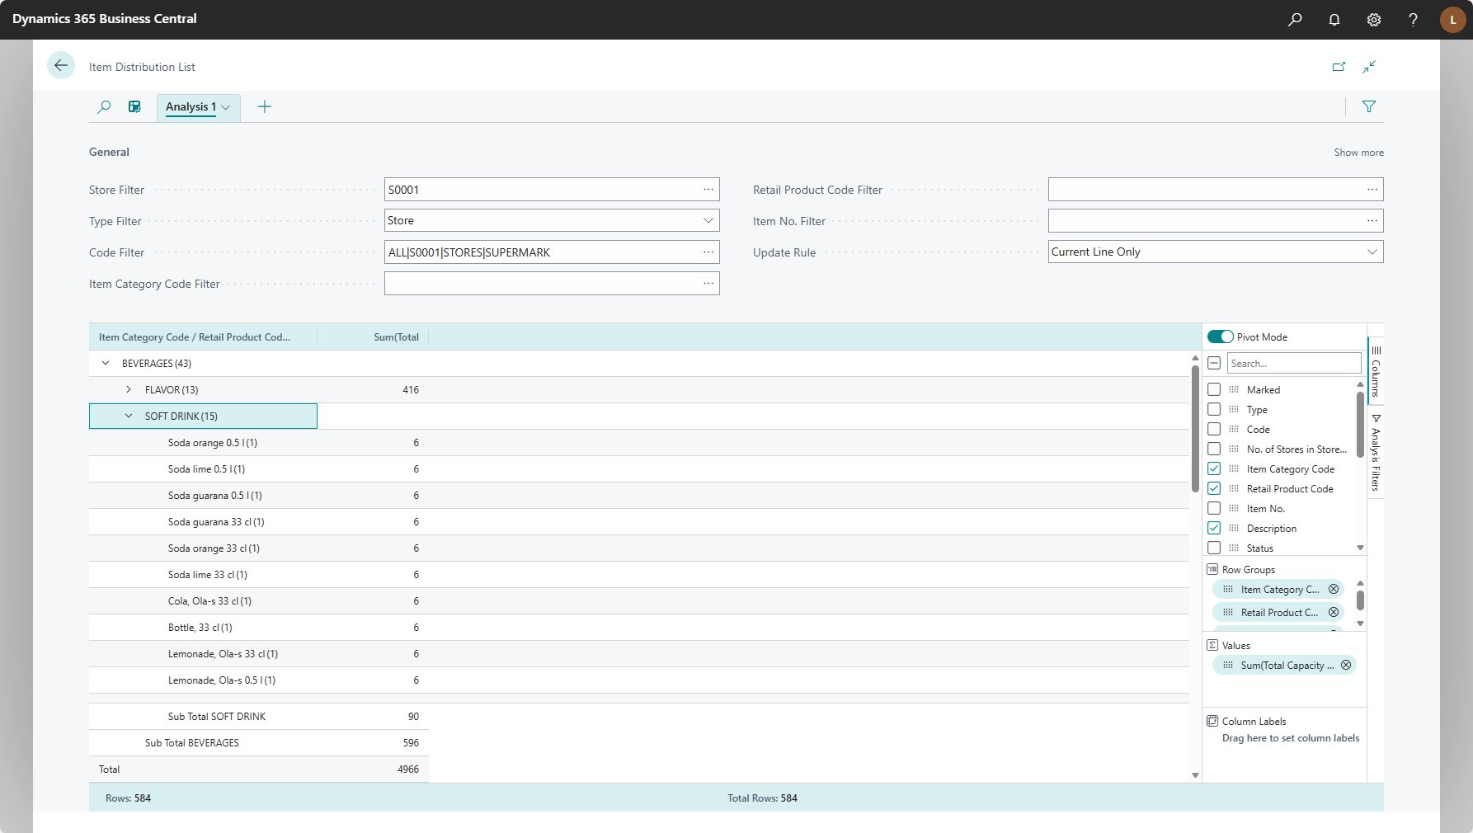
Item Distribution List

Slide 41
Even more attractions
Retail Budgets
with
Hierarchy
nodes
Sales Order creation in Transfer Journals
Document
Date
handling
Fashion Features
- Dim. Pattern for Xdock and
Buyers Push
- VFW handling
- Many more

Slide 42

Long awaited …
… finally arrived!
Multi Location Sourcing and
Order Fulfillment rules

Slide 43
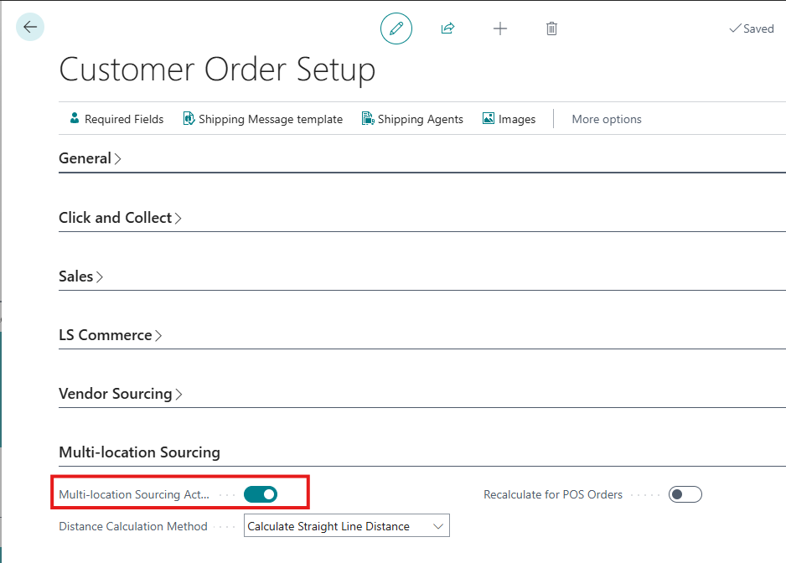
Turn on Multi-location Sourcing

Slide 44
Turn on Multi-location Sourcing
Fulfillment rules
Stay within the destination market
Minimize split fulfillment
Ship from the closest location
Use location priority

Slide 45
Fulfillment rules
Stay within the destination market
Ensures sourcing locations are only selected from the customer’s market based on defined market and country mappings.

Slide 46
Fulfillment rules
Minimize split fulfillment
Selects the combination with the fewest number of shipments to simplify logistics and reduce costs.

Slide 47
Customer
Warehouse
Store

Slide 48
Fulfillment rules
Ship from the closest location
Prioritizes locations with the shortest distance to the customer, using Azure Maps distance calculations.

Slide 49
Customer
Warehouse
Store

Slide 50
Fulfilment rules
Use location priority
Evaluates sourcing based on location priority points. Lower points indicate higher priority.

Slide 51
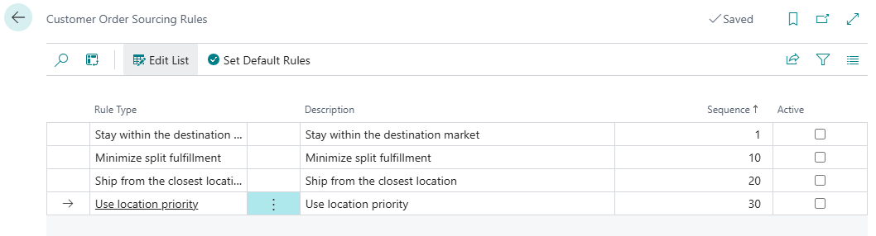
Fulfillment rules

Slide 52
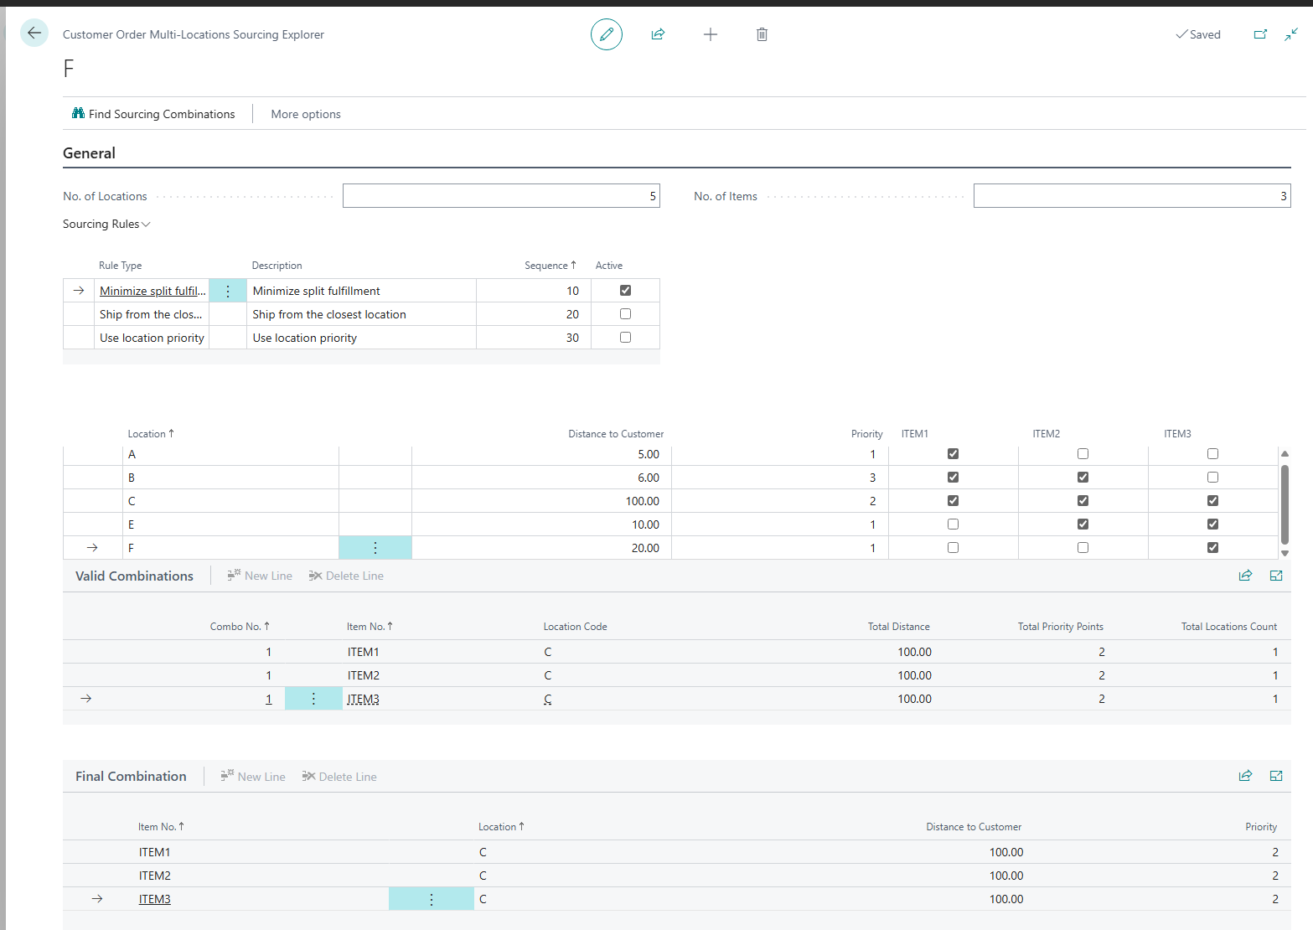
Multi-Location Sourcing Explorer

Slide 53
Multi-Location Sourcing Explorer

Slide 54
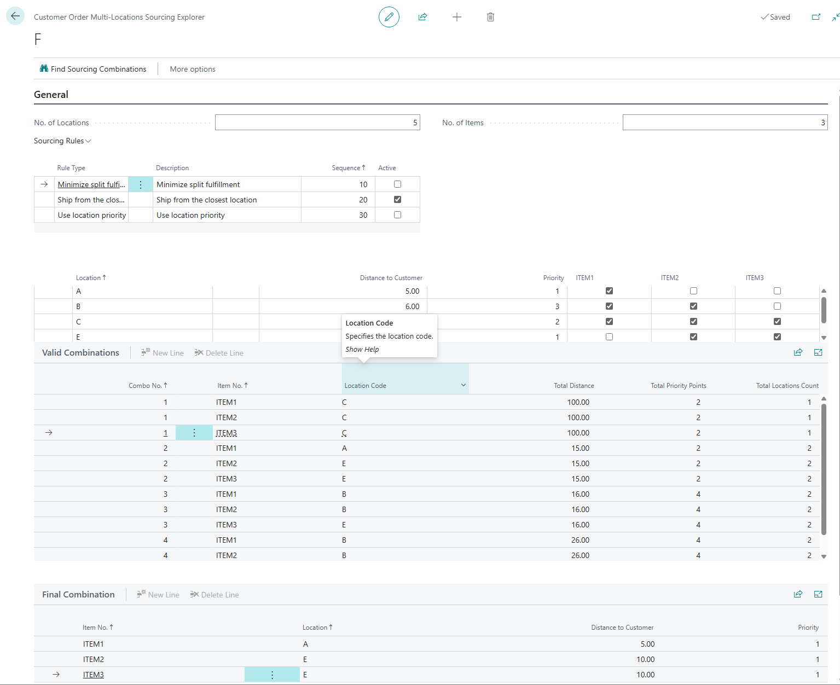
Multi-Location Sourcing Explorer

Slide 55
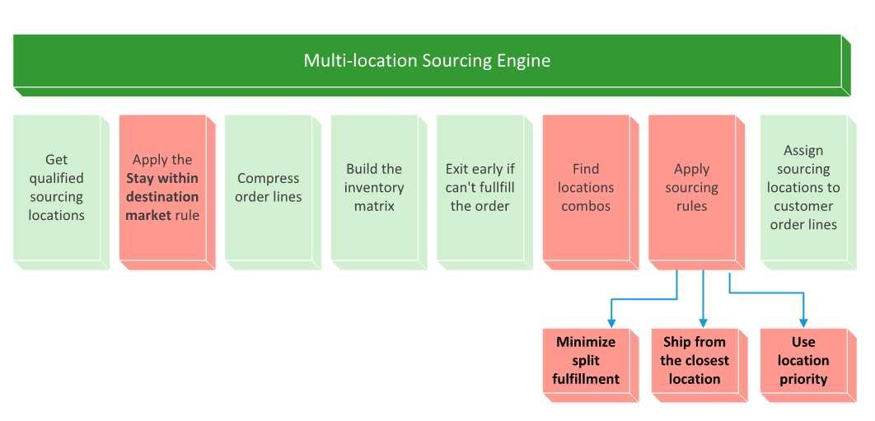
The engine

Slide 56

Stock protection & effective inventory
Stock protection
Enable stores to define safety stock,
which is unavailable for customers to order
Per store or store group
As quantity or % of total stock
Per Item or Retail Product Group

Slide 57
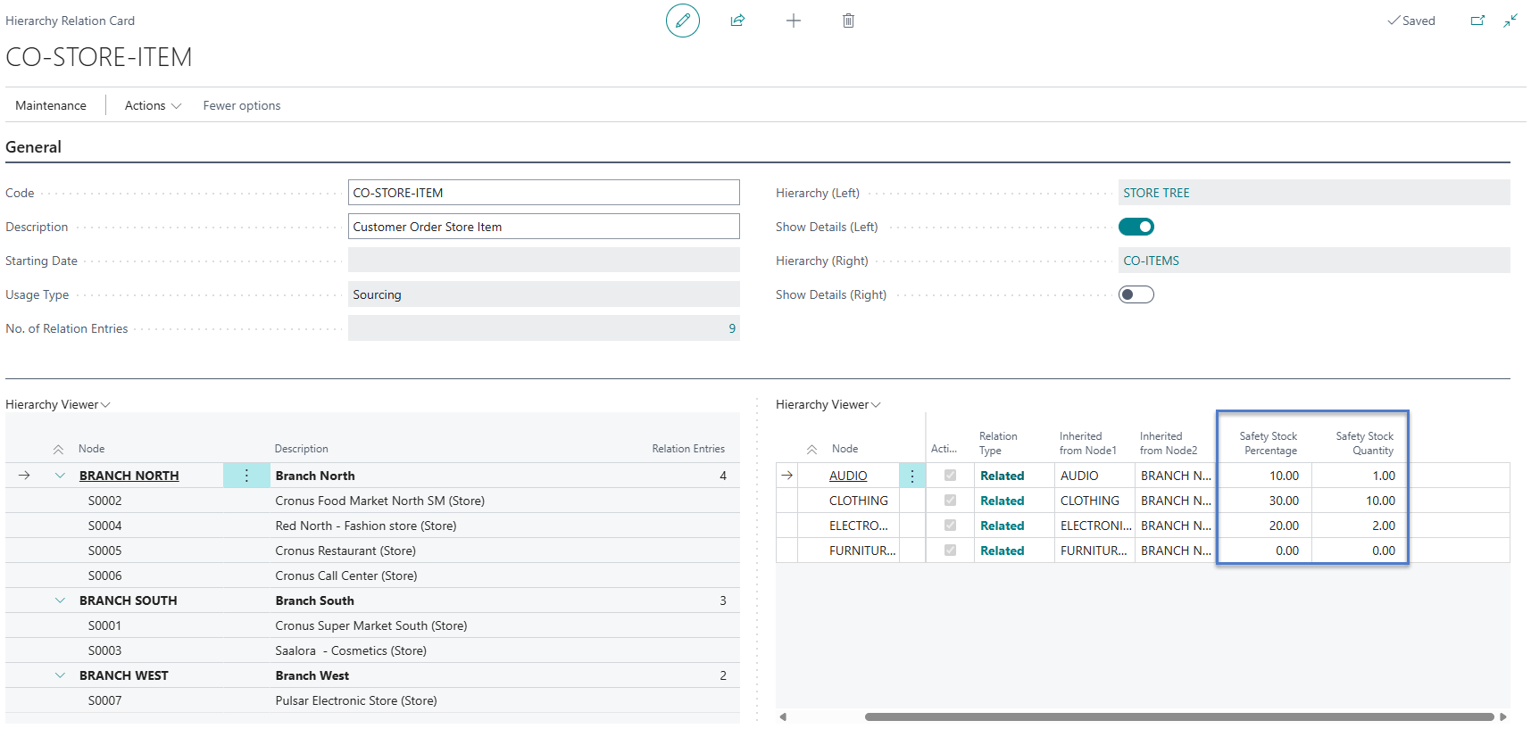
Stock protection - Setup

Slide 58
Effective inventory
Effective Inventory
Considers expected inbound and outbound quantity on documents
Inbound
Purchase Orders
Inbound Transfer Orders
Outbound
Sales orders
Inbound Transfer Orders

Slide 59
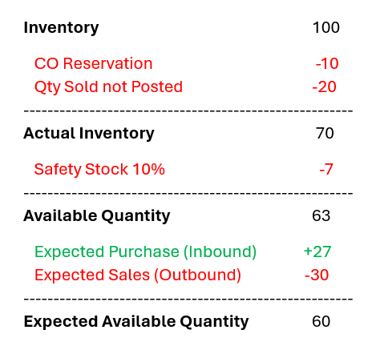
Stock protection & effective inventory
Enables the stores to keep some safety stock and make this stock unavailable for customer orders.
Considers expected inbound and outbound quantity on documents such as purchase, sales and transfer orders

Slide 60
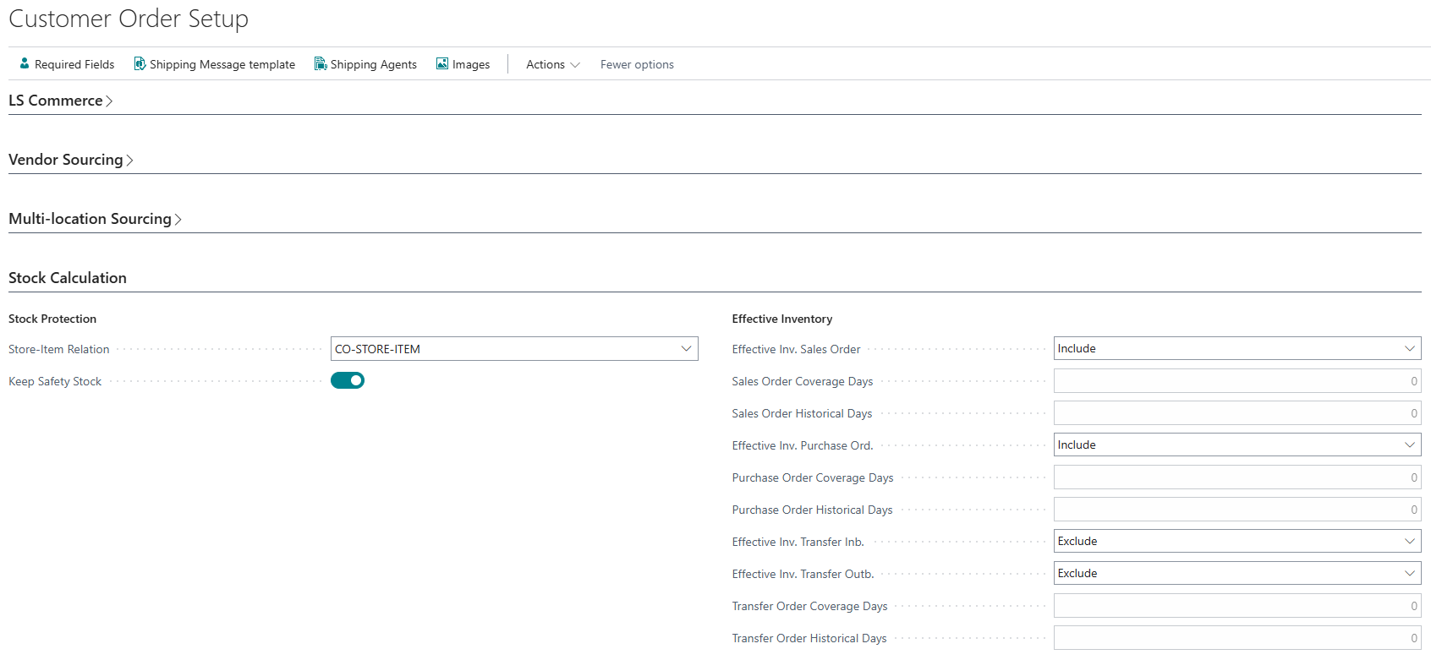
Stock protection & effective inventory - Setup

Slide 61
Multi-location sourcing
Fulfillment rules
  Stay within destination market
  Maximum distance
  Minimize split
  Ship from the closest location
  Use Location Priority
Stock protection
Effective inventory

Slide 62
Attractions
in the planning phase
Replenishment as
separate app
Capacity
driven
Assortment
planning
Safety
Stock
handling
Customer
Orders
as
separate app

