Slide 1
Monitoring and Analyzing Telemetry
Johann Sveinsson
Damir Babikov

Slide 2
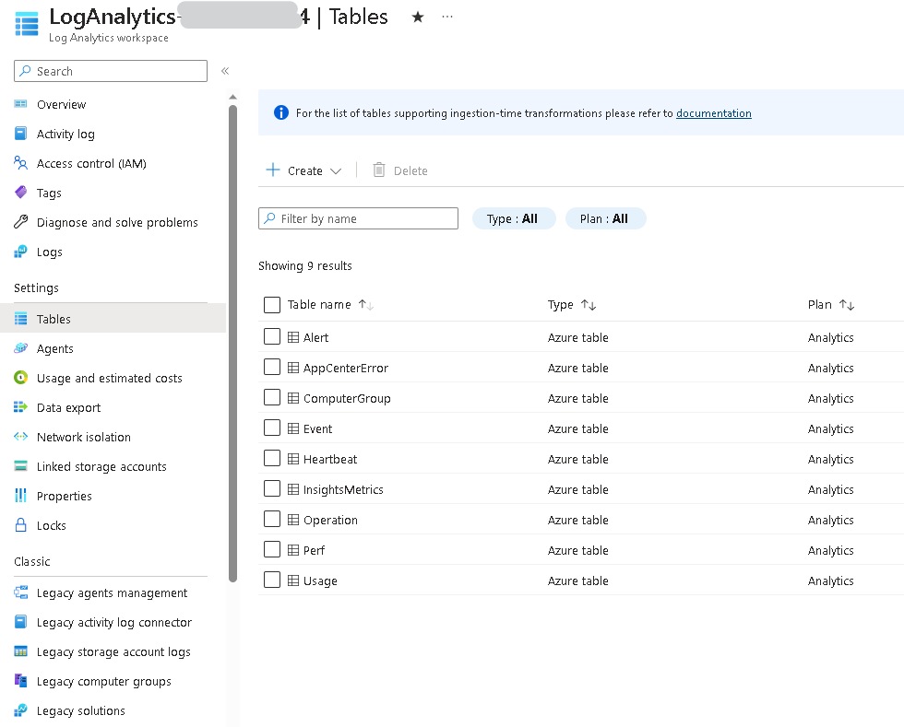
Overview of BC Telemetry History
Windows Events (ETW)
Performance Counters
SaaS – now creators themselves need it
Log Analytics
Application Insights

Slide 3
Anatomy of Event
Part of BC service core, both on-prem & SaaS
Can be on App level
Use Windows OS subsystem, negligible performance impact
Do not look pretty (even in friendly view)
Various info sent under different event ID
Do not exist long on very busy server
Not transaction dependent
Can be pushed to any cloud analytics or Azure Application Insights
Can be turned on/off

Slide 4
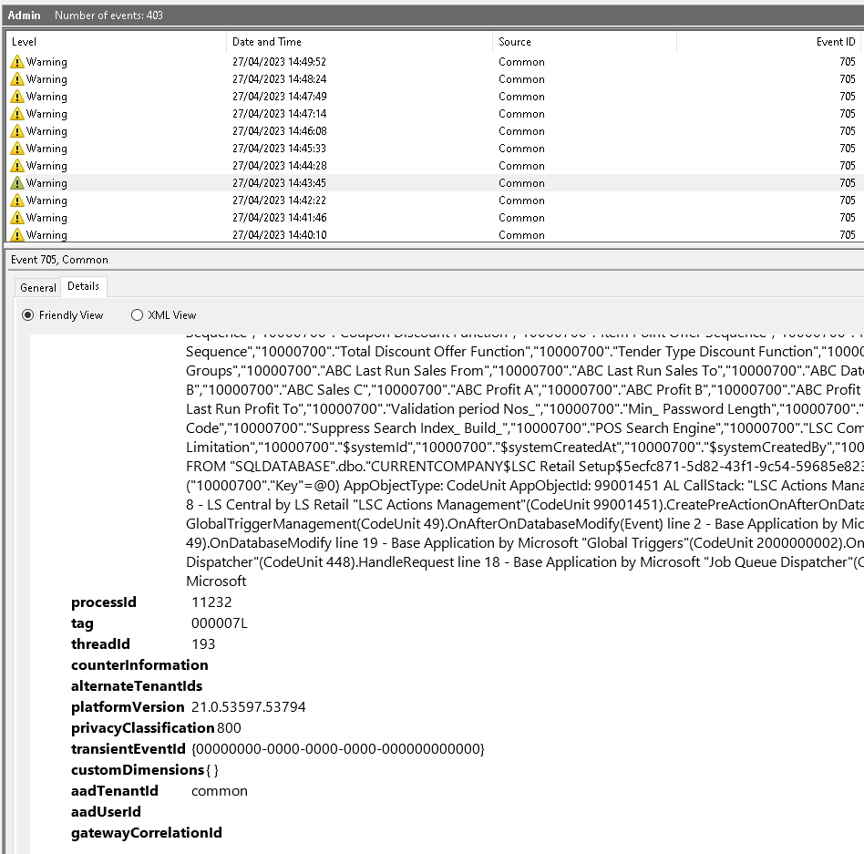
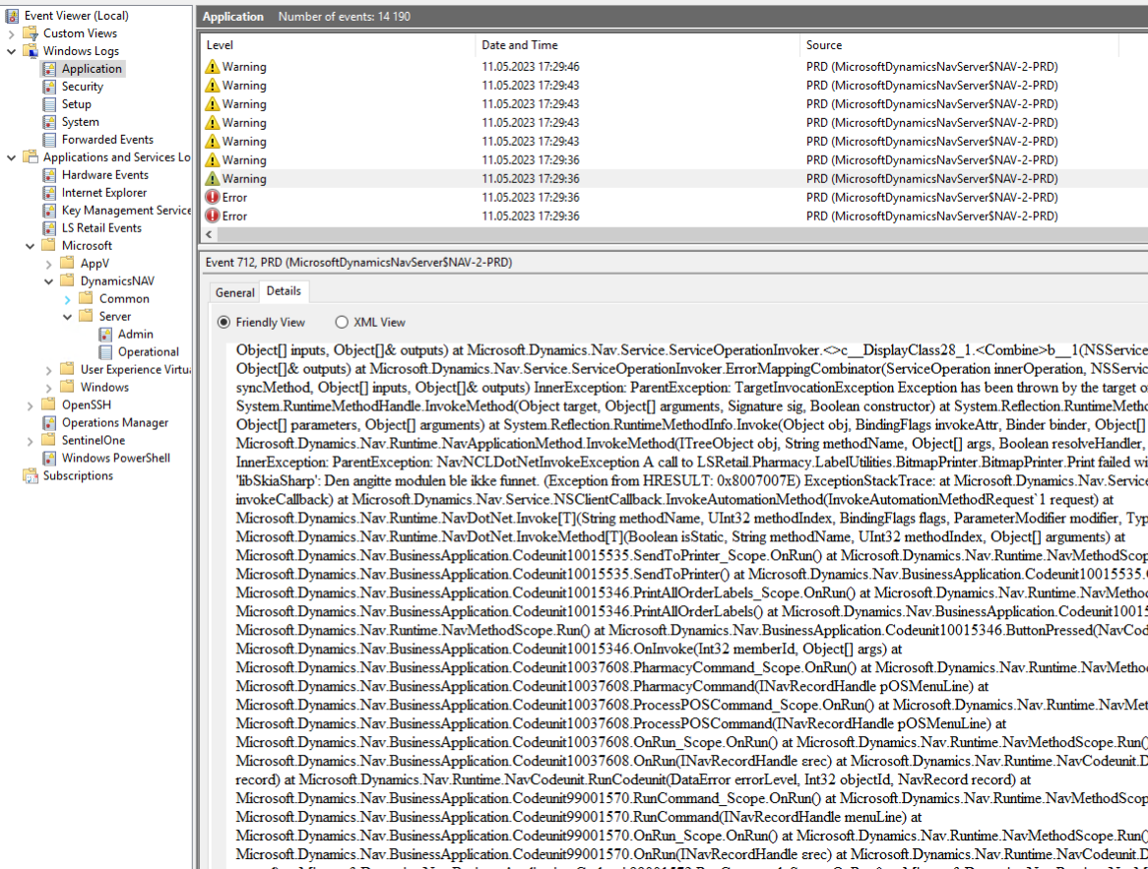
Not So Friendly View

Slide 5
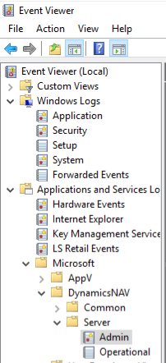
Standard Events
Admin & operational
Windows Logs / Application
NAV server trace Events
Application and Services Logs / Microsoft / DynamicsNAV / Common
Application and Services Logs / Microsoft / DynamicsNAV / Server

Slide 6
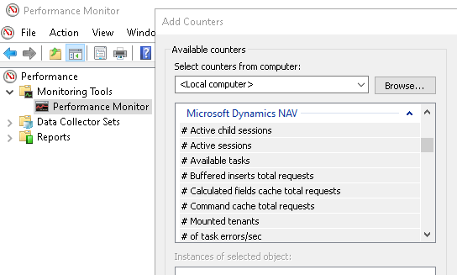
Performance Counters
Windows has plenty, just few here
Memory(*)\% Committed Bytes In Use
Processor(_Total)\% Processor Time
System(*)\Processor Queue Length
LogicalDisk(*)\Avg. Disk sec/Write
LogicalDisk(*)\Current Disk Queue Length
More available for Dynamics NAV server instances
# Active sessions
# Open application connections
# Primary key cache total requests
More here: https://learn.microsoft.com/en-us/dynamics-nav/microsoft-dynamics-nav-performance-counters

Slide 7
Custom Events / Traces
Session.SendTraceTag(Tag: Text, Category: Text, Verbosity: Verbosity, Message: Text [, DataClassification: DataClassification])
NOTE: Above method is supported only in Business Central on-premises.
Session.LogMessage(EventId: Text, Message: Text, Verbosity: Verbosity, DataClassification: DataClassification, TelemetryScope: TelemetryScope, CustomDimensions: Dictionary of [Text, Text])
SENDTRACETAG(Tag, Category, Verbosity, Message)
NOTE: In older versions, CAL

Slide 8
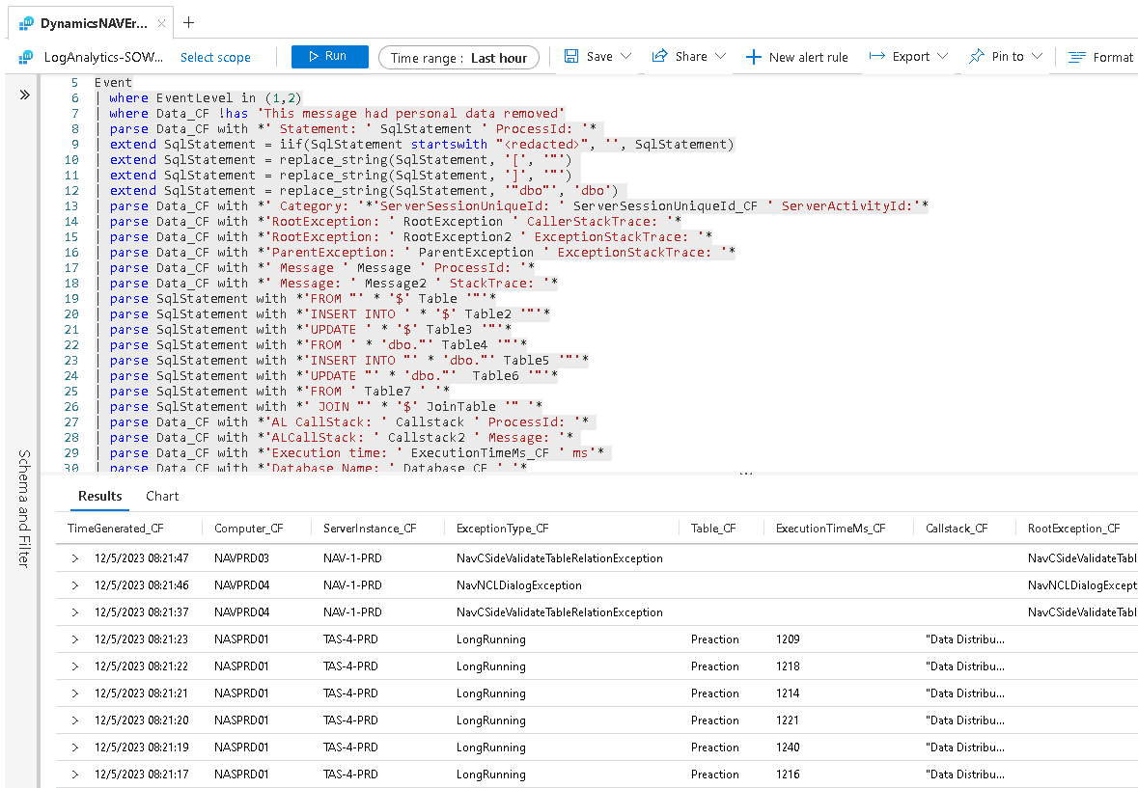
Case Study I
On-premises
Older BC version
CAL + AL
Events
Performance counters
Custom traces
Azure Log Analytics
KQL + Alerts
Dashboards

Slide 9
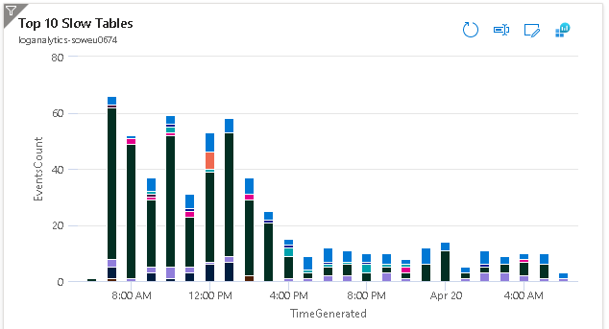
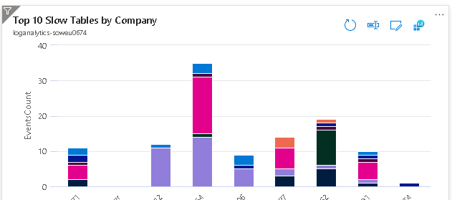
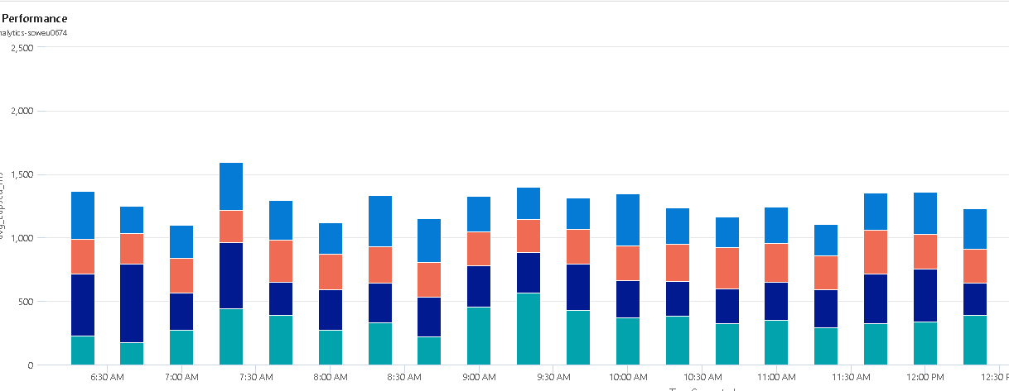
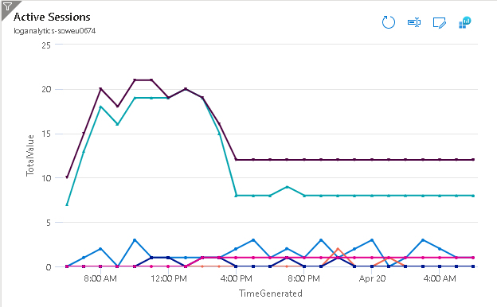

Slide 10
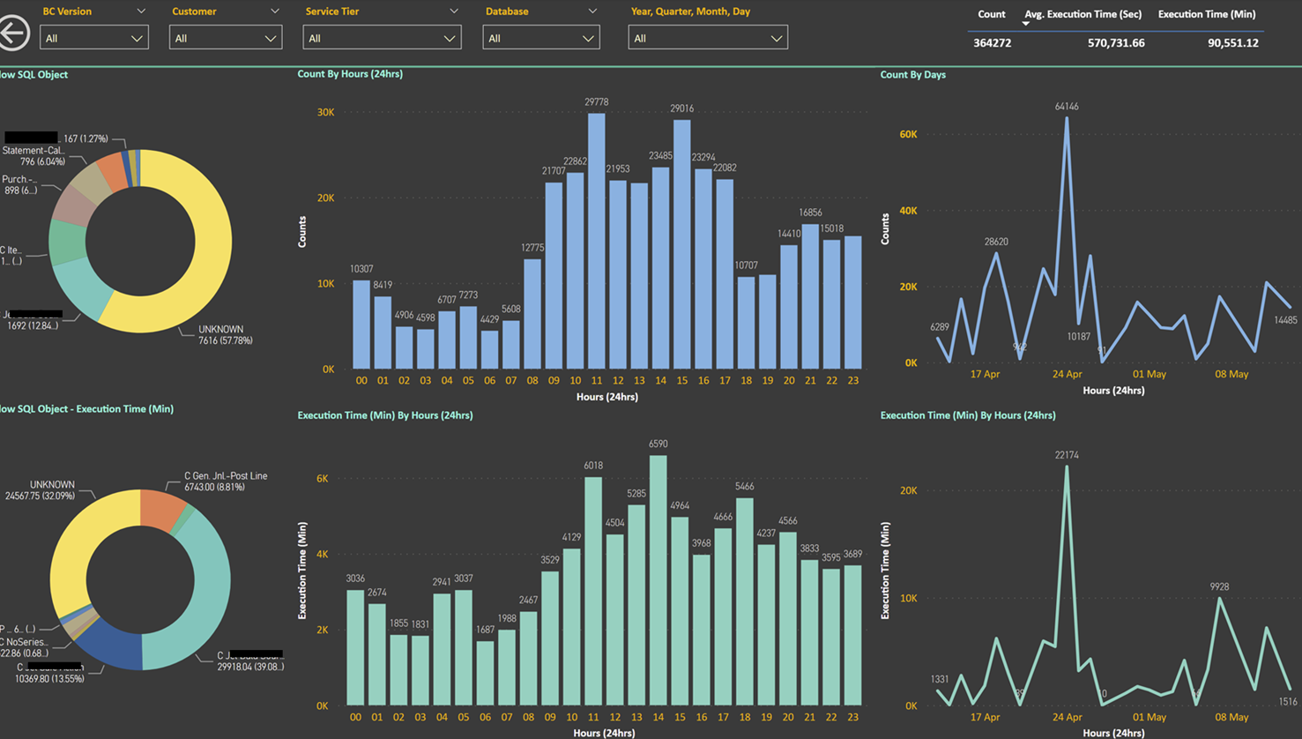

Slide 11
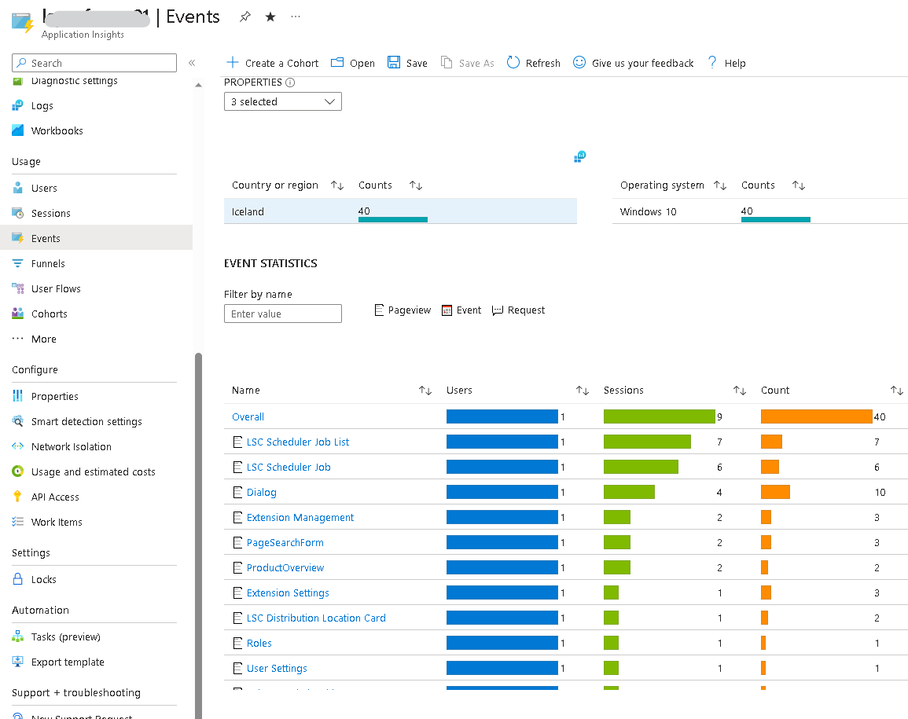
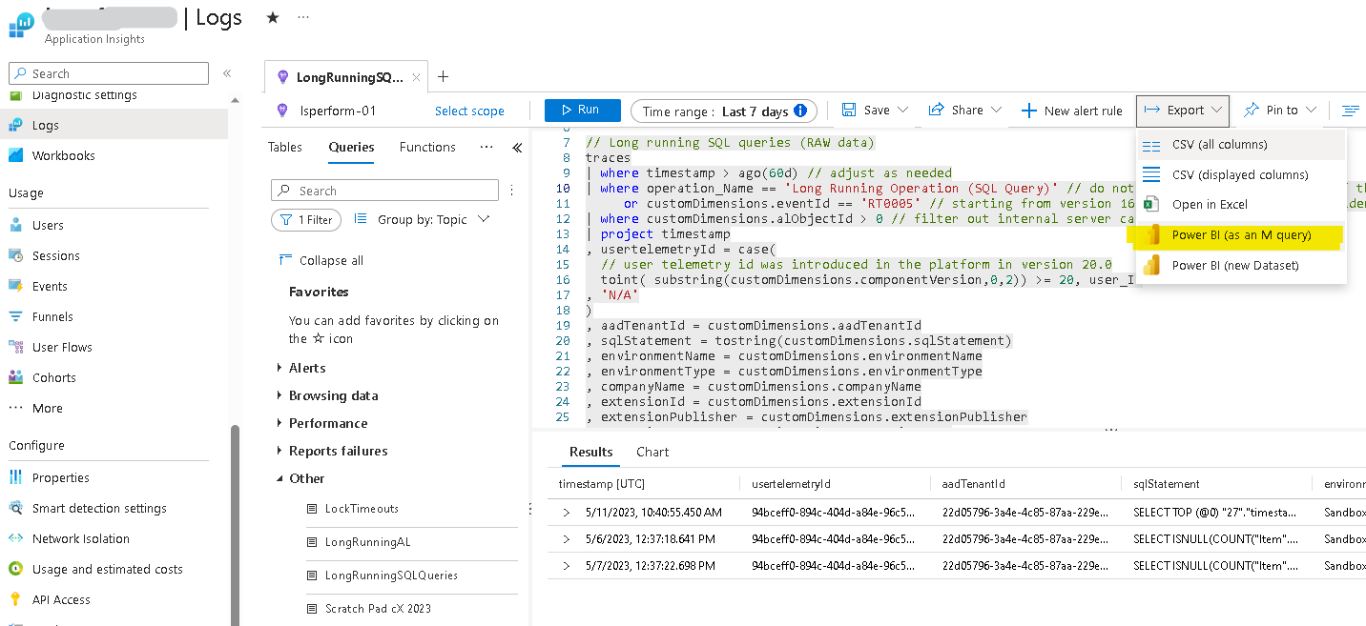
Case Study II
SaaS
Application Insights
KQL
Power BI App

Slide 12
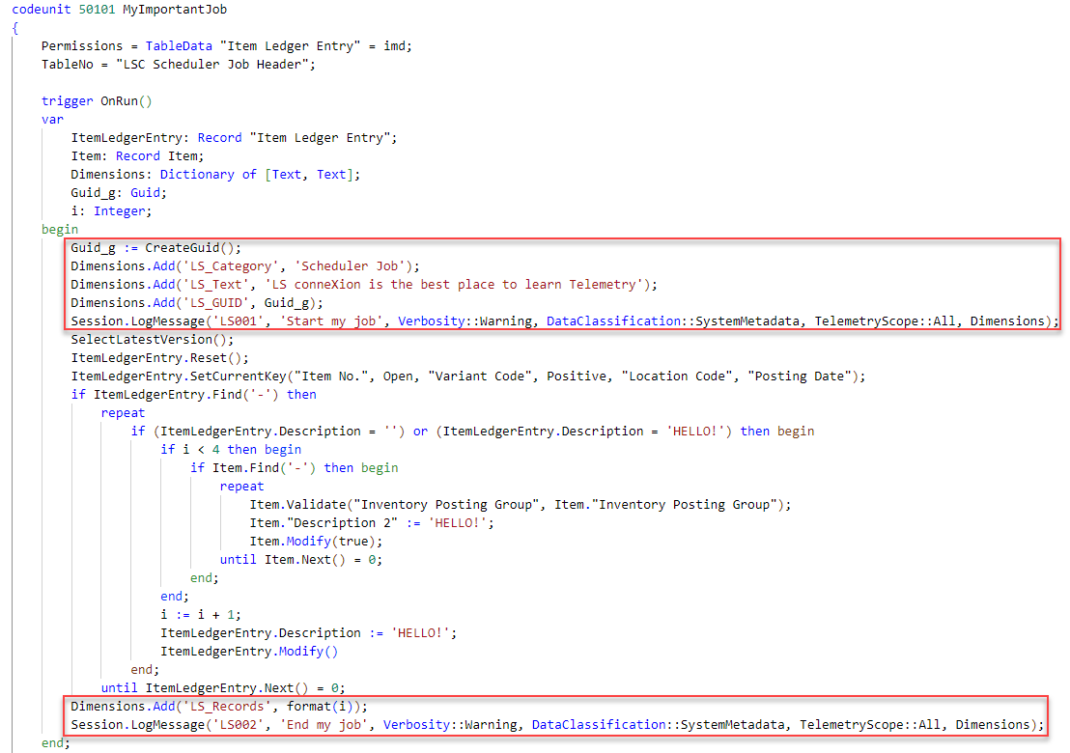
Codeunit to run in a scheduler

Slide 13
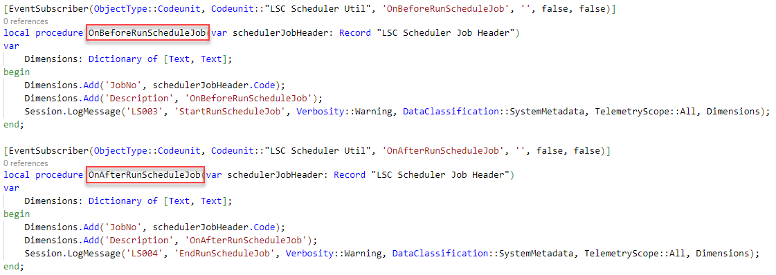
Subscribe to events

Slide 14
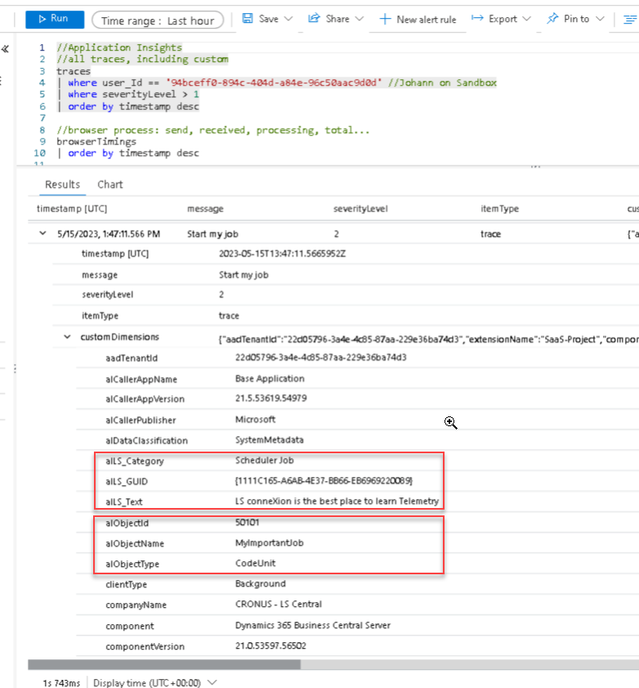
Application Insights
Data from LogMessage function
alLS_Category
alLS_GUID
alLS_Text
Data from BC
alObjectId
alObjectName
alObjectType

Slide 15
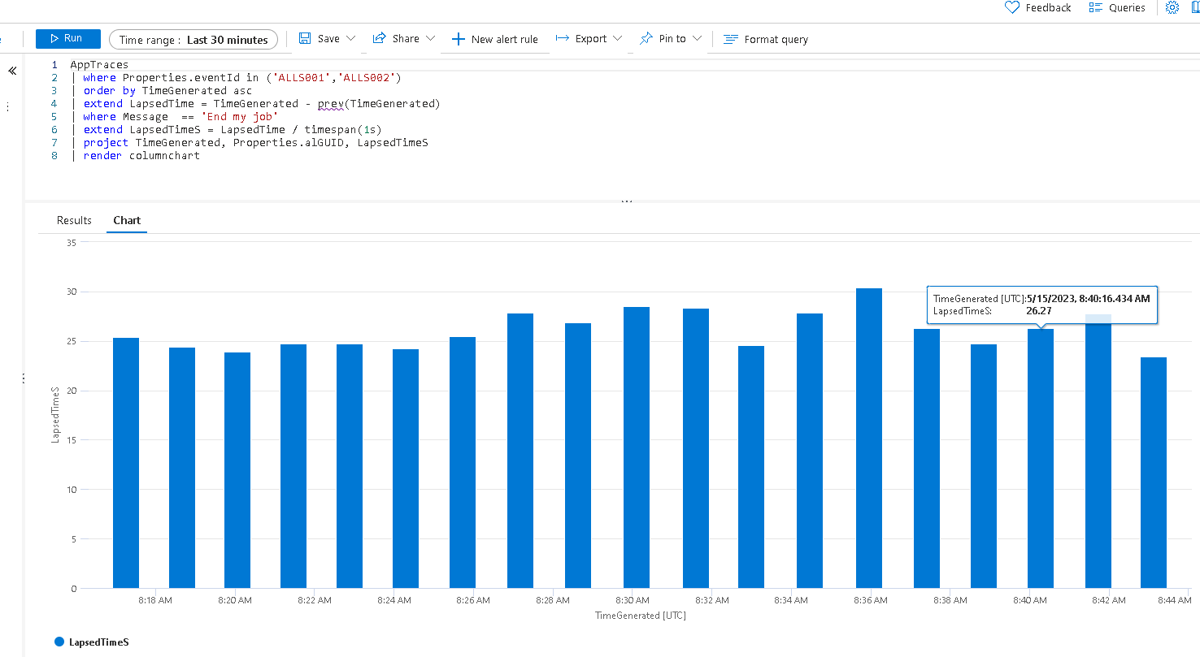

Slide 16
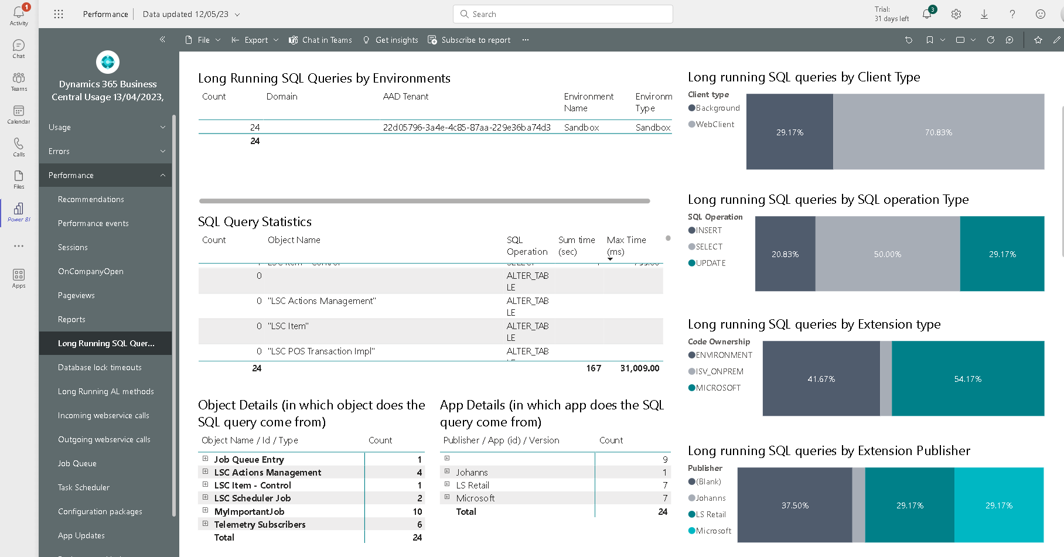

Slide 17
Resources
Telemetry in BC https://aka.ms/bctelemetry
Telemetry FAQ https://github.com/microsoft/BCTech/blob/master/samples/AppInsights/FAQ.md
Videos https://github.com/microsoft/BCTech/blob/master/samples/AppInsights/VIDEOS.md
Samples, including KQL https://aka.ms/bctelemetrysamples
Power BI App https://github.com/microsoft/BCTech/tree/master/samples/AppInsights/PowerBI/Reports/AppSource
Azure Monitor References https://learn.microsoft.com/en-us/azure/azure-monitor/overview

Slide 18
Thank you!

