Slide 2
LS Pay
Secure payments for LS Central and Business Central
Petur Thor
Sigurdsson

Slide 3


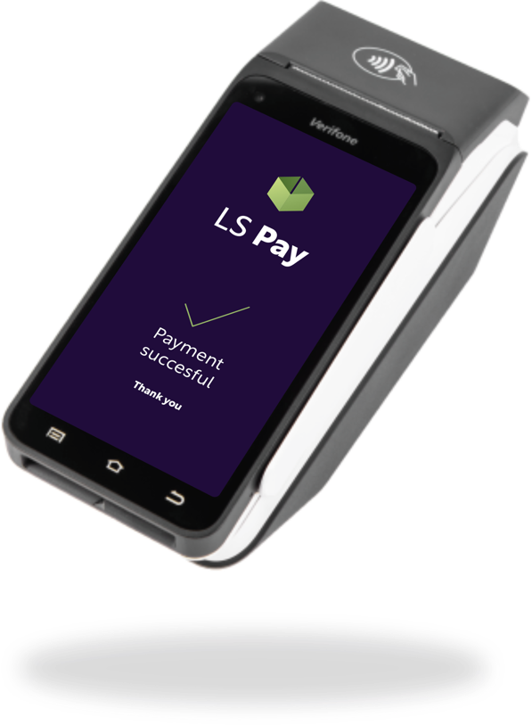
Offering EFT integrations to the leading PSPs in all our main market regions
Empowering our customers
to have a choice

Slide 4

Built on a solid base
LS Central extends Microsoft Dynamics 365 Business Central ERP
leveraging the Microsoft Dynamics 365 investment and ecosystem
More than 50,000 businesses use Business Central as their ERP
Business Central was awarded best cloud ERP of 2024 according to Forbes

Slide 5
An enhancer to LS Central since 2017
A part of LS Central’s modular architecture
LS Pay
Integration to payment providers
eCommerce
Integration
Staff Management
Staff rosters & timetables
Analytics
Reporting and data analytics
& more
Restaurants
Kitchen & menu management
Pharmacies
Dispensing and retail items
Hotels
Property management system
Forecourt
Gas stations and c-stores
& more
HQ
Back office
Stores
Product management
Prices, offers & promotions
Inventory & mobile inventory
Replenishment
POS management
Loyalty management
Store management
Chain management
ERP
Financials · Purchasing · Warehouse · Supply chain · Sales & marketing

Slide 6
80+
PSP Integrations
40+
Active PSPs
50+
Supported countries

Slide 7

Supported countries
Australia
Austria
Belgium
Brazil
Bulgaria
Canada
Chile
China
Colombia
Croatia
Cyprus
Czech Republic
Denmark
Estonia
Faroe Islands
Finland
France
Germany
Greece
Hong Kong
Hungary
Iceland
India
Ireland
Israel
Italy
Japan
Latvia
Liechtenstein
Lithuania
Luxembourg
Malaysia
Malta
Mexico
Monaco
Netherlands
New Zealand
Norway
Poland
Portugal
Romania
Saudi Arabia
Singapore
Slovakia
Slovenia
South Africa
Spain
Sweden
Switzerland
Turkey
United Arab Emirates
United Kingdom
United States

Slide 8






















Slide 9
Supported PSPs
AddPay
Adyen
AltaPay
Blikk
BNP Paribas
ClearOne
Credibanco
EFTPOS
Elavon
Fawry
FreedomPay
FIUU
Geidea
Global Payments
HagarPay
Ingenico
Linkly
Moneris
MultiPay
MX51
Nets (Nordics)
Nets (SG)
Network International
DNA
PayEx
Planet
RazorPay
Redeban
Shift4
SoftPay
Straumur
Stripe
Teya
TransaXPay
Transbank
Tyro
UnionPay
Verifone
Viva Wallet
WorldPay

Slide 10









We are trusted by these customers, and more

Slide 11



Adyen
Elavon
Planet
Worldpay

Slide 12




Adyen
Elavon
Planet
Worldpay
*Acquiring/Processing:

Slide 13
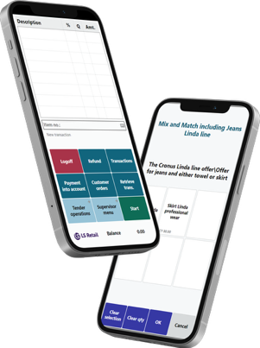
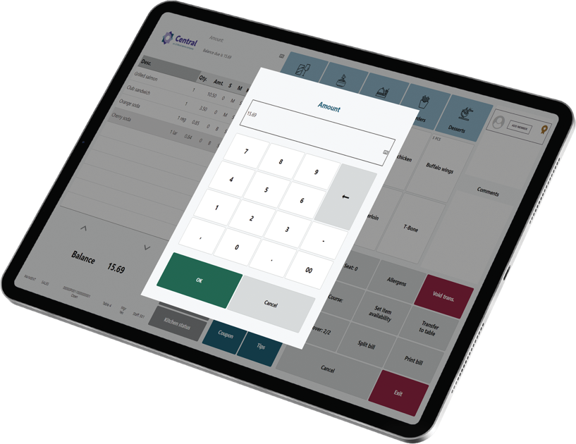

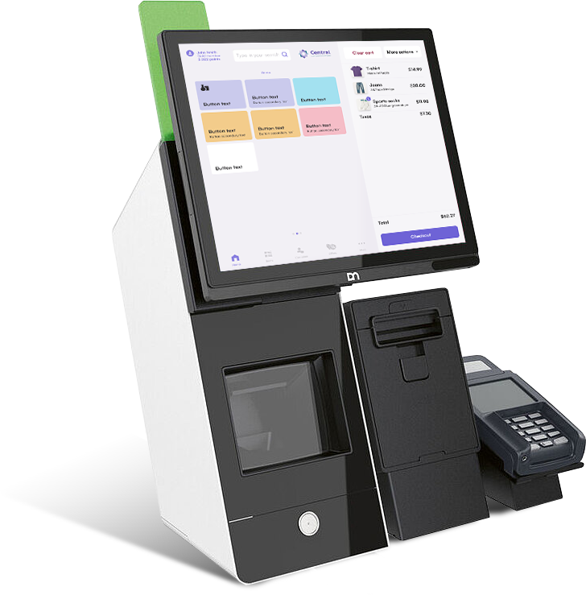
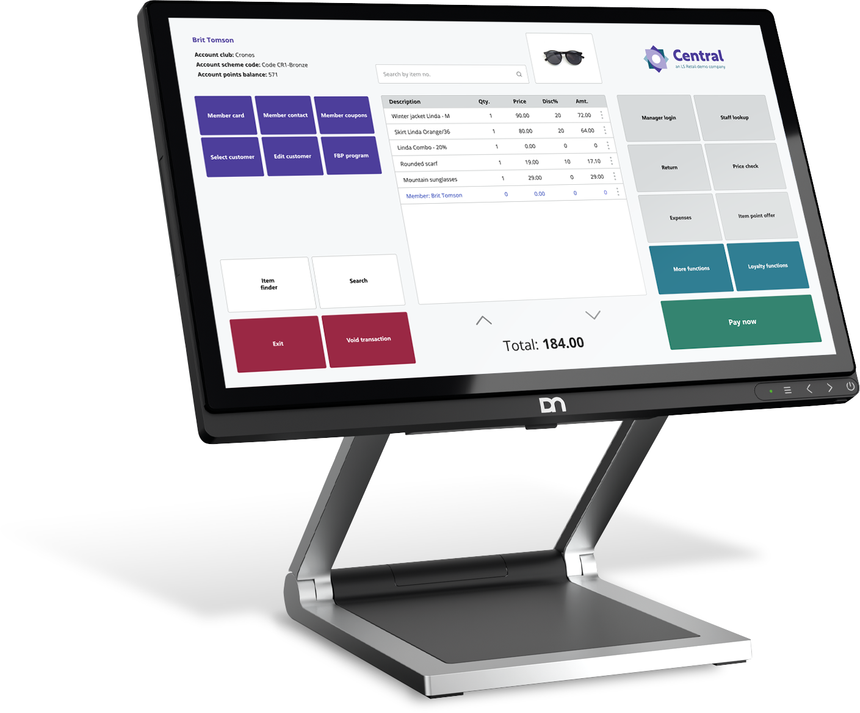
Supporting all platforms & formats

Slide 14
LS Pay for Business Central
Payment support for standard Sales Documents in BC
Published on the Microsoft AppSource

Slide 15
Businesses in scope
LS Central merchants
Requiring back-office payments
Enterprises using Business Central
Not having a Point-of-Sale solution
Selling into sales documents
  Sales Orders
  Sales Invoices
Requiring payment support
  Card-present
  Card-not-present
More than 50,000 businesses use
Business Central as their ERP

Slide 16

Adyen
Business
Central
Elavon
Planet
Worldpay

Slide 17

LS Pay Service
Adyen
Elavon
LS Pay Service
Planet
Worldpay

Slide 18
Introducing the EFT Extension
Contains all payment logic and dialogs for EFT payments
Exposes a payments API that the various solutions can interface
Connects to the LS Pay Service
A generic Business Central extension
EFT Extension
LS Pay Service

Slide 19
LS Pay – Base topology
A part of LS Central’s modular architecture
Business Central
POS
BO
HO
Hotels
EFT
Extension
EFT
Extension
EFT
Extension
POS
BO
LS Pay
App
LS Pay Service

Slide 20

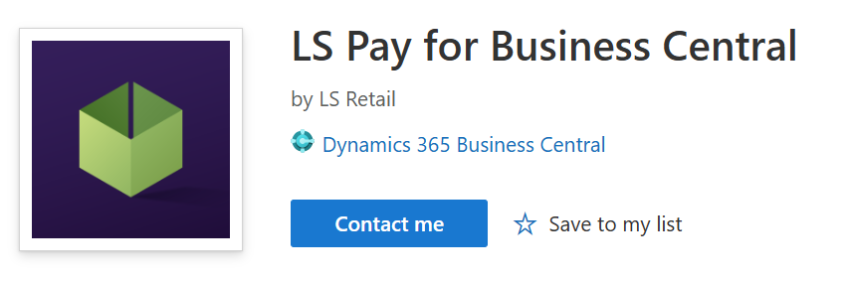
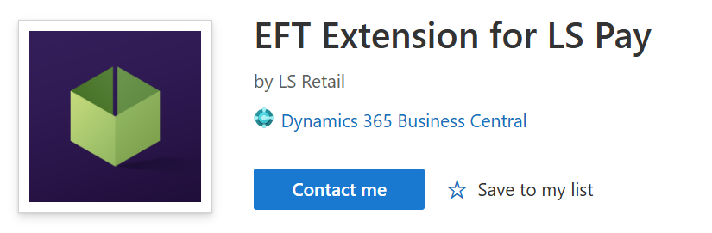
Two deployment options
Business Central
Business Central
LS Pay
App
EFT
Extension
Partner
App
EFT
Extension
Available on the Microsoft AppSource

Slide 21
Payment API
BC Sales documents operations
Purchase
Refund
Void
X & Z reports
Settlement
Payment links
Tokens
Etc.
Card present payments and returns
  Sales orders
  Sales Invoices
  Sales return orders
  Sales credit memos
Card not-present payments
  Online payment links
  Manual card number entry (MOTO)
Multiple tender types
Payment profiles

Slide 22
LS Pay for
Business Central
Demo

Slide 23
Supported countries
Europe
Austria
France
Latvia
Portugal
Belgium
Finland
Lithuania
Romania
Bulgaria
Germany
Luxembourg
Slovakia
Croatia
Greece
Liechtenstein
Slovenia
Cyprus
Hungary
Malta
Spain
Czech Republic
Iceland
Netherlands
Sweden
Denmark
Ireland
Norway
Switzerland
Estonia
Italy
Poland
United Kingdom

Slide 24
Supported countries
Americas
APAC
MEA
Brazil
Australia
United Arab Emirates
Canada
Hong Kong
Mexico
Japan
Puerto Rico
Malaysia
United States of America
New Zealand
Singapore

Slide 25






Supported
PSPs

Slide 26


Security
LS Pay is out of scope for PCI DSS certifications
LS Pay is out of scope for PCI DSS related vulnerabilities

Slide 27


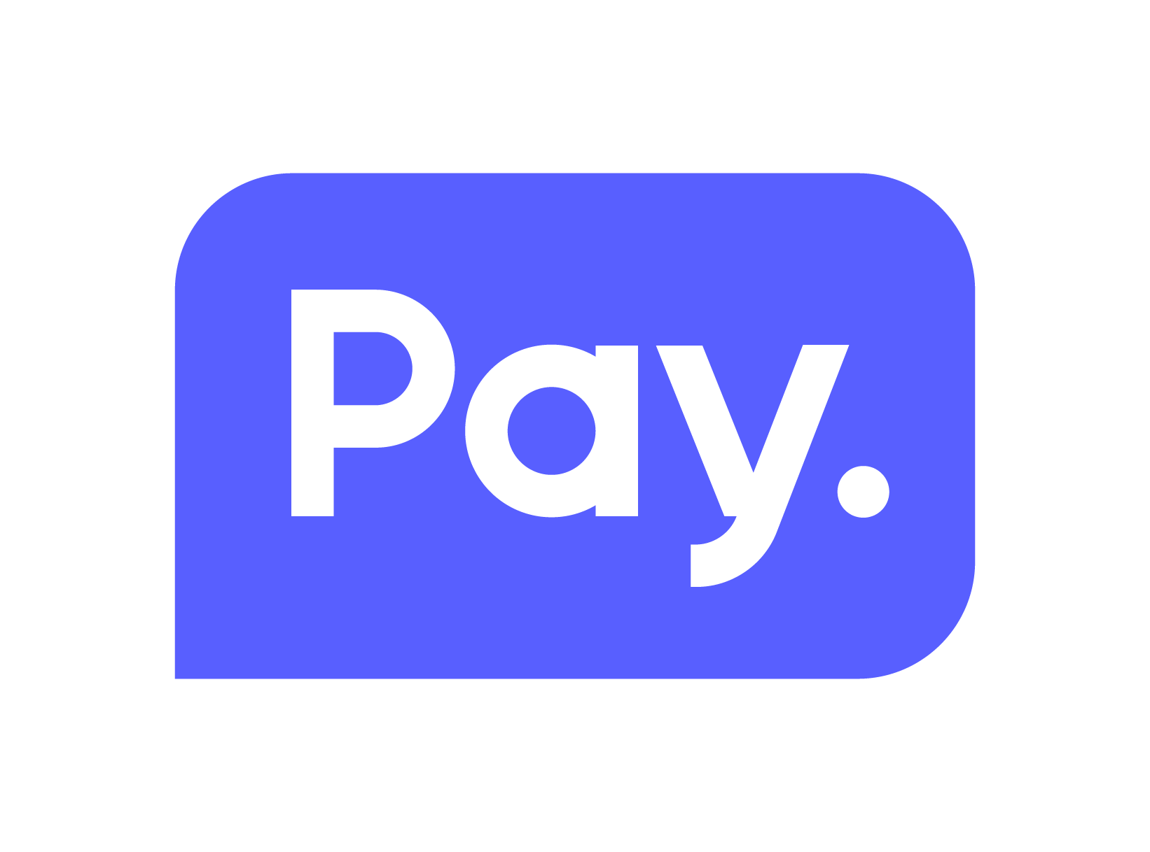



Roadmap
Automatic reconciliation
Virtual terminal support
Service orders support
Tokenization / Token storage
  Card on file
  PreAuth & Full Capture

Slide 28


Integrations via our Professional Services

Slide 29


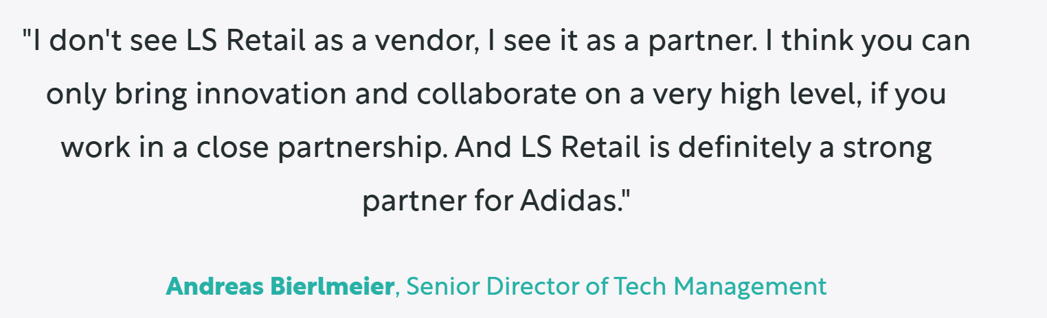

Slide 30

Rapid integrations
Statement of Work (SOW)
  Contract for delivery
  Time and material
Short lead time
  Next available consultant
Development
  Typical timeline is approximately 3 months
    Development and certification
  Full support from the LS Pay team
  Using LS Pay’s development processes
Deployment
  Integration is incorporated into standard LS Pay, with continuous maintenance and support provided

Slide 31
How to get started?
Available on the Microsoft AppSource

Slide 32
Licensing
Same license model as with LS Pay for LS Central
The number of LS Pay licenses equals the number of connected pin pads (PEDs)
SaaS, on prem subscription or on prem perpetual
Pricelist available on the LS Retail portal or by demand

