Slide 3
Intelligent Cloud Suite
add intelligence to your ERP!
LS Insight
LS Recommend
LS Forecast
Martin Kleindl
Product Director
Martin.Kleindl@LSRetail.com

Slide 4
Dubrovnik

Slide 5
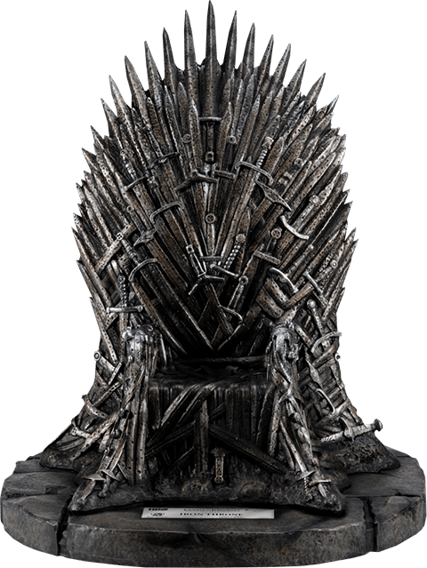

Slide 6
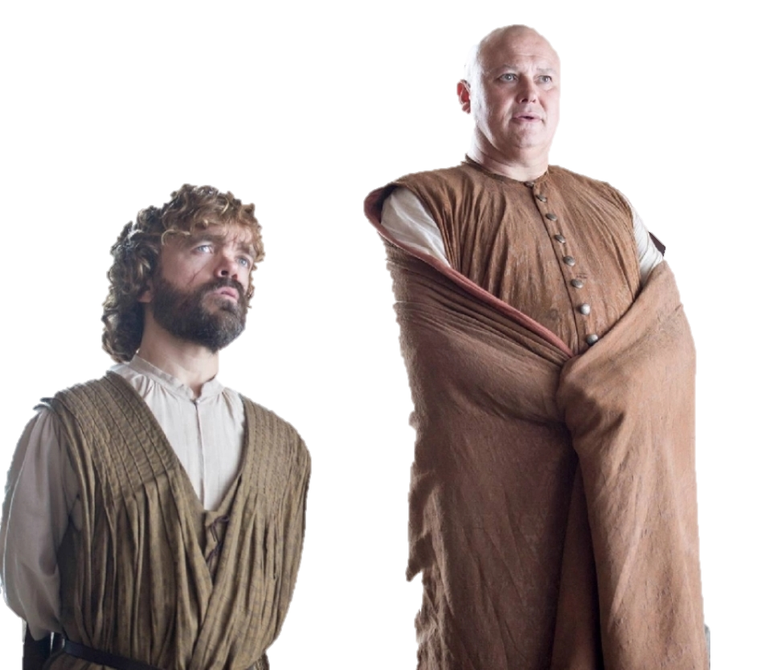

Slide 7
Intelligent Cloud Suite

Slide 8
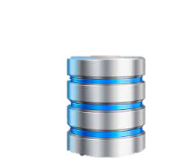
Intelligent Cloud Suite
LS Insight (Datawarehouse & Analytics)
LS Central (ERP)

Slide 9
Intelligent Cloud Suite
New release: Q1 2022
LS Recommend
LS Forecast
LS Basket Analysis
LS Insight (Datawarehouse & Analytics)
LS Central (ERP)

Slide 10
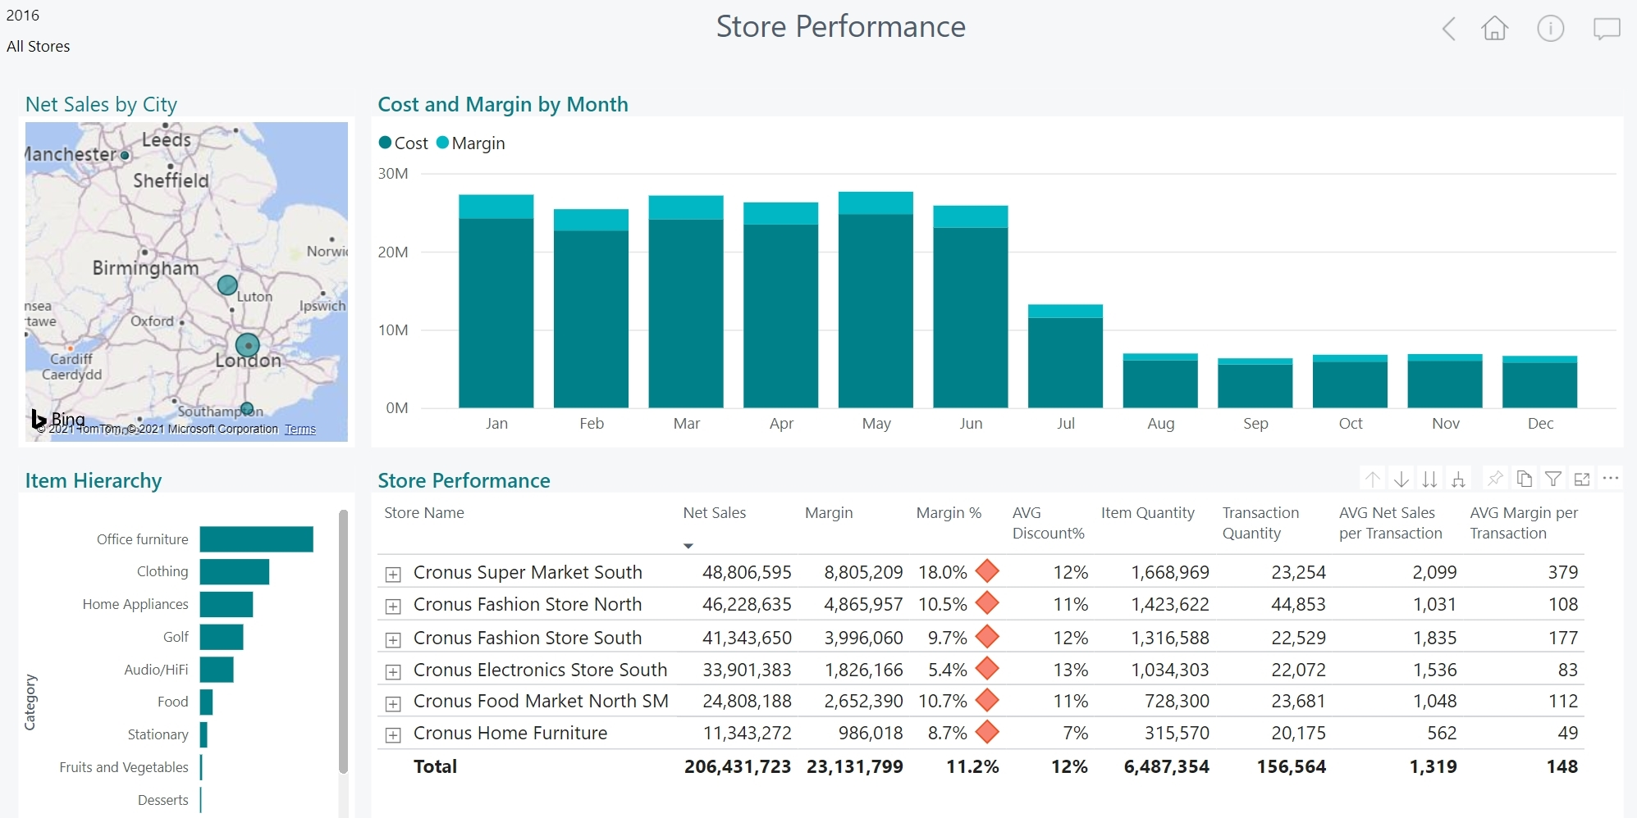
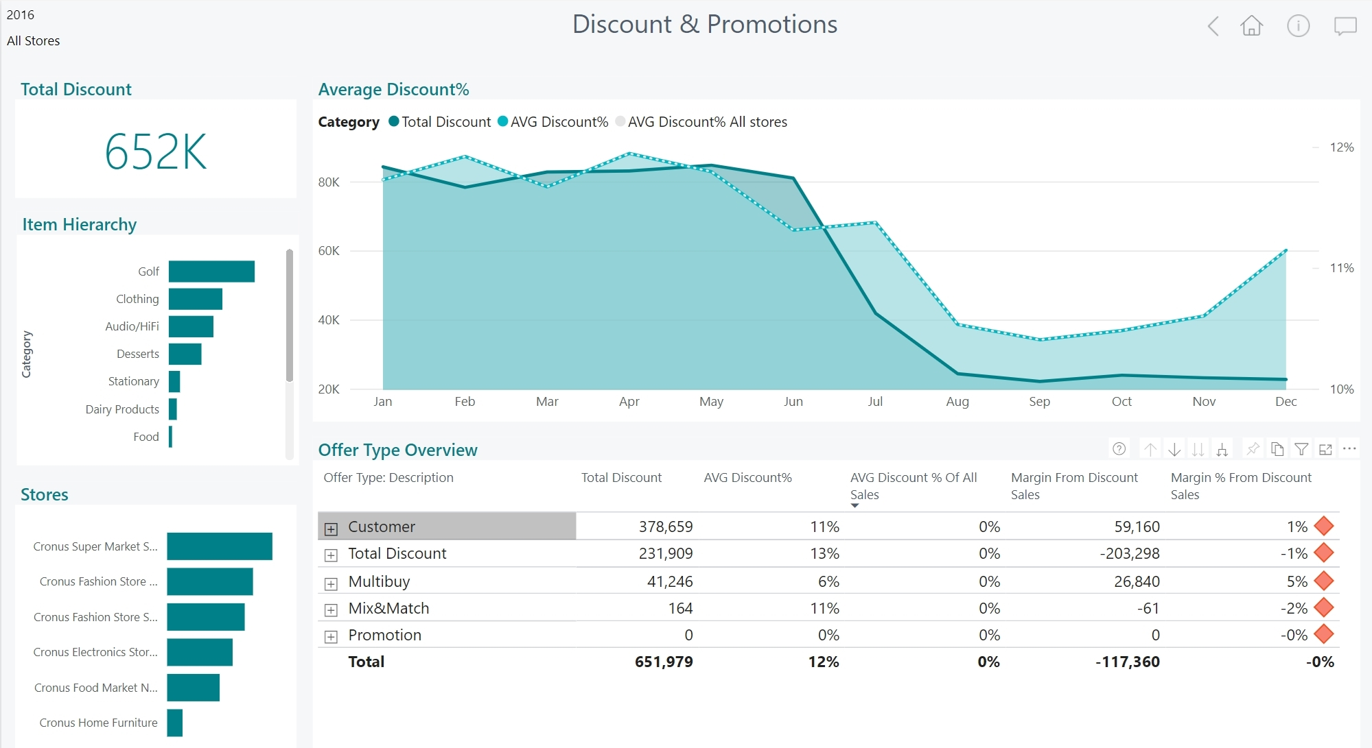
LS Insight
Datawarehouse and Analytics platform
Datawarehouse built on Azure SQL (Cloud)
Open, easy to extend with other data sources
Reports and Dashboards based on Power BI
Browser based, supports mobile devices
Report templates for Sales, Inventory, Supply Chain, Actionable Insights and Hotels. More to come
Hosted by customers
Access actionable reports. Take better business decisions.

Slide 11
LS Insight
Architecture options
LS Central On-prem → LS Insight Cloud (Azure Data Factory)
LS Central Cloud → LS Insight Cloud (Data Director & Webservices)
LS Central On-prem → LS Insight on-prem (SQL Server Int. Services or Data Director, Azure Data Factory)
LS Central Cloud → LS Insight on-prem (evaluating demand, Data Director & Webservices)
Cloud
On-premise
Azure Data Factory
Data Director Webservices

Slide 12
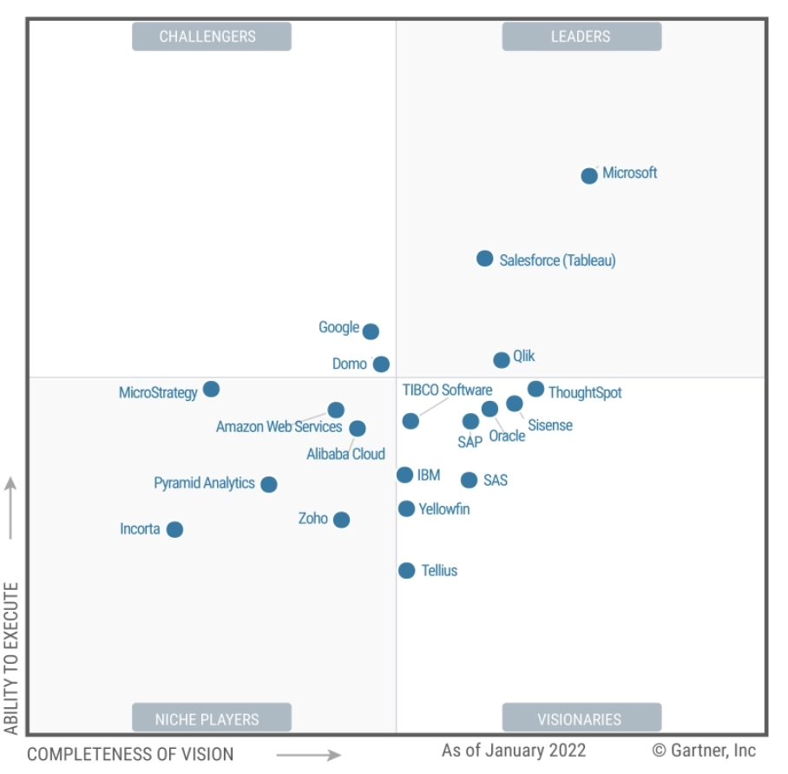
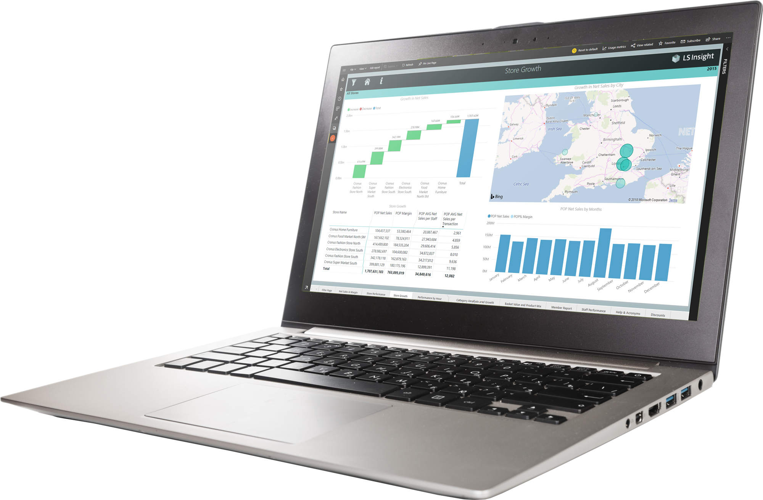
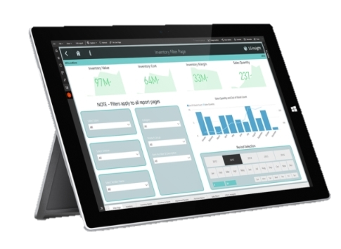
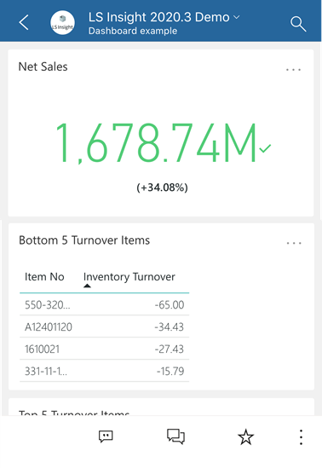
LS Insight
Gartner®
^{March 2022} PBI named as Leader in Analytics & BI Platforms and scored highest for the 4th consecutive year. ^{Microsoft Power BI has helped} ^{over 250,000 organizations} including 97 percent of Fortune 500
*) Magic Quadrant for Analytics and Business Intelligence Platforms, from 2013 – 2022

Slide 17
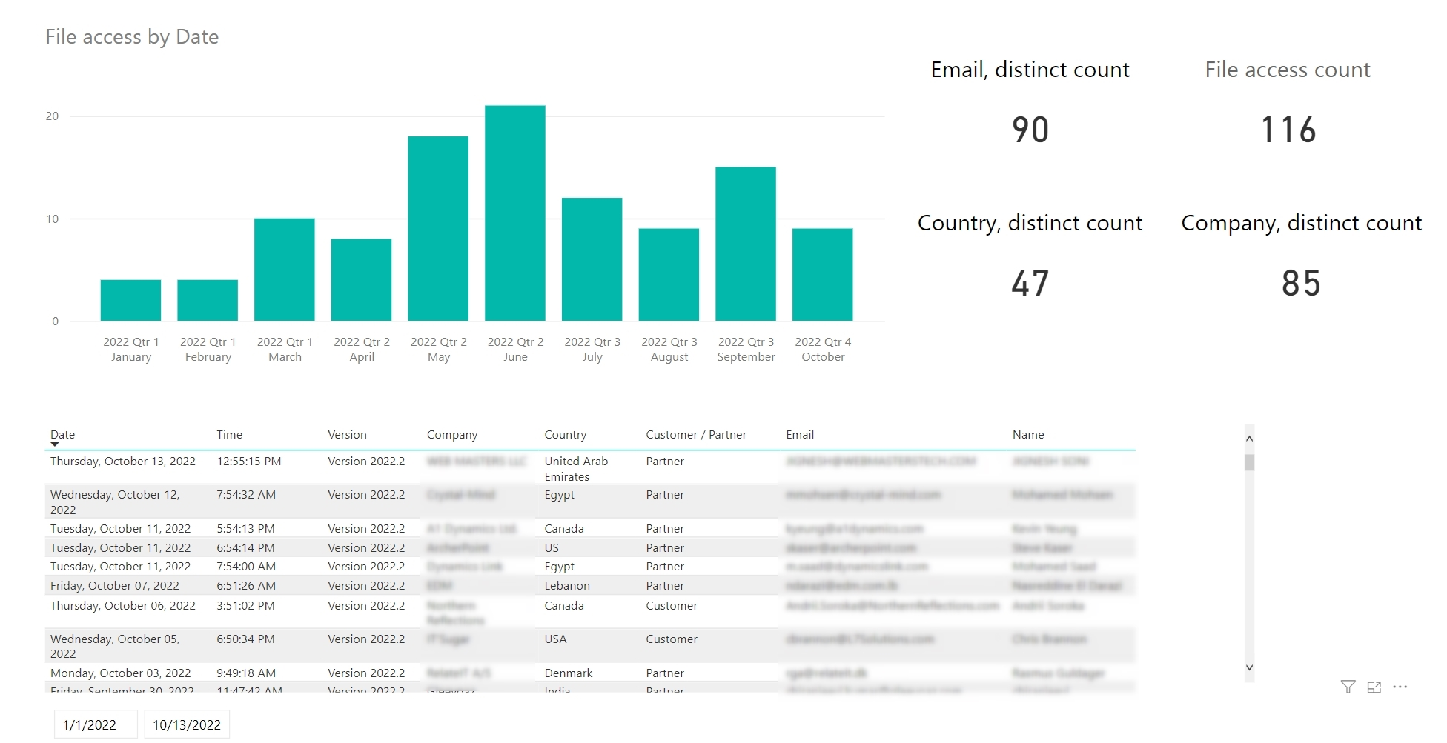
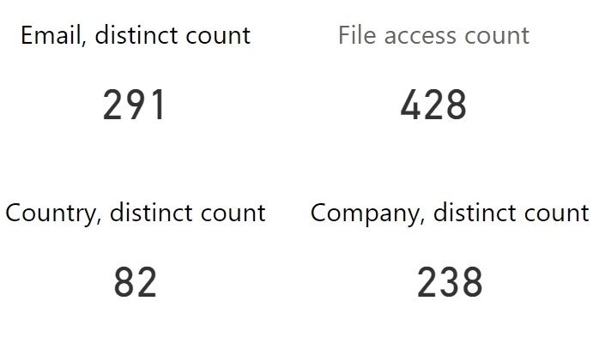
Since 2020 (when we started logging)

Slide 18
Try it
Request form: https://portal.lsretail.com/Products/LS-Insight
Get product files
Follow onboarding instructions, Done!
Documentation
LS Retail Online Help, LS Insight https://help.lscentral.lsretail.com/
PowerBI readiness
Documentation https://docs.microsoft.com/en-us/power-bi/
Learning https://docs.microsoft.com/en-us/learn/
How to get started ?

Slide 19
LS Recommend
Machine learning solution
Azure cloud-based solution
Software as a Service (SaaS)
Easy to start
Low risk
Pay as you go

Slide 20
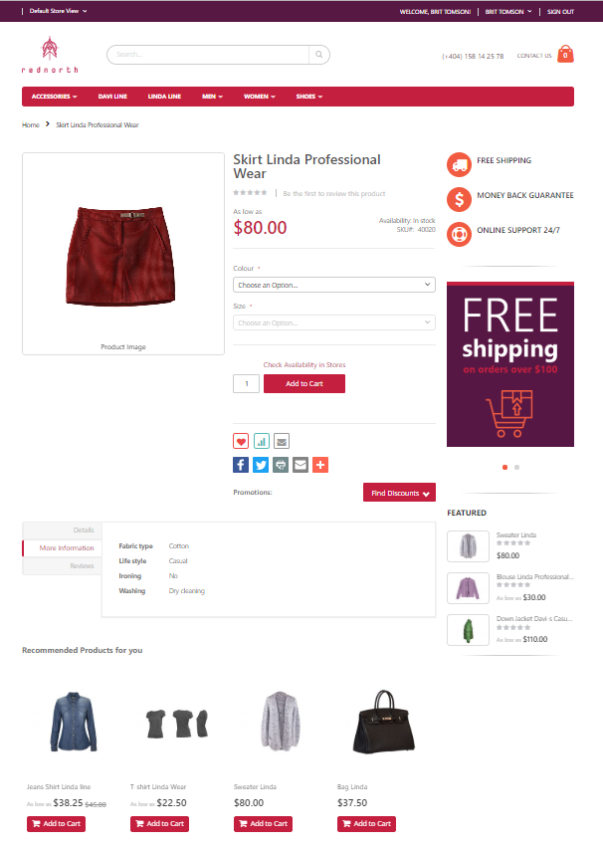
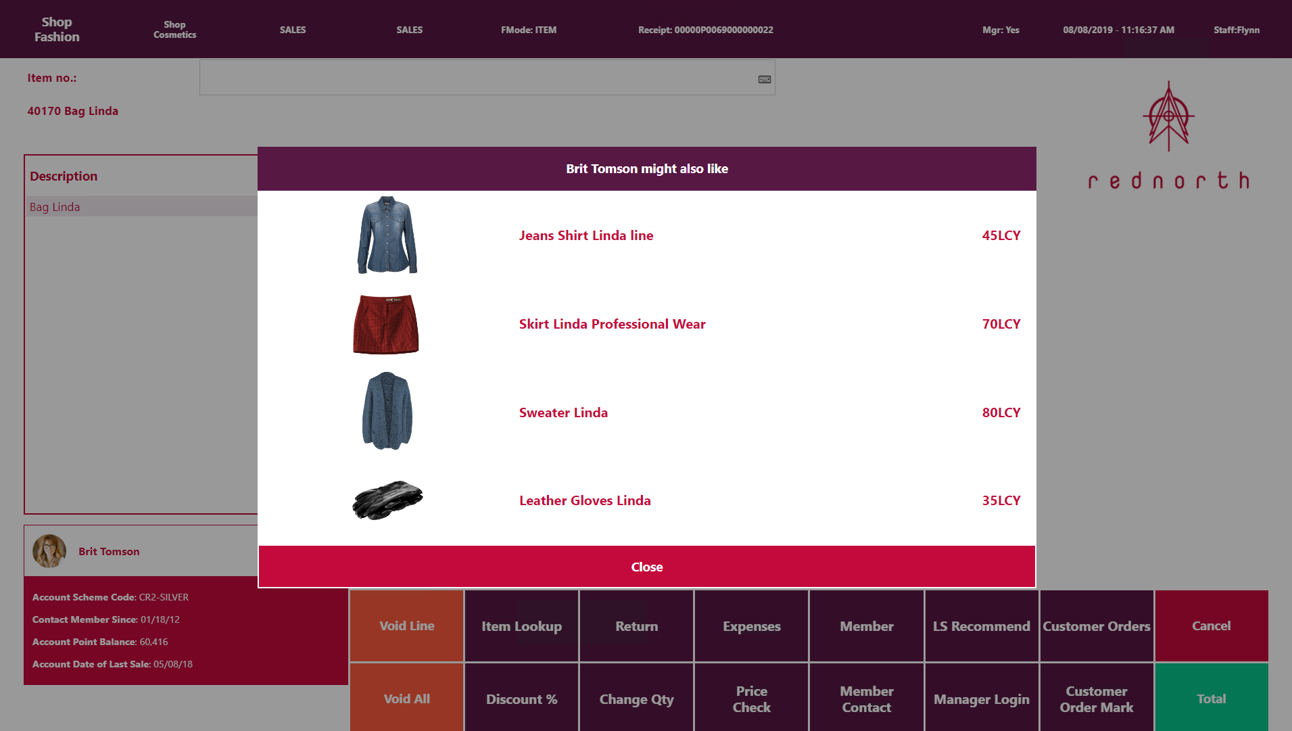
LS Recommend
Product recommendations
Basket analysis and Recommendation engine
Provides targeted, personalized suggestions based on your shopping history and preferences
Optimized upselling and cross-selling
Supports POS and eCommerce
SaaS solution - hosted by LS Retail
Know what your customers want, before they do through machine learning

Slide 21
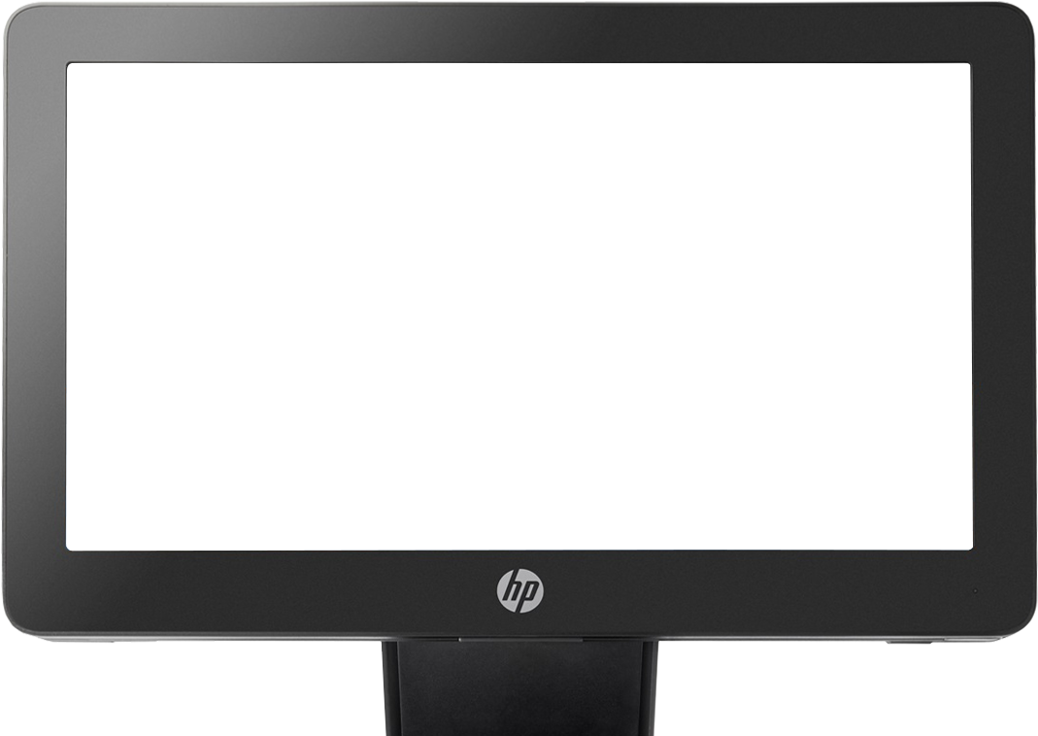
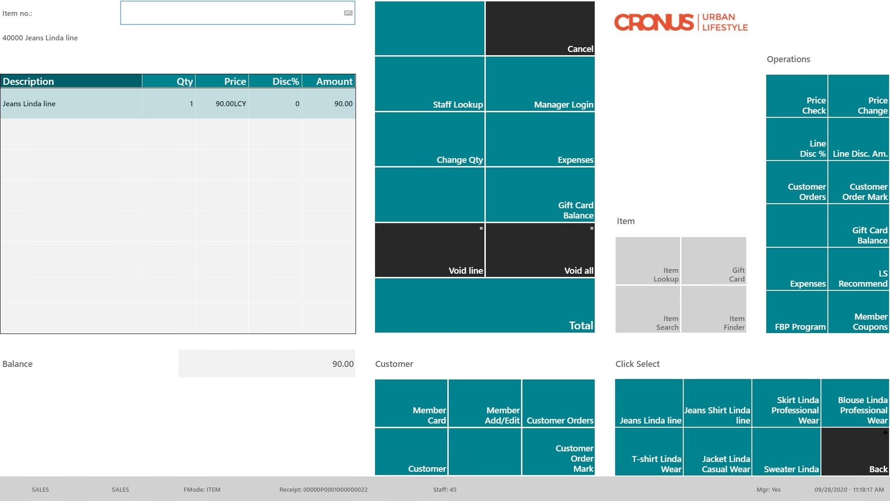
Item “Jeans” in the sale

Slide 22
Item “Jeans” in the sale
Recommendation triggered manually or when pressing “TOTAL”

Slide 23
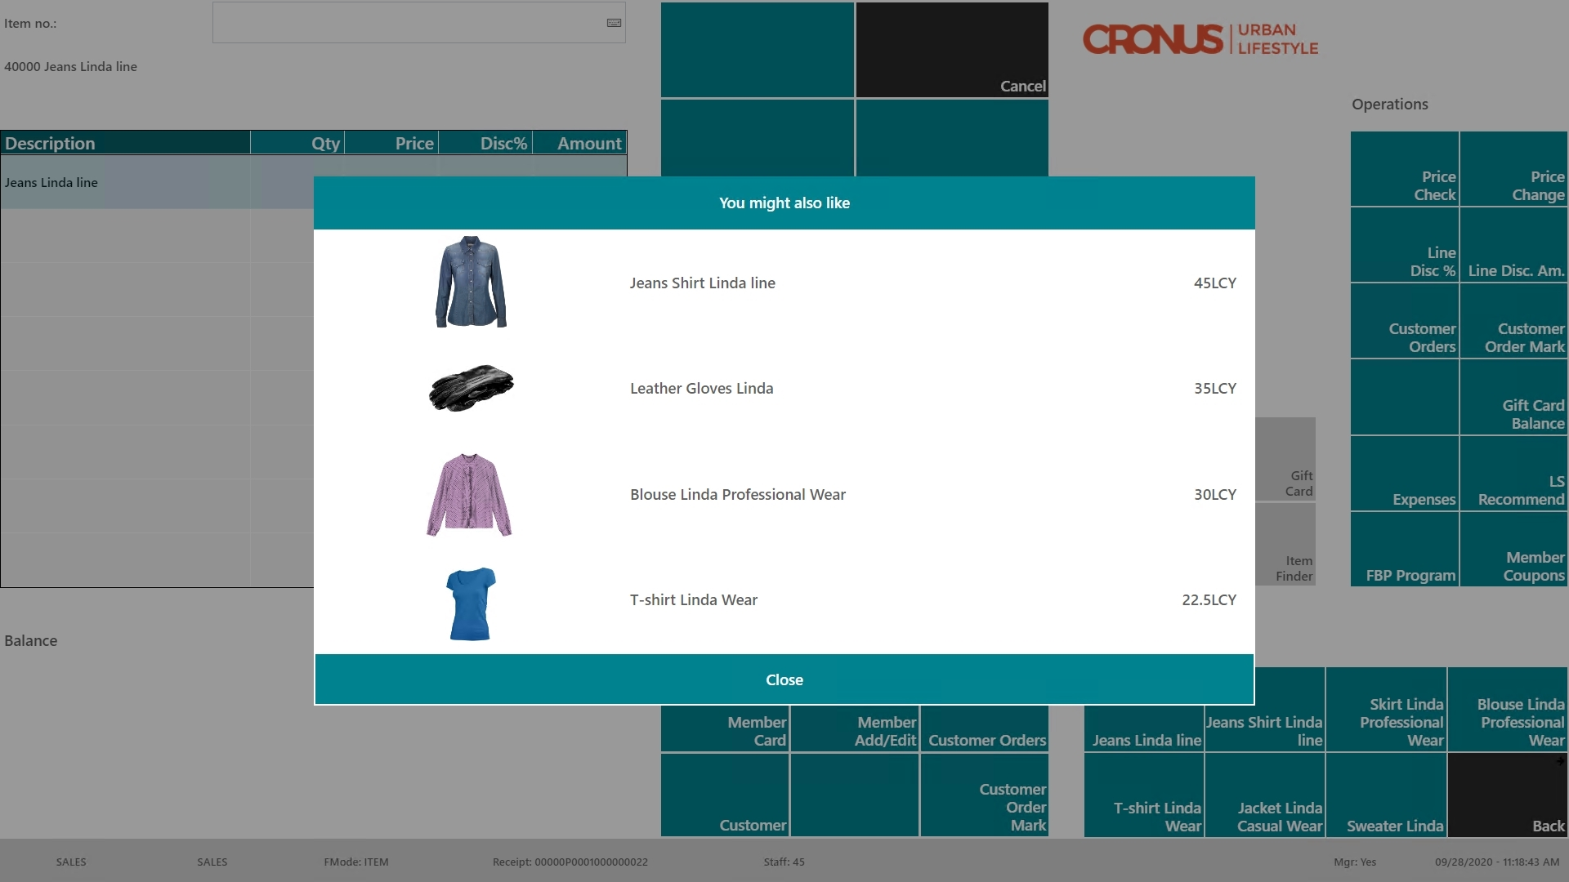
Item “Jeans” in the sale
Recommendation triggered manually or when pressing “TOTAL”
Recommendation page with options

Slide 24
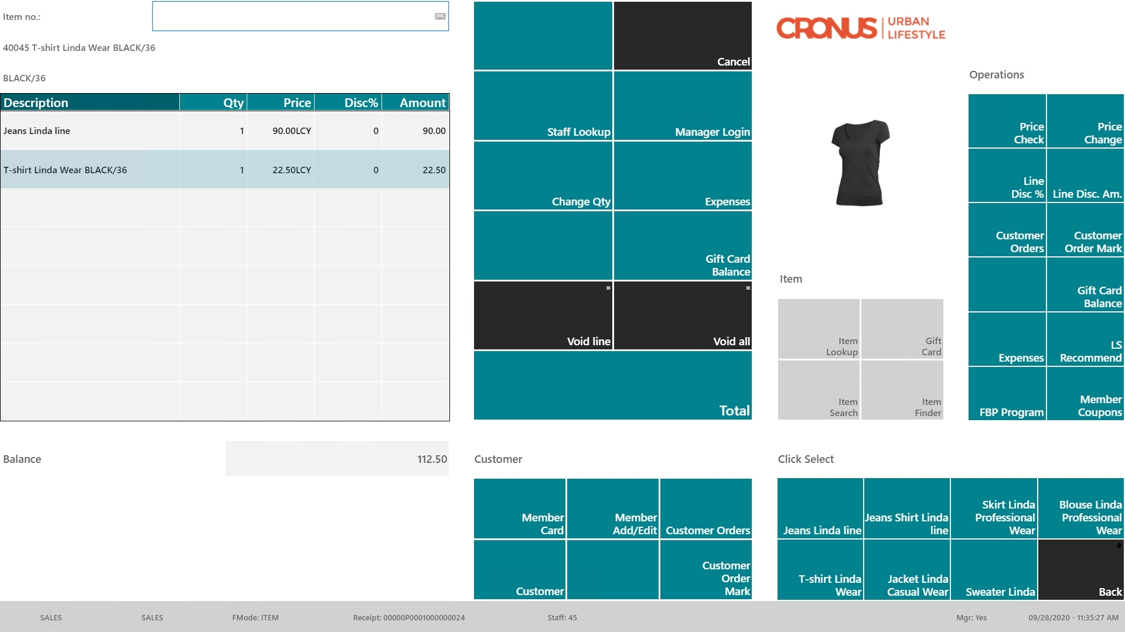
Item “Jeans” in the sale
Recommendation triggered manually or when pressing “TOTAL”
Recommendation page with options
Item “T-Shirt” added

Slide 25
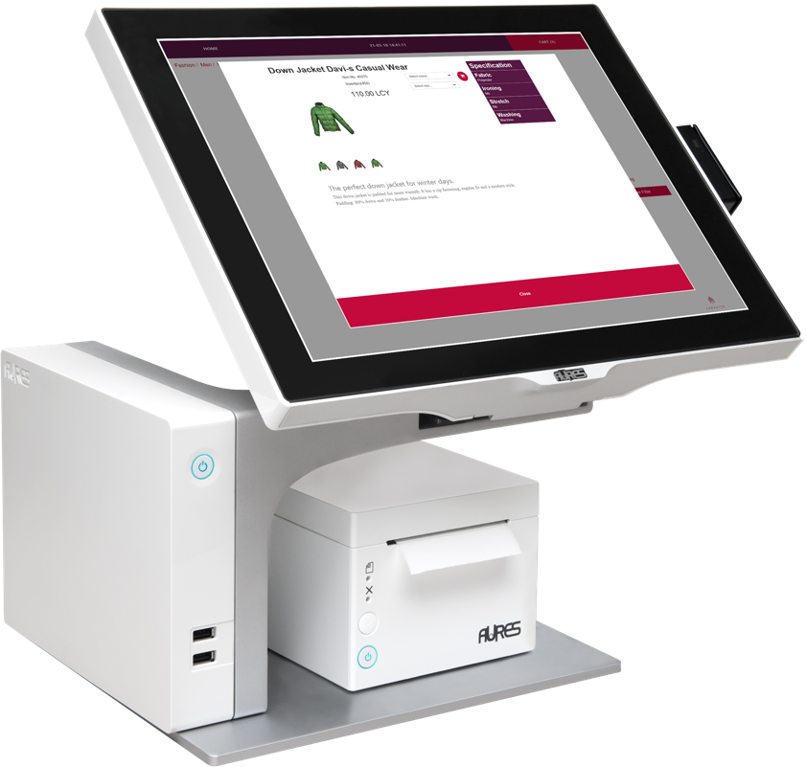
LS Recommend
Model calculation
Version 2 available (LS Central 19.5)
Supports LS Central SaaS
Simplified setup in LS Central
Faster Model calculation
Improved scalability with Model Readers
Pricing model change
Now based on considered Transaction Sales Lines during calculation
Model download
Model Reader
Model Reader
Recomm- endation

Slide 26
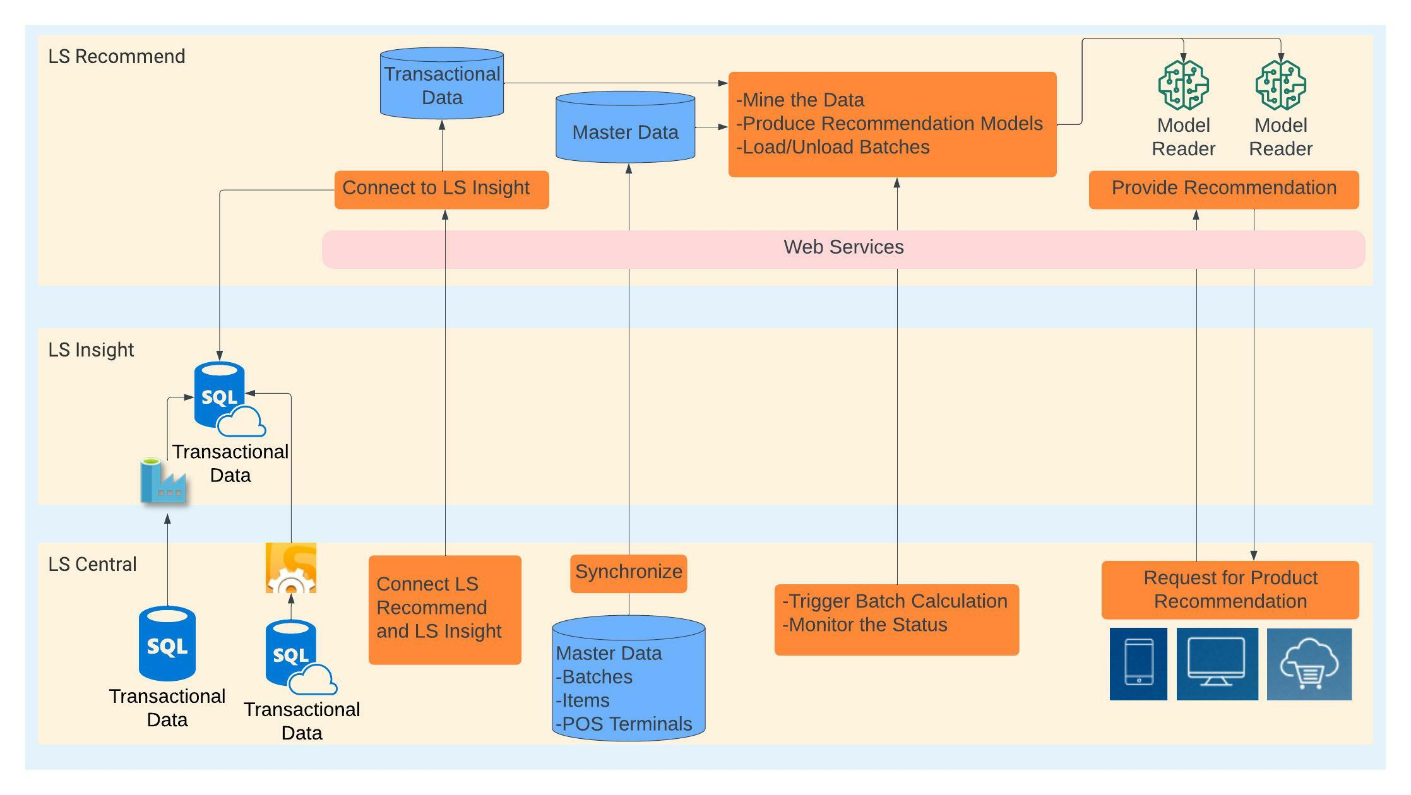
LS Recommend
hosted by LS Retail
hosted by customer
operated by customer

Slide 27
PRICE MODEL
Cost per run
Billed monthly
(calculated from considered Transaction Sales Lines)
Pack LSREC-10M
Pack LSREC-50M
Pack LSREC-100M
Pack LSREC-1B
(0 – 10M TSL)
(10M – 50M TSL)
(50M – 100M TSL)
(100M – 1B TSL)
Fixed cost:
decreasing price; price per 1 Mio Trans. S. Lines
Base pack (includes 1 Model Reader)
Additional Model Readers
Invoice:
1 x Base Pack 0 x Add. Model Reader
1 x LSREC-50M (30@ 3€)
1 x LSREC-100M (90@ 2€)
Calculation (30 Mio TSL)
Calculation (90 Mio TSL)
250,00 0,00
90,00
180,00
End of month:
01.04
30.04
Pack LSREC- 50M 30 * 3€ = 90,00€
Pack LSREC- 100M 90 * 2€ = 180,00€
Total
520,00
* example prices for explanation

Slide 28
How to get started?
Try it
Reach out to LS Retail’s Partner Operations team or the responsible Sales Manager in your region
Subscribe for LS Recommend service
Receive account information for setting up the module
Install LS Insight (it’s free!!)
LS Central
Base setup, Define items to be considered
Upload sales history, calculate model, GO!
Resources
LS Retail Academy course (available soon)
Documentation, Online Help https://help.lscentral.lsretail.com/

Slide 29
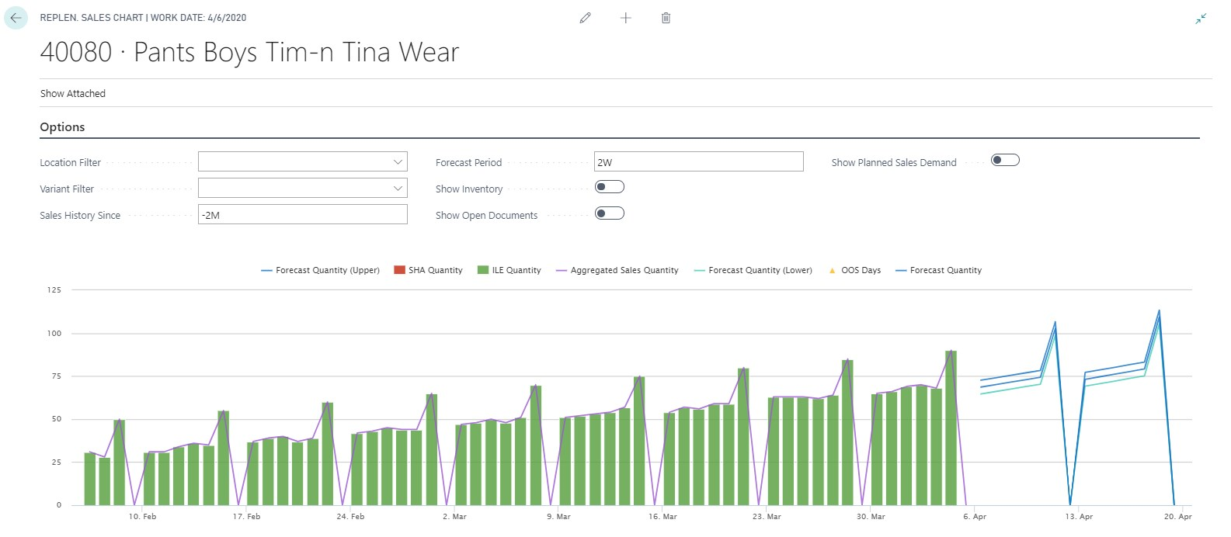
LS Forecast
Forecast with Quality measurement
Sales History

Slide 30
LS Forecast
Advanced sales forecasting for everyone
Predicts future sales based on sales history
Improves availability
Reduces out-of-stock situations
Automatic forecast model selection
Turn-key solution, no data scientists needed
SaaS solution - hosted by LS Retail
Increase availability and sales with advanced sales demand forecasts
Sales history
Forecast

Slide 31
LS Forecast
LS Forecast:
Turn-key solution
Seamless integration with Replenishment
No data scientists/experts needed
Advanced demand forecasting for everyone
LS Replenishment
Planning & Data Maintenance
Manual Replenish- ment
Automatic Replenish- ment
Execution
Monitoring
Sales & Purchase Budgets
Allocation Plans
Buyer‘s Push, Stock Recall
Allocation Rules
Variant Weight Dim. Pattern
Demand Forecasts
Store Stock Redistribution
Purchase & Transfer Orders
Stock Requisition
Buyer‘s Workbench
Inventory and Demand
Store Capacity
Stock Coverage
Vendor Performance
Open to Buy
Assortment Mgmt.
Lifecycle Mgmt.
Replenishment Journal Calculation
Threshold Mgmt.
Lifecycle Planning WS
Cross Docking
Manual Purch. & Transfer Orders
Replen. Item Quantity Calculation
Out-of-Stock Calculation
Item Import

Slide 32
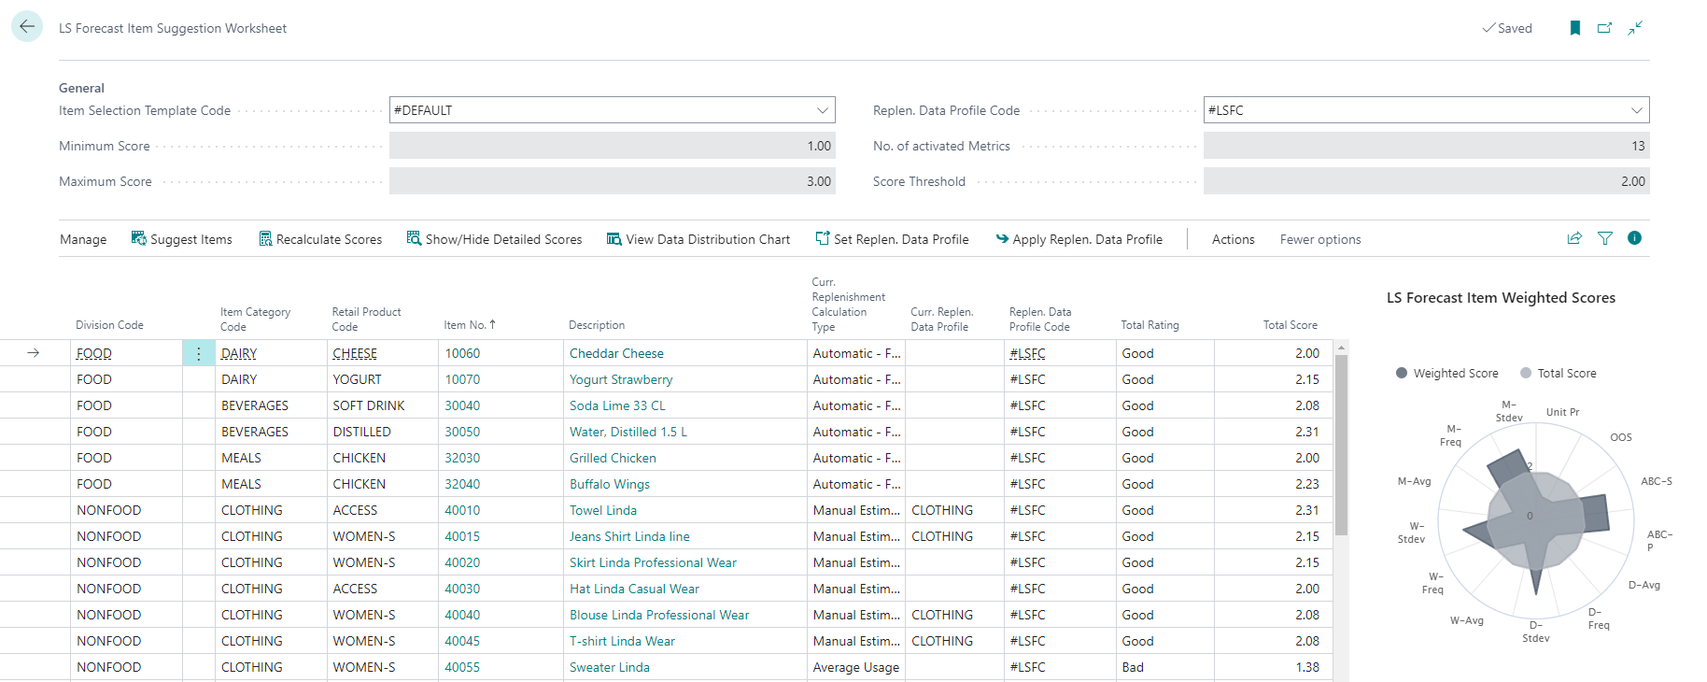
LS Forecast: Item Suggestion Worksheet
Tool for partners and customers
Identify good item candidates
Scorecard approach with weights
Easy, simple, fast
Total Rating
Total Score

Slide 33
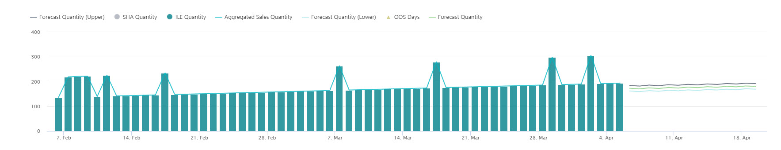
LS Forecast: additional dimensions
40300 – Linda Sleeveless Dress
Without dimension:
RRR R R R R R R
With dimension RAIN:

Slide 34
LS Forecast: additional dimensions
40300 – Linda Sleeveless Dress
Without dimension:
RRR R R R R R R
With dimension RAIN:
RR R R R

Slide 35
LS Forecast: additional dimensions
40300 – Linda Sleeveless Dress
With dimension RAIN and lift values:
RR R R R

Slide 36
LS Forecast: additional dimensions
What we do
RRR R R R R R
RR R R R
New table for “RAIN” history
New table for “RAIN” forecast

Slide 37
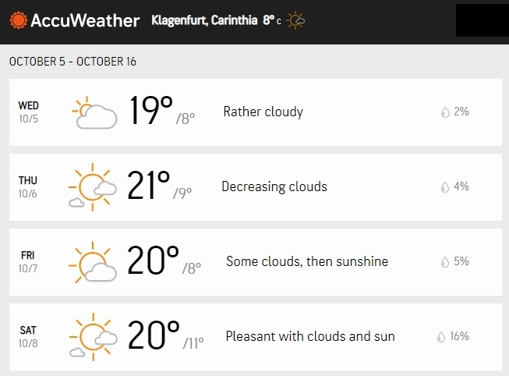
LS Forecast: additional dimensions
Additional dimensions
Affects: Enables LS Forecast to forecast based on weather data, etc.
Solution:
Detect dimension patterns in time series
5 Location based dimensions
2 Item based dimensions
Integration to Replenishment
Out of the Box integration with AccuWeather ☺
Easy to extend for your dimensions

Slide 38
PRICE MODEL
Cost per run
Billed monthly
(calculated from Item/Variant/Location calculations per run)
Pack LSFC-10k
Pack LSFC-50k
Pack LSFC-100k
Pack LSFC-500k
Pack LSFC-1M
(0 – 10k calculations) 5,98€
(10k – 50k calc.) 2,98€
(50k – 100k calc.) 2,49€
(100k – 500k calc.) 1,80€
500k – 1Mio calc.) 1,20€
No fixed cost
decreasing price; price per 1000 calculations
Invoice:
1 x LSFC-50k (30@ 2,98€)
1 x LSFC-100k (90@ 2,49€)
Run 1 (30.000 calc.)
Run 2 (90.000 calc.)
89,40
224,10
End of month:
01.04
30.04
Pack LSFC- 50k 30 * 2,98€ = 89,40€
Pack LSFC- 100k 90 * 2,49€ = 224,10€
Total
313,50
* example prices for explanation

Slide 39
How to get started?
Try it
Reach out to LS Retail’s Partner Operations team or the responsible Sales Manager in your region
Subscribe for LS Forecast service
Receive account information for setting up the module
Install LS Insight (it’s free!!)
LS Central
Base setup, Define items to be considered
Upload sales history, calculate model, GO!
Resources
LS Retail Academy training
Documentation, Online Help https://help.lscentral.lsretail.com/

Slide 40
The future
LS Insight New report packs (hotel & hospitality) Alternative approach for data load (via Azure Data Lake)
LS Forecast Generic Forecasts
LS Recommend Improvements based on your feedback
LS Basket Analysis Basket analysis solution to calculate correlations in sales history Will affect: - Assortment decisions - Promotions and Discount Offers

Slide 41
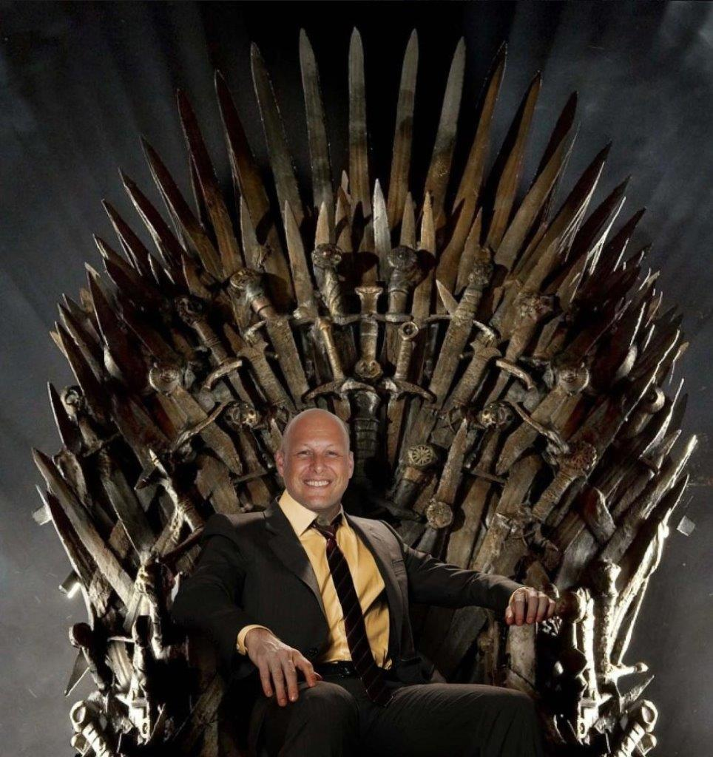
?

Slide 43
Questions?

