Slide 1
Performance in Business Central:
Analysis, testing, development practices
Aleksandr Drogin
Solution Architect

Slide 2

When do we experience performance issues?
Long processing
  Inappropriate indexing
  Unnecessary joins due to missing SetLoadFields
  Too many database queries
Multiple users accessing the same resource simultaneously
  Massive updates triggering lock escalation
  Excessive locking on reads

Slide 3
Missing index
AL statements relying on indexes
Functions: FindSet, FindFirst, FindLast, IsEmpty
FlowField calculation (CalcFields)
Aggregations (CalcSums)
Query joins and filtering (DataItemLink, DataItemTableView)
Report data items: (DataItemLink, DataItemTableView)
Pages: SourceTableView, SubpageLink / SubpageView

Slide 4
Planning indexes ahead
Telemetry can capture long-running queries, but we want to validate application performance before deploying to production.
Static code analysis (CodeCop)
Load testing
Performance monitoring (telemetry)

Slide 5
Excessive indexing
Indexes consume database space
Excessive indexes (especially SIFT views) increase insert/update time and session contention.
Insert operations on indexed views (SIFT) acquire range locks on rows increasing the number of lock conflicts.

Slide 6
Too many DB queries
if TransSalesEntry.FindSet() then
repeat
if Item.Get(TransSalesEntry."Item No.") then
if ItemVariant.Get(
TransSalesEntry."Item No.",
TransSalesEntry."Variant Code")
then
...
Depends on the number of distinct values retrieved in the loop.
May be mitigated by BC server caching.

Slide 7
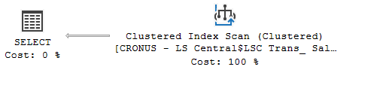
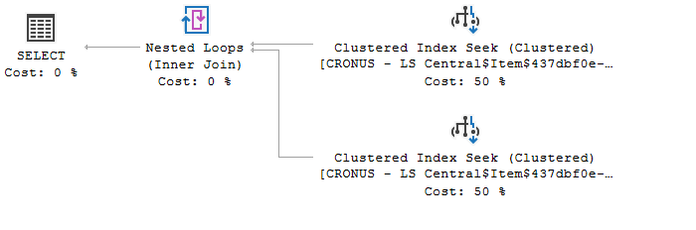
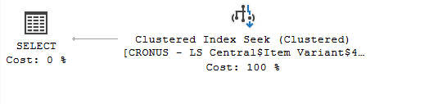
SQL Queries
Executed once
Executed once per every loop iteration

Slide 8
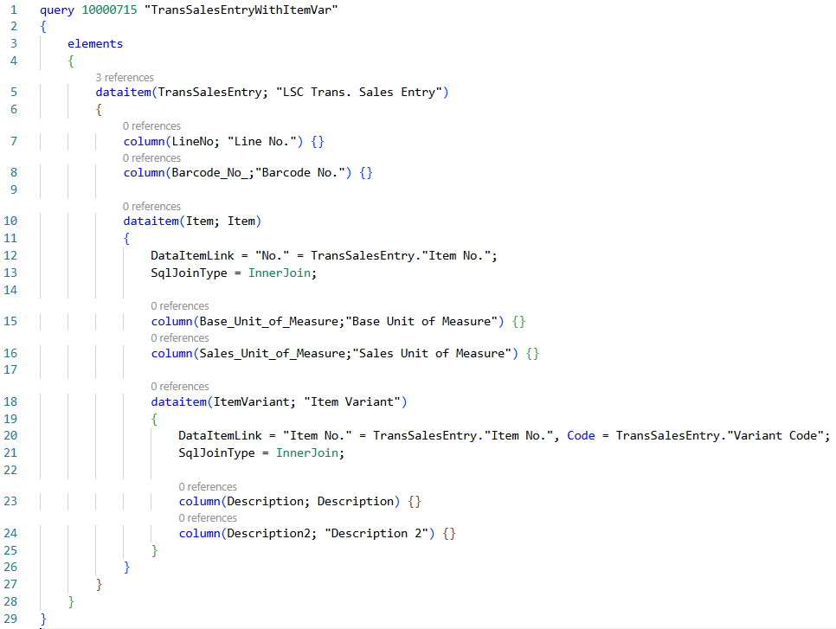
Code can be replaced with an inner join query
Single SQL query instead of multiple DB requests in a loop is more efficient.
Unlike Find* functions, query objects can read data from a covering index.

Slide 9
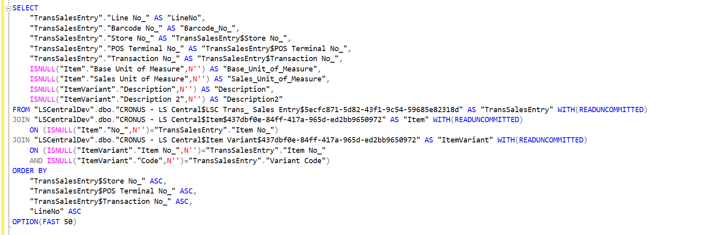
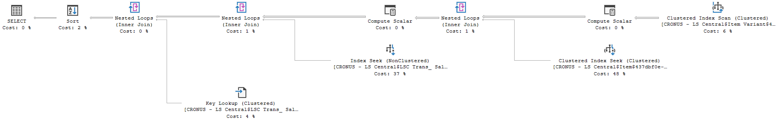
SQL Query

Slide 10
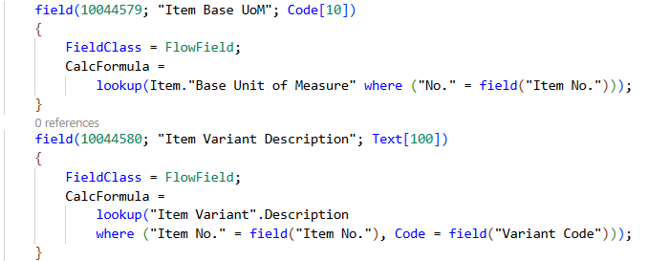
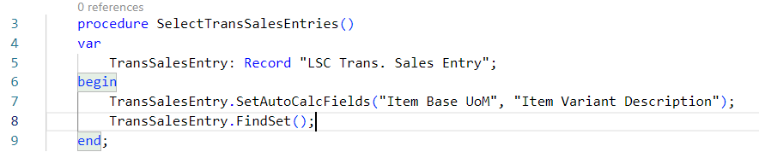
Alternative solution
This solution generates two correlated subqueries, but still a single database request from BC.

Slide 11
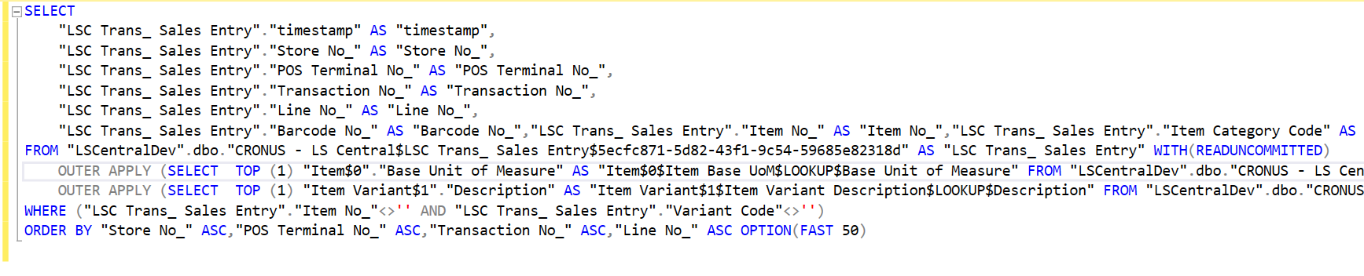
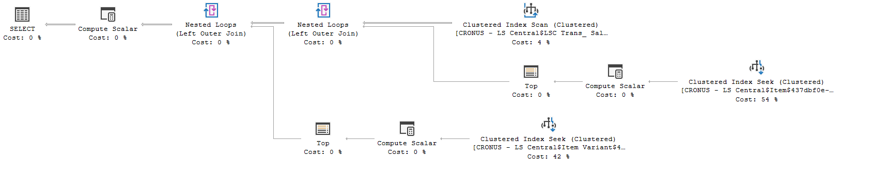
SQL Query

Slide 12
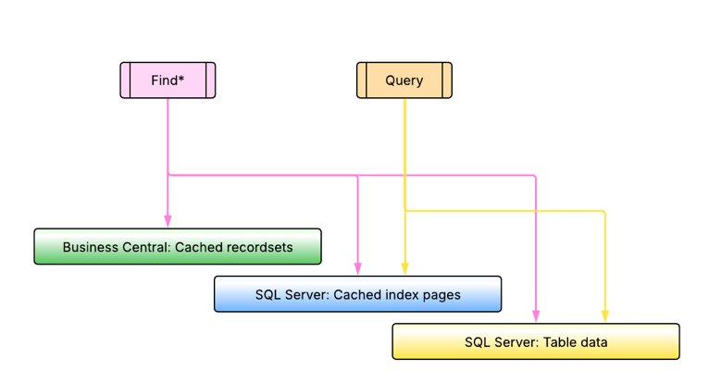
BC and SQL caching
BC caches results of a function call​
Up to 1024 rows for each Find are cached​
Results of Query objects are not cached
SQL Server caches index/data pages​
Therefore, all rows fitting into a page will be cached​
AL function SelectLatestVersion resets the cache and should be used carefully

Slide 13
Locking during reads
FindSet(true)
Find*/Get statements with prior LockTable or IsolationLevel other than ReadUncommitted
CalcFields / CalcSums with prior LockTable or IsolationLevel
Any Find* / Get that follows a data modification statement on the same table (if RCSI is disabled)
Lock is a DBMS mechanism intended to ensure the required transaction isolation. It is a way to communicate the state of the resource between multiple transactions.
Each of the methods listed here acquires a lock on table rows, although lock types and duration differ.

Slide 14
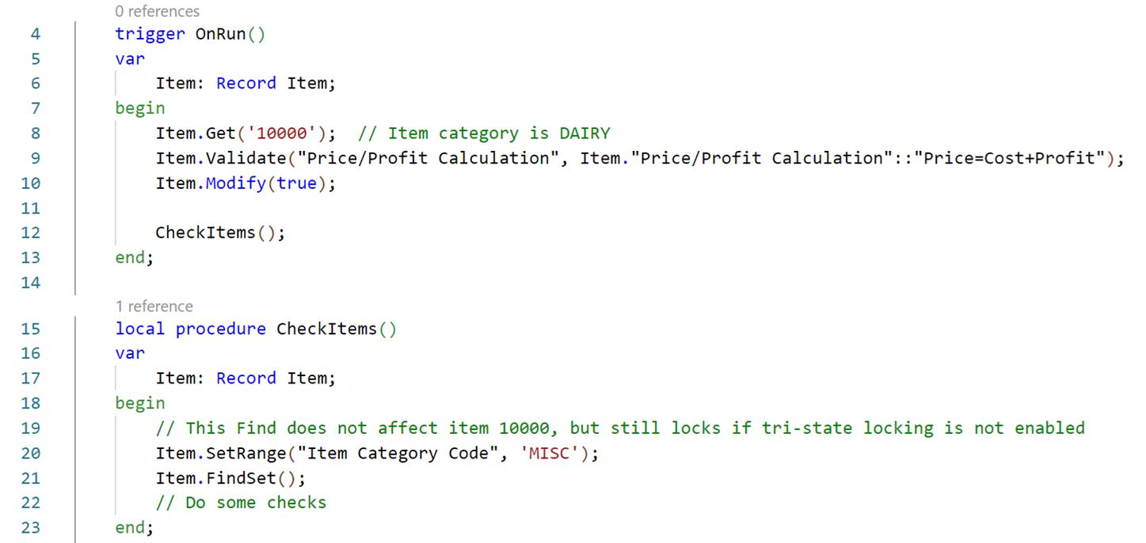
Two-state locking (before BC v23)
All Select statements after data modification are issued with UPDLOCK hint
SELECT … WITH (READUNCOMMITTED)
UPDATE
SELECT … WITH (UPDLOCK)

Slide 15
Tri-state locking (BC v23 and later)
More optimistic and less restrictive locking behaviour.
Select statements after data modification are issued with READCOMMITTED hint.
SELECT … WITH (READUNCOMMITTED)
UPDATE
SELECT … WITH (READCOMMITTED)

Slide 16
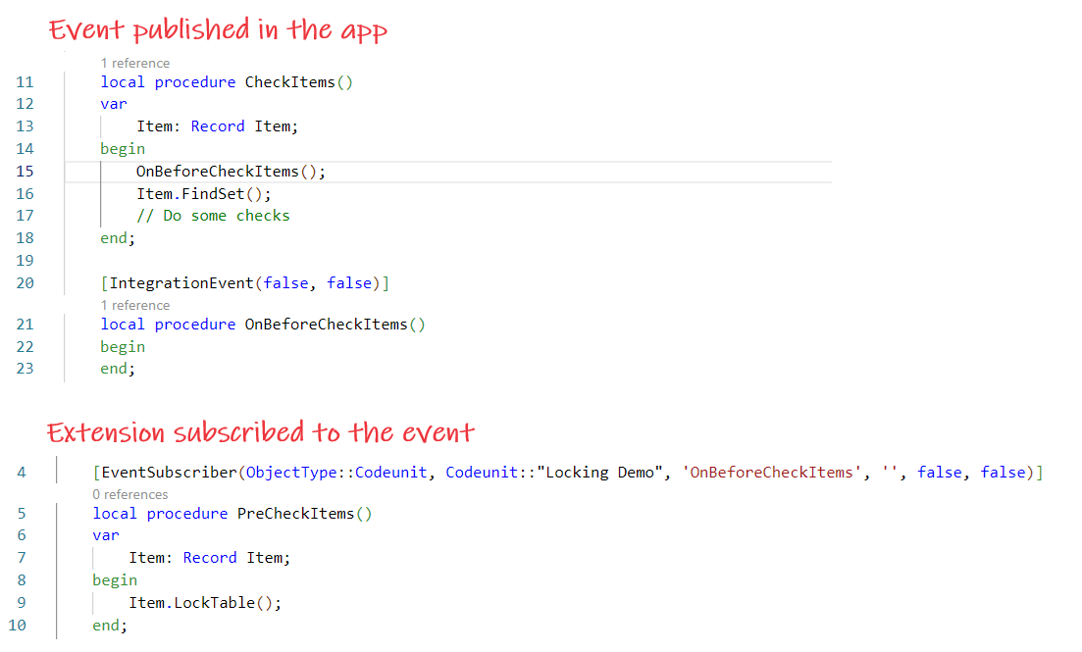
LockTable and ReadIsolation
Event published in the app
LockTable affects all variable instances in the session referencing the same table.
ReadIsolation applies to a single variable instance.
SELECT … WITH (UPDLOCK)
Extension subscribed to the event
Global table state changed
Instead, use Item.ReadIsolation(IsolationLevel::UpdLock)

Slide 17
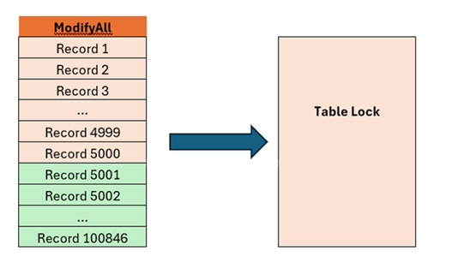
Massive updates/inserts can block parallel reads
Lock escalation is a mechanism of turning multiple granular locks (row-level and page-level) to a single table-level lock.
Escalation attempt occurs when the number of active locks on one table in a single SQL statement reaches approximately 5000.
AL statements that can escalate a lock
ModifyAll
DeleteAll
FindSet with LockTable or ReadIsolation set to UpdLock or RepeatableRead
FindSet(true)

Slide 18
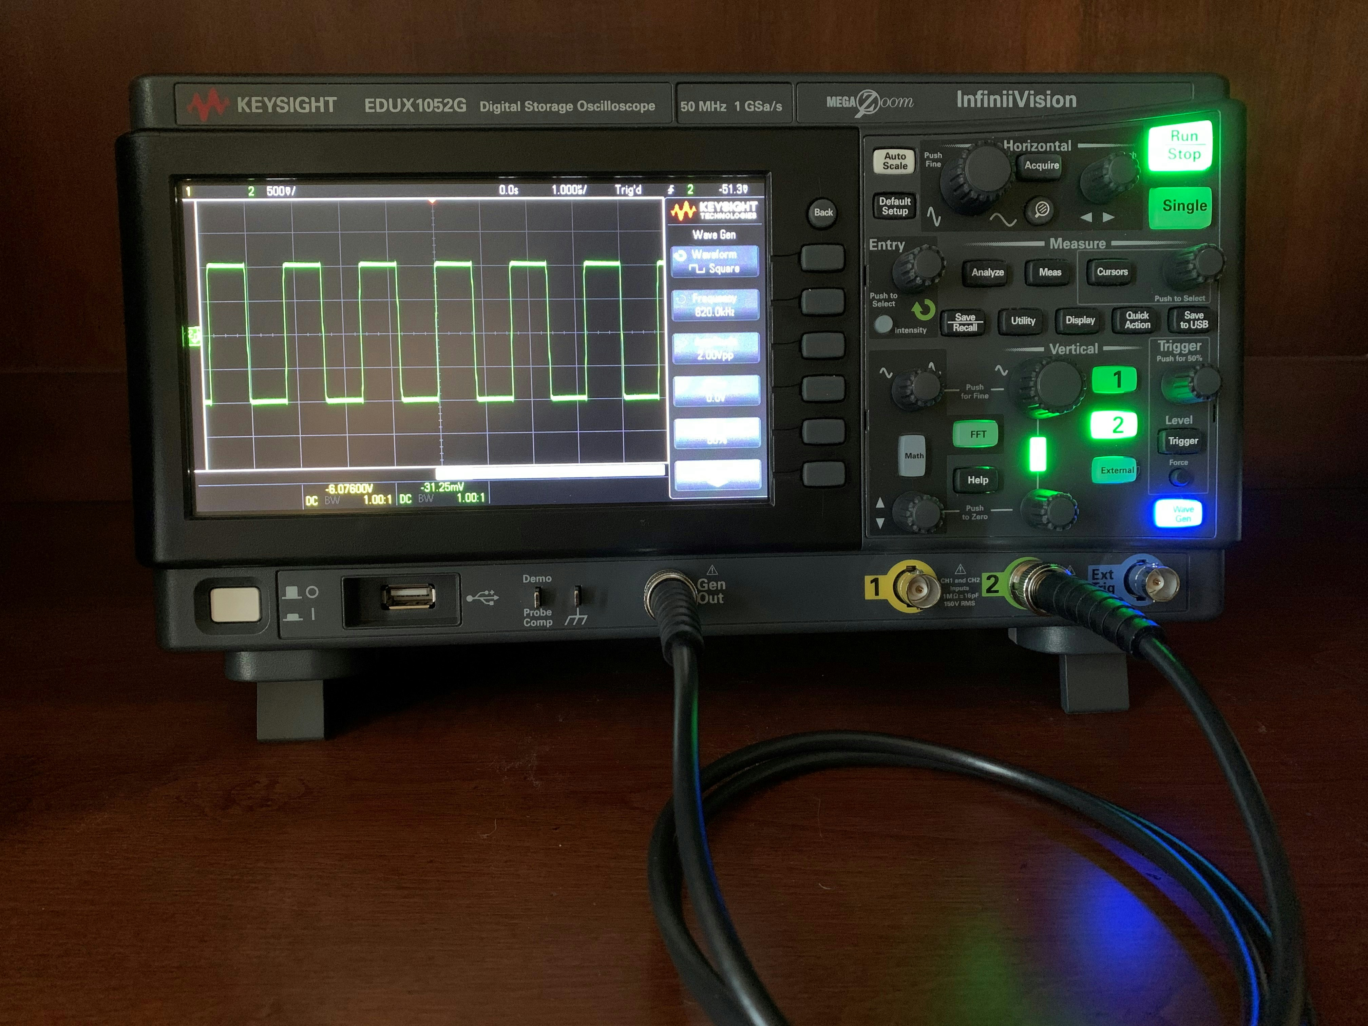
Performance analysis tools

Slide 19
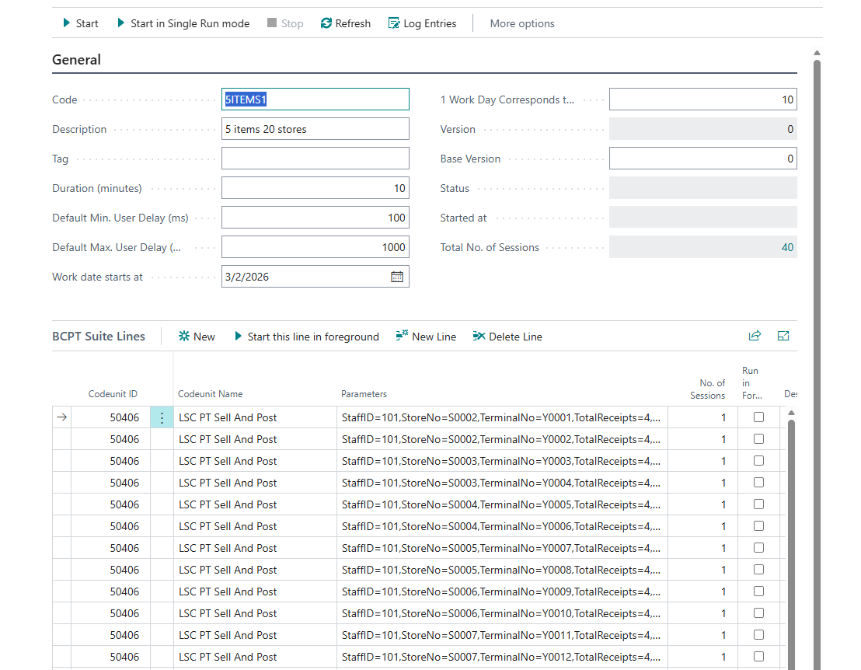
Business Central Performance Toolkit
Business Central Performance Toolkit (BCPT) is a tool used to simulate user activity and test system behavior under a heavy workload.

Slide 20
Business Central Performance Toolkit
Pros
Each scenario requires development work
Cons
Can simulate parallel workload from multiple sessions
When to use
Load testing
Debugging concurrency problems

Slide 21
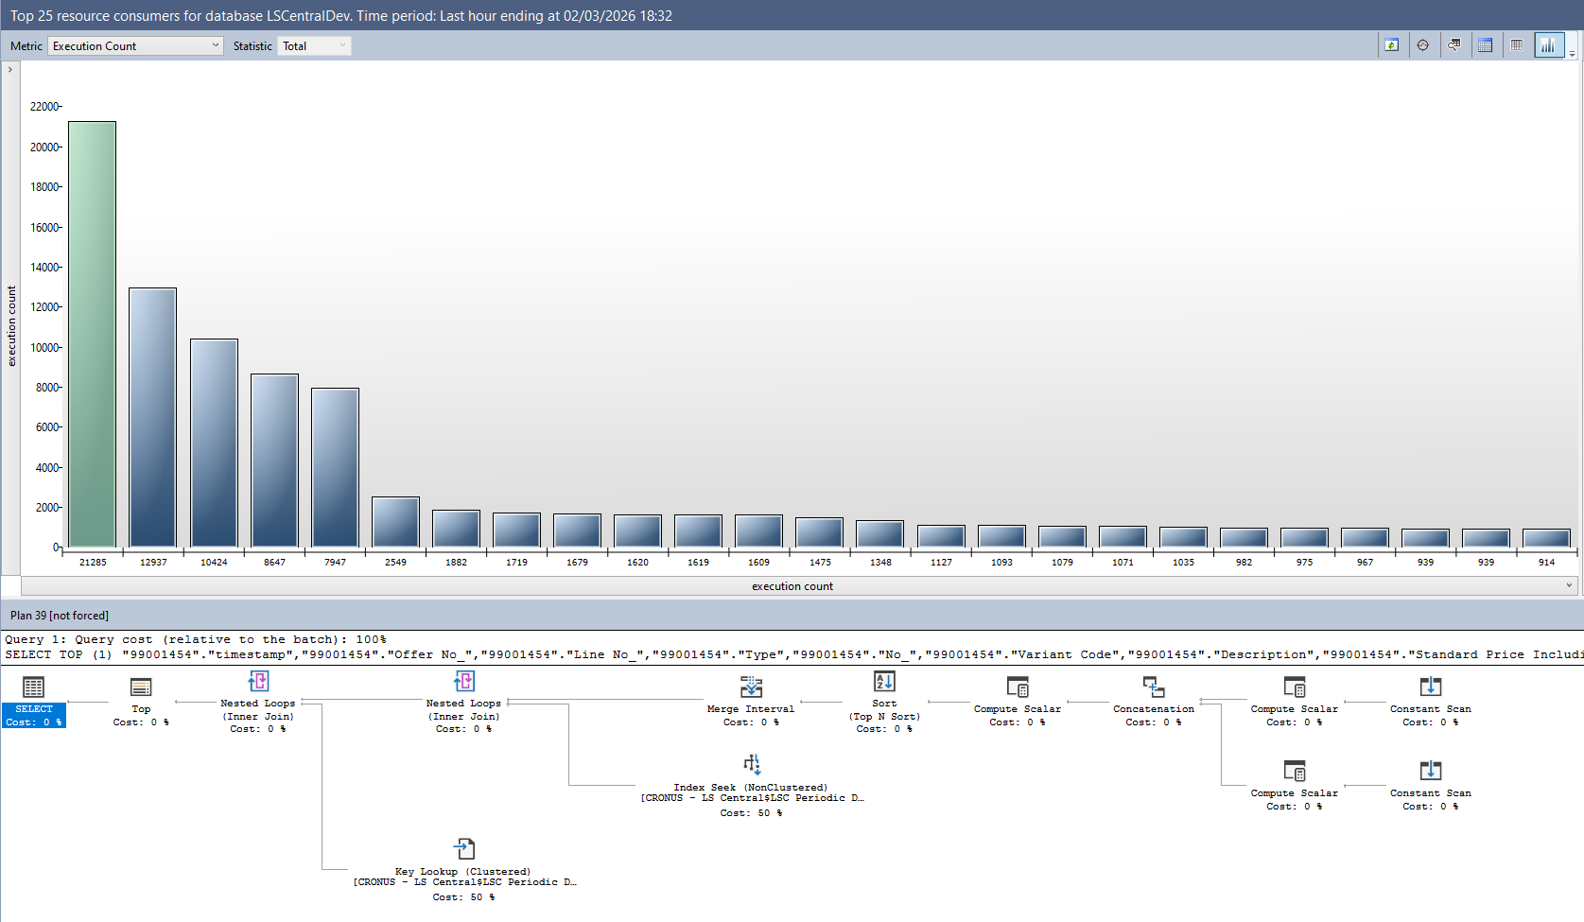
SQL Server Query Store
Built-in SQL Server tool collecting query statistics – execution frequency, run time, execution plan, memory usage, etc.

Slide 22
SQL Server Query Store
Pros
Requires access to the SQL Server, therefore not usable in cloud BC instances
Cons
Rich query insights available out of the box
When to use
Profiling database bottlenecks when an issue can be reproduced on a local BC instance

Slide 23
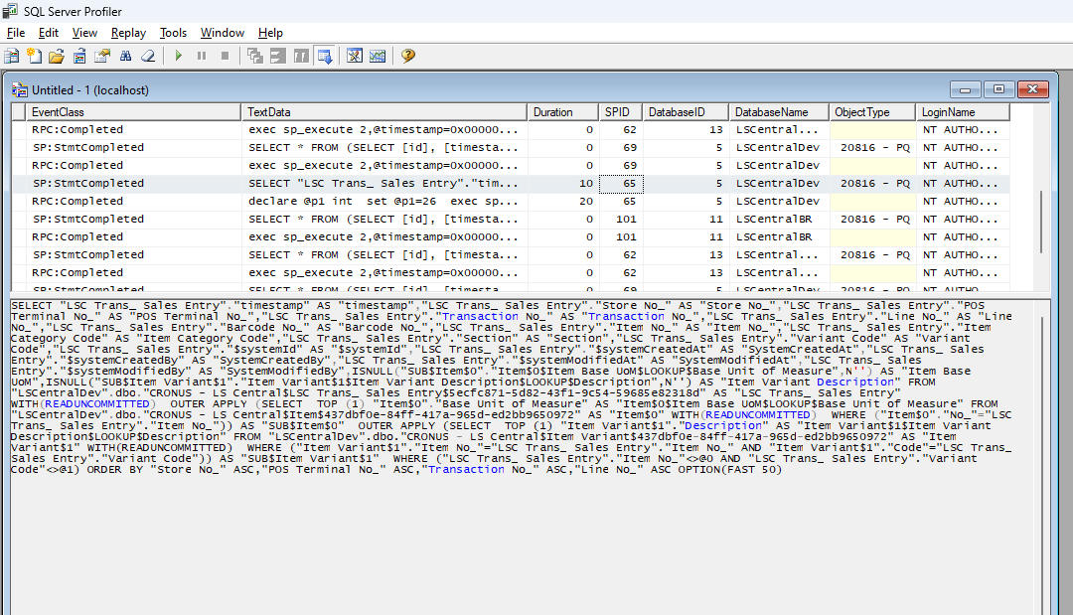
SQL Server Profiler and XEvents
Another native SQL Server tool providing a large amount of detailed information on all database processes.
SQL Trace and SQL Server Profiler are being deprecated and replaced by Extended Events (XEvents).

Slide 24
SQL Server Profiler
Requires access to the SQL Server
Cons
When to use
Detailed insights into an individual query
May be difficult to analyze without aggregations
Capturing deadlocks
Pros
Most detailed information on every database query

Slide 25
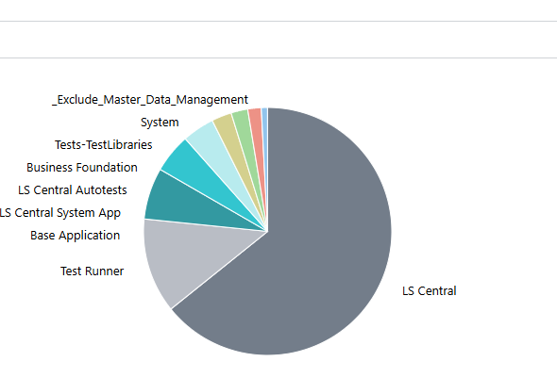
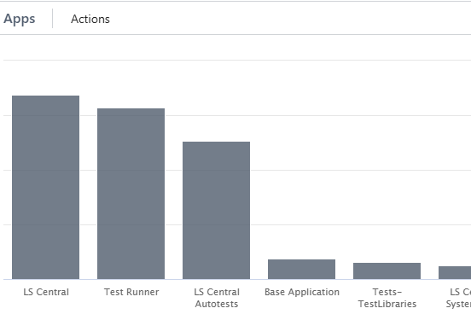
BC Performance Profiler
Can capture AL functions, as well as SQL statements
Measures execution time
Measurements are based on call stack snapshots taken at configured intervals

Slide 26
BC Performance Profiler
Pros
Results can be deceptive for small and frequently called functions
Cons
BC tool that can trace AL functions
When to use
Initial screening of a performance issue

