Slide 1
Empower LS Central with Power Platform
Alejandro Vázquez
Senior Consultant

Slide 2
Agenda
What is Power platform?
What is Power apps?
What is needed and how to implement
Demo

Slide 3
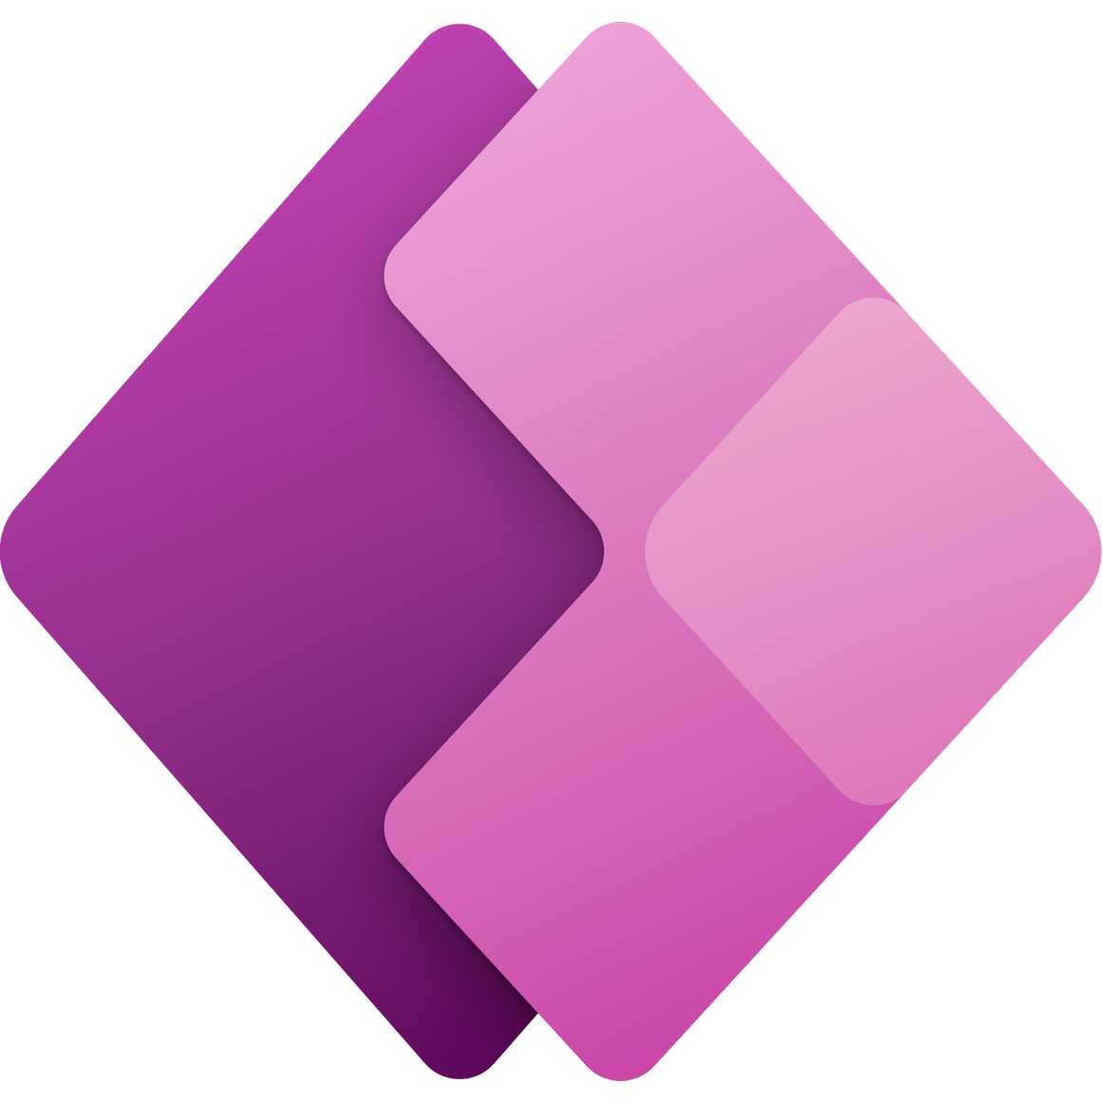
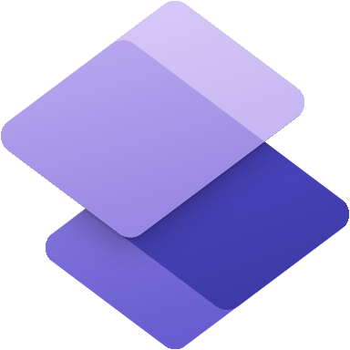
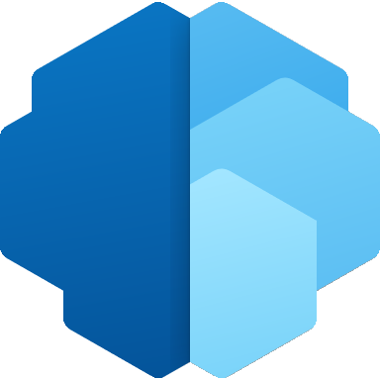
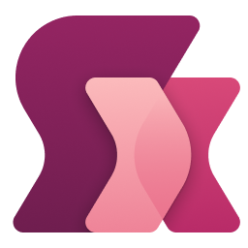
Microsoft Power Platform | Low Code Platform
The world’s most complete set of integrated, low-code development tools
Power Apps
Power Automate
Power Virtual Agents
Power Pages
Power BI
for web and mobile application development
for process or workflow automation
for chatbots and conversational agents
for
building secure, data-centric business websites
for data exploration, analytics and reporting
Data connectors
AI Builder
Microsoft Dataverse
Power Fx
Managed Environments

Slide 4
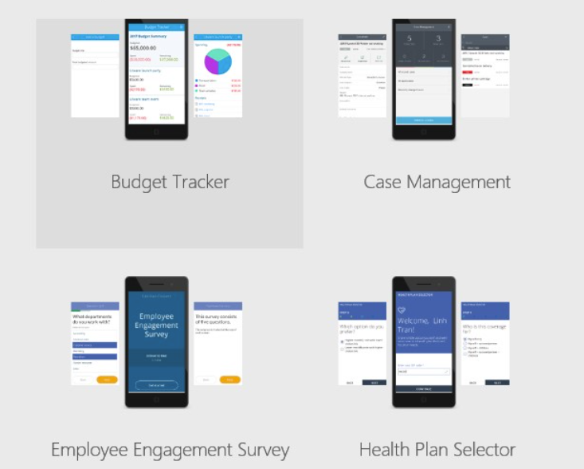
What is Power Apps?
Microsoft designed the Power Platform and Power Apps to let you build any business application based on your data.
Power Apps helps create custom applications that allow your team to efficiently communicate and share information.
Its highly intuitive interface was designed to allow as many people as possible to create unlimited apps.
Save time and resources on training and coding, while meeting your business needs with the most personalized solution.
Specifically, it allows you to create the app that best suits your needs with your own data source, with basic programming or app development skills.
Your custom applications can be fully linked to your Microsoft solutions or other IT tools already used in your business.

Slide 5
What is needed and how to implement
What is needed?
How to implement?
Technical
Power App tool
BC or another backoffice environment
Integration tool through connector
If using dataverse already in the licence of Power App, no need for a backoffice and an integration tool (easier with Azure), which requires internet
Competence
Basic technical skills for the app development
More powerful skills needed for more functionalities
Business
Define the Customer Journey
Design of the App
Information flow data exchange need with backoffice system
Which business process to improve?
What is the business value?
How to draw the Customer Journey?
Dream big and implement step-by-step
Interact with key users from start
Improve based on customer inputs
Empower the key users to implement power app over time
Evaluate the time it needs for users to learn
Test and test until you can launch

Slide 6
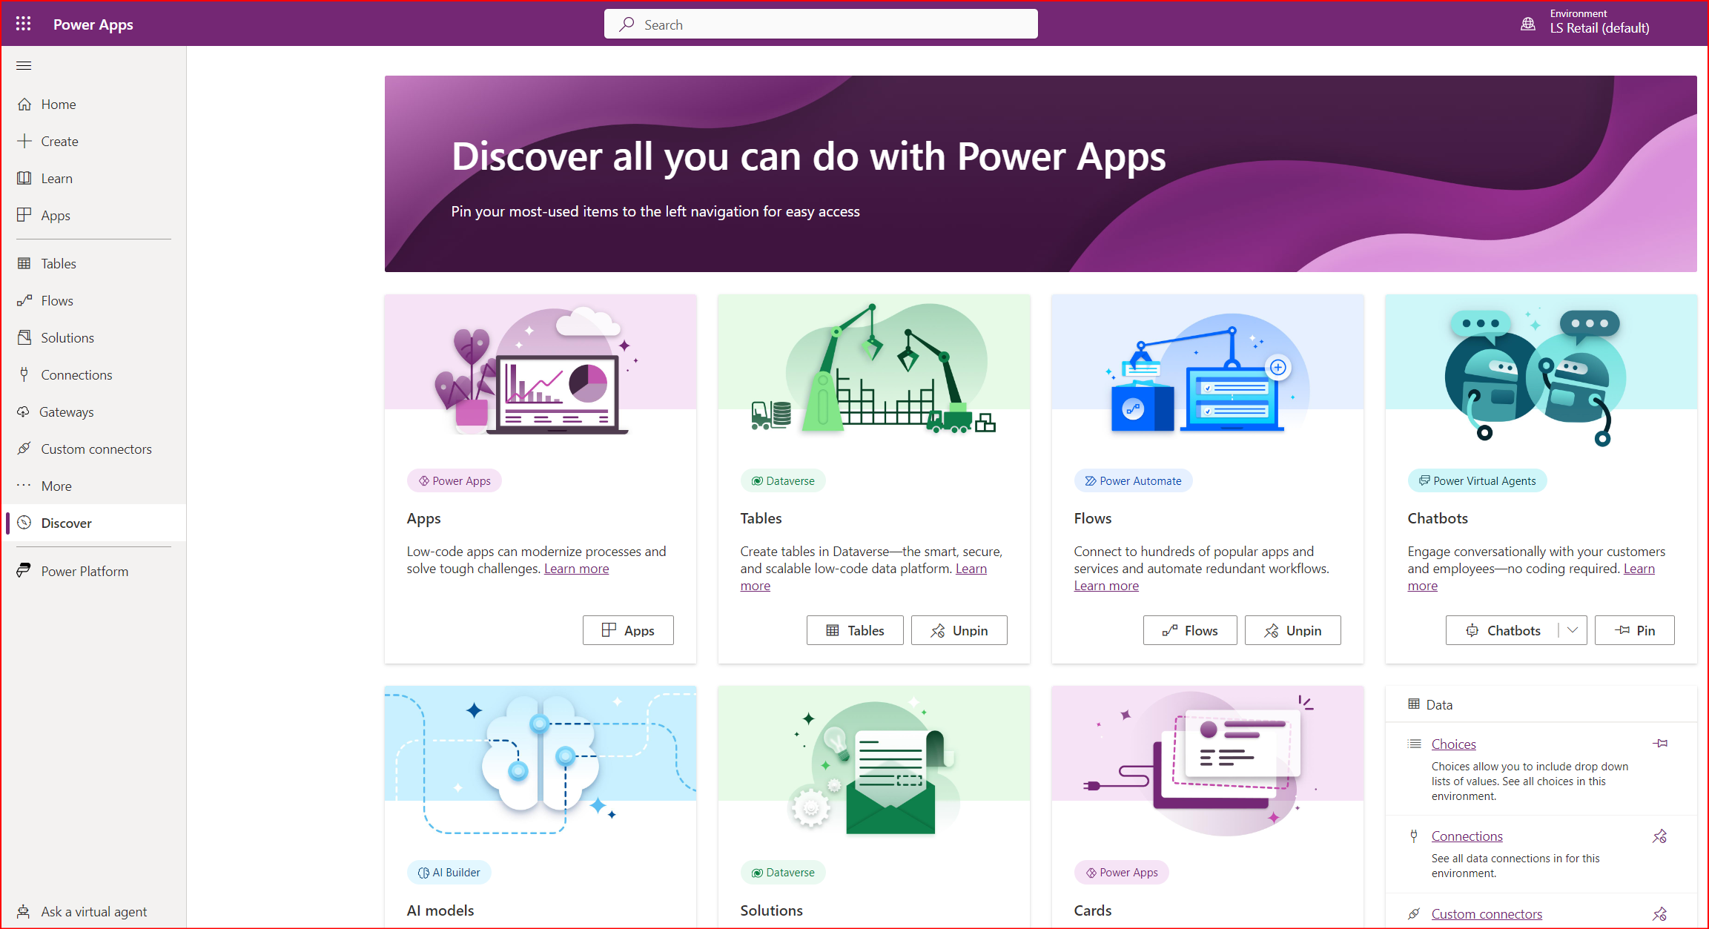
PowerApps Center

Slide 7
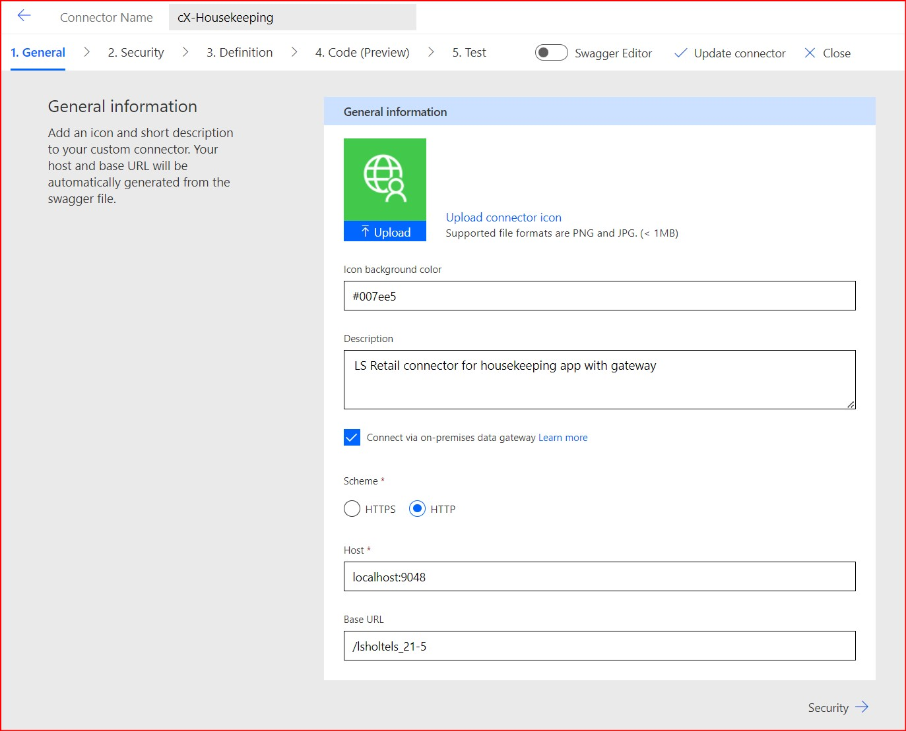
Custom Connector
General
Setup general information for the connector and main definition of the host
Security
Setup the type of connection and credentials
Definition
Definition of the methods that will be available on our app to get data from our datasource; usualy rest api methods
Test
You can test the methods here to confirm that connection and definition is correctly made.

Slide 8
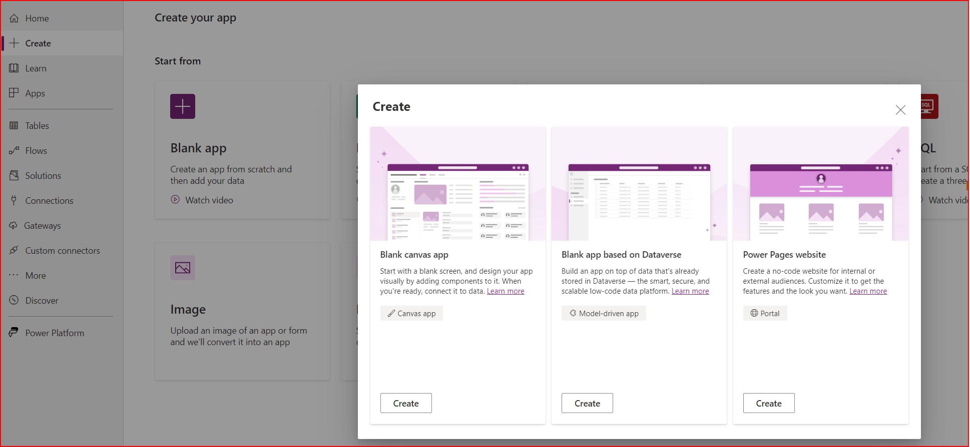
Create center

Slide 9
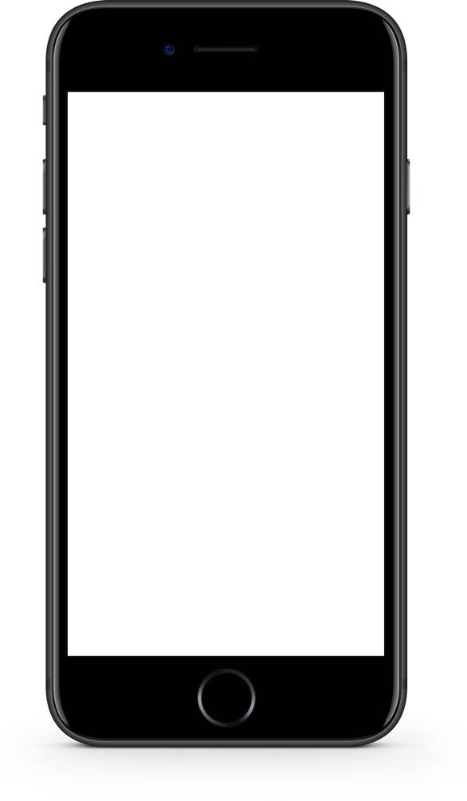
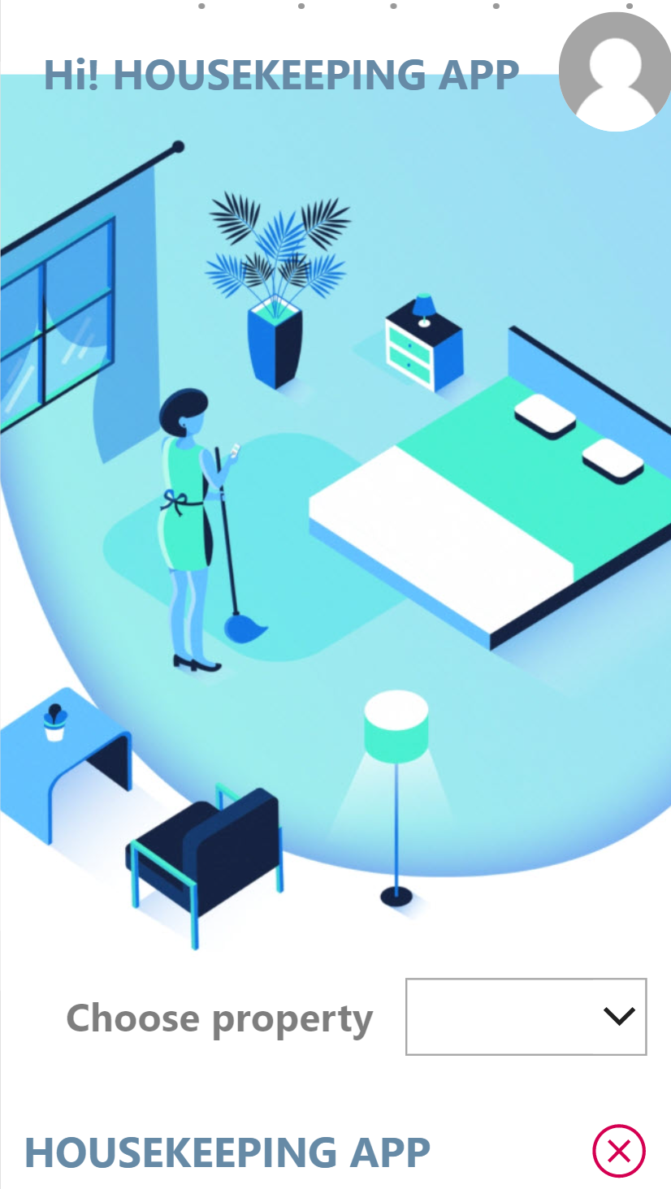
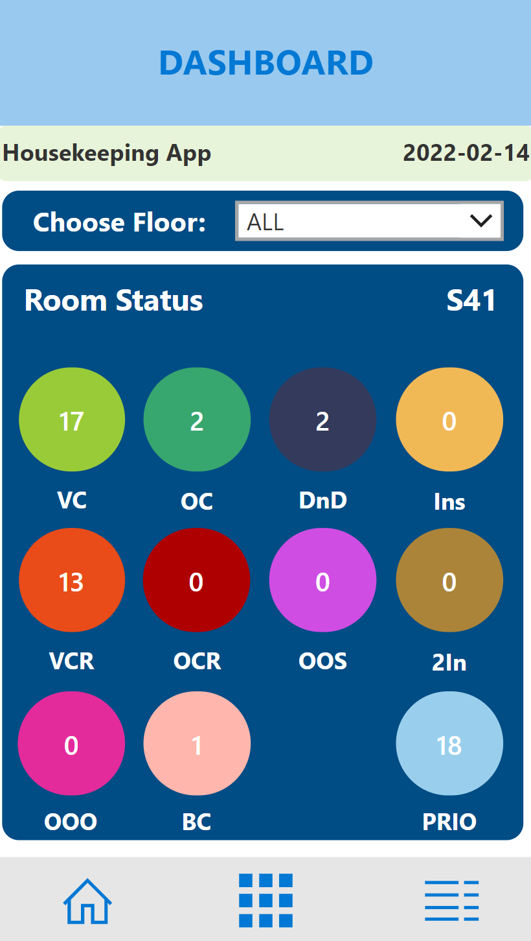
Demo
LS Retail Consulting created a Power App for the Blue Lagoon to handle housekeeping in the hotel
Users are room attendants
After choosing a property you will get an overview of the HK Status of the hotel.
In the example we can see that there are 13 rooms with status VCR (vacant cleaning request )

Slide 10
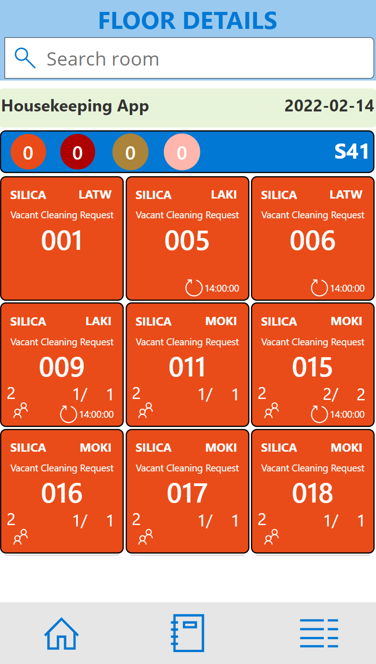
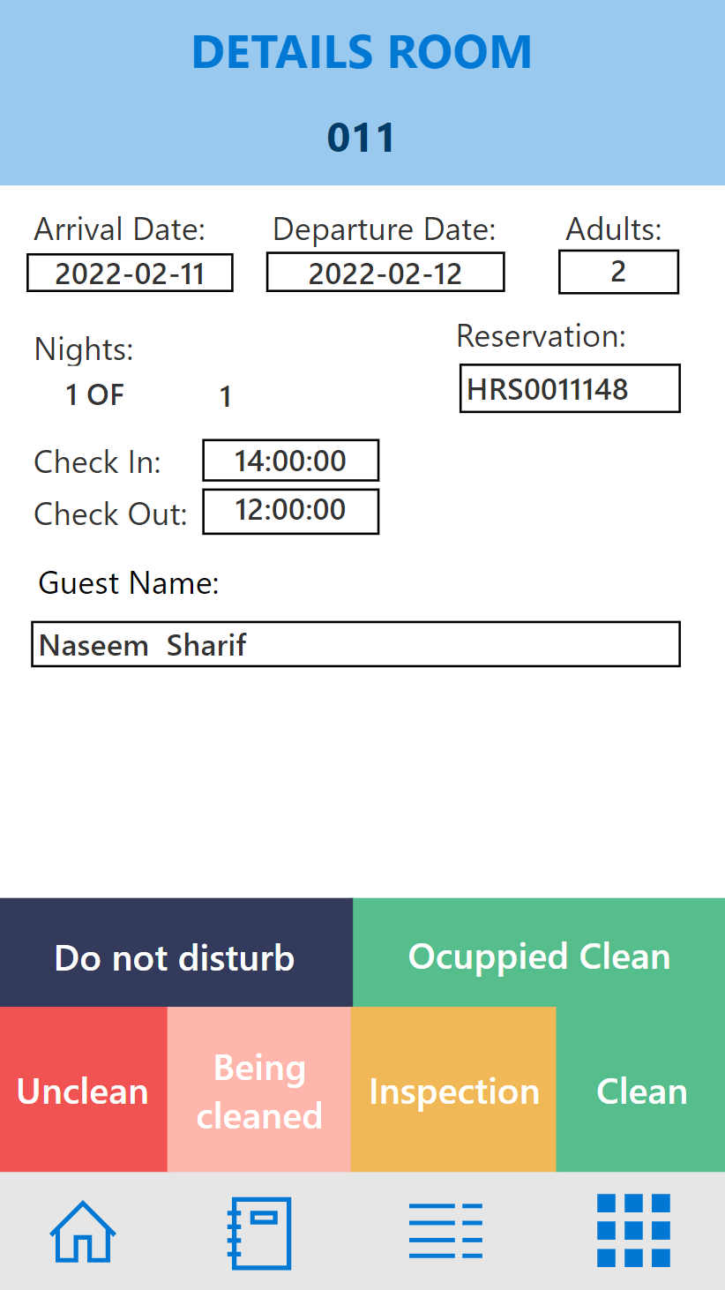
Demo
By clicking the icon, you will access the rooms with that status. In this view you get more info about the room.
Room type
How many persons in the room
Checkout time
How many nights they will/have stayed
Priority room or not
Extra bed or crib in the room
By clicking a room, the room attendant can change the HK status, when done in the room. This will then update the status in the system.

Slide 11
Thank you

