Slide 1

Jeroen Betten
Global Head of Sales Experts
Driving Connected Commerce

Slide 2


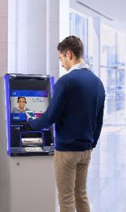



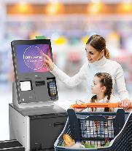
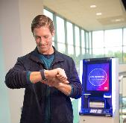
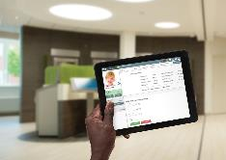

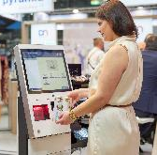
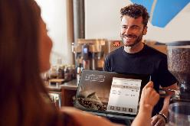

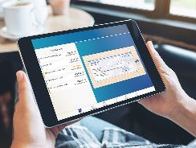
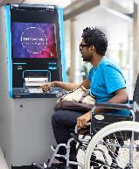

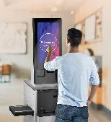

DN | We Automate, Digitize and Transform the Way People Bank and Shop
Touchpoints
Solutions
Automate
Digitize
Transform
Banking Solutions
Retail Solutions
Software
Services
    Branch Transformation
  Cash Management
    ATM as a Service
  Digital Banking
    Consumer Centric
    Experiences
    StorevolutionTM
    Self-Service
    Store Operations
    Consumer & Staff journeys
    Advisory Service

Slide 3







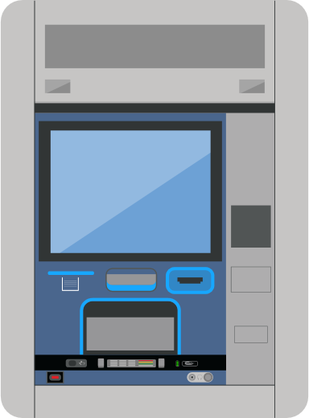






















DN | Bridging Digital & Physical Channels
DN Vynamic Software
TM
API/ OPEN SOFTWARE
CHANNELS
EXPERIENCE
OPERATIONS
PAYMENTS
KIOSK
MOBILE/
TABLET
ATM
LAPTOP/
DESKTOP
TELLER
CONNECTED
(e)COMMERCE
SELF-SERVICE
POS
DN Managed Touchpoints
RETAIL CASH
MANAGEMENT
SELF-SERVICE
ORDER KIOSK
MANAGED SERVICES
ALL TOUCHPOINTS
SELF-SCAN
IMPLEMENTATION
MAINTENANCE
SUPPORT
OPERATIONS
APPLICATION MANAGEMENT
MOBILITY
SOLUTIONS
DN Touchpoints

Slide 4

A little background

Slide 5




Retail | A fast changing landscape, be ready!
Global Retail Trends
Consequence on Stores
Strategic focus
Online business growing
New role for stores as fulfillment center
Accelerate Journeys orientation
Implement short consumer journeys
Great moments for long consumer journeys
Digitalize staff journeys
Resilient & healthy journeys
Open innovation
Repurpose
the Store
Strengthen
Consumer
Experience
Combine
Online
and Offline
Drive-in, Click & Collect, Lockers
Different sized formats more popular
Demand for less physical contacts
Full Automation of journeys / stores
Fast Adaptation
of Consumer
Journeys
Self-service acceleration
Cashless / contactless touchpoints
Evolution of checkout Mix
Personalization / Mobility for all staff
Store
Digitalization
In Store Digitalization accelerating
Cash usage going down
O2O: share / centralize bus. logics
Enable multiple checkout options
Smart Promotion / Engagement
Integrate more payment methods
Digitalize
Staff
Journeys
Build an
Omnichannel staff
CONSUMER
Centricity
Self Service utilization reducing waste
Role and skills of staff associates change
Journeys
Fragmentation/
Orchestration
Connect easily new touchpoints
Integrate digital apps / Ecosystem
Orchestrate via API based platform
Strengthen network / infrastructure
HIGH
CONNECTIVITY
Economic uncertainty
Reduced investment capabilities
Manage E2E flexible journeys
Manage Mobility
Availability / TIS transformation
As a service / transaction models
Store
as a Service

Slide 6
DN | Global market insights
SCO market momentum continues, encouraged by COVID-19: retailers investment increases across the world
Global market - SCO shipments by region, 2019 - 2020 and forecast 2021 – 2026
CAGR 2021-2026
DN SCO Shipments
36%
50%
+6%
+6%
+6%
265.018
+6%
+6%
249.154
+7%
235.092
66.516
(25%)
+11%
222.646
63.650
(26%)
+25%
209.894
61.377
(26%)
195.379
60.224
(27%)
176.112
59.102
(28%)
46.691
(18%)
57.481
(29%)
45.318
(18%)
140.514
50.344
(29%)
45.840
(19%)
47.416
(21%)
47.625
(23%)
AMERICAS
53.293
(38%)
47.682
(24%)
52.669
(30%)
EMEA
32.636
(23%)
140.186
(56%)
151.811
(57%)
115.006
(52%)
127.875
(54%)
90.216
(46%)
103.167
(49%)
54.585
(39%)
73.099
(42%)
APAC
2019
2020
2021 FC
2022 FC
2023 FC
2024 FC
2025 FC
2026 FC
Source: RBR 2021, Global EPOS and Self-Checkout (data per end-2020)
Claudia Kopp | Market Intelligence | June 2021

Slide 7
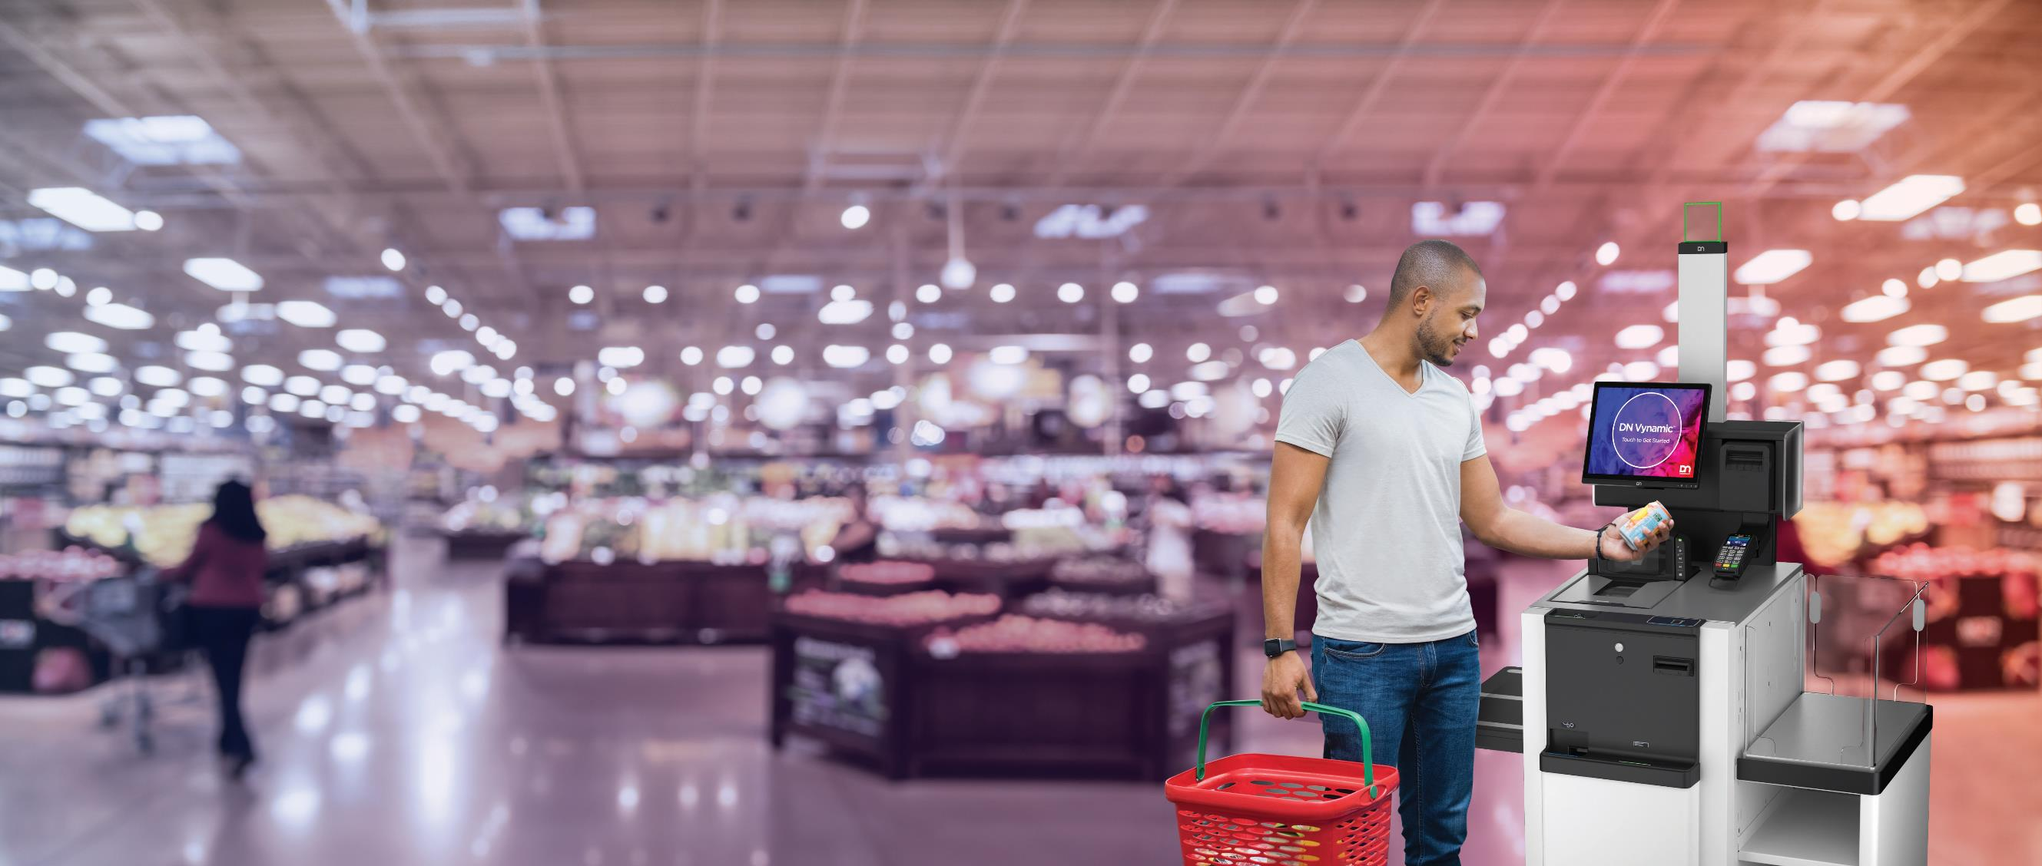
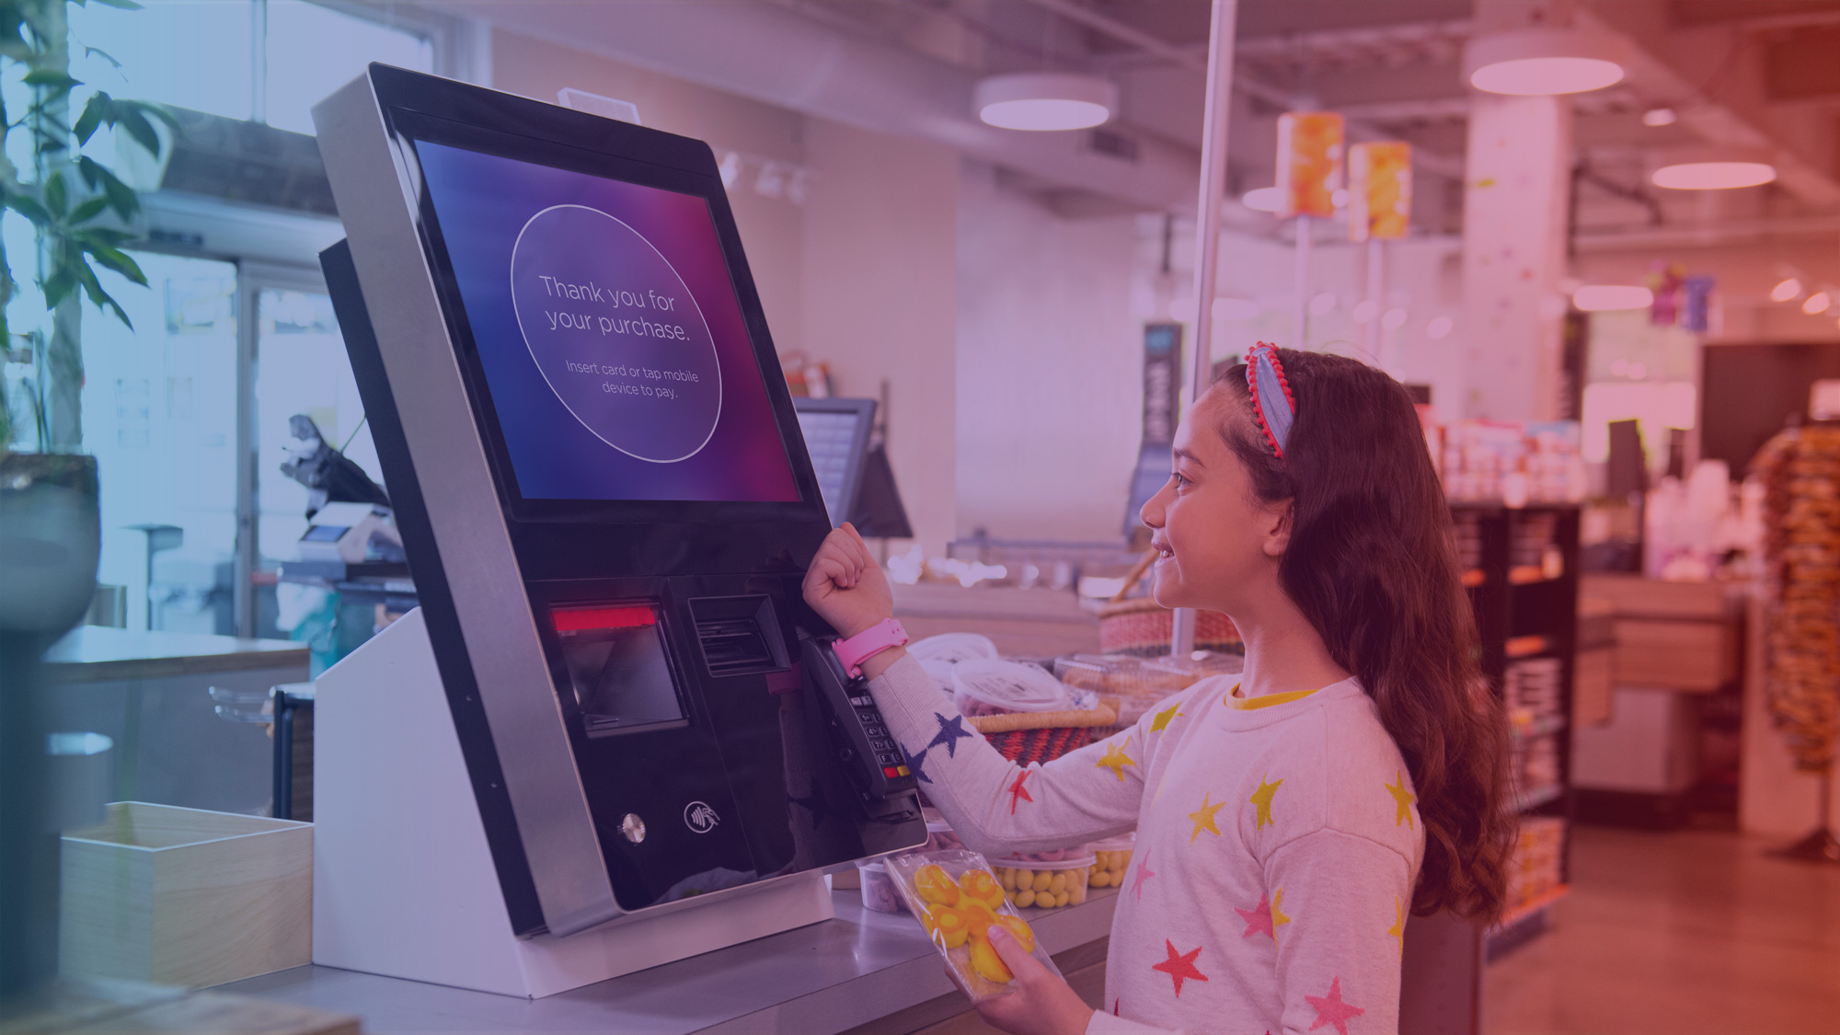

MCS
"Retail will be one of the
most changing industry
in the next ten years."
Hermann Wimmer – SVP Retail Diebold Nixdorf
7 | DN Series™ EASY – Advanced Self-Service

Slide 8

Modern Customers and New Demands
89%
80%
of millennials say technology improves the retail experience
of shoppers will use cashless
payments in future
of shoppers are at least interested in using Self Service store technology
63%
of shoppers say Self Service improve the shopping experience
92%
32%
of Self Service checkout users say it is important to know there is a person close by in case problems occur
of people left a store
recently due to long queues
90%

Slide 9
“Finding the optimal mix of technology is becoming increasingly more complex”
*A participant in the EHI survey

Slide 10
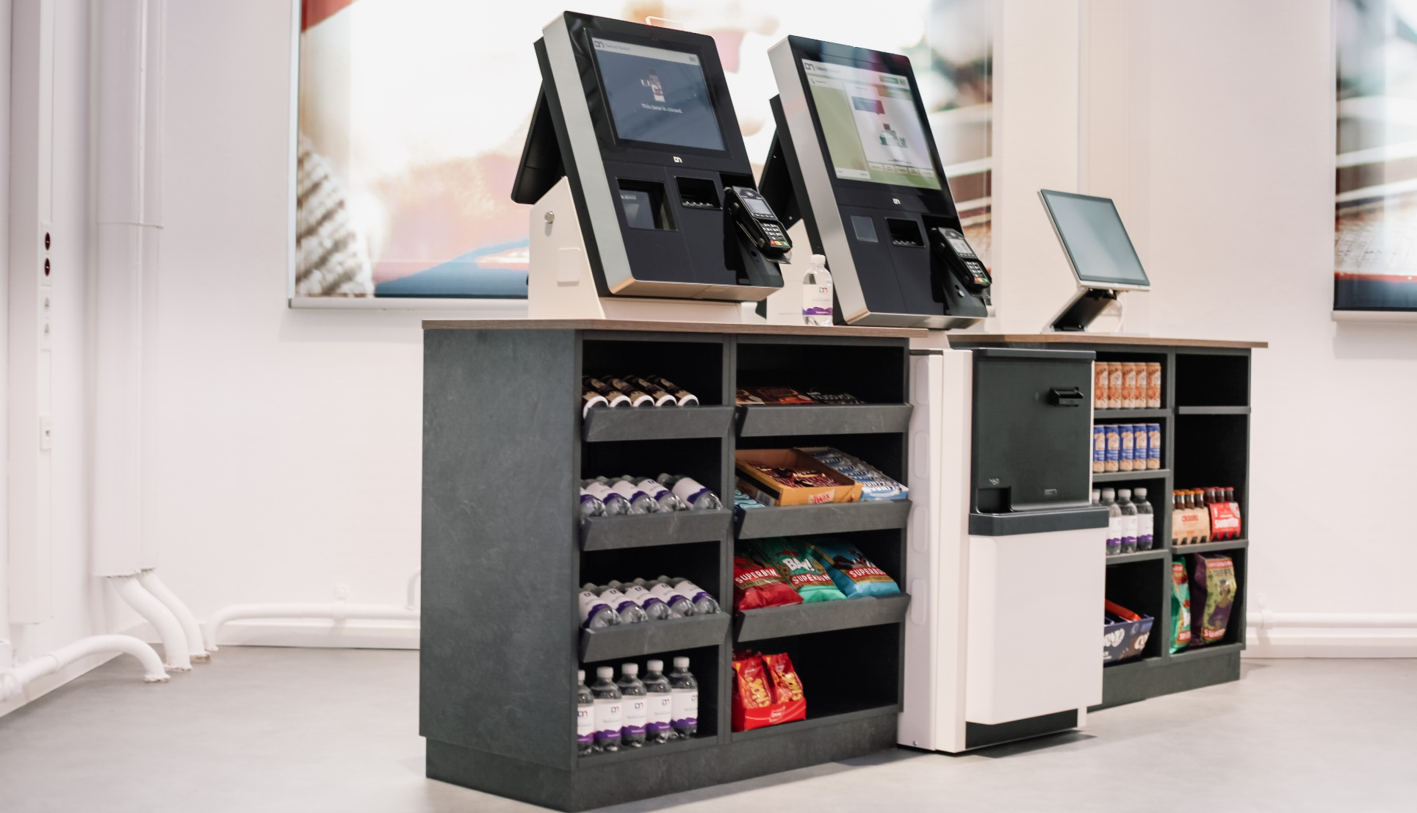
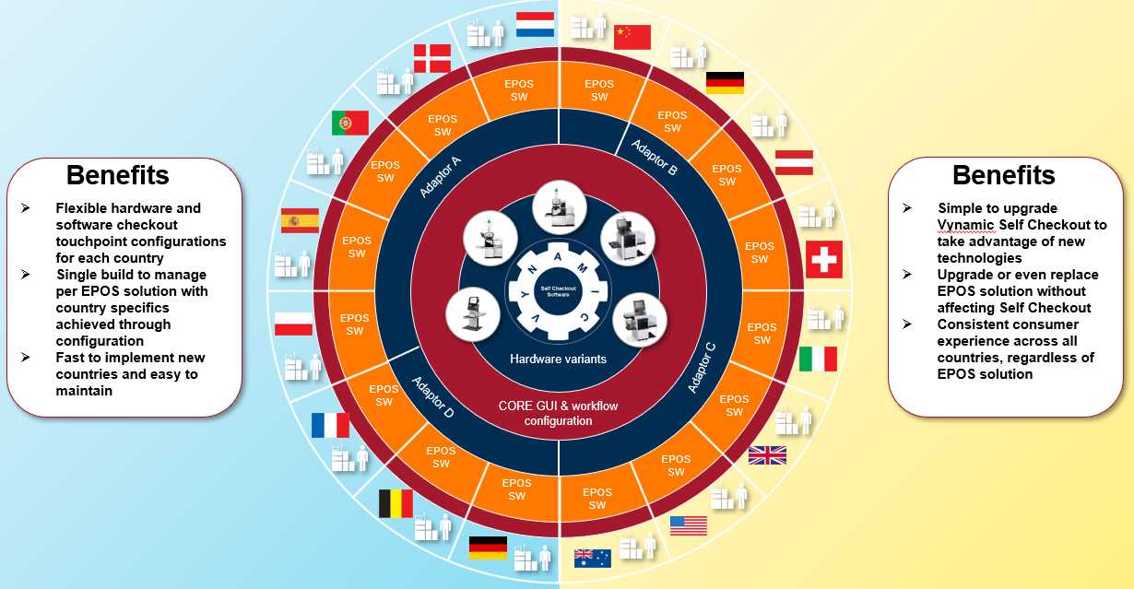


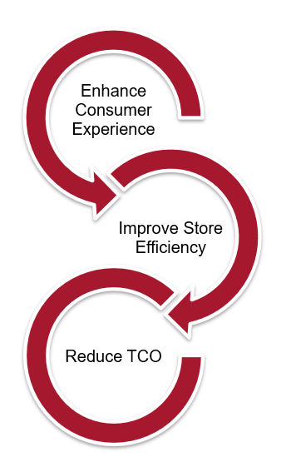



Availability, Upgradability and Compliance
How we help
INNOVATION
SCO as a Platform
1
Global Platform & Serial production, large order volumes led by design professionals reducing technical and logistic issues
2
Pro-active Life cycle management and large volume last buy options. Assurance on compliance with standards and CE certifications as OEM obligation
3
Fully integrated and centrally led (remote) monitoring capabilities with seamless and certified component integration, improving easy self-help or First Time Fix
4
Single Point of Contact so you can focus on your core business and dedicate your resources, time and cost to where it is needed for growth.
5
Accommodation of different customer journeys with different SCO formfactors inside the same SCO platform, future proofing your initial investment
6
Lower TCO with an availability of the solution for
5y+5y including SW updates/patches, releases and driver supported by a globally rolled out platform

Slide 11




DN Advisory Services | What can Advisory Services do for you?
Optimize Space
in Stores
Improve Customer
Service
Increase
Sales
Reduce
Store Costs
Analysis to decide on the most suitable checkout mix for your stores based on your data
Ensure there is consistently a great customer experience with enough capacity available to cover busy periods
Help you envision your new front end by providing a 3D visualization

Slide 12


DN Advisory Services | It is a Process
Stores
Consumers
Geographies
Operations
Staff
Sales
Assortment
Business
Knowledge
Market & Solution
Expertise
Market Trends
Consumer Expectations
Solution Capabilities
Frictions Points
Best Practices
Reachable Targets
Optimal Mix
Success of
Self-Service
Retailer
DN Consultant

Slide 13



DN Self-Service Solutions are Built for MORE
MORE Modular
MORE Open
MORE Available
One platform with different modules, incl. different cash options
Right-sizing versus “one size fits all”
On-site scalability and upgradability
Smallest footprint
Optimized checkout mix
Open API for third-party integration
UX / UI personalization
Independent software modules
Integrated with > 75 POS applications
Global / local Professional Services practice
Migration services for multivendor strategies
Advanced Self-Service Innovation Roadmap
E2E integrated solution
German engineering / reliability
Managed Services for Retail stores utilizing the one platform approach
Remote monitoring tools, remote fix and TCO reduction
99.8% availability services contract
Designed for 24 x 7 operations
Adapt consumer journeys for today and tomorrow
Integrate to the IT environment
and leverage the ecosystem
Ensure the self-service process is ‘always on’

Slide 14



DN Series™ EASY | Innovation, More to come
DN Series EASY | Platform plus Modules for backwards compatibility and quick Time2Market
Improve
STORE
efficiency
Enhance
consumer experience
Reduce
TCO
Smart Assist
Staff Wearable technology
Further ECO-System Integration
Smart Control
Screen Mirroring
Modular Camera Approach
Smart Vision
Age Verification
Smart Vision
AI Integration (e.g. shrinkage)
Smart Control
Voice Control
Advisory Services
Real-Time Data Analytics
Smart Vision
Scan Error Identification
Robotics & Future Journeys
Enhanced GUI Interface
(e.g. Easy Adaption to Promotions)
Footprint reduction & adaptability enhancements

Slide 15
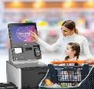


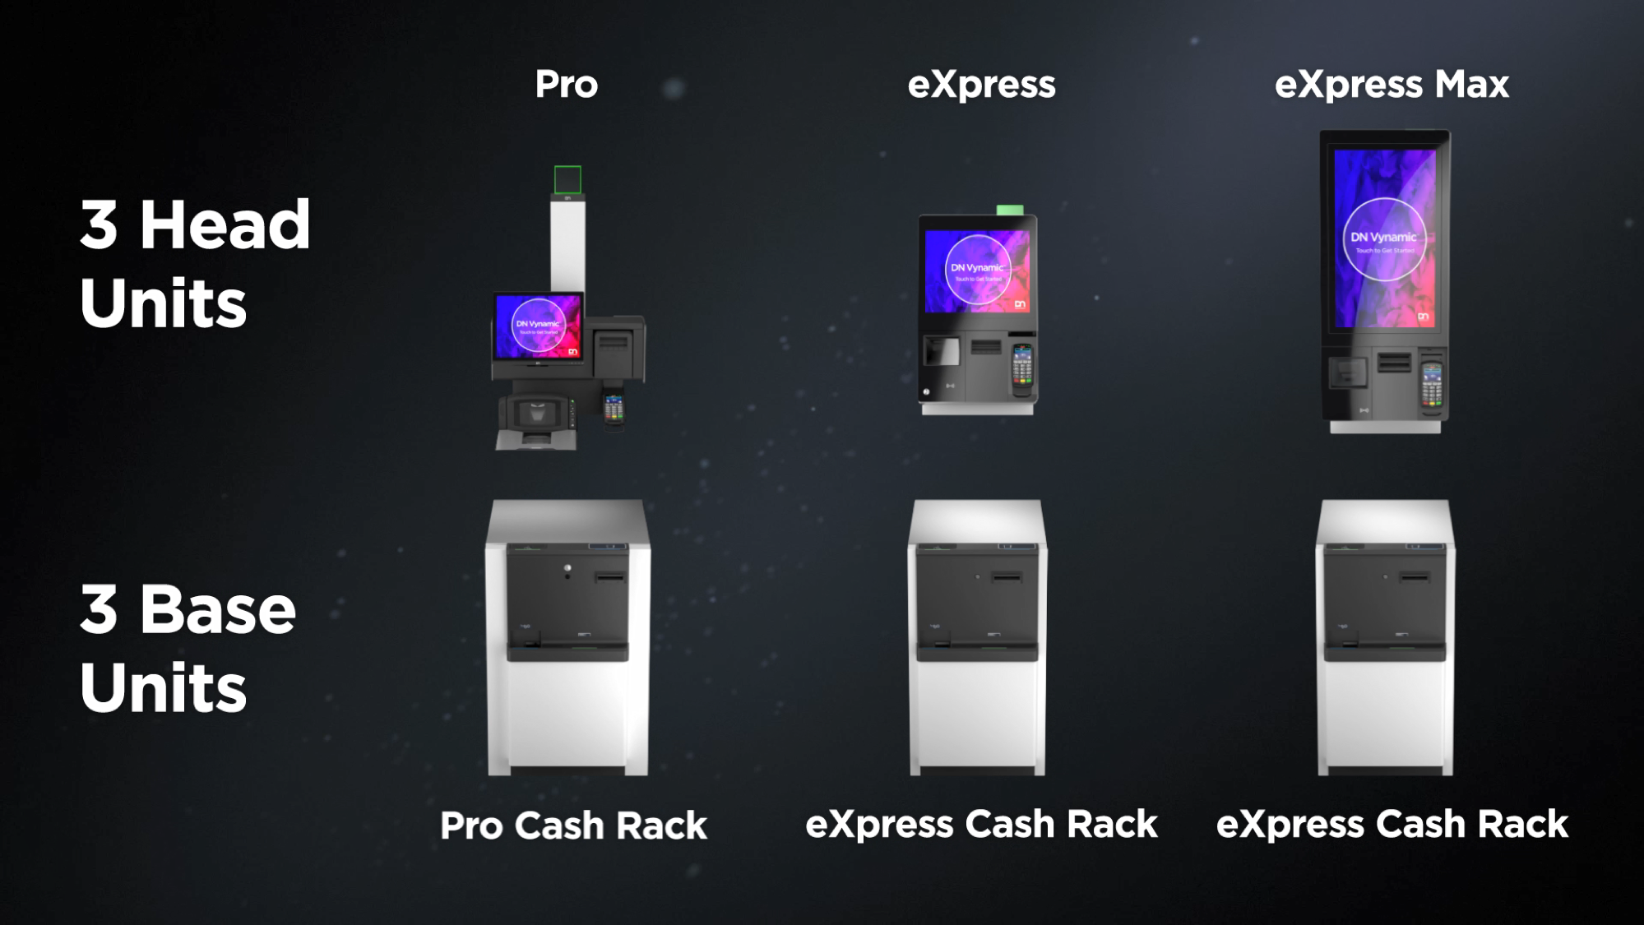
DN | Summary
01
02
03
OPTIMISE
BE OPEN
AND ADAPT
The optimum Self Service mix per store via the right tilling approach
Increased efficiencies with Hybrid SCO and flexibility
Core technology platform evolving the solution over time
Best TCO, today and tomorrow
Adapt over time, protecting your investment
One technology provider for the complete estate
API based platfor independent from POS business logic
Adaptable and Upgradable
Quick Time2Market for changes and innovation
“Always On”
Adapt easily to changing customer or staff journeys
Introduce new innovative journeys quickly and be the market leader
Technological enablement helping your Staff to focus on customer service and store efficiency, instead of focus on technical issues
Increase loyalty by better service

