Slide 1
LS Central
How is it made?
Hilmar Vilhjalmsson
Lovisa Juliusdottir
Unnur Askelsdottir
Product Owner
Director of Development
Solution Lead

Slide 2
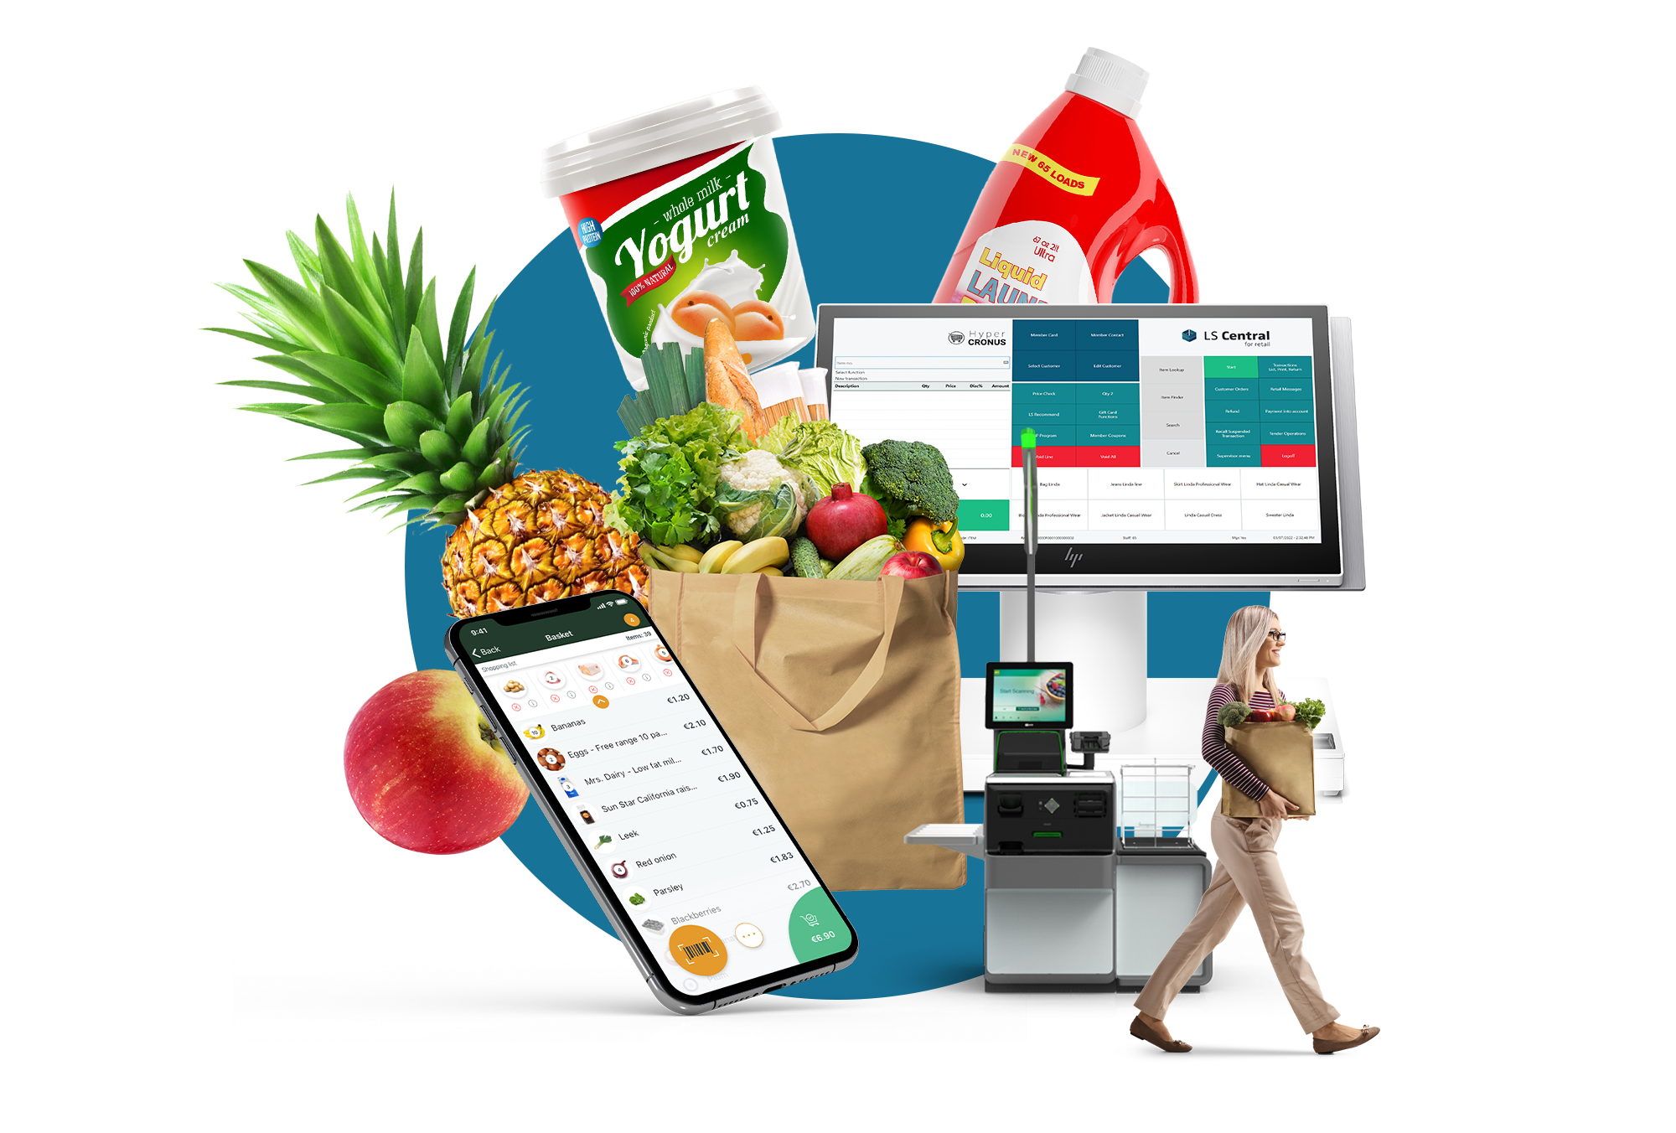


Slide 3

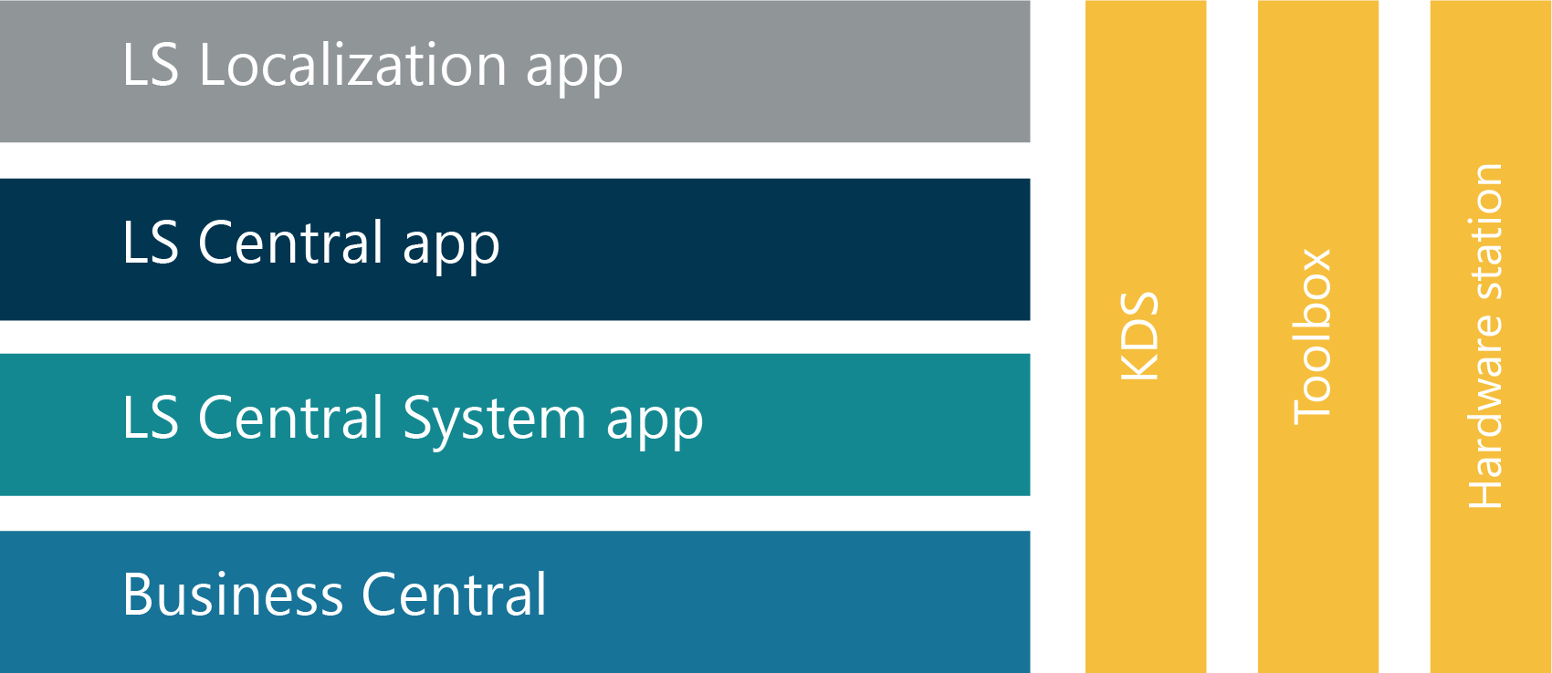
The scope – LS Central

Slide 4
The scope – LS Central

Slide 5
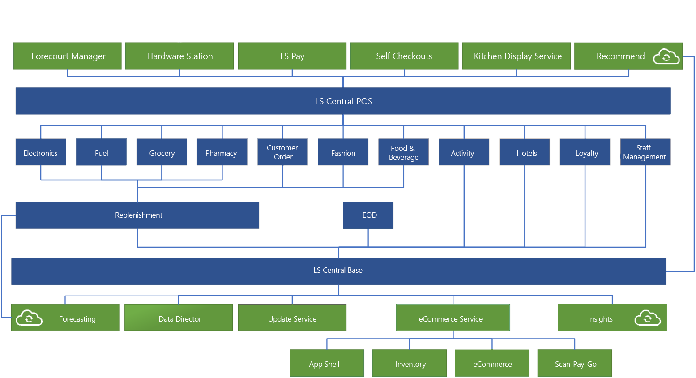
AL Code
C#, JS

Slide 6
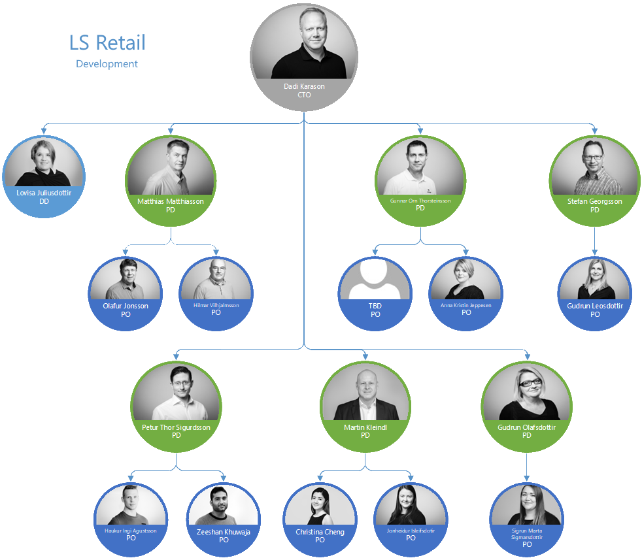
LS Central - Team structure
Product directors
Product owners

Slide 7
LS Central - Team structure
Product directors
Product owners
Distributed teams

Slide 8
LS Central - Team structure
Product directors
Product owners
Distributed teams
DevOps team
Support team

Slide 9

LS Central new features
Direction

Slide 10
LS Central new features
Direction
Roadmap
Backlog

Slide 11

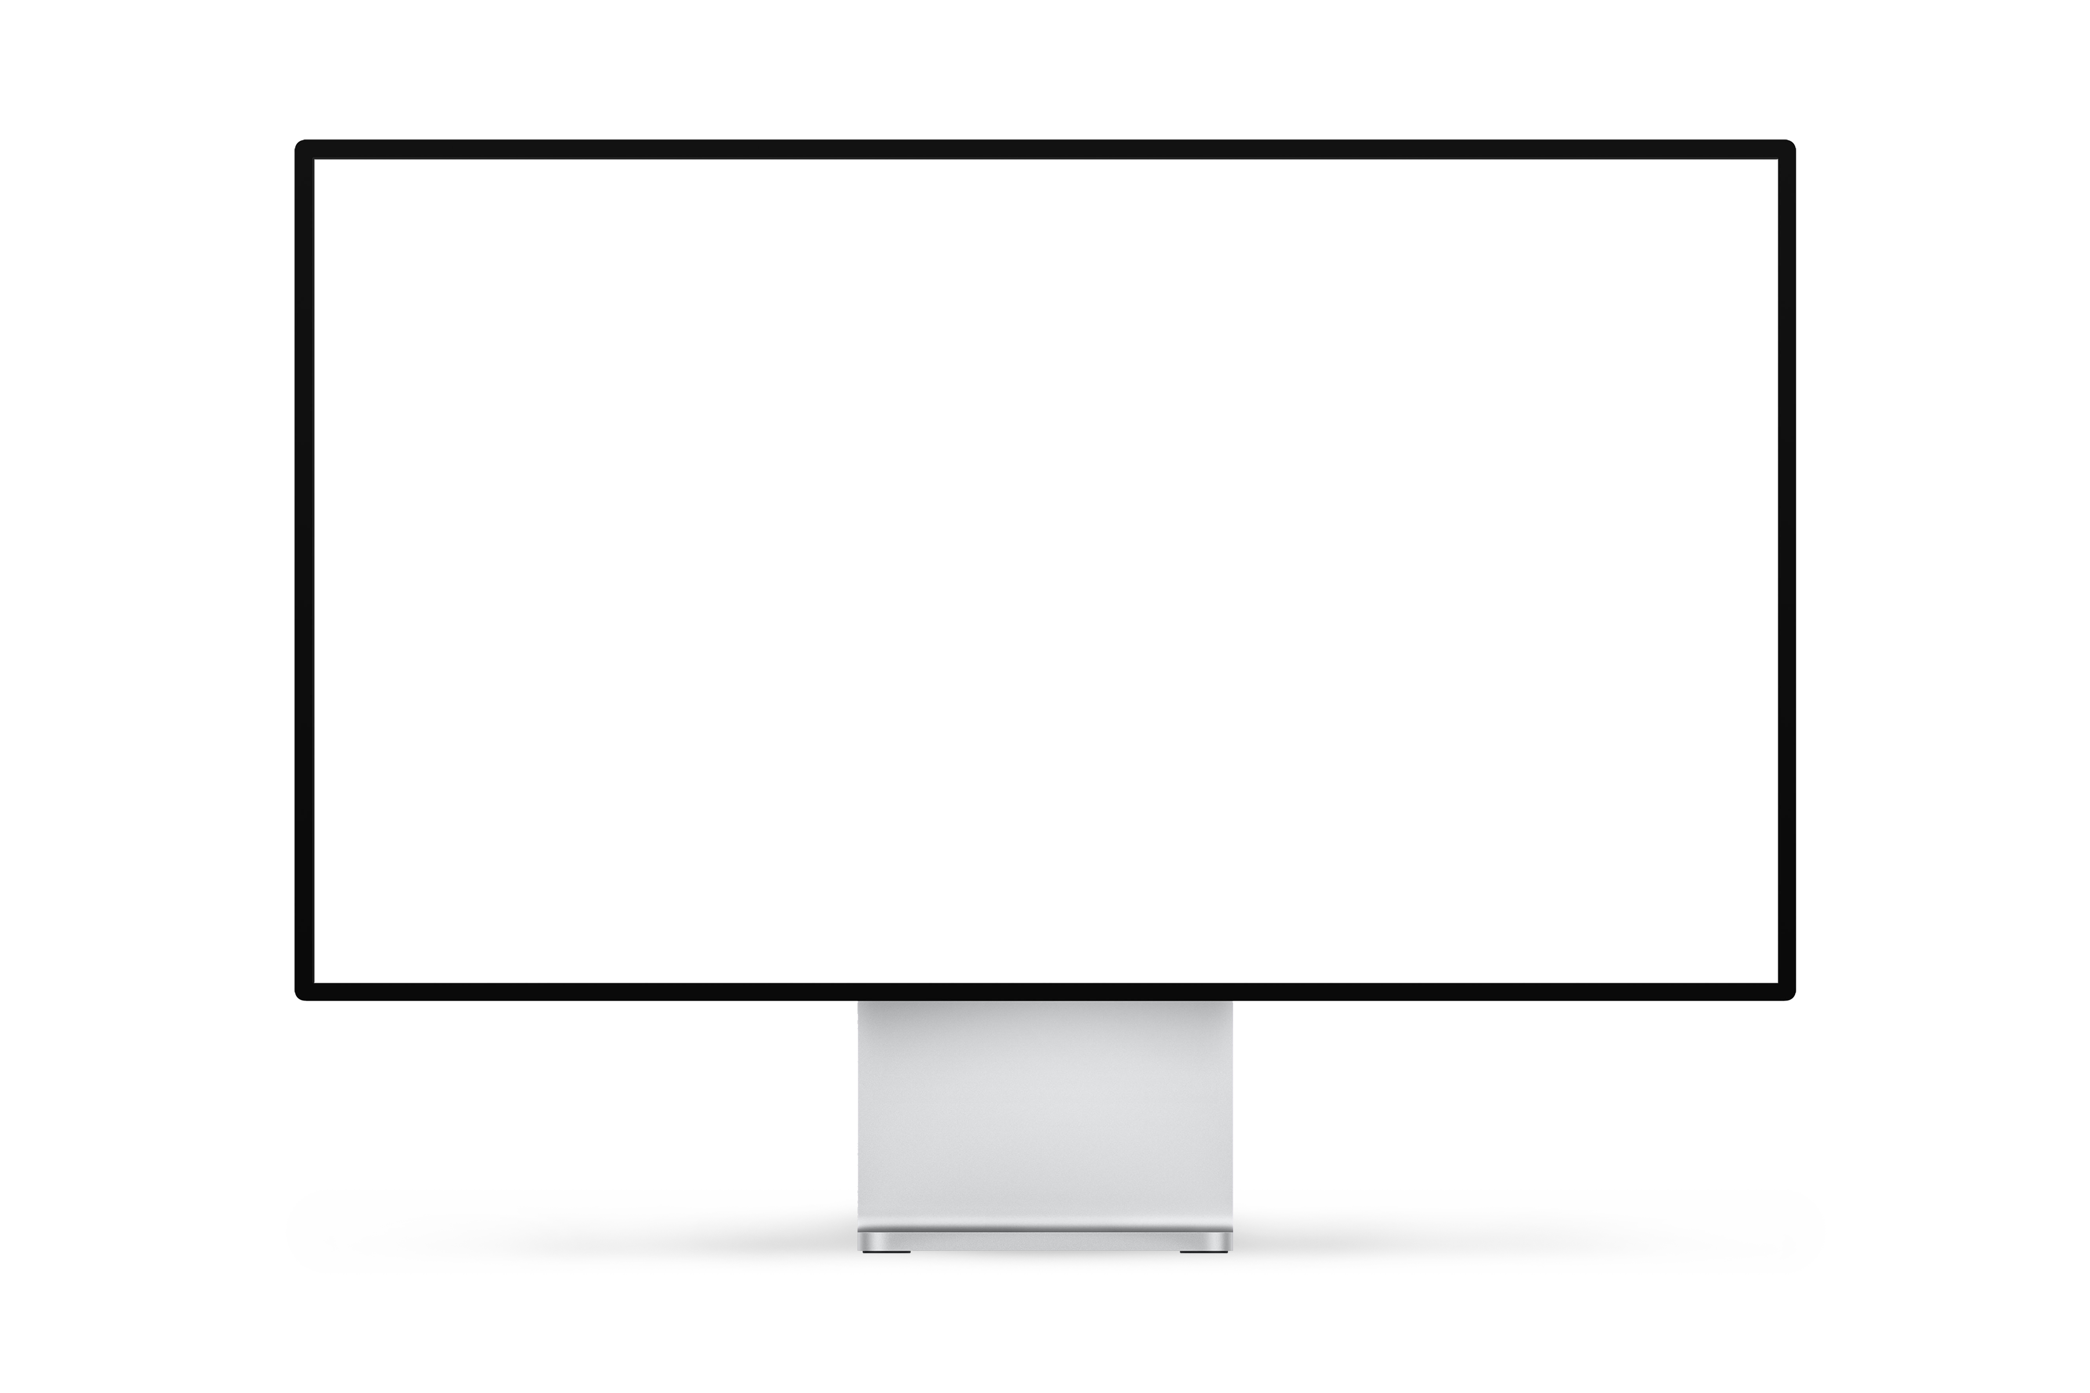
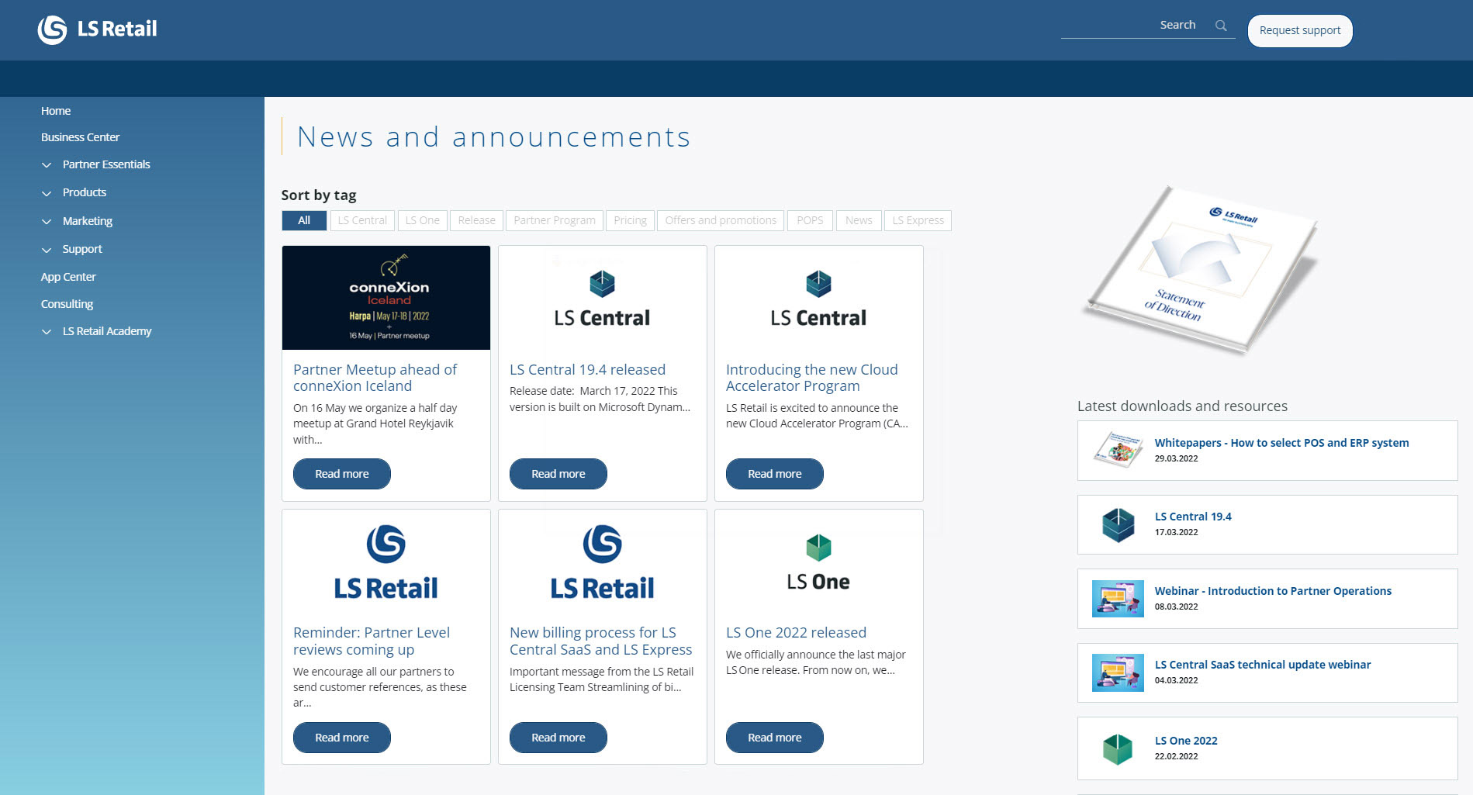
LS Central - maintenance
Support portal
Request for new events
Bugs
Change request

Slide 12
LS Central - maintenance
Support portal
Bugs
Change request
Request for new events

Slide 13

The requirements
Refinement
Is it clear what should be develop
Estimate complexity and effort

Slide 14

Development

Slide 15


Sprint
Plan

Slide 16
Sprint
Plan
Develop

Slide 17
Sprint
Plan
Develop
Peer review

Slide 18
Sprint
Plan
Develop
Peer review
Functional test

Slide 19
Sprint
Plan
Develop
Peer review
Functional test
Merge to master

Slide 20
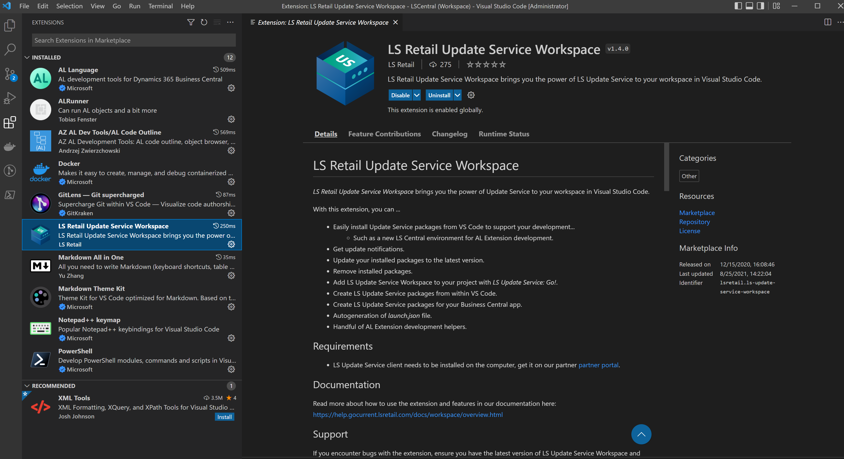
The dev environment
Azure DevOps
VS Code
LS Update Service
  Developers
  Testers
Jira support desk

Slide 21
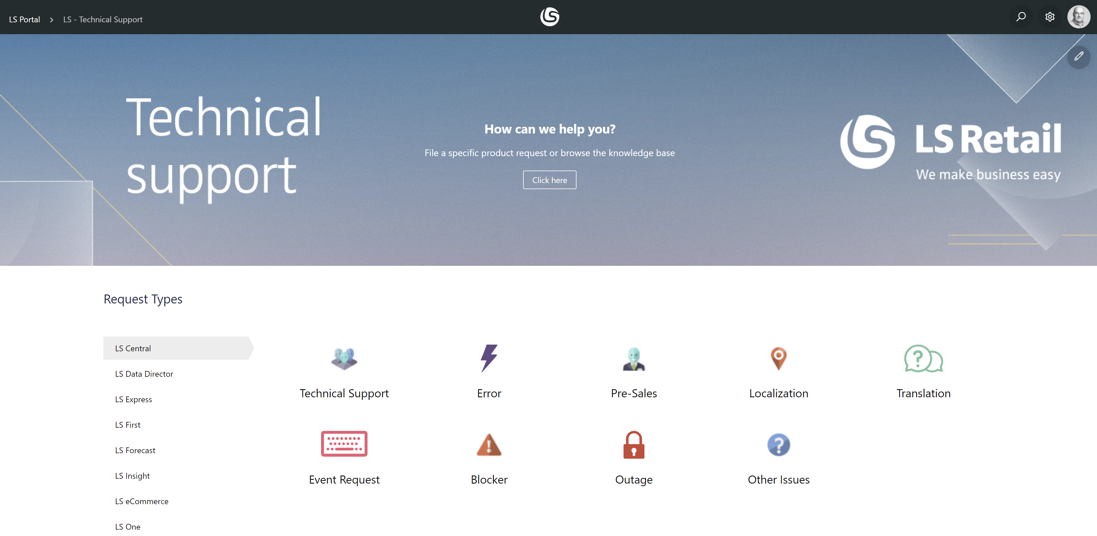
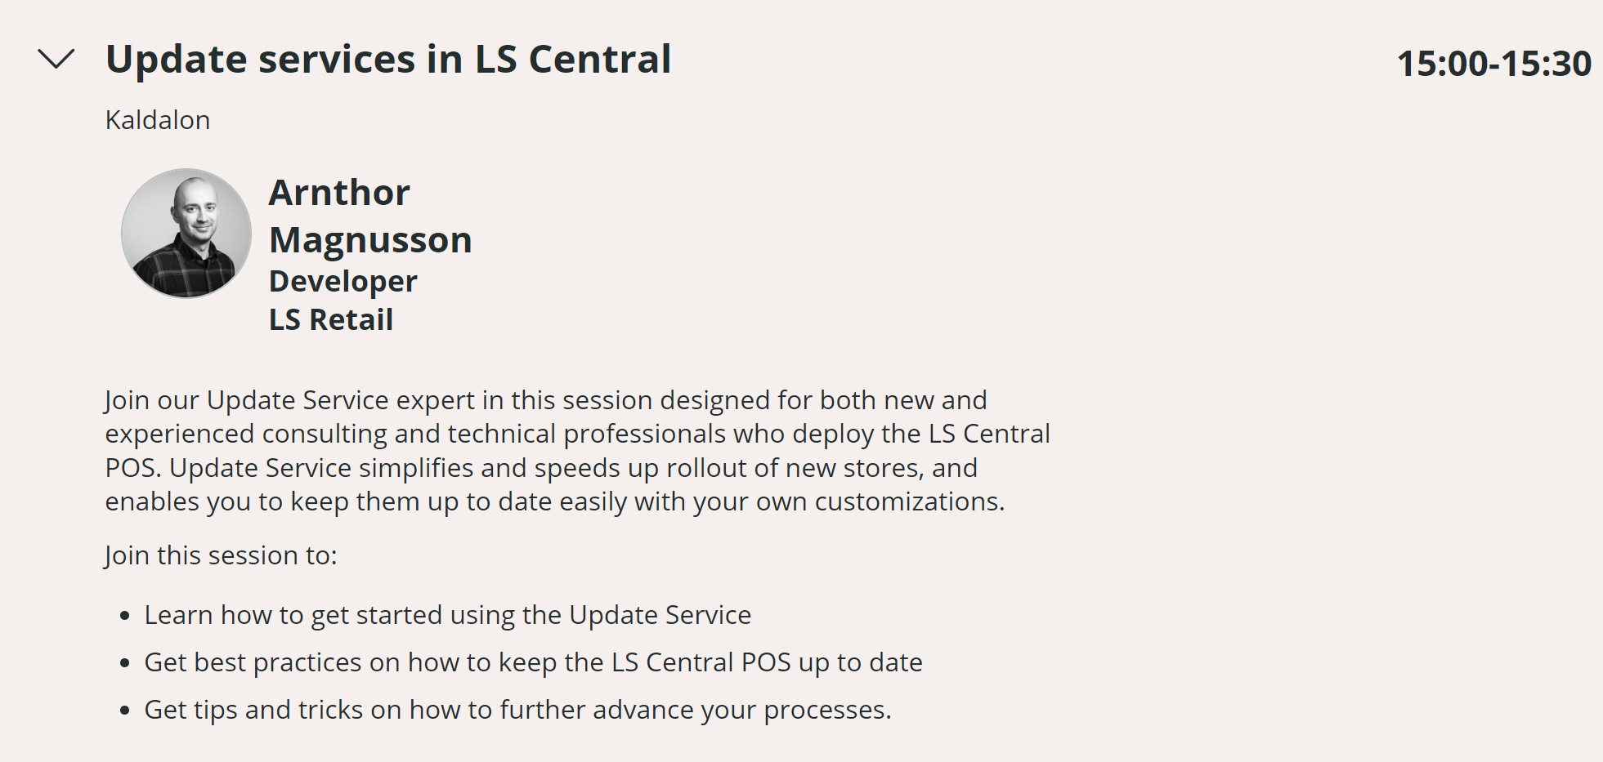
The dev environment
Azure DevOps
VS Code
LS Update Service
  Developers
  Testers
Jira support desk

Slide 22
The dev environment
Azure DevOps
VS Code
LS Update Service
  Developers
  Testers
Jira support desk

Slide 23

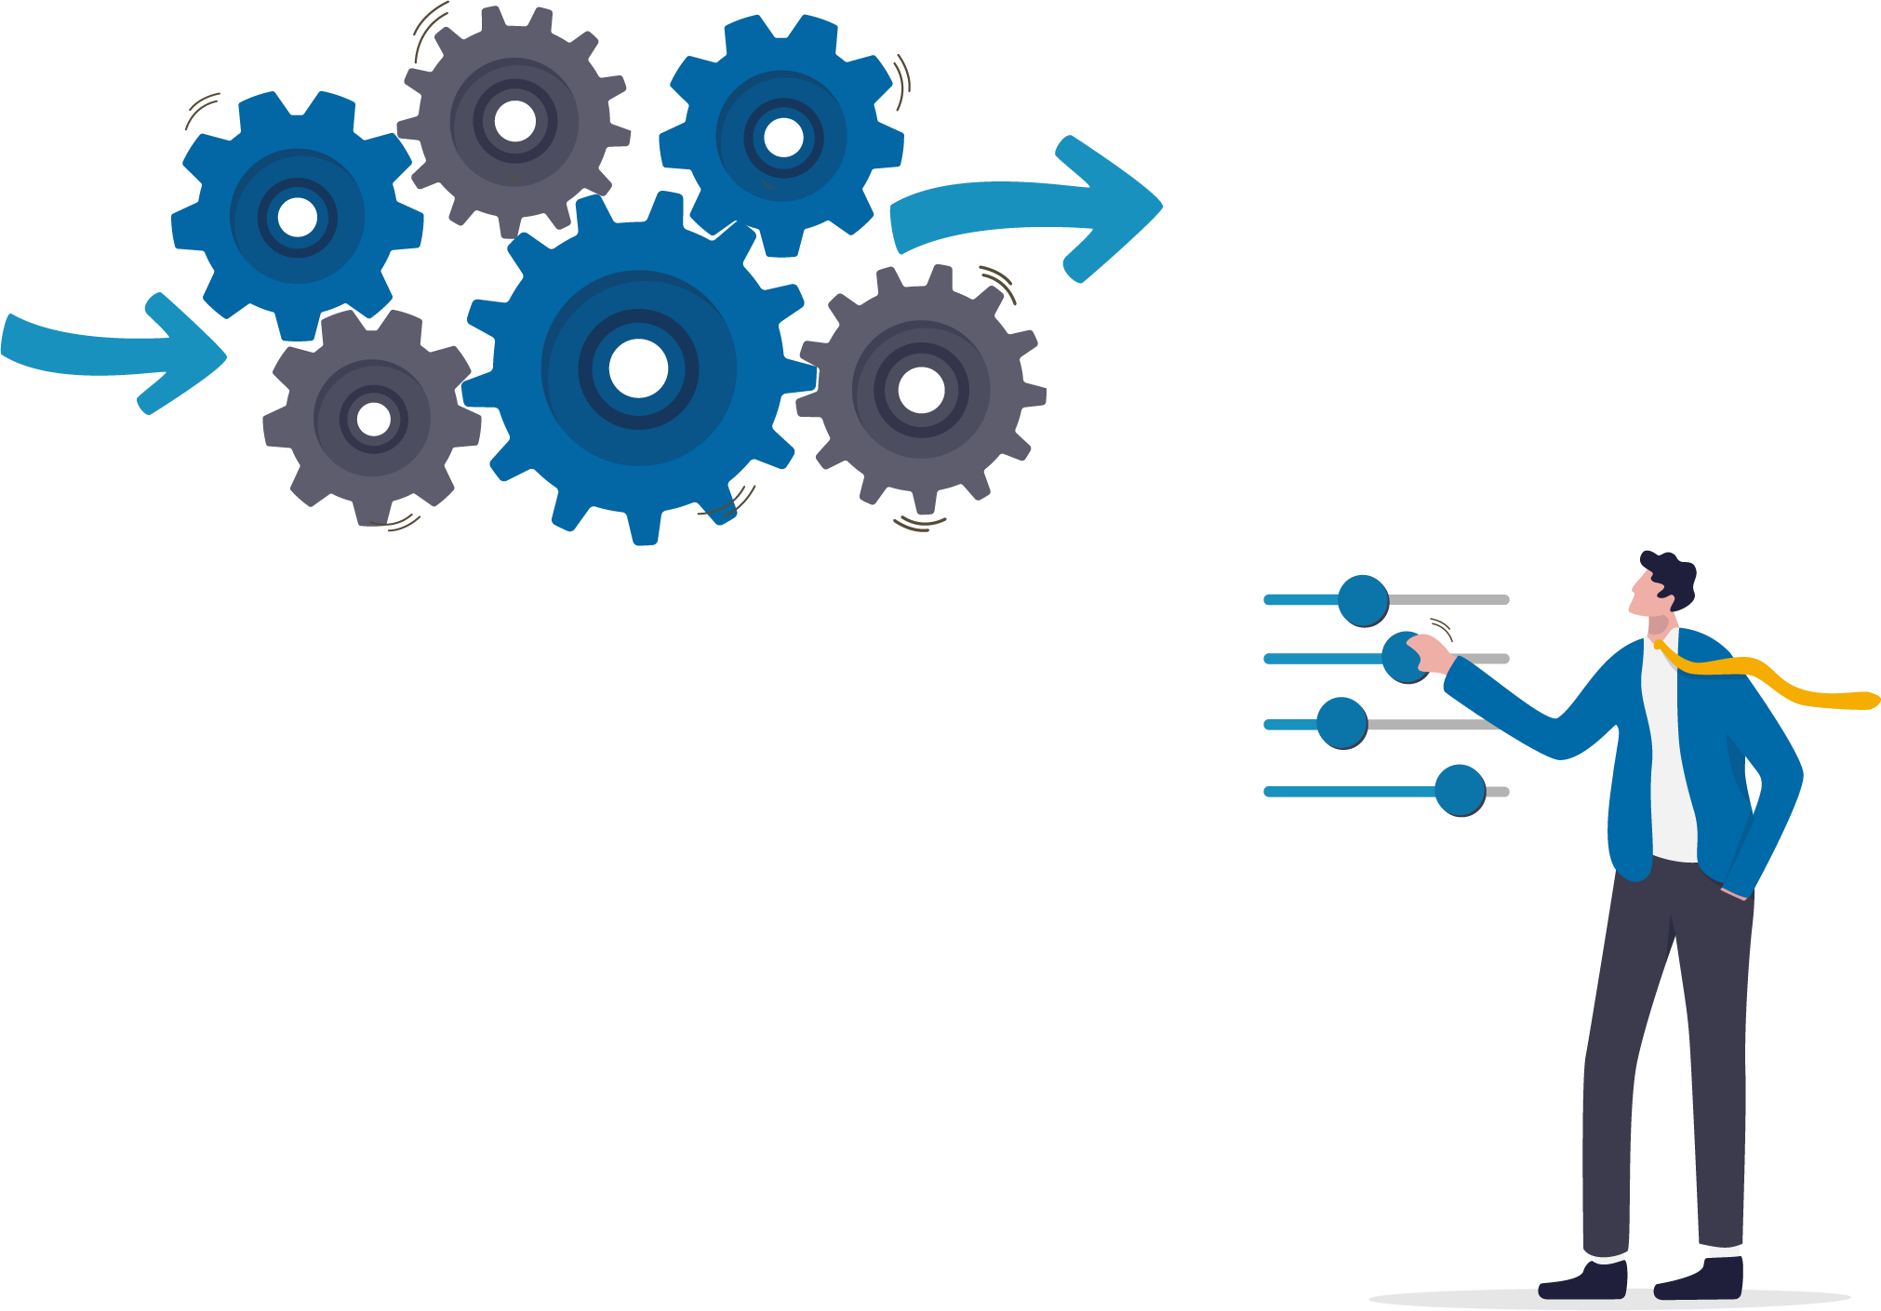
Autotests
2.529
457
LS Central
Hardware station

Slide 24
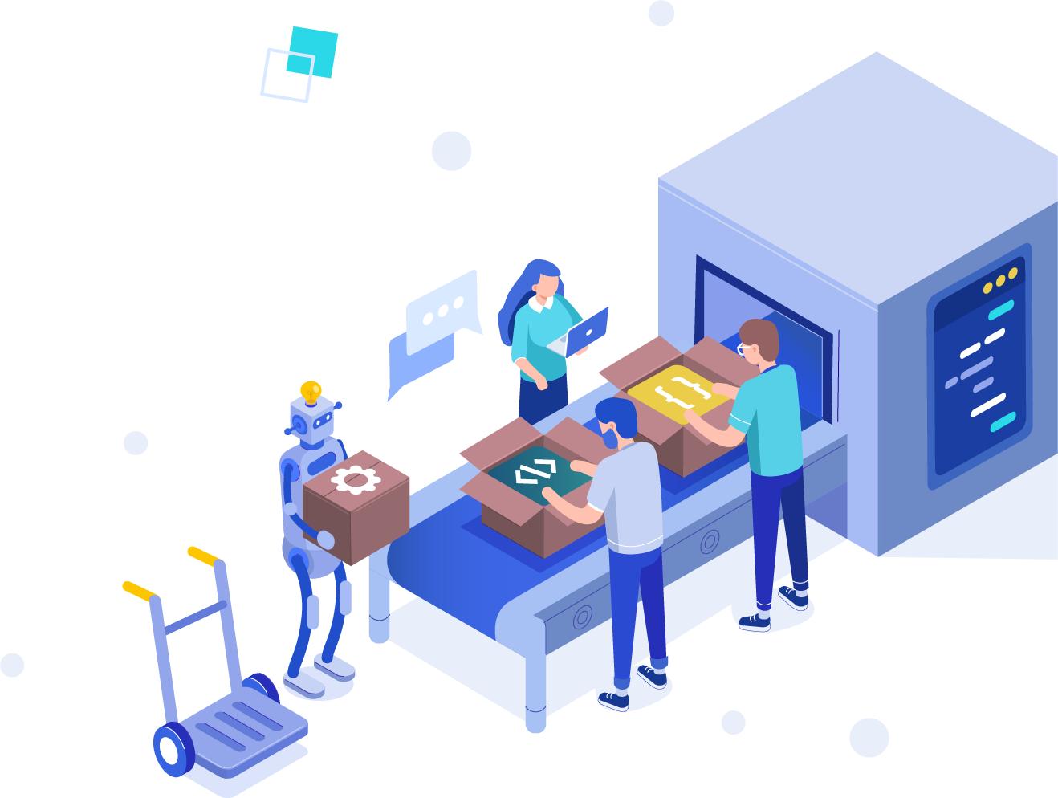
Upgrading master to a new version of Business Central
Branch with new version
Compile apps, fix issues
Upgrade database with LS Update Services

Slide 25
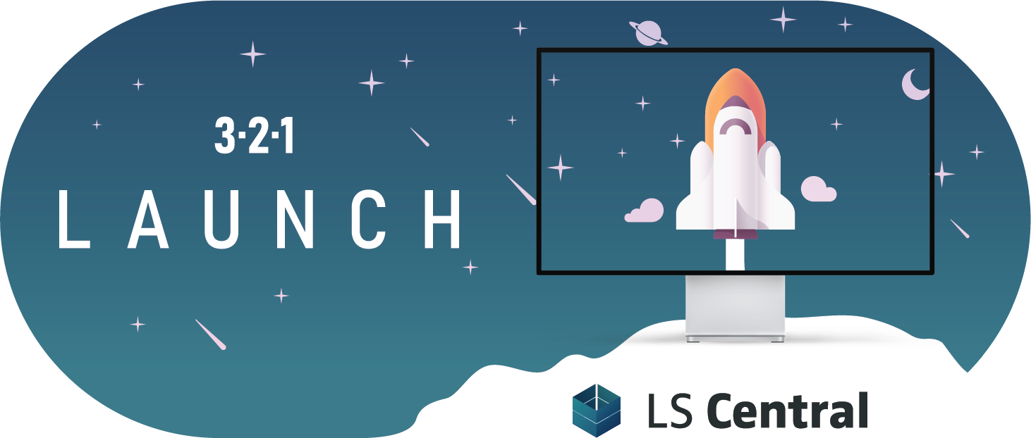

Slide 26
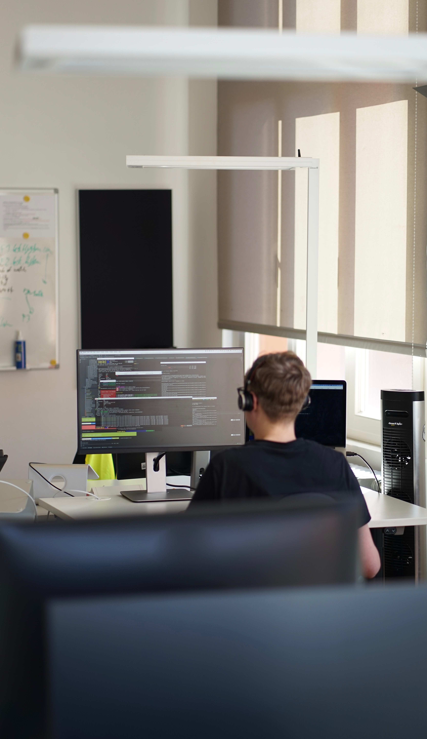







Release cycle
Code Freeze
Demo Data Freeze
Release candidate
QA
W1 release
Localization
Localization release

Slide 27
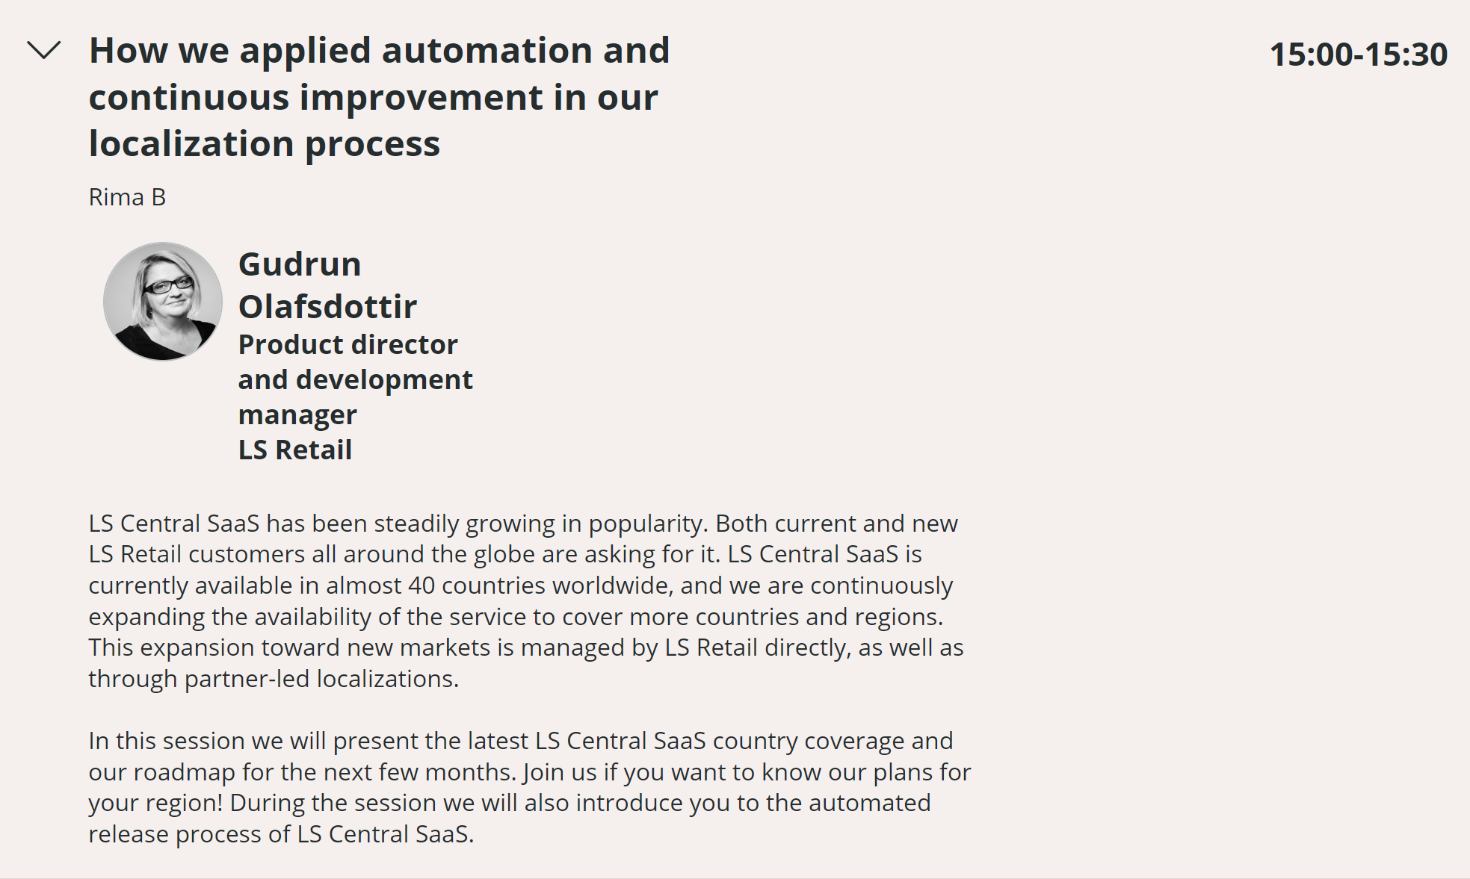
Release cycle

Slide 28

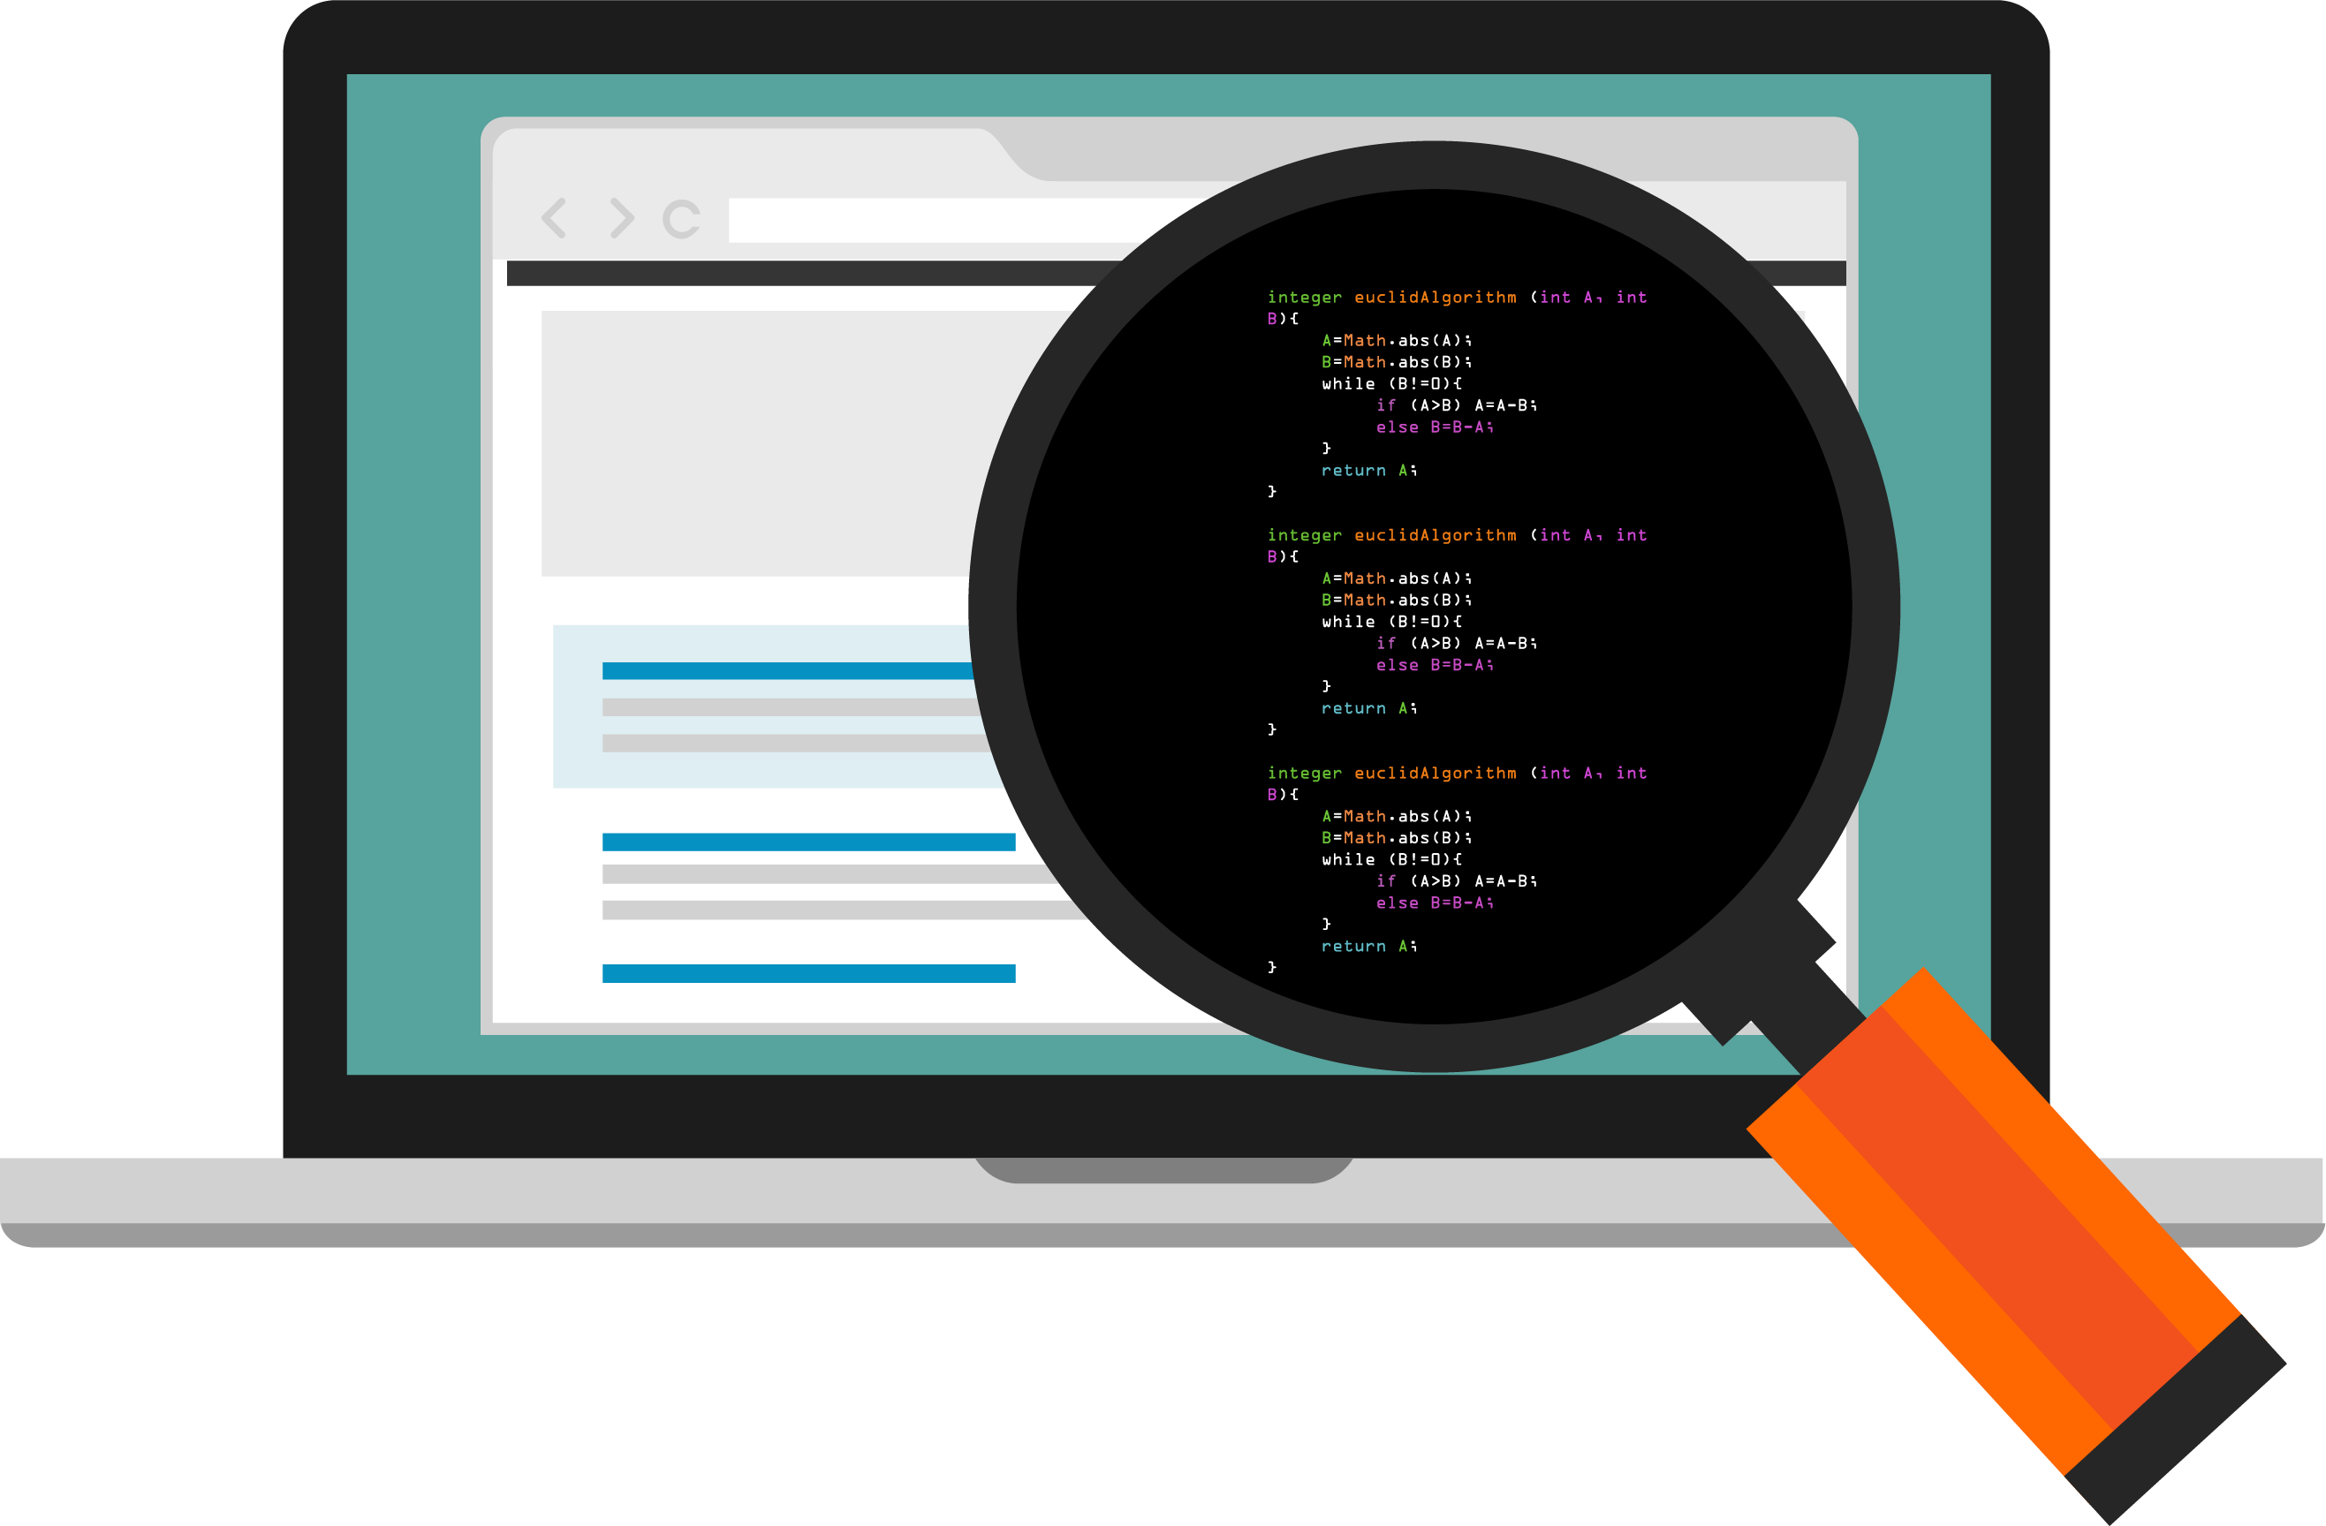
Release test

Slide 29
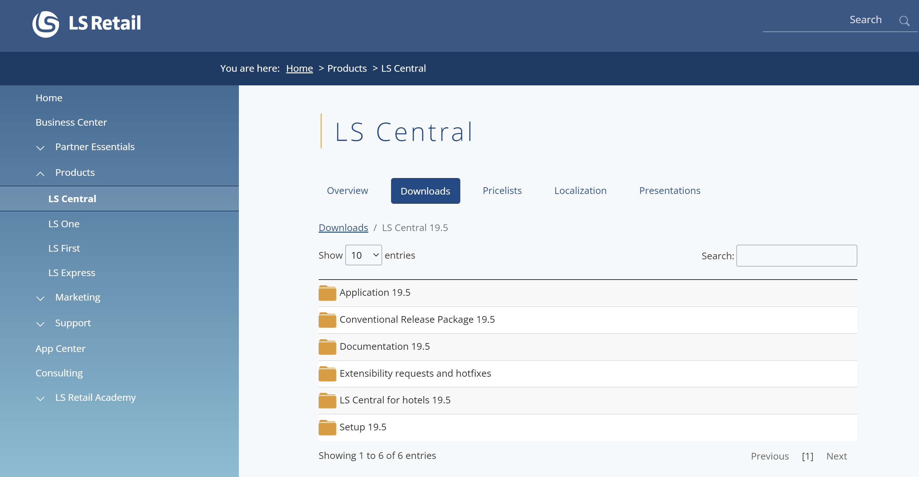
On-prem releases
LS Central
  LS Central System app
  LS Central app
Hardware Station
Kitchen Display Service
Toolbox
Not in package:
LS Hotel
LS Commerce server
Online Help

Slide 30
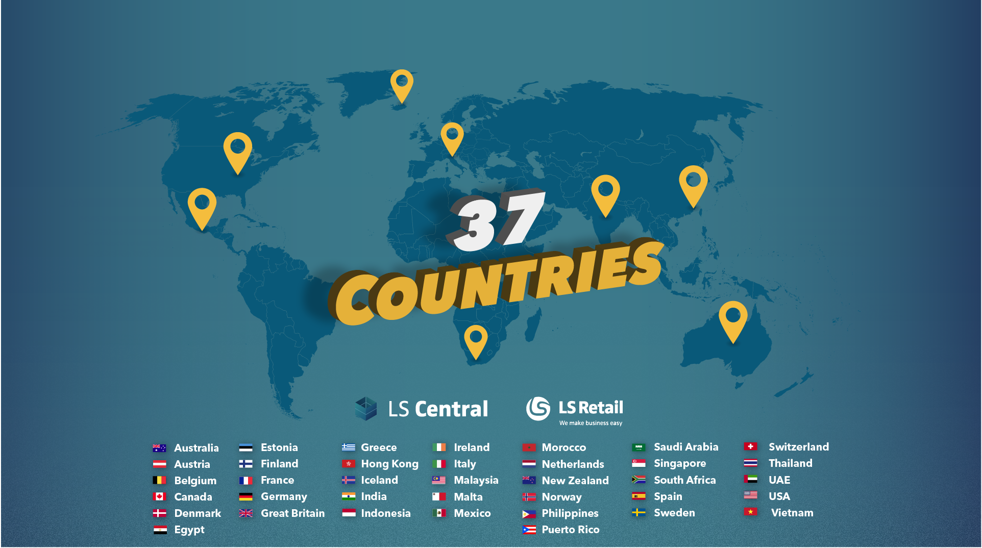

Slide 31
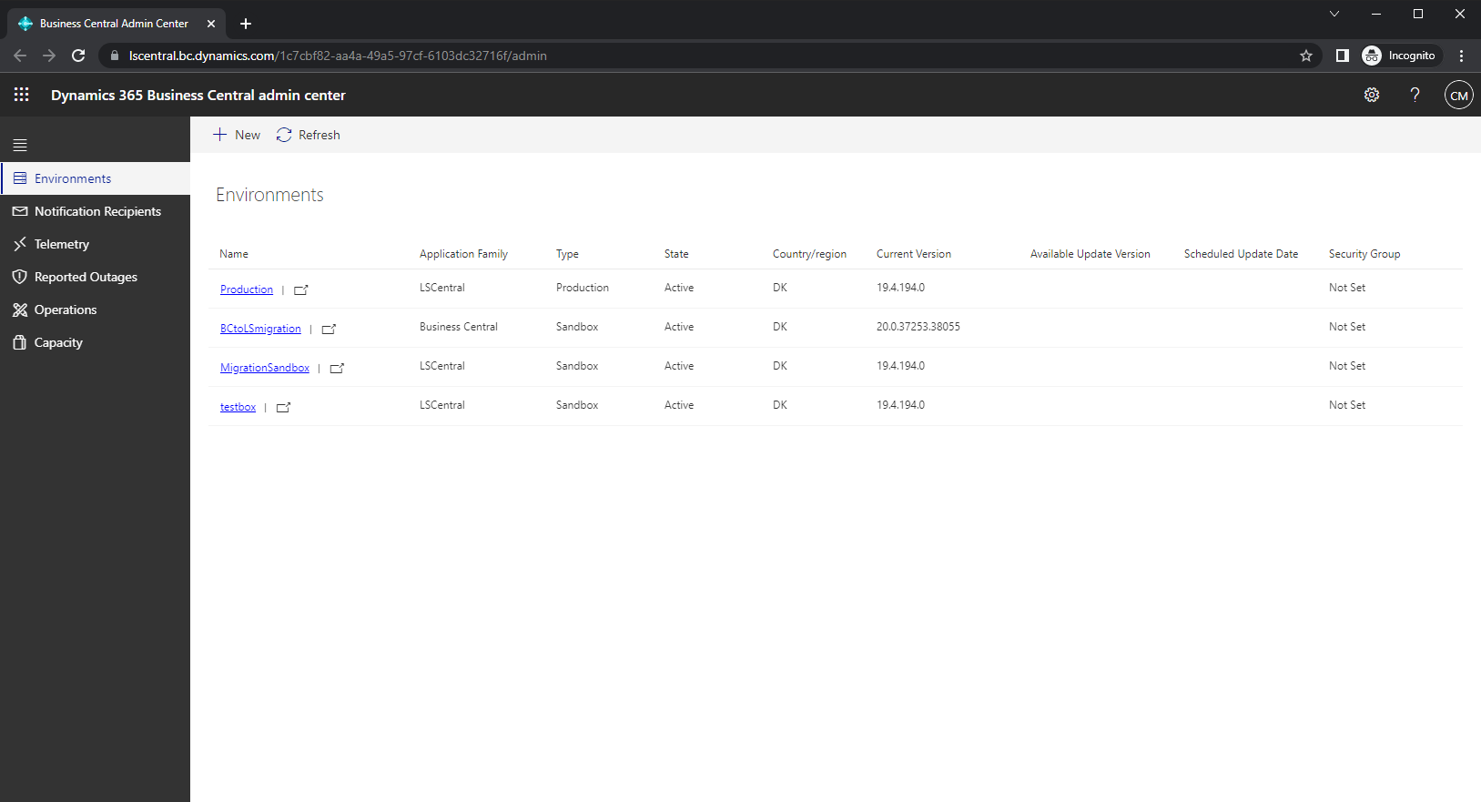

Business Central Admin Center
Environments
Notification recipients
Telemetry

Slide 32
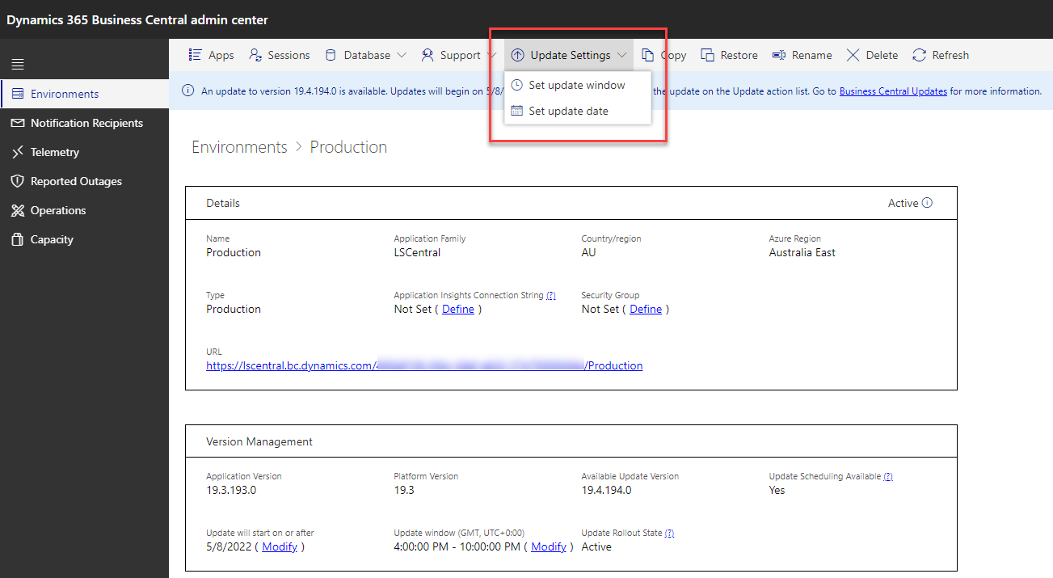

How to schedule an upgrade?

Slide 33
What if the upgrade fails?
Environment restored to previous version
Upgrade error visible in Admin Center

Slide 34


Hotfixes
What can be released as a hotfix?
Only AL code changes
Hotfix release
Available on the partner portal
New version is deployed to SaaS
Online help
Hotfix version
  LS Central v. 19.5.11

Slide 35
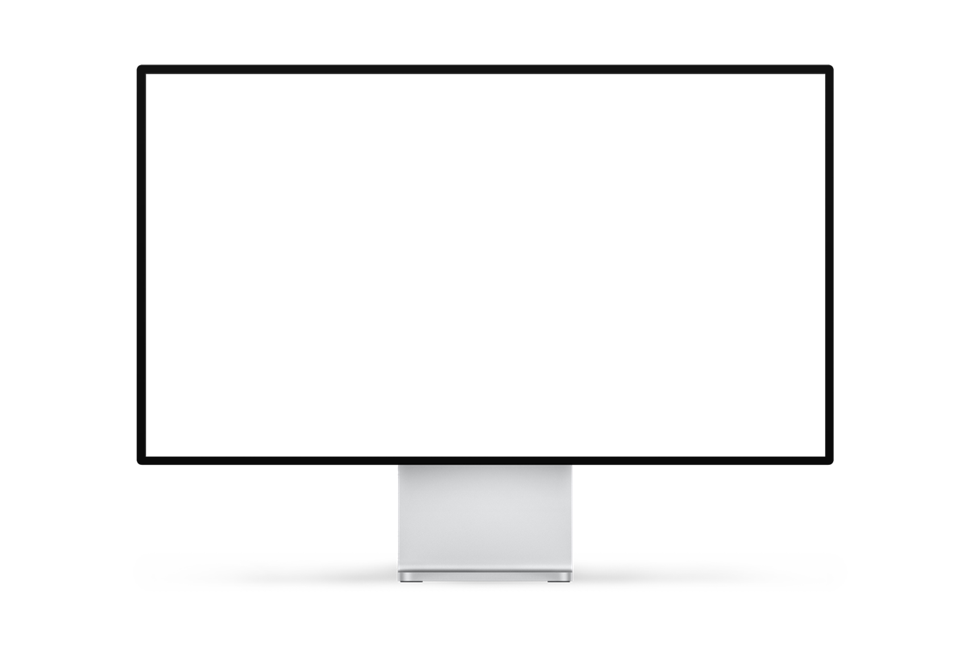
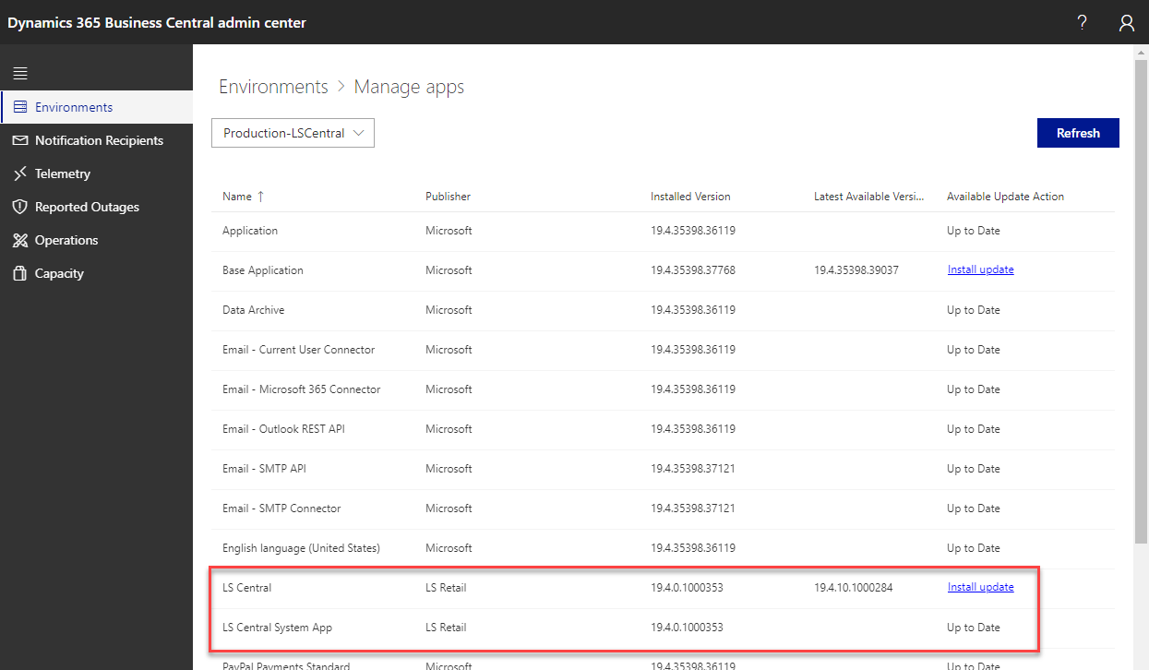
How to install a hotfix?

Slide 36
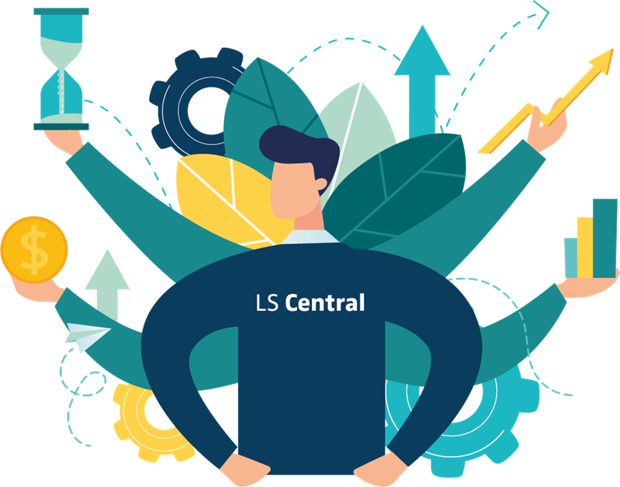
What the customers get every year
Before AL
After
10
12
LS Central W1
LS Central W1
30
360
Localizations
Localizations (12 x 30)
40
372
Apps released every year
Apps released every year

Slide 37

Quality is a key element building LS Central.
One system benefiting a wide spectrum of customers.

