Slide 1
SaaS architecture
and Replication
Matthias Matthiasson
Johann Sveinsson
Jacob Nickelsen

Slide 2

Agenda
Architecture
Scheduler
Data Director
Send Transaction
Web Replication
Hybrid
  Server
  SaaS Replication
  Azure Services

Slide 3
Architecture

Slide 4
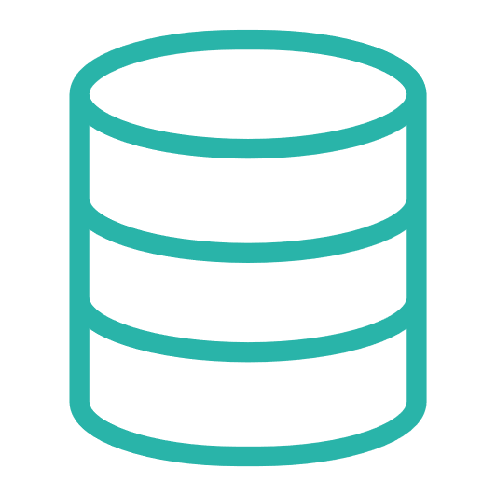

Architecture
Retailer Hosted or
Outsourcing Hosted
HQ
Data Director
Store
Offline POS
Offline POS Service

Slide 5

Architecture
Dynamics 365 cloud
HQ
Hybrid component server
Store
Online POS
Offline POS
Offline POS Service

Slide 6
Architecture
Web
Replication
Dynamics 365 cloud
HQ
Hybrid component server
Store
Online POS
Offline POS
Offline POS Service

Slide 7
Scheduler

Slide 8
Scheduler - overview
Define the object to execute
Define tables and fields
Runs the jobs (objects)
Same as before
Controls all replications

Slide 9
Data Director

Slide 10
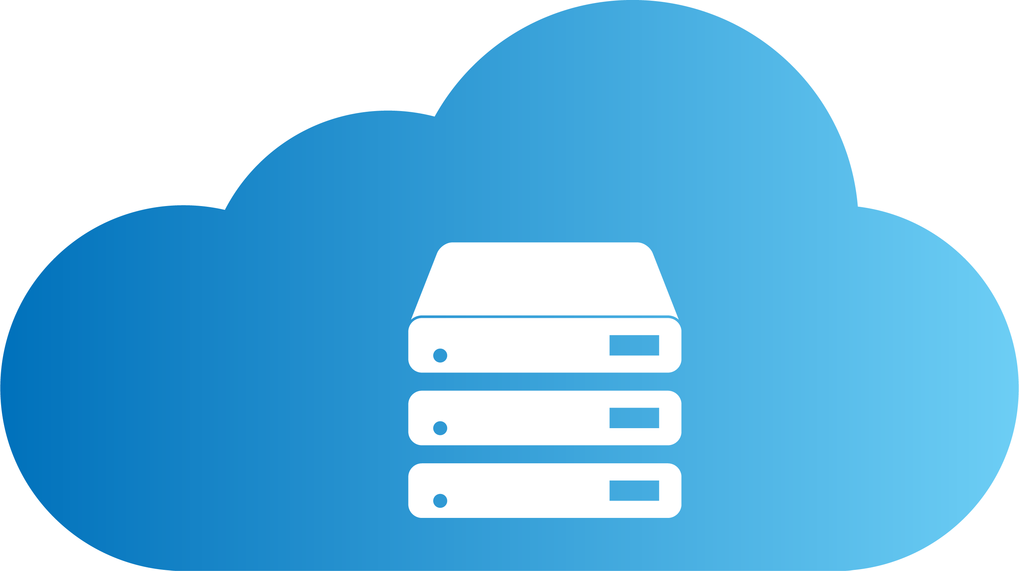


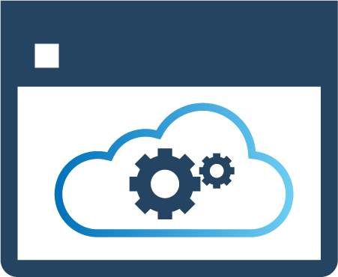


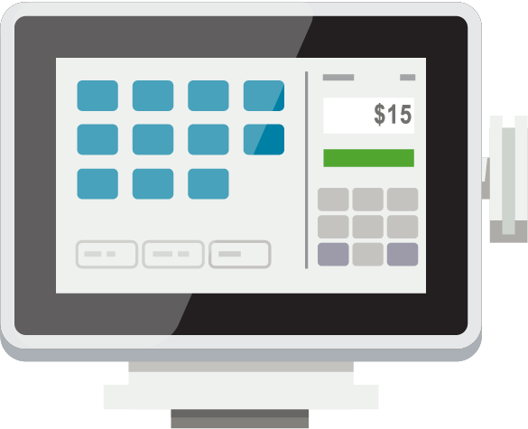
Data Director
DD gets the data
Generates data files and compresses the data
Sends it over to the destination Host
Destination host unpacks the data and inserts the data
DD Webservice mode​
HYBRID
COMPONENT SERVER
POS MASTER
DATA DIRECTOR
UPDATE SERVICE
Offline POS
Offline POS

Slide 11
Data Director
Changes for SaaS
Data Director needs webservice to read from SaaS SQL
DD needs to be hosted by the partner / retailer
DD Webservice mode​
HYBRID
COMPONENT SERVER
HYBRID
COMPONENT SERVER
HYBRID
COMPONENT SERVER
UPDATE SERVICE
POS MASTER
UPDATE SERVICE
POS MASTER
DATA DIRECTOR
DATA DIRECTOR
Offline POS
Offline POS

Slide 12
Send Transactions

Slide 13
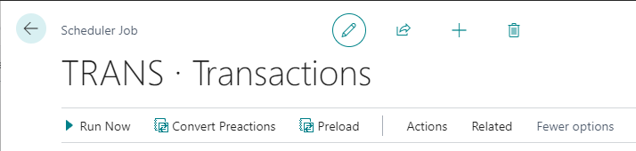

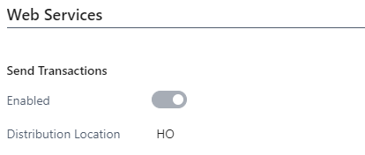
Send Transaction
How to Send Transactions
Replicate by Scheduler Jobs, indirect (Data Director)
DD Push – Pos creates the packages and DD moves
  Controlled by POS Functional Profile (Data Director)
Replicate using web requests, direct
  Controlled by POS Functional Profile (Web Services)
  Recommended for SaaS

Slide 14

Send Transaction
By dedicated Web Request SendTransaction
Can be run directly or in the background Session
xmlport defines tables and fields.
How to extend
New xmlport, implementing all fields and table (SendTransactionXML).
New codeunit to publish the new xmlport (SendTransaction).
New codeunit to extend the standard SendTransactionUtils
Use events to implement changes (SendTransactionUtils).

Slide 15

Send Transaction
By using Web Replication in Background Session
No xmlport
Includes all fields for selected tables.
How to extend
New codeunit to define additional tables in the replication
local procedure OnAfterLoadTransactionTables(var TransactionHeaderTemp: Record "LSC Transaction Header" temporary;
var BufferUtility: Codeunit "LSC Buffer Utility")

Slide 16
Web Replication

Slide 17
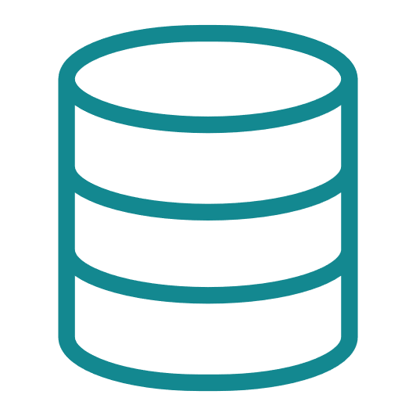

Web Replication
All within BC (AL code)
Uses webservices (no DD)
Controlled by Scheduler Job
Between two BC companies
  Same or different (another BC company) tenants
Creates data packages
Packages moved and inserted to temporary table
Run a Scheduler job
Data collected for transfer
Pack 1
Receive data
Insert data to tables
Pack 2
Pack 3
Pack 4
Done
SaaS company B
SaaS company A

Slide 18
Web Replication
Creates data packages
Packages moved and inserted to temporary table
When last/done package arrives then tables are updated
All data is rolled back if there is a problem
All within BC (AL code)
Uses webservices (no DD)
Controlled by Scheduler Job
Between two BC companies
  Same or different (another BC company) tenants
Run a Scheduler job
Data collected for transfer
Collect data
Insert data to tables
Pack 1
Pack 2
Pack 3
Pack 4
Done
SaaS company A
SaaS company B

Slide 19
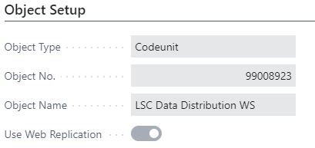
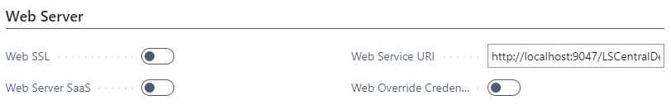
Web Replication
Replication activated on the Scheduler job card
All Destination Locations must have valid Web Server Connection.
Monitoring UI found in the Scheduler Setup page

Slide 20
Web Replication - limitations
From distribution – current location
Normal jobs – only Add-update
Only replication between identical tables
Some other filtering limitations and constants on linked table

Slide 21
Company Replication
Concept – not in solution

Slide 22

Company Replication
Web Replication
What is Company Replication?
What challenge does Company Replication Solve?
Company
Replication
Dynamics 365 cloud
Environment
Concept – not in solution

Slide 23
Company Replication
Web Replication
What is Company Replication?
What challenge does Company Replication Solve?
What do you think? – DISCUSSION PLEASE
Company
Replication
Dynamics 365 cloud
Environment
Concept – not in solution

Slide 24
Hybrid

Slide 25

Head office user
HEAD OFFICE IN THE CLOUD
SendTransaction WS
DD Webservice mode​
SendTransaction using Web Replication​
HYBRID
COMPONENT SERVER
POS MASTER
DATA DIRECTOR
UPDATE SERVICE
DD
DD
STORE 1
STORE 2
Back office
Offline POS
Offline POS
Offline POS
Offline POS

Slide 26
SaaS Replication

Slide 27
Head office user
HEAD OFFICE IN THE CLOUD
SendTransaction WS
DD Webservice mode​
SendTransaction using Web Replication​
HYBRID
COMPONENT SERVER
POS MASTER
DATA DIRECTOR
UPDATE SERVICE
DD
DD
STORE 1
STORE 2
Back office
Offline POS
Offline POS
Offline POS
Offline POS

Slide 28
HEAD OFFICE IN
THE CLOUD
DD Webservice mode​
HYBRID
COMPONENT SERVER
POS MASTER
DATA DIRECTOR
UPDATE SERVICE
DD
DD
STORE 1
STORE 2
Offline POS
Offline POS
Offline POS
Offline POS

Slide 29

HEAD OFFICE IN
THE CLOUD
Azure
Storage
Anything
new?
Fetch 20,21,22
Done
HYBRID
COMPONENT SERVER
Pack
20,21,
22
20
21
UPDATE SERVICE
22
STORE 1
STORE 2
Offline POS
Offline POS
Offline POS
Offline POS

Slide 30
Azure Services

Slide 31
HEAD OFFICE IN
THE CLOUD
Azure
Storage
HYBRID
COMPONENT SERVER
UPDATE
SERVICE
Commerce Service
Hosted by
LS Retail
Hosted by
LS Retail
UPDATE SERVICE
STORE 1
STORE 2
Offline POS
Offline POS
Offline POS
Offline POS

Slide 32
SaaS HEAD OFFICE
Hosted by Microsoft
Commerce
Service
LS Retail Services
Hosted in Azure
by LS Retail
UPDATE
SERVICE
Azure
Storage
STORE 1
STORE 2
Offline POS
Offline POS
Offline POS
Offline POS

Slide 33

Join us in SaaS

Slide 34
Thank you

