Slide 2
What LS Retail Consulting Americas can do for you as a Partner
Barry Tipping
John Baker
Regional Director
Sales Director
Deena Frye
Principal Consultant

Slide 3

Global thinking
and local support
Over 390 partners
In more than 90 countries

Slide 4
91,000+
Retail and Hospitality Locations
Worldwide
Over 6,400 customers
in more than 157 countries

Slide 5

LS Retail Consulting Services
Vision and mission
LS Retail Consulting Services’ aim is to increase the success of our partners and customers worldwide.
Our goals are to:
Increase the capability and capacity in the channel
Support our partners and customers in sales, and in the full project lifecycle
Increase the quality of the implementations
Reduce project risk and cut down implementation time
Improve license revenue generated by our partners
Bring customer insights into product development
Attract and cultivate talent

Slide 6
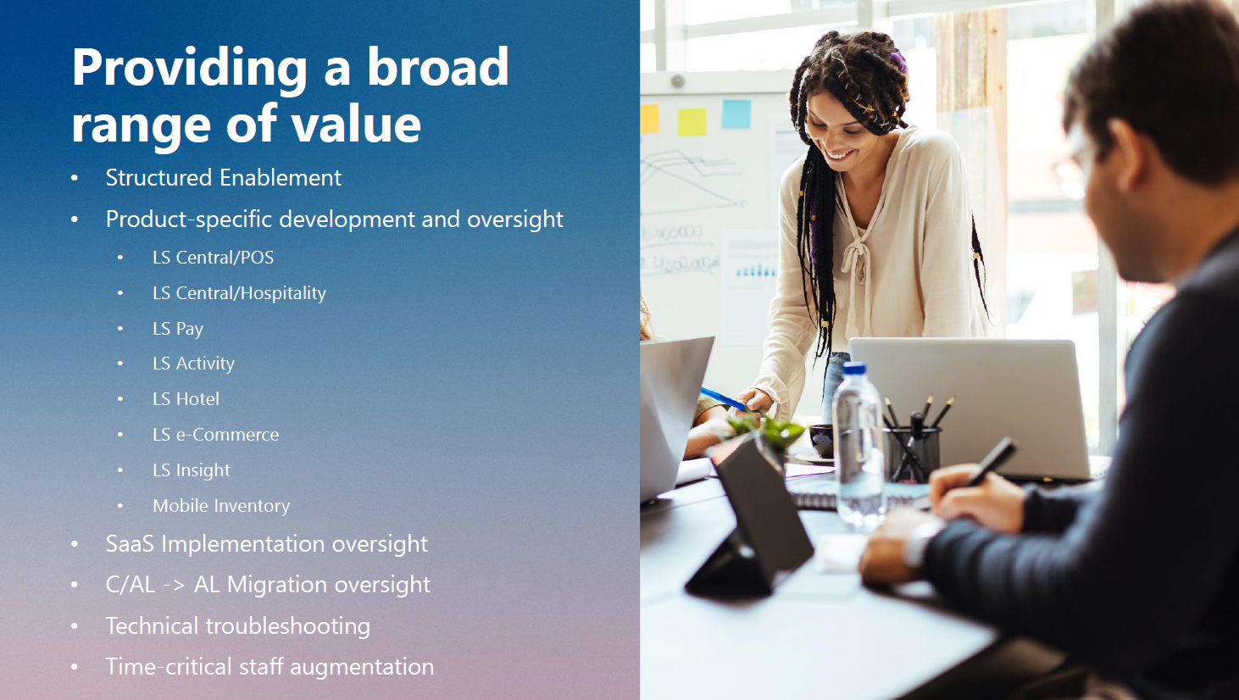
The Partner Enablement Program
Initiated in 2018
Intended to extend LS technology expertise to partners in the Americas
Provided via a T&M SOW

Slide 7
Triage/Troubleshooting
Our Technical Consultants have an average BC experience of 12 years and LS Central experience of 10 years
We have the ability to query LS Retail Product Development when issues arise with product functionality
Our consultants use a team problem-solving approach so your assigned consultant acts as your advocate and leverages the combined strength of all the Americas consultants

Slide 8
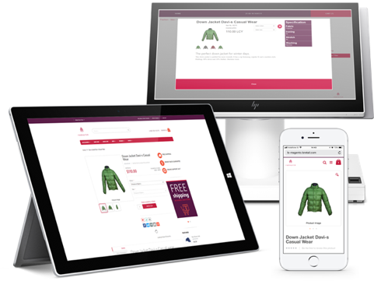
Product Specific Development and Oversight
Providing mentoring or customization support for:
  LS Central/POS
  LS Central/Hospitality
  LS Pay
  LS Activity
  LS Hotel
  LS e-Commerce
  LS Insight
  Mobile Applications

Slide 9
SaaS Implementation, Upgrade, and Migration
Our consultants have implemented some of the largest SaaS implementations on LS Central SaaS
Areas that they can share knowledge include:
  AL Development
  DEVOPS/GIT
  Extension design
  PowerShell
  Azure environment
  Update Service (aka GoCurrent)
  Telemetry/Performance monitoring
  Hybrid POS configuration

Slide 10
Structured Enablement
Provides full lifecycle support to partners implementing LS Central
Activities include:
  Project Kick-off meeting
  Post Kick-off planning and prioritization meeting
  Project Plan Review
  Functional Requirements Review
  Technical Requirements Review
  Architecture Review
  Design Review(s) (Integrations, Customizations, etc.)
  Milestone checkpoints/risk reviews
  Code Review(s)
  UAT readiness review
  Go-live readiness review
  Go-live support/Post-live support (as requested)

Slide 11

C/AL -> AL Migration
For projects migrating from legacy versions, our consultants can provide two types of support:
Guidance for partners as they work through migration of C/AL code to AL
Migration of discrete portions of C/AL code to AL with KT to partner resources

Slide 12
Time-critical Staff Augmentation
Senior resources that can help your team achieve important delivery goals
Ideally positioned to support a team as an “expeditor” to help overcome obstacles and drive issues to closure or
As the owner of discrete portion of functionality that can be accomplished in under 100 hours

Slide 13
Partner Enablement Success
As of May 2023, over 50 partners in the Americas have participated in the program, some on multiple occasions
The most popular offerings are:
  Technical Troubleshooting
  Enhancement/Customizations
  Product Specific mentoring/troubleshooting
  Full-lifecycle oversight

Slide 14

Case Study: Retail Caribbean
Engaged LS Central Consulting for Structured Enablement of their first LS Central project in December of 2020
A T&M SOW was signed for 200 hours
The LS Central Consulting team participated in:
  Project Kick Off
  Project Plan Development
  Requirements/FRD review
  Project Checkpoint/Risk Review meetings
  Go-live Readiness Assessment
  Go-live/Post-live Support for Retail Caribbean team
Retail Caribbean has since gone on to deliver additional LS Central Projects with minimal assistance from LS Central Consulting

Slide 15
2023 Offerings

Slide 16
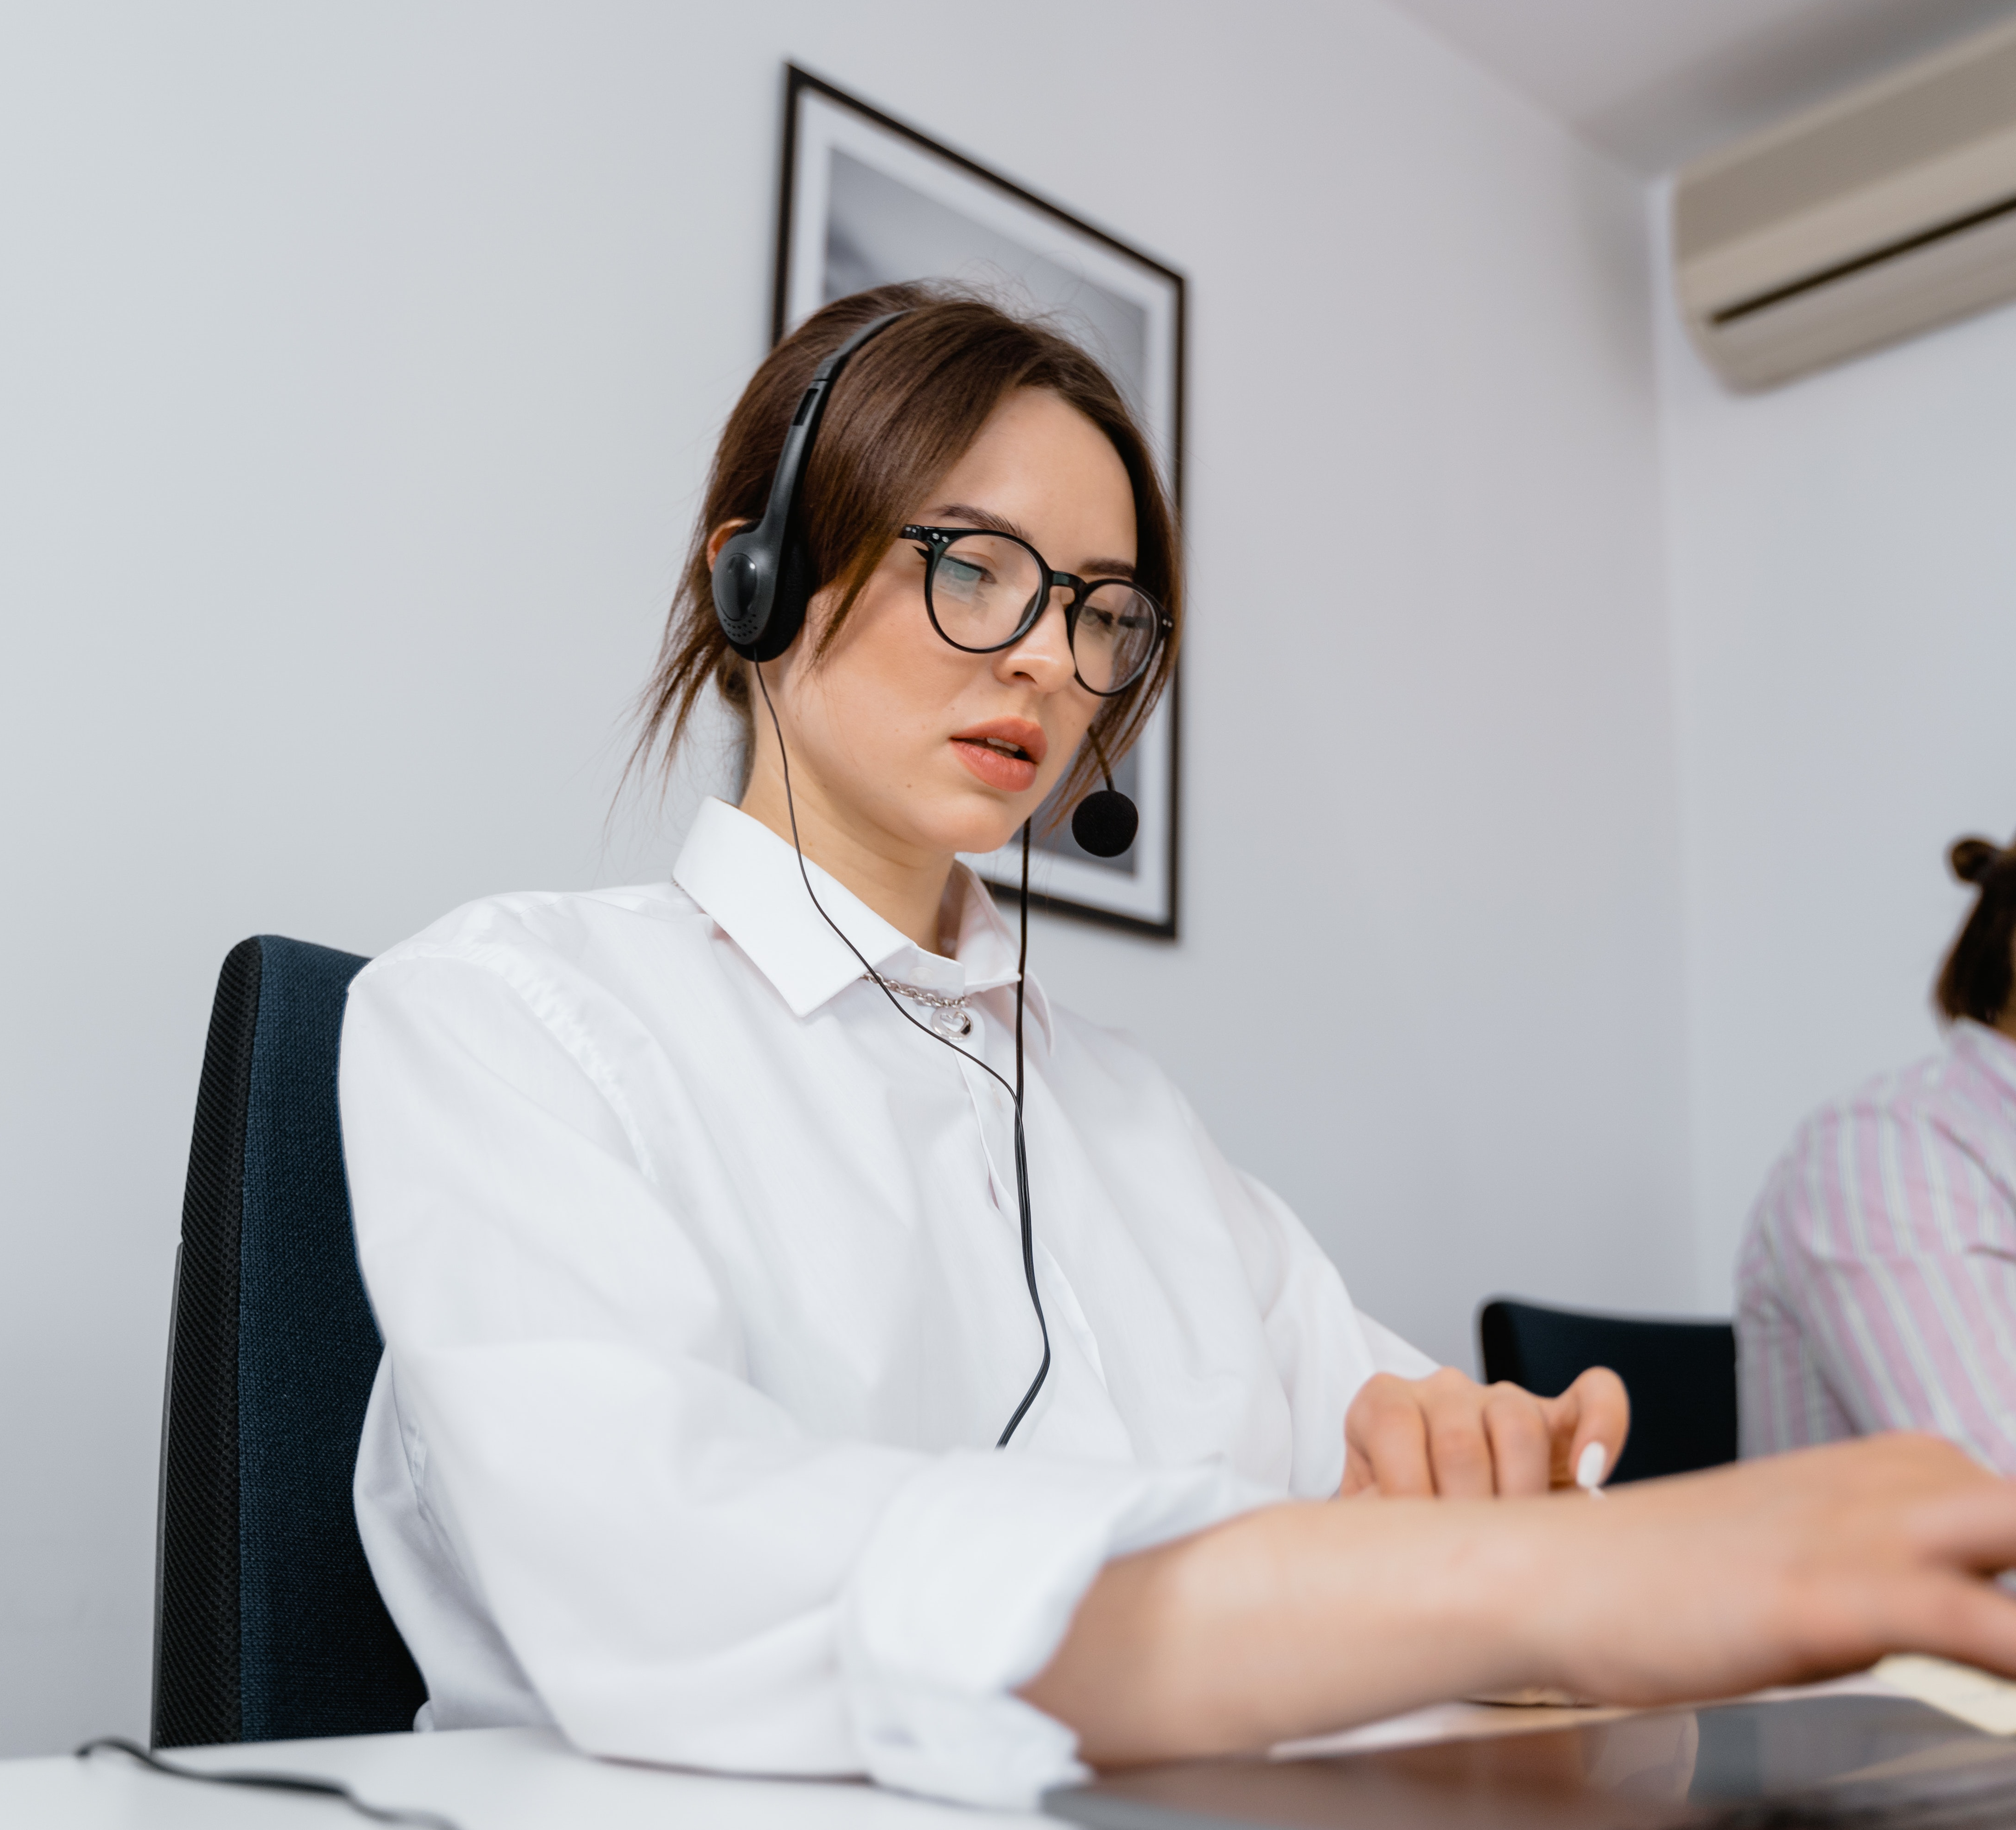
New offerings for 2023 – Level 2 Support
Extremely competitive monthly subscription and per case fees
24/7 ZenDesk Support portal with e-mail/chat/portal case submission
BC and LS Central Knowledgebase
Backed by LS Central Consulting for complex cases
1-month free LS Academy with annual subscription
20% discount on Consulting Services
Cancel with 30-day written notice

Slide 17





New for 2023 Leveraging the Better Together theme
LS Retail will assist partners in joint marketing and promotion opportunities
Target scenarios include engagements that include shared technology partners that can be coordinated to issue press releases and other content
Hypothetical Example:
+
+
+
LS
Impl. Partner
Tech Partner
Customer

Slide 18
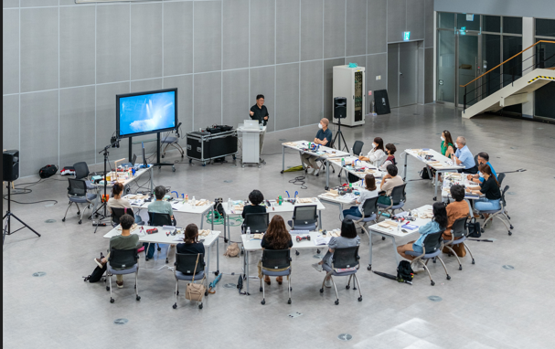
New for 2023 – Consulting Round Tables
1-2 day meetings provided by Principal Consultants from LS Retail Consulting in regional locations for interested partners
Topics will include:
  Replenishment
  Data Director/Scheduler Best Practices
  Hospitality Best Practices
  SaaS Implementation Best Practices
  Update Service Best Practices
Provided in exchange for travel
expenses of the Principal Consultant

Slide 19
LS Central Health Check
The LS Central Health Check Service is a detailed analysis of all functional areas of a BC/LS Central implementation as compared to LS Central Consulting Best Practices
Provides a Comprehensive Health Check Report
1-week of onsite analysis by two senior consultants
1-week report preparation time
$36,000 fixed price regardless of add-on modules or integrations

Slide 20

We welcome your Suggestions
Help us help you!
Send your suggestions for services that LS Retail can provide partners to
Barry Tipping – barryti@lsretail.com
John Baker – john@lsretail.com

Slide 21
Thank you!

