Slide 1
LS First
What we are building on D365 Commerce
Sigurdur Eggert Gunnarsson
Product Director LS First

Slide 2
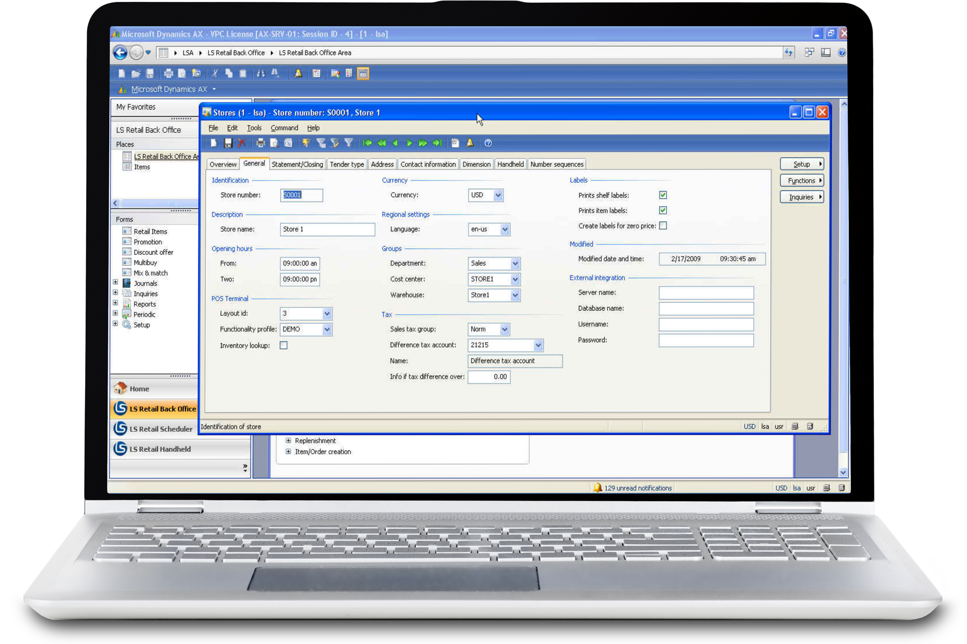
Some history
LS Retail AX sees the light of day in 2006

Slide 3
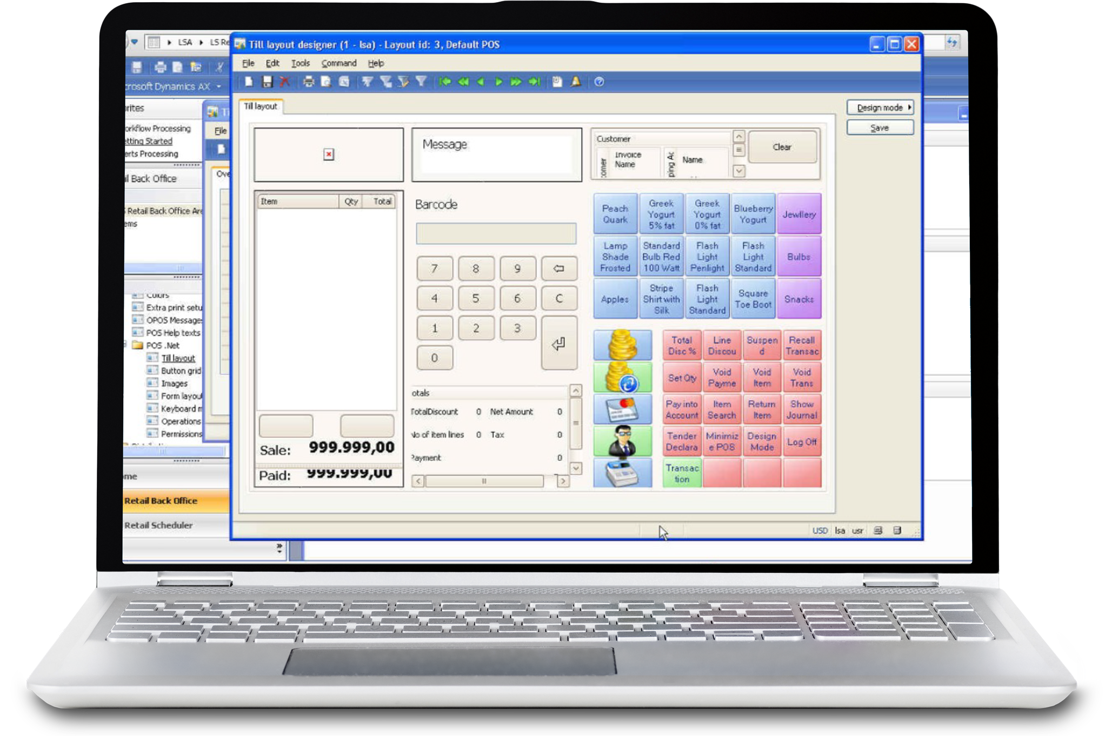
Some history
LS Retail AX sees the light of day in 2006
Microsoft acquires LS Retail AX and POS in 2009

Slide 4
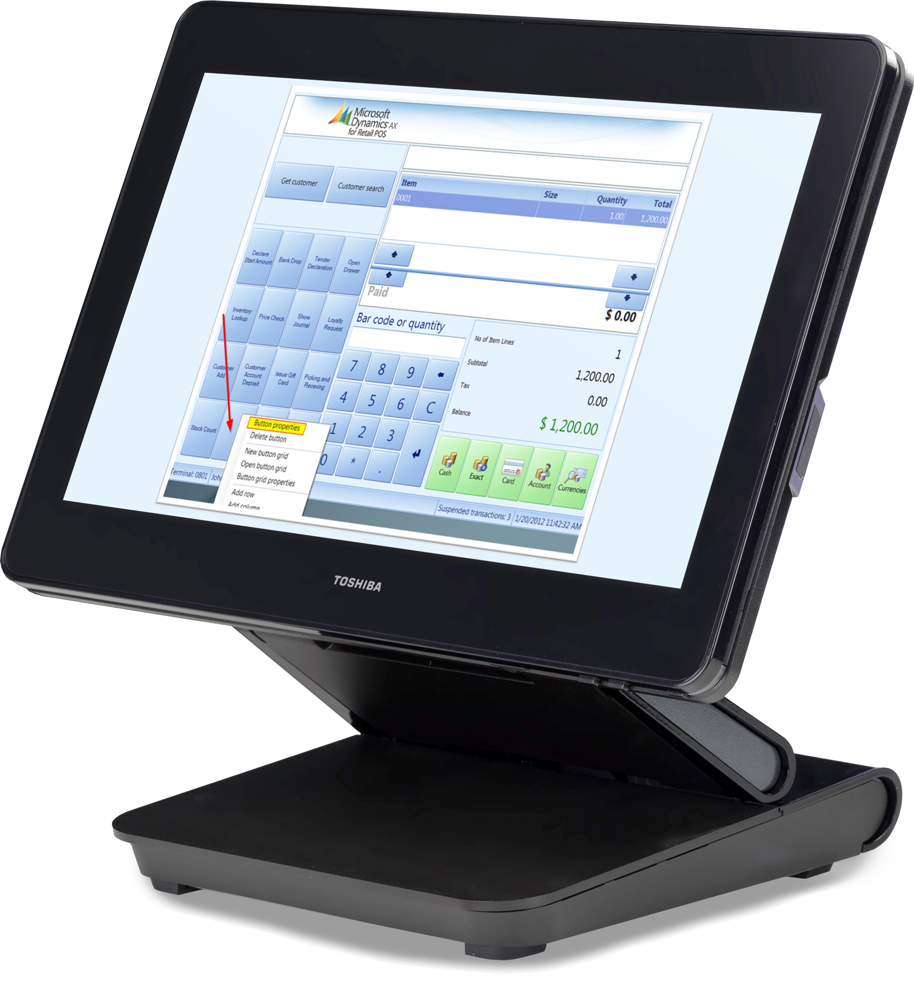
Some history
LS Retail AX sees the light of day in 2006
Microsoft acquires LS Retail AX and POS in 2009
New module released from Microsoft in 2012 - Dynamics AX for Retail

Slide 5
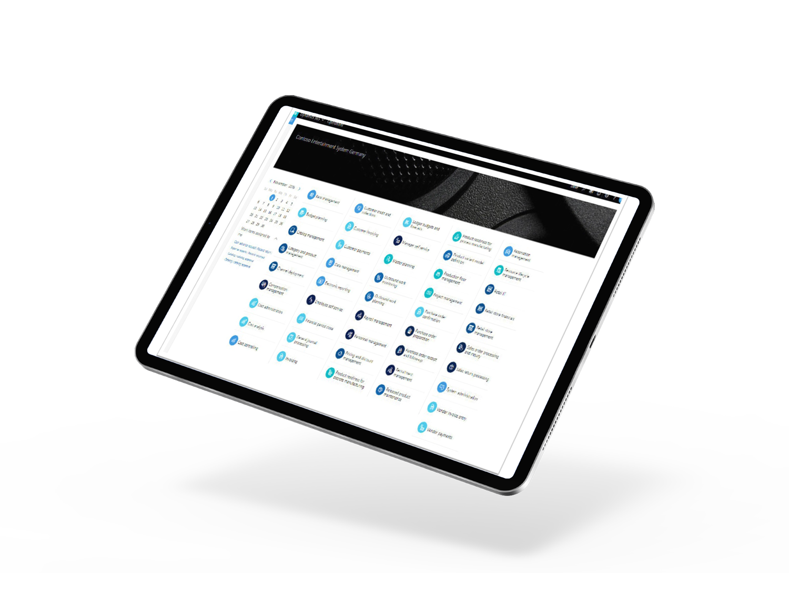
Some history
LS Retail AX sees the light of day in 2006
Microsoft acquires LS Retail AX and POS in 2009
New module released from Microsoft in 2012 - Dynamics AX for Retail
Dynamics 365 for Operations introduced in 2015 – rebranded as Dynamics 365 for Finance and Operations a year later or so

Slide 6
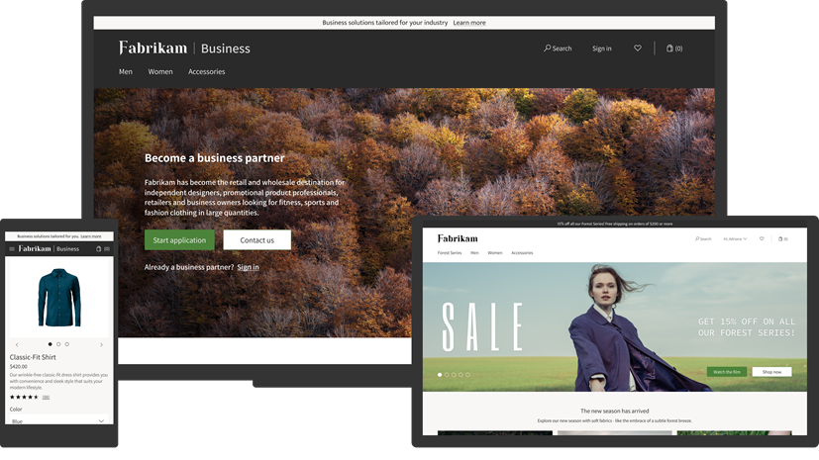
Some history
LS Retail AX sees the light of day in 2006
Microsoft acquires LS Retail AX and POS in 2009
New module released from Microsoft in 2012 - Dynamics AX for Retail
Dynamics 365 for Operations introduced in 2015 – rebranded as Dynamics 365 for Finance and Operations a year later or so
Dynamics 365 for Commerce was released in 2020, an evolution of Dynamics 365 Retail including new and improved capabilities for e-commerce, content management etc.

Slide 7











LS Retail ”current” product portfolio
Microsoft Dynamics 365 Commerce
Microsoft Dynamics 365 Business Central
Microsoft Dynamics 365 Commerce

Slide 8


LS Retail planned product portfolio
Microsoft Dynamics 365 Business Central
Microsoft Dynamics 365 Commerce

Slide 9
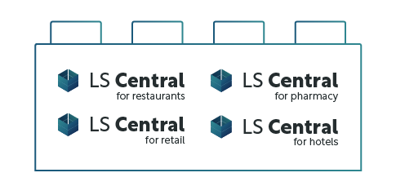
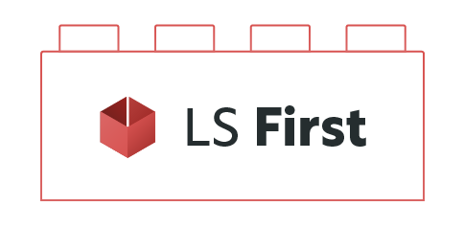

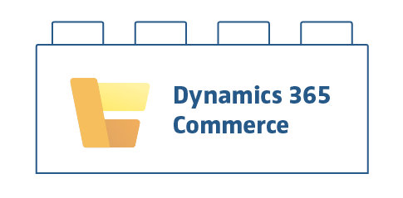
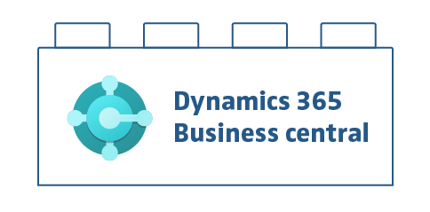
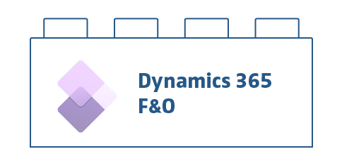
D365 Commerce vs. LS Central

Slide 10
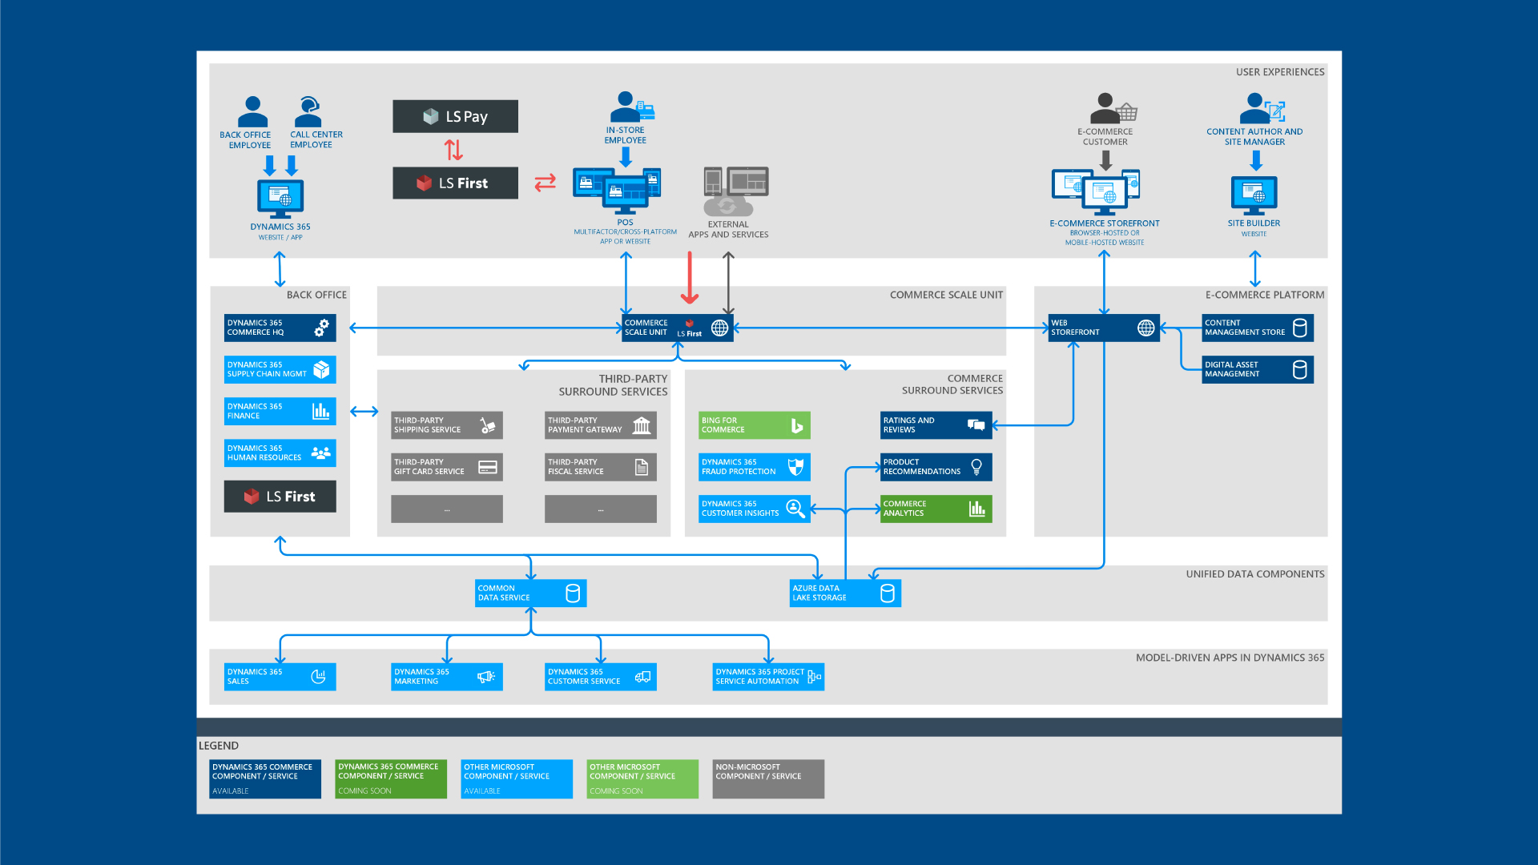

Slide 11


Slide 12
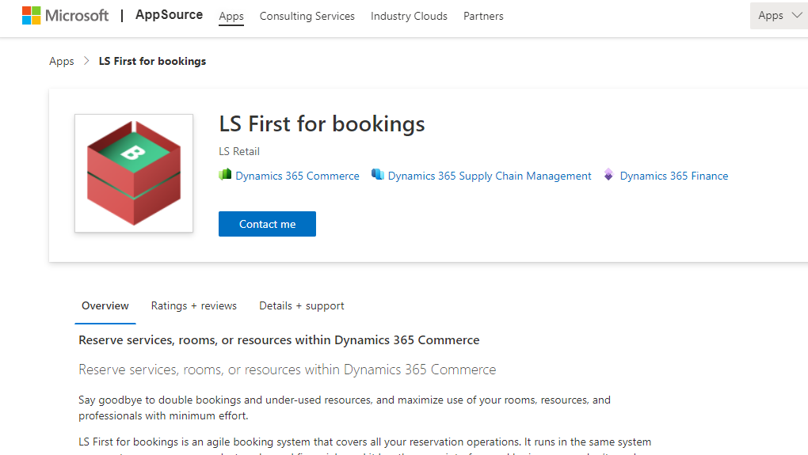
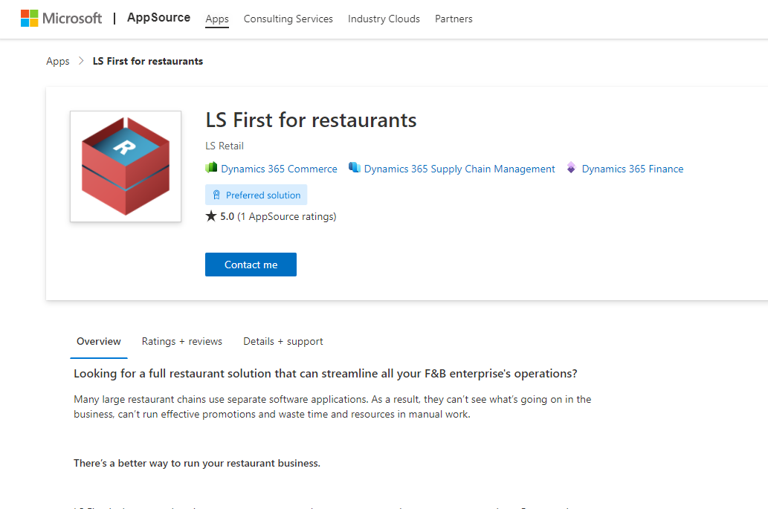
So, what is this LS First?

Slide 13


LS First
Restaurant Solutions

Slide 14
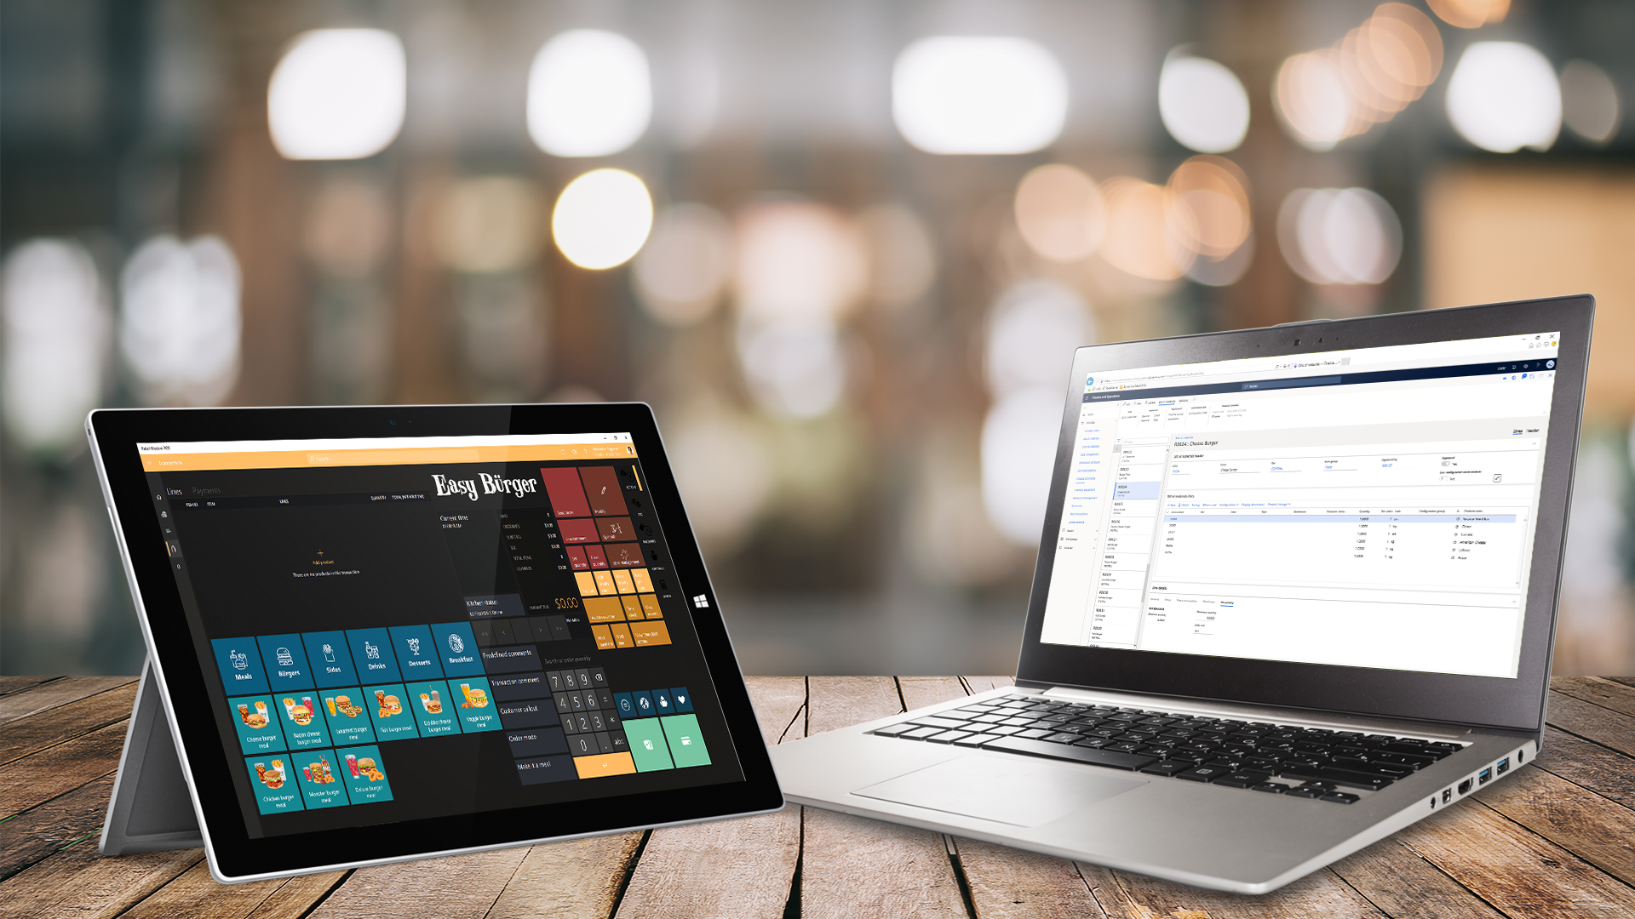

Slide 15
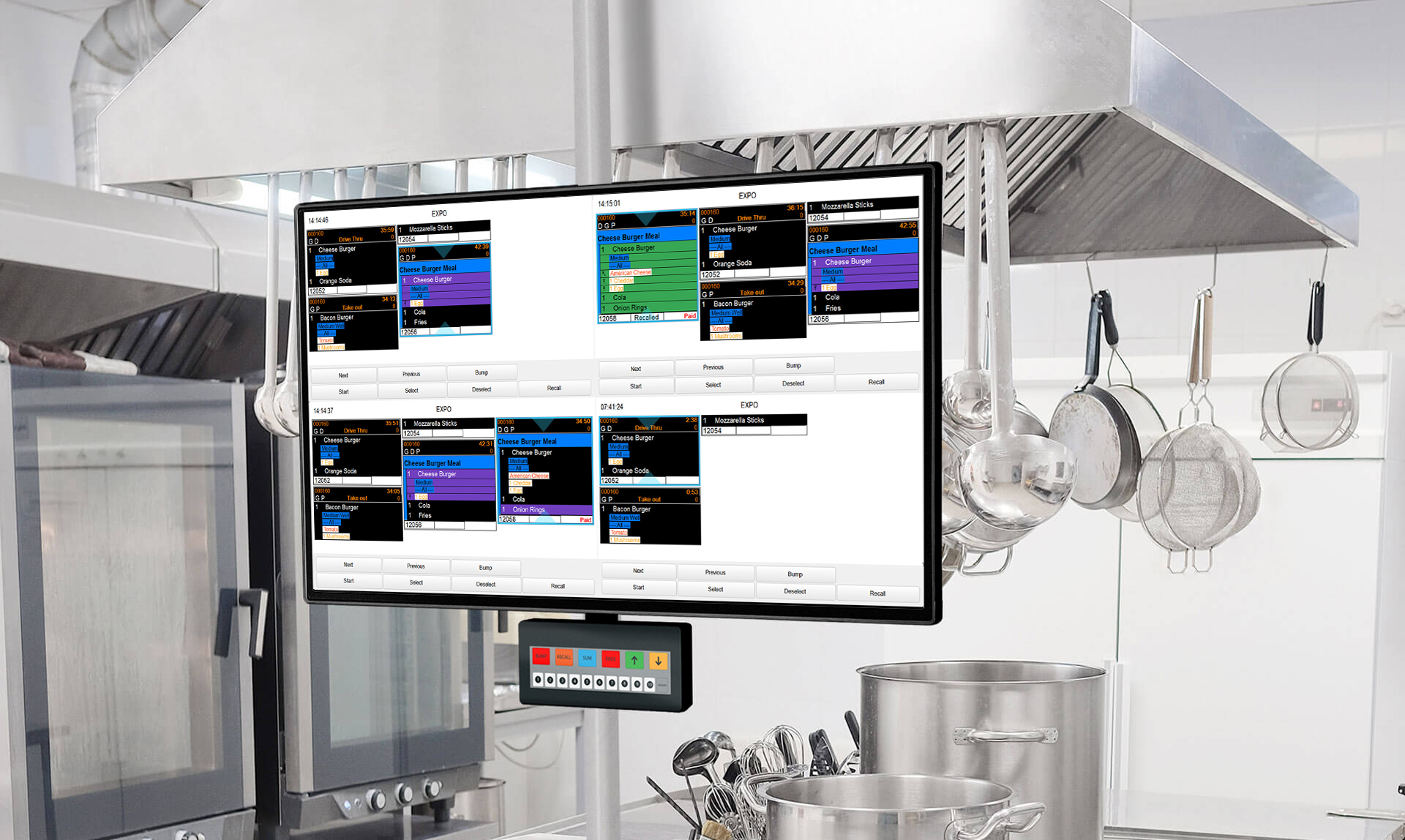

Slide 16
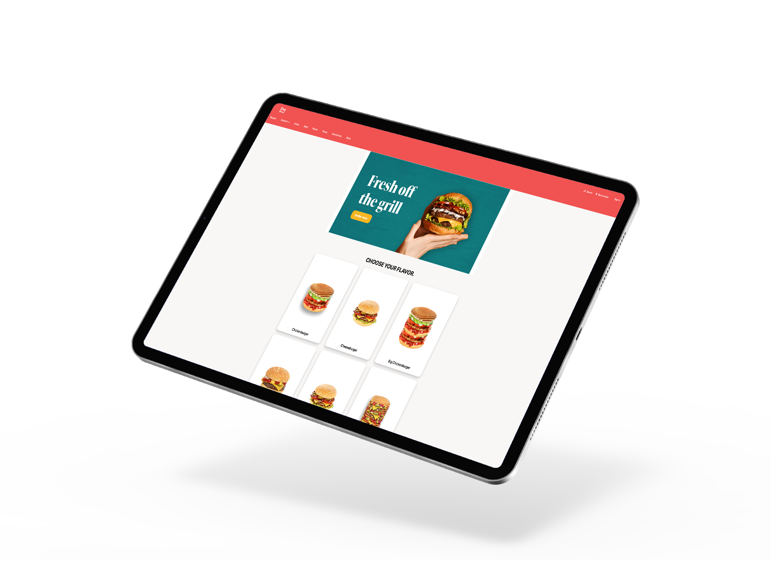
LS First
unified commerce
eCommerce platform is part of D365 suite from Microsoft
We will have a demo website for our restaurant solution available for our partners

Slide 17
So, what is this LS First?

Slide 18

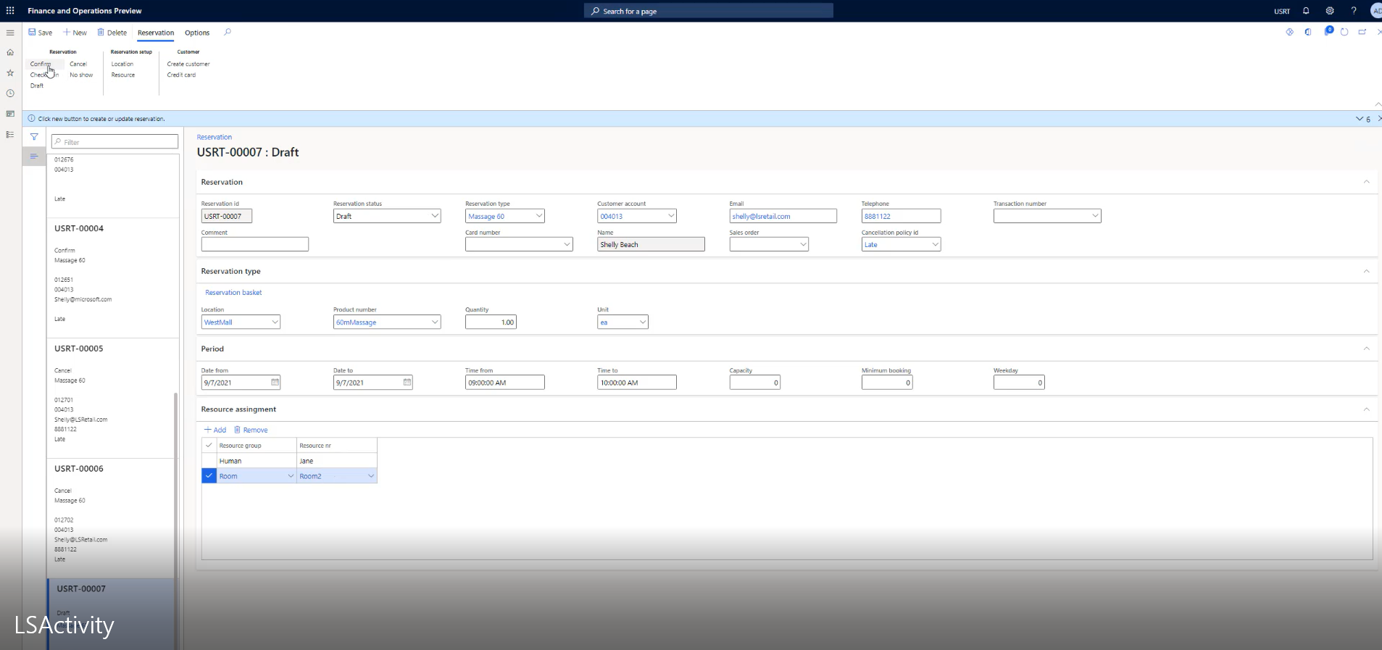
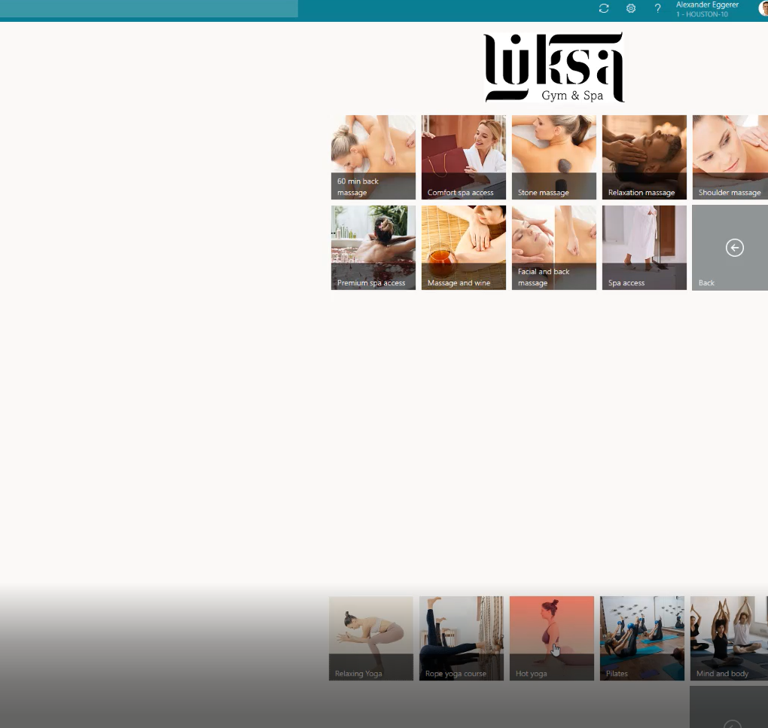
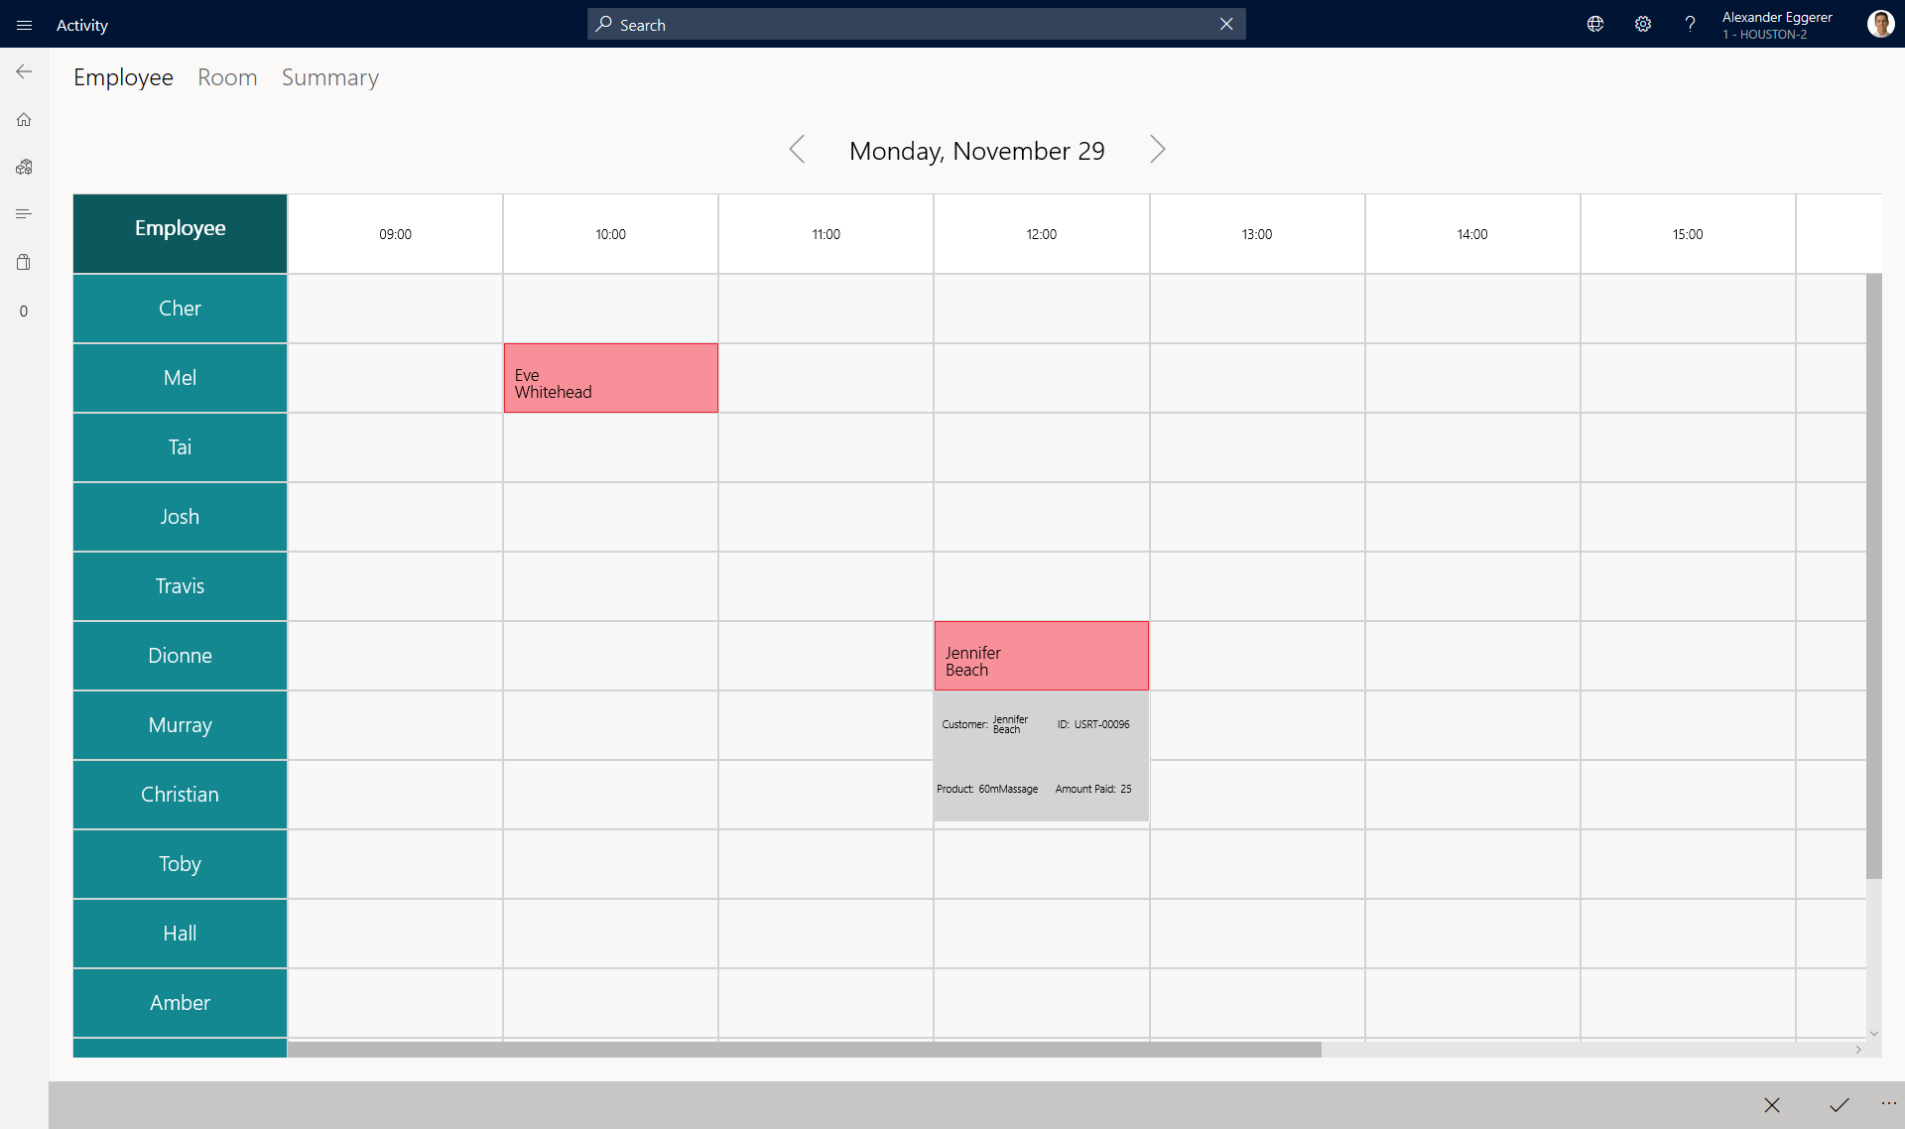

Slide 19
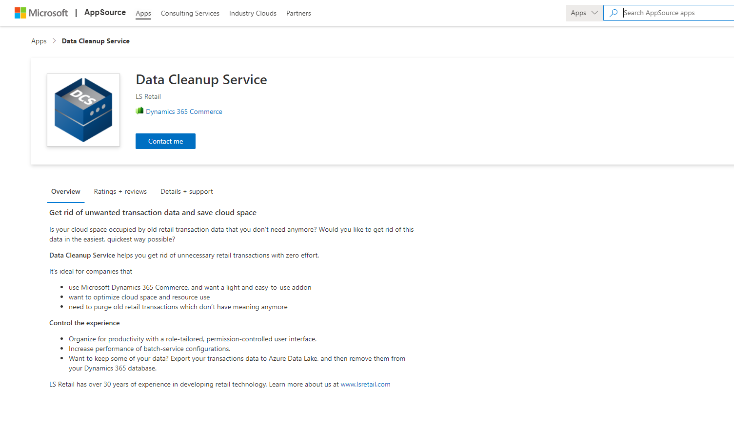
Other side products
First offer on Appsource in years from the LS First team approved a couple of weeks ago.
We used this product to document the Appsource process as we don’t do that everyday ☺

Slide 20
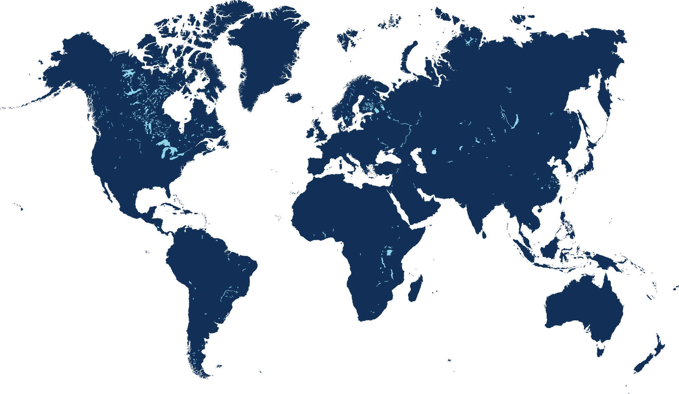

Team rebuild at relaunch
12
0
1
0
0
US: 12
UK: 1
Iceland: 0
Portugal: 0
Spain: 0

Slide 21
Team rebuild at relaunch
12
6
2
4
1
US: 12
Iceland: 6
Portugal: 4
UK: 1
Spain: 1

Slide 22


Slide 23
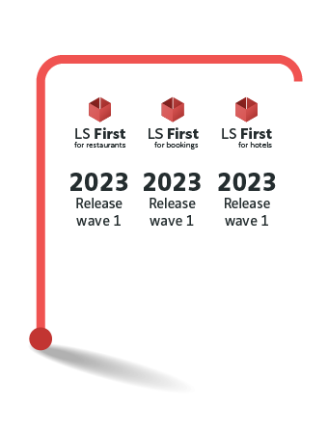

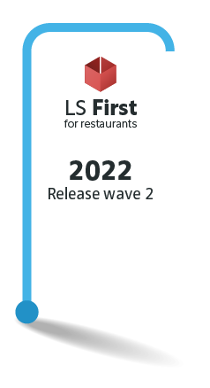
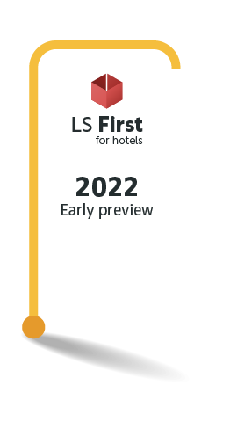
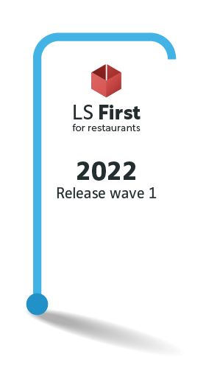
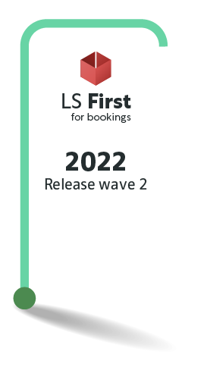
May
December
November
Our Release
Plan
June
September
*Everything is subject to change as projects might need different prioritization

Slide 24
Thank you!

